Slide 1
Comparing Fractions

Slide 2
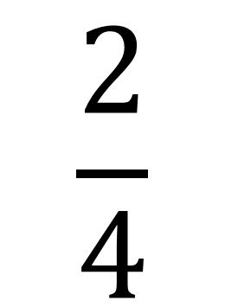
What is a fraction?
$$\frac{2}{4}$$
Number of parts shaded in
Total number of parts

Slide 3
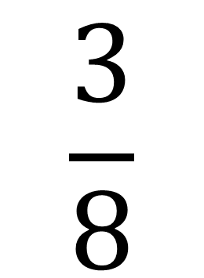
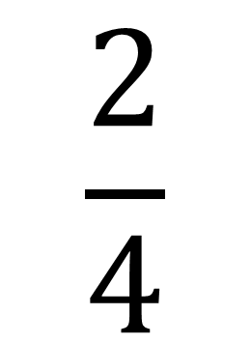
2 more example fractions
$$\frac{2}{4}$$
$$\frac{3}{8}$$

Slide 4
Which of these fractions is bigger?
$\frac{2}{4}$ But what if we didn’t have the pictures to help us?
$$\frac{2}{4}$$
$$\frac{3}{8}$$
or

Slide 5


Which is bigger?
To compare the fractions we need the denominator (number of parts) to be the same
To find out what denominator to use we need to write out the multiples of 3 and 9
Find the smallest number that is the same! This gives us our lowest common denominator!
$$\frac{1}{9}$$
$$\frac{1}{3}$$
or
3
6
9
12
15
Multiples of 3
9
18
27
36
45
Multiples of 9

Slide 6



If the denominator is multiplied by 3 then the numerator is also multiplied by 3
We need to change this fraction to an equivalent!
This fraction already has a denominator of 9! We don’t need to do anything with it
$$\frac{1}{3}$$
$$=\frac{3}{9}$$
$$\frac{1}{9}$$
Both fractions need a denominator of 9!
Multiply the denominator by 3 to change it to 9

Slide 7
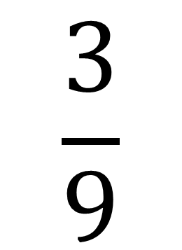
Which is bigger?
$$\frac{3}{9}$$
$$\frac{1}{9}$$
or
Show Diagrams
Show Answer

Slide 8
$\frac{3}{9}$ is bigger
Next question

Slide 9
Which is bigger?
$$\frac{3}{9}$$
$\frac{3}{9}$ is bigger
$$\frac{1}{9}$$
or
Next question

Slide 10


Which is bigger?
To find out what denominator to use we need to write out the multiples of 3 and 4
To compare the fractions we need the denominator (number of parts) to be the same
Find the smallest number that is the same! This gives us our lowest common denominator!
$$\frac{2}{3}$$
or
$$\frac{3}{4}$$
3
6
9
12
15
Multiples of 3
4
8
12
16
20
Multiples of 4

Slide 11


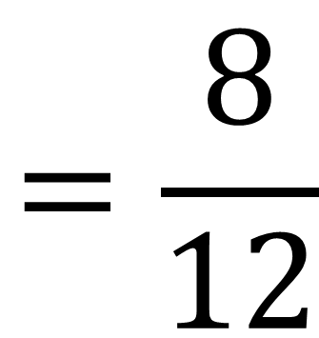
If the denominator is multiplied by 4 then the numerator is also multiplied by 4
If the denominator is multiplied by 3 then the numerator is also multiplied by 3
We need to change this fraction to an equivalent!
Both fractions need a denominator of 12!
We need to change this fraction to an equivalent!
$$\frac{2}{3}$$
$$=\frac{8}{12}$$
$$\frac{3}{4}=\frac{9}{12}$$
Multiply the denominator by 4 to change it to 12
Multiply the denominator by 3 to change it to 12

Slide 12
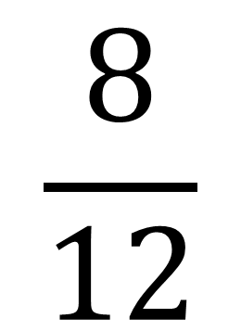
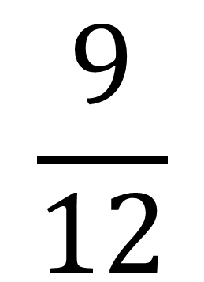
Which is bigger?
$$\frac{8}{12}$$
$$\frac{9}{12}$$
or
Show Diagrams
Show Answer

Slide 13
$\frac{9}{12}$ is bigger
Next question

Slide 14
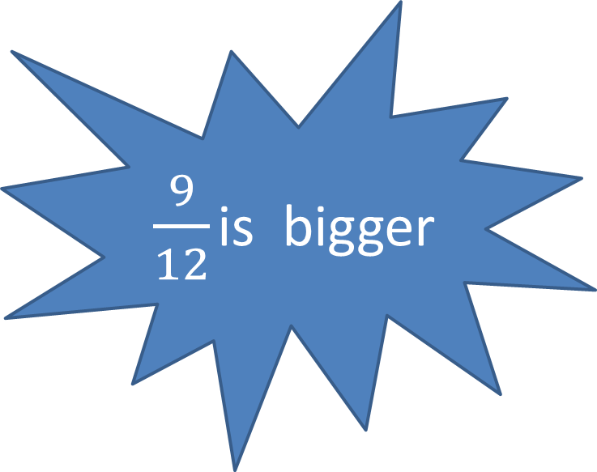
Which is bigger?
$$\frac{8}{12}$$
$\frac{9}{12}$ is bigger
$$\frac{9}{12}$$
or
Next question

Slide 15
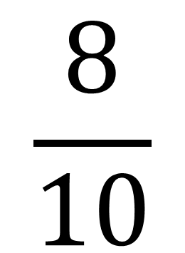
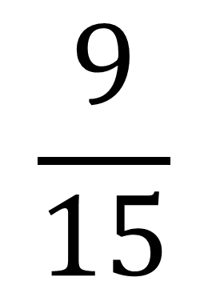
Which is bigger?
Find the smallest number that is the same! This gives us our lowest common denominator!
To compare the fractions we need the denominator (number of parts) to be the same
To find out what denominator to use we need to write out the multiples of 15 and 10
$$\frac{9}{15}$$
or
$$\frac{8}{10}$$
15
30
45
60
75
Multiples of 15
10
20
30
40
50
Multiples of 10

Slide 16

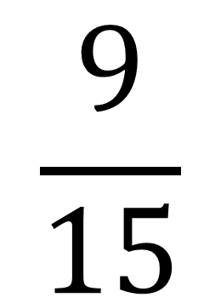
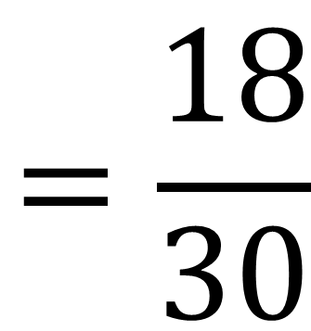
If the denominator is multiplied by 2 then the numerator is also multiplied by 2
If the denominator is multiplied by 3 then the numerator is also multiplied by 3
Both fractions need a denominator of 30!
$$\frac{9}{15}$$
$$=\frac{18}{30}$$
$$\frac{8}{10}=\frac{24}{30}$$
Multiply the denominator by 2 to change it to 30
Multiply the denominator by 3 to change it to 30

Slide 17
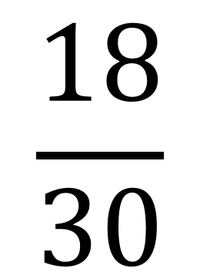
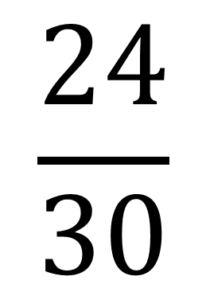
Which is bigger?
$$\frac{18}{30}$$
$$\frac{24}{30}$$
or
Show Diagrams
Show Answer

Slide 18
$\frac{24}{30}$ is bigger
Next question

Slide 19
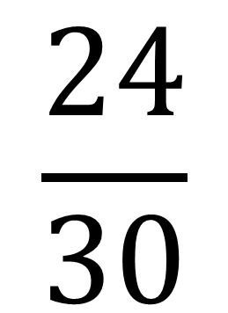
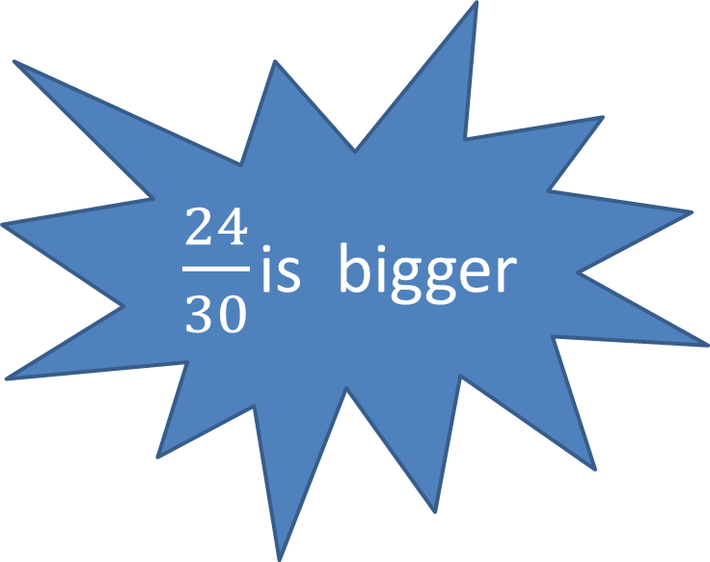
Which is bigger?
$\frac{24}{30}$ is bigger
$$\frac{18}{30}$$
$$\frac{24}{30}$$
or
Next question

Slide 20


Which is bigger?
To compare the fractions we need the denominator (number of parts) to be the same
Find the smallest number that is the same! This gives us our lowest common denominator!
To find out what denominator to use we need to write out the multiples of 16 and 20
$$\frac{4}{16}$$
or
$$\frac{6}{20}$$
16
32
48
64
80
Multiples of 16
20
40
60
80
100
Multiples of 20

Slide 21

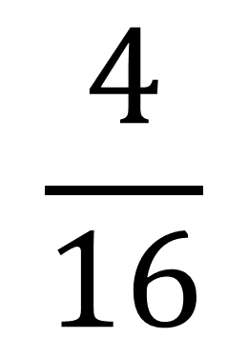
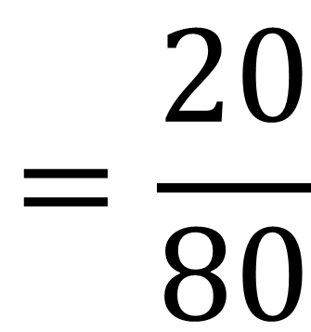
If the denominator is multiplied by 5 then the numerator is also multiplied by 5
If the denominator is multiplied by 4 then the numerator is also multiplied by 4
Both fractions need a denominator of 80!
$$\frac{4}{16}$$
$$=\frac{20}{80}$$
$$\frac{6}{20}=\frac{24}{80}$$
Multiply the denominator by 5 to change it to 80
Multiply the denominator by 4 to change it to 80

Slide 22
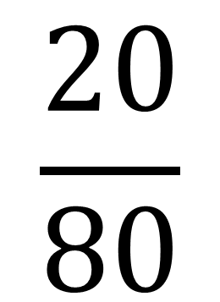
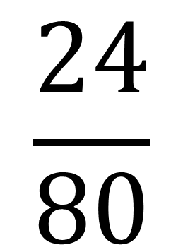
Which is bigger?
$$\frac{20}{80}$$
$$\frac{24}{80}$$
or
Show Answer

Slide 23
$\frac{24}{80}$ is bigger

