Slide 1
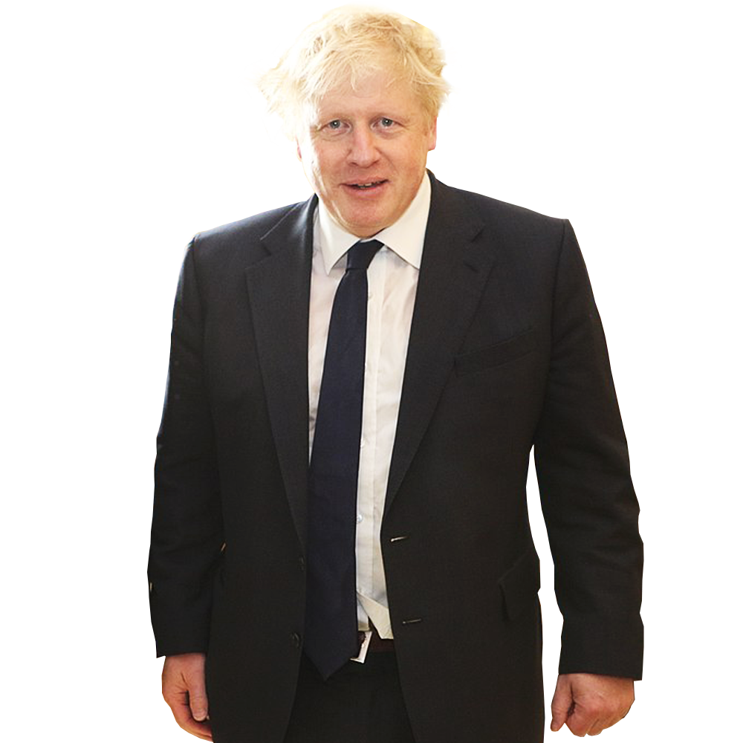
Starter: What does the Prime Minister do?
Talk to other Prime Ministers around the world.
Choosing what we learn at school.
Deciding how much doctors and nurses get paid.
Deciding how much our food and drink costs.
Discuss (1 min)
Would you like to make these decisions?
Discuss (1 mins)
Why might this be a difficult job?
Notes:
Images:
http://freepngimages.com/boris-johnson-no-background-image/
iStock

Slide 2
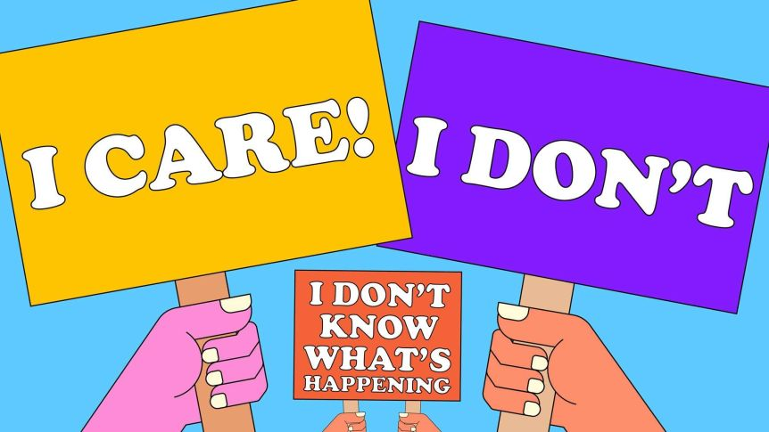
Would you like to be a politician?

Slide 3
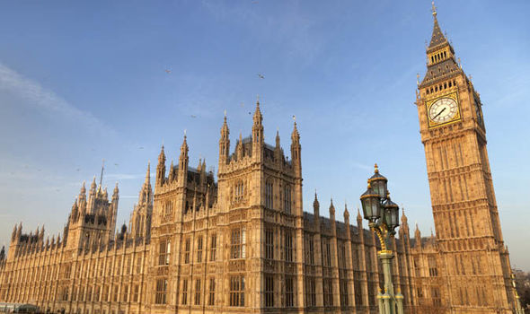
What is a politician?
The Prime Minister doesn’t make all the decisions by himself. He works with a big group of people called Parliament.
People that work in parliament are called politicians.
Politicians are chosen by adults here in the UK. Every five years, they vote to choose the Prime Minister and the people to help them. The people with the most votes become the Government.
Question (1-2 mins)
Do you know the names of any politicians?
Notes:
Images:
http://freepngimages.com/boris-johnson-no-background-image/
https://www.express.co.uk/news/politics/1000387/parliament-injury-compensations-taxpayers

Slide 4
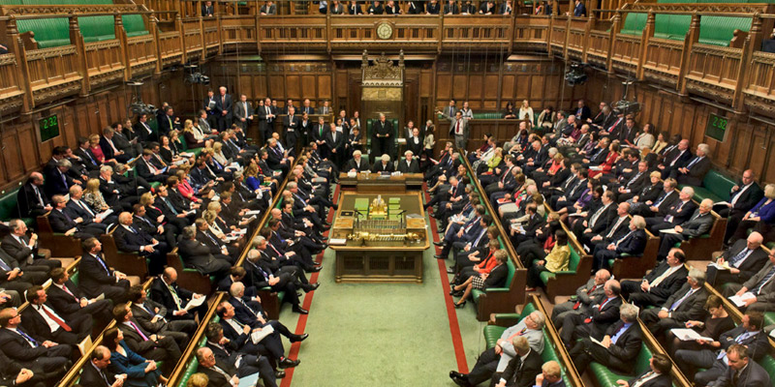
What is a politician?
The United Kingdom (UK) is made up of England, Scotland, Wales and Northern Ireland.
The Prime Minister needs to know what the people in the UK want.
650 politicians come from all over the country to share what people in their town or city want to see in the UK!
Discuss (2-5 mins)
What would you like to see change in your town or city?
Notes:
Images:
https://www.tomtom.com/en_gb/sat-nav/maps-services/shop/travel-map/united-kingdom-ireland/
https://www.sporcle.com/blog/2017/06/hung-parliament/

Slide 5
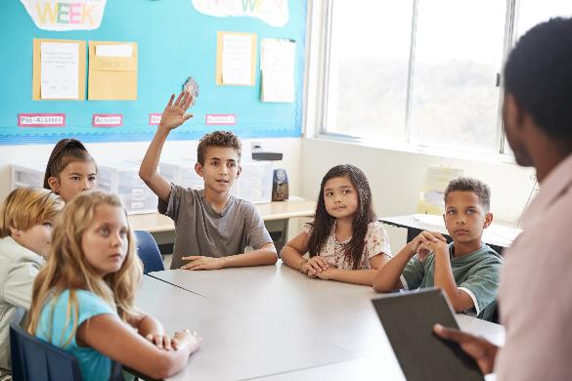
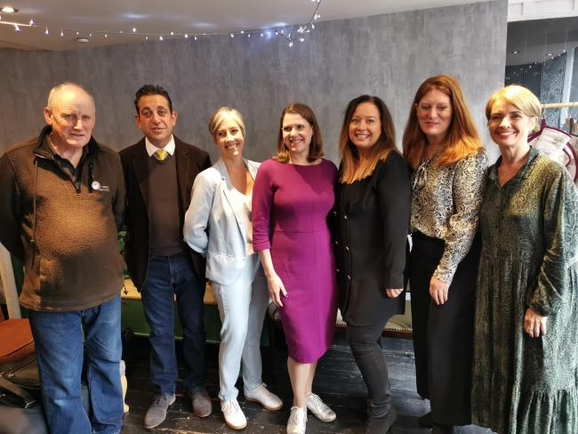
What does a politician do?
Discuss (1-3 mins)
Do you have a school council? If so, what do your school councillors do?
Politicians are a bit like school councillors. Instead of representing a class, they represent a whole area!
A politician listens to people in their community and shares their worries and suggestions with Parliament.
This is Jo Swinson. She is talking to shop owners in her area.
Notes:
Images:
iStock
https://www.politicshome.com/news/uk/social-affairs/house/house-magazine/91990/dawn-butler-%E2%80%9C2018-year-women-we-are-starting-we

Slide 6
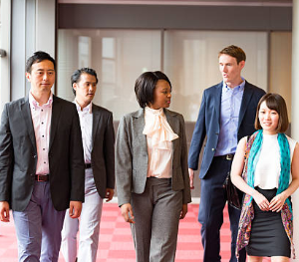
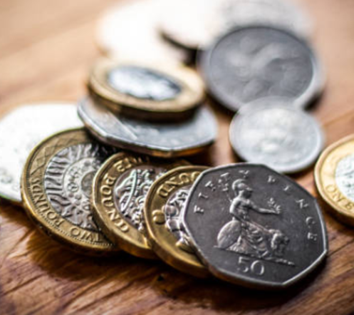
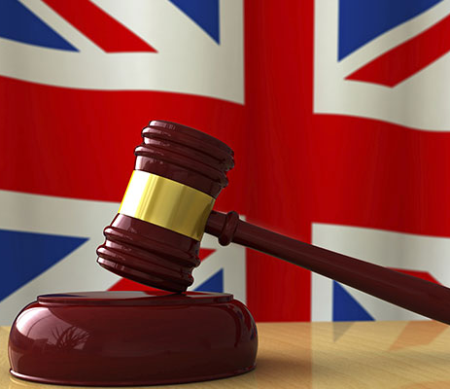
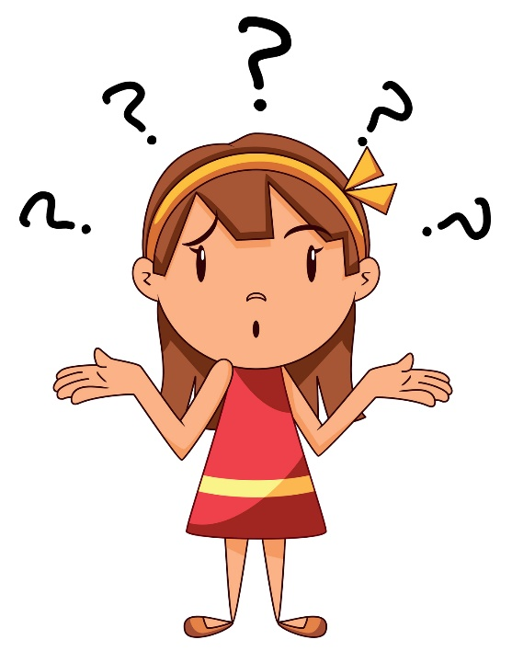
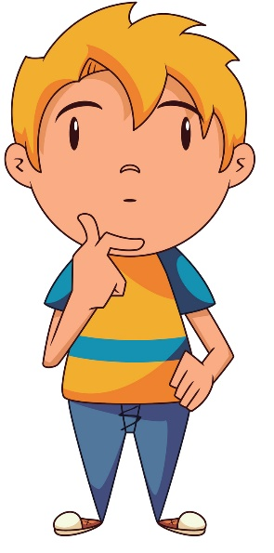
What does a politician do?
Politicians will visit people in the community to see if they need help.
Politician’s are sent lots of letters from people in their community.
They also have to decide what they should spend the UK’s money on.
They often have to vote on whether a new law should be passed or not.
Discuss (1-2 mins)
Which of these jobs would you like to do? Which would you not like to do? Why?
Notes:
Images:
iStock
http://www.bigshocking.com/weird-facts-about-england-you-didnt-know/strange-uk-laws/
References:
1) https://www.watfordobserver.co.uk/news/17952100.jo-swinson-speaks-effects-brexit-high-streets-st-albans-visit/

Slide 7
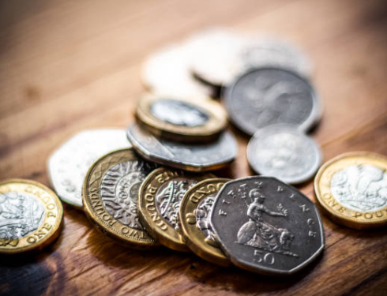
What choices would you make?
When you have a job, you pay some of your money to the Government. This is called tax.
Everybody’s tax money is added together in a big pot that the Government spends.
Government:
The politicians in parliament that had the most votes.
They have to decide how to spend this money to help all of the people in the UK.
Watch (1 min)
Watch the Prime Minister and Jeremy Corbyn argue about decisions in Parliament.
0:00-0:31
https://safeshare.tv/x/xQc1UmYRogA
Notes:
Alternative video link: https://www.youtube.com/watch?v=xQc1UmYRogA (1:59-2:30)
Images:
1) iStock

Slide 8
Would you like to be a politician?
Yes
No
I would like to be involved in making decisions for the future.
If I was a politician I could make huge changed for the country.
It would be fun to tell people what to do.
I would like to make sure everyone was looked after.
Politics is boring so I’m not interested.
I wouldn’t like to make decisions for the whole country.
I wouldn’t want to spend my days debating issues and voting.
Some people might not

