Slide 1
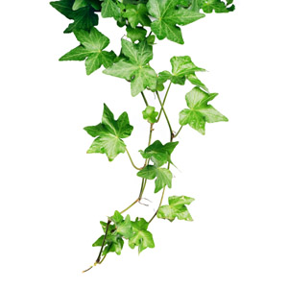
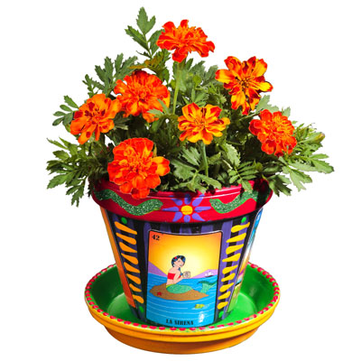
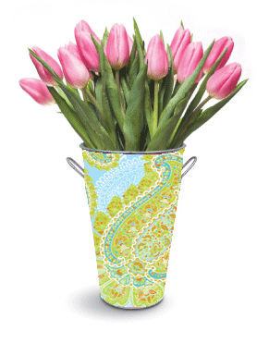
Plants: Their parts and what they need to grow
Science!
www.TheStorySeed.com

Slide 2
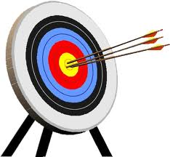
Science!
Objectives
To be able to label the parts of the plant.
To know what plants need for growth.

Slide 3
Science!
Can you label the different parts of the plant?

Slide 4
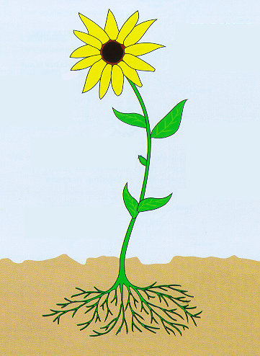
Science!
Let’s have a go at labelling this flower.
Petals
Stem
Bud
Leaves
Roots

Slide 5
Science!
Quick note!
1 petal | 2 petals
1 _____ | 2 _____
leaf
leaves

Slide 6
Plants
WALT: explore the requirement of plants for life and growth (air, light, water, nutrients from soil, and room to grow) and how they vary from plant to plant.
https://www.bbc.com/education/clips/zyvs34j
Are plants alive?

Slide 7
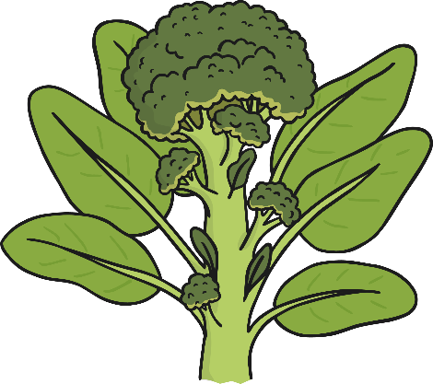
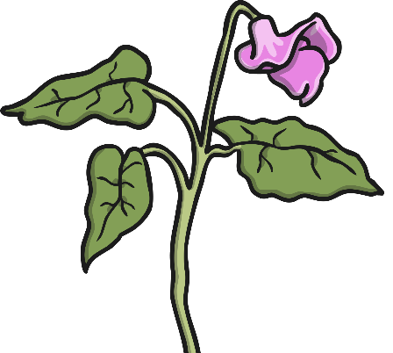
What Do Plants Need?
Plants are living things. There are 7 life processes that tell us if something is alive.
The 7 life process are movement, respiration, growth, reproduction, excretion, nutrition and sensitivity. Plants do all 7 of these things.
Plants need certain conditions to help them grow well.
Have you ever looked after a plant? What did you have to provide it with to help it to grow?
What do you think plants need? Share your ideas with your class.

Slide 8
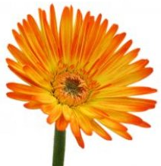
Science!
What plants need to
grow

Slide 9
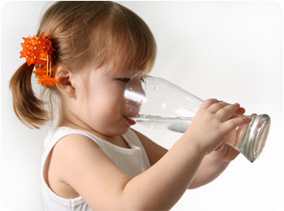
Science!
We need to eat food and drink water to grow.

Slide 10
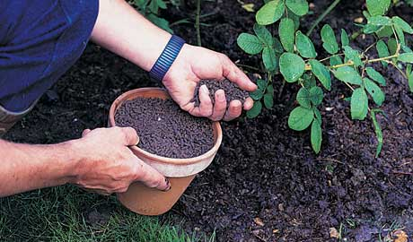
Science!
Plants need water too, just like us. But plants don’t eat anything. They make their own food.
?
So why do plants need fertiliser?

Slide 11
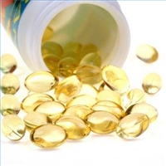
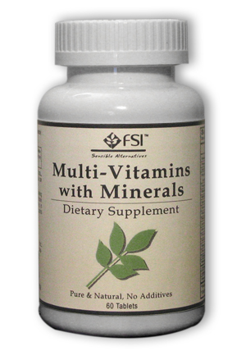
Science!
Fertilisers have nutrients in them. Plants use the nutrients to help them make their food.
Some of our parents, or maybe some of us, take supplements (extras) too, like vitamin tablets or cod liver oil.

Slide 12
Science!
Let’s look at the things plants need in order to grow properly.

Slide 13
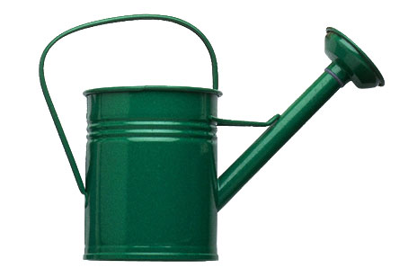
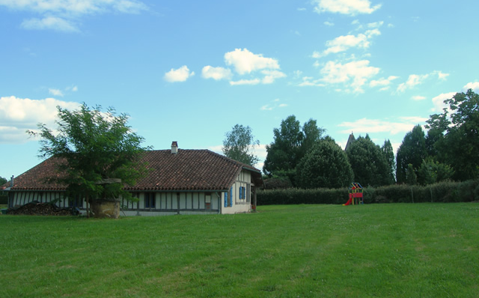
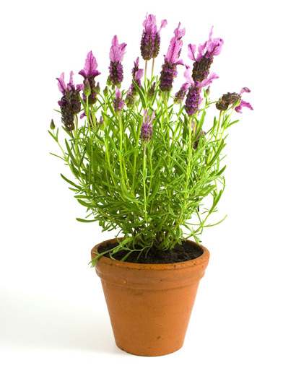
Science!
What can you
see here?
Water
Light
Air
Warmth
Space
Nutrients

Slide 14
Science!
STOP AND
THINK
So, can you remember what is it plants need in order to grow properly?
Now let’s find out why they need those things.

Slide 15
Science!
Light
Plants use light to make their own food. When plants make their food, this is called photosynthesis.
Photo means light.
Synthesis means making.
So, plants make food by using light.

Slide 16
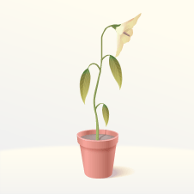
Science!
Light
A plant that is kept in a dark place will grow tall and spindly in search of light and then become weak and die.

Slide 17
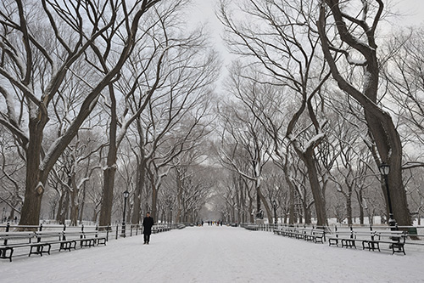
Science!
Warmth
Plants will die if the temperature is too low (if it’s too cold).
Think about what happens to plants and trees in the winter season.

Slide 18
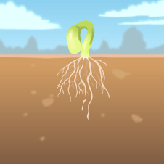
Science!
Warmth
A seed will not produce a plant at all if it is kept too cold. The seed needs warmth to germinate (develop from a seed into a plant) and start to grow into a healthy plant.

Slide 19
Science!
Nutrients
Plants use nutrients to help them make their food. Fertiliser contains a lot of nutrients.
Different nutrients help the plant in different ways. Some help the roots grow. Some help the flowers grow. Nutrients provide plants with the strength they need to grow big, strong, and healthy.

Slide 20
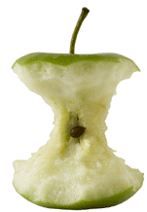
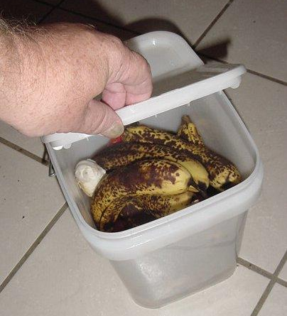
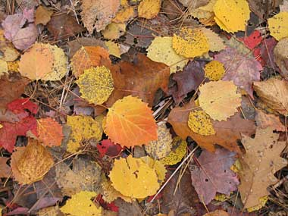
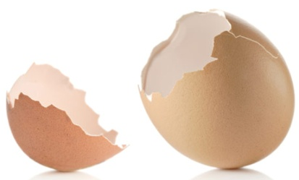
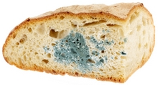
Science!
http://www.bbc.co.uk/guides/z86ktv4
Who has a compost bin at home?
You can make your own fertiliser by leaving natural things to rot in your compost bin.

Slide 21
Science!
Water
Plants need water for photosynthesis.
Who can remember what photosynthesis is?

Slide 22
Science!
Water
The water also dissolves the nutrients so that they can be can be taken into the plant by the roots.

Slide 23
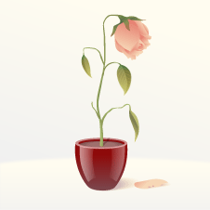
Science!
Water
A plant that is not watered will have a weak stem and dried-up leaves and will eventually die.

Slide 24
Science!
Air
Plants need air for making their food through photosynthesis.
For photosynthesis plants need sunlight, water and air.
Plants need air (the oxygen in the air) to breathe. During the day and night time, plants take in oxygen. They absorb oxygen and carbon dioxide through pores found on the undersides of the leaves.

Slide 25
Science!
Space
Roots and foliage take up space. Each plant has their own specific space requirement needs. Plants that are spaced too close together will be stressed as they compete for their basic needs, resulting in weaker plants, higher susceptibility to diseases and insects, and ultimately poor food production

Slide 26
Science!
OK, can you list the things plants need to grow healthily?
Light
Suitable temperature
Water
Nutrients
Air
Space
All plants need water and the correct temperature to germinate but they may need different amounts.
The temperature and nutrients needed by a plant will be different for different plants. For example, some plants for example need warmer condition than others.

Slide 27
What do plants need to grow healthily?
Describe how plants are living things (Remember the 7 life processes).
What five things do plants need in order to grow healthily?
Why do plants need these things? (Remember to include what part of the plant uses them).
a). Light
b). Suitable temperature
c). Water
d). Nutrients
e). Space
f). Air
What two of these requirements do plants need to germinate (develop from a seed to a plant)?
GT: Do you think all plants require the same amount of light, warmth, water, nutrients and space? Why?

Slide 29
How can we prove that water is absorbed by roots and transported through the stem?

Slide 30
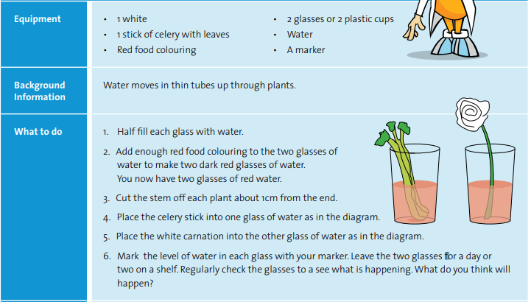
How to show water transportation…

