Slide 1
Number, Fractions, Money
Counting in ¹/₂s and ¹/₄s
Finding fractions of amounts
Objectives
Day 1
Count on in fraction steps.
Day 2
Find ¹/₂, ¹/₃, ¹/₄ and ³/₄ of amounts using sharing and number facts.
Day 3
Find ¹/₂, ¹/₃, ¹/₄ and ³/₄ of amounts using sharing and number facts.
Notes:
Before teaching, be aware that:
On Day 1 you will need a paper rectangle and a paper circle, Paper shapes (see starter).
On Day 2 you will need a teaching clock or ITP clock, bananas.
On Day 3 children will need mini-whiteboards and pens.

Slide 2
Number, Fractions, Money
Counting in ¹/₂s and ¹/₄s
Finding fractions of amounts
Starters
Day 1
Halves and quarters of shapes (pre-requisite skills)
Day 2
Count in ¹/₂s and ¹/₄s (pre-requisite skills)
Day 3
Count in 3s (simmering skills)
Notes:
Choose starters that suit your class by dragging and dropping the relevant slide or slides below to the start of the teaching for each day.

Slide 3
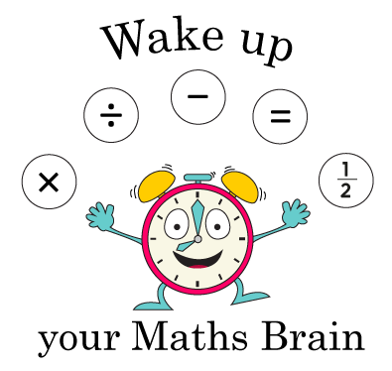
Number, Fractions, Money
Counting in ¹/₂s and ¹/₄s
Finding fractions of amounts
Starter
Halves and quarters of shapes
Notes:
Pre-requisite skills – to use this starter, drag this slide to the start of Day 1
Give each child a paper rectangle and a paper circle (different sizes across the class). Ask them to fold their circle into halves and their rectangle into quarters. Note that to make quarters you halve twice. Also point out that ²/₄ is the same as ¹/₂.

Slide 4
Number, Fractions, Money
Counting in ¹/₂s and ¹/₄s
Finding fractions of amounts
Starter
Count in halves and quarters
Notes:
Pre-requisite skills – to use this starter, drag this slide to the start of Day 2
Using a teaching clock or ITP clock, begin at 12, move the hands half an hour at a time while children count: 12 o’clock, half past twelve, one o’clock, half past one, etc. Repeat, this time moving the hands a quarter of an hour at a time while children count: twelve o’clock, quarter past 12, half past twelve, quarter to one, one o’clock, etc.

Slide 5
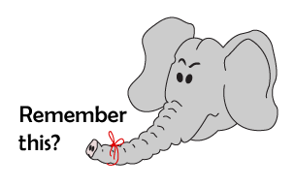
Number, Fractions, Money
Counting in ¹/₂s and ¹/₄s
Finding fractions of amounts
Starter
Count in 3s
Notes:
Simmering skills – to use this starter, drag this slide to the start of Day 3
Display the ITP Number Grid with multiples of 3 highlighted. Lead counting on in 3s. Encourage children to try not to refer to the grid unless they really have to.

Slide 6
Number, Fractions, Money
Counting in ¹/₂s and ¹/₄s
Finding fractions of amounts
Objectives
Day 1
Count on in fraction steps.

Slide 7
Day 1: Count on in fraction steps.
Ask children to sit in a circle with their folded shapes from the ‘Halves and Quarters of Shapes’ starter.
Today we are going to count on using number steps that are smaller than 1.
We have met numbers like this before – remember, we call them fractions.

Slide 8
Day 1: Count on in fraction steps.
Using your half circles, we are going to hold them up one at a time to count on in halves.
Notes:
The first child raises their half circle saying: half, then opens it saying: one. Support the next child with what comes next, saying: one and a half and then opening their shape, saying: two. Repeat this – slowly - round the circle until you reach 10, then start again at ¹/₂ with the next child (click onto the next slide). The children will need this repetition to appreciate the counting pattern.

Slide 9
Numbers that have a whole and a fraction part are called mixed numbers.
Day 1: Count on in fraction steps.
Let’s start back at the beginning.
¹/₂
1 ¹/₂
2 ¹/₂
3 ¹/₂
4 ¹/₂

Slide 10
Day 1: Count on in fraction steps.
Now use the rectangles which were folded into quarters.
Children should fold them twice so that only ¼ is showing.
Using your quarter rectangles, we are going to hold them up one at a time and unfold them to count on in quarters.
Notes:
The first child begins: one quarter, then opens up the rectangle to reveal two quarters, then opens up the shape again to point to three quarters, one. Support the next child with pointing to their shapes and counting: 1 and one quarter, 1 and two quarters, 1 and three quarters, 2, etc.
Repeat this – slowly - round the circle until you reach 5, then start again at ¹/₄ with the next child.

Slide 11
Day 1: Count on in fraction steps.
Let’s start back at the beginning.
^{¼}
^{½}
^{¾}
^{1¼}
^{1½}
^{1¾}
^{2¼}
^{2½}
^{2¾}
^{3¼}
^{3½}
^{3¾}
^{4¼}
^{4½}
^{4¾}
Remember that the numbers that have a whole and a fraction part are called mixed numbers.
Notes:
Children can now go on to do differentiated GROUP ACTIVITIES. You can find Hamilton’s group activities in this unit’s TEACHING AND GROUP ACTIVITIES download.
WT/ARE/GD: Write, hide and spot halves and quarters on a number line.
WT/ARE/GD: Play counting in halves and quarters card game.

Slide 12
Notes:
The Practice Sheet on this slide is suitable for most children.
Differentiated PRACTICE WORKSHEETS are available on Hamilton’s website in this unit’s PROCEDURAL FLUENCY box.
WT: What comes next? Halves and quarters Sheet 1
ARE/GD: What comes next? Halves and quarters Sheet 2

Slide 13
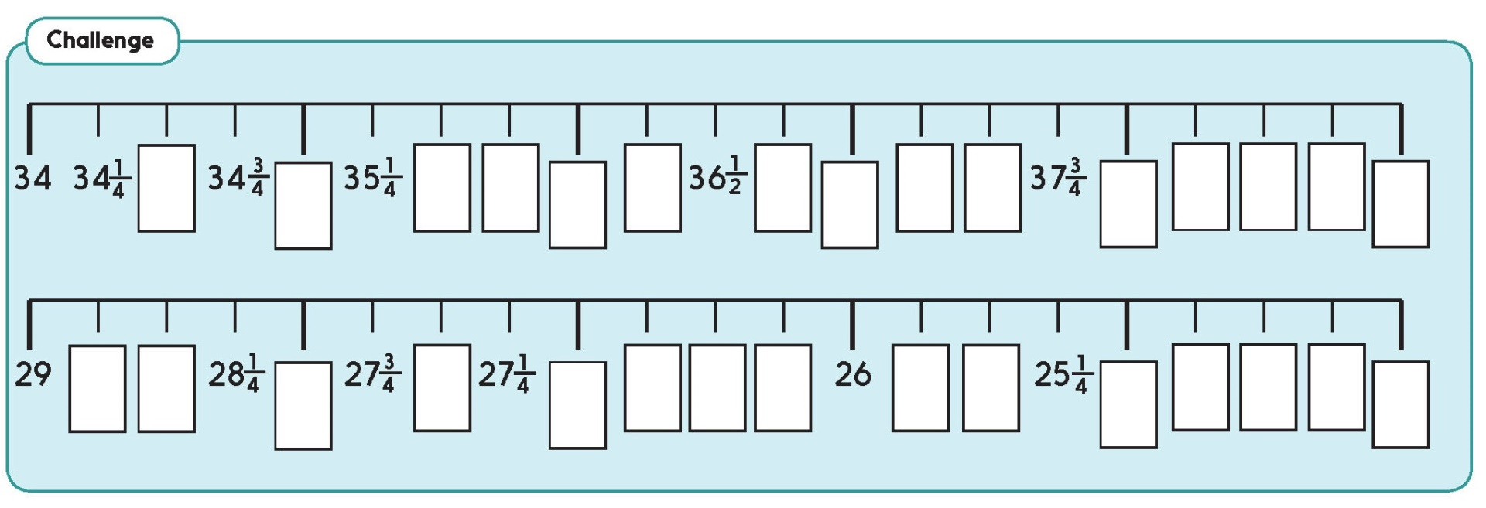
Challenge
Notes:
The Practice Sheet on this slide is suitable for most children.
Differentiated PRACTICE WORKSHEETS are available on Hamilton’s website in this unit’s PROCEDURAL FLUENCY box.

Slide 14
Number, Fractions, Money
Counting in ¹/₂s and ¹/₄s
Finding fractions of amounts
Objectives
Day 2
Find ¹/₂, ¹/₃, ¹/₄, ³/₄ of amounts using sharing and number facts..

Slide 15
Day 2: Find ¹/₂, ¹/₃, ¹/₄, ³/₄ of amounts using sharing and number facts.
Last time we
used fractions to count in small steps along the number line.
Today we are going to use them for something a bit different – to help share out amounts of objects.

Slide 16
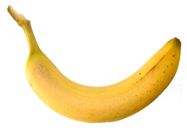
Day 2: Find ¹/₂, ¹/₃, ¹/₄, ³/₄ of amounts using sharing and number facts.
Have 12 bananas available to share out.
I am going to give half of these bananas away and keep the rest.

Slide 17
Day 2: Find ¹/₂, ¹/₃, ¹/₄, ³/₄ of amounts using sharing and number facts.
The fraction tells us what to do with this amount.
The 1 tells us that we just want to know what is in one of those groups.
¹/₂
The 2 tells us
to share the whole amount between two.

Slide 18
Day 2: Find ¹/₂, ¹/₃, ¹/₄, ³/₄ of amounts using sharing and number facts.
Choose two children to come and share the bananas.

Slide 19
Day 2: Find ¹/₂, ¹/₃, ¹/₄, ³/₄ of amounts using sharing and number facts.
We can also use number facts to split the bananas…
… we know that half of 12 if 6 (because double 6 is 12).
_{½ of 12 = 6}

Slide 20
Day 2: Find ¹/₂, ¹/₃, ¹/₄, ³/₄ of amounts using sharing and number facts.
How could we find ¼ of the bananas?
We could halve each half.
_{¼} _{of 12 = ?}

Slide 21
Day 2: Find ¹/₂, ¹/₃, ¹/₄, ³/₄ of amounts using sharing and number facts.
_{¼} _{of 12 = 3}

Slide 22
Day 2: Find ¹/₂, ¹/₃, ¹/₄, ³/₄ of amounts using sharing and number facts.
What should we do to solve this?
_{¾} _{of 12 = ?}

Slide 23
Day 2: Find ¹/₂, ¹/₃, ¹/₄, ³/₄ of amounts using sharing and number facts.
_{¾} _{of 12 = ?}
Let’s see what the fraction tells us to do.
_{¾} _{of 12 = ?}
The 3 tells us that we want to know what is in three of those groups.
³/₄
The 4 tells us
to share the whole amount between four.

Slide 24
Day 2: Find ¹/₂, ¹/₃, ¹/₄, ³/₄ of amounts using sharing and number facts.
_{¾} _{of 12 = 3 lots of 3 bananas}
_{¾} _{of 12 = 9}

Slide 25
Day 2: Find ¹/₂, ¹/₃, ¹/₄, ³/₄ of amounts using sharing and number facts.
What about this one? How can we solve it?
This says one third.
¹/₃ of 12 = ?
A third tells us that we share the whole lot of bananas three ways.

Slide 26
Day 2: Find ¹/₂, ¹/₃, ¹/₄, ³/₄ of amounts using sharing and number facts.
¹/₃ of 12 = 4

Slide 27
Day 2: Find ¹/₂, ¹/₃, ¹/₄, ³/₄ of amounts using sharing and number facts.
This time we have 18 bananas.

Slide 28
Day 2: Find ¹/₂, ¹/₃, ¹/₄, ³/₄ of amounts using sharing and number facts.
¹/₃ of 18 =
?
6
Notes:
Children can now go on to do differentiated GROUP ACTIVITIES. You can find Hamilton’s group activities in this unit’s TEACHING AND GROUP ACTIVITIES download.
WT/ARE/GD: Find and record in a table ¹/₂, ¹/₃, ¹/₄ and ³/₄ of given numbers.
WT/ARE/GD: Play ‘Find the fraction’ card game, calculating and collecting fraction amounts.

Slide 29
Notes:
The Practice Sheet on this slide is suitable for most children.
Differentiated PRACTICE WORKSHEETS are available on Hamilton’s website in this unit’s PROCEDURAL FLUENCY box.
WT/ARE/GD: How many? Finding fractions of amounts Sheet 1

Slide 30
Number, Fractions, Money
Counting in 1/2s and 1/4s
Finding fractions of amounts
Objectives
Day 3
Find ¹/₂, ¹/₃, ¹/₄ and ³/₄ of amounts using sharing and number facts.

Slide 31
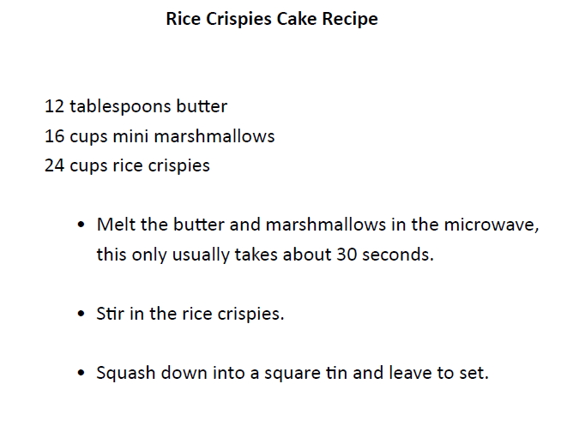
Day 3: Find ¹/₂, ¹/₃, ¹/₄ and ³/₄ of amounts using sharing and number facts.
This recipe would make more cakes than we need.
We need to halve the amounts.
Talk to
your partner.
How much of each ingredient would we need?

Slide 32
Day 3: Find ¹/₂, ¹/₃, ¹/₄ and ³/₄ of amounts using sharing and number facts.
We can use number facts to halve 12.
So we would need 6 tablespoons of butter.

Slide 33
Day 3: Find ¹/₂, ¹/₃, ¹/₄ and ³/₄ of amounts using sharing and number facts.
What about 16? Let’s share 16 into two groups.

Slide 34
Day 3: Find ¹/₂, ¹/₃, ¹/₄ and ³/₄ of amounts using sharing and number facts.
Half of 16 is 8

Slide 35
Day 3: Find ¹/₂, ¹/₃, ¹/₄ and ³/₄ of amounts using sharing and number facts.
How can we work out half of 24?

Slide 36
Day 3: Find ¹/₂, ¹/₃, ¹/₄ and ³/₄ of amounts using sharing and number facts.
We can halve 24 using partitioning.
So, half of 24 is 12.
Half of 20 is 10.
20 + 4
Half of 4 is 2.
10 +
2
= 12

Slide 37
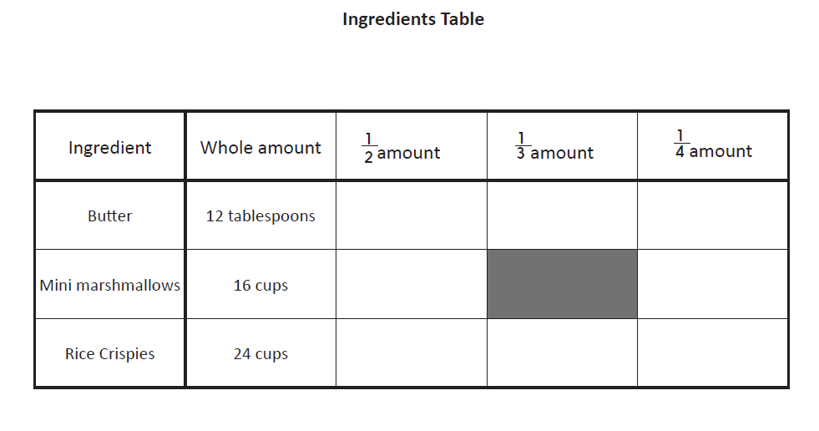
Day 3: Find ¹/₂, ¹/₃, ¹/₄ and ³/₄ of amounts using sharing and number facts.
Let’s record our new amounts.
6
8
12

Slide 38
Day 3: Find ¹/₂, ¹/₃, ¹/₄ and ³/₄ of amounts using sharing and number facts.
To make a chewier version, we would need to use ¹/₃ of the butter and ¹/₃ of the Rice Crispies.
6
8
12

Slide 39
Day 3: Find ¹/₂, ¹/₃, ¹/₄ and ³/₄ of amounts using sharing and number facts.
How can we work out ¹/₃ of 24 marshmallows?

Slide 40
Day 3: Find ¹/₂, ¹/₃, ¹/₄ and ³/₄ of amounts using sharing and number facts.
¹/₃ of 24 is 8

Slide 41
Day 3: Find ¹/₂, ¹/₃, ¹/₄ and ³/₄ of amounts using sharing and number facts.
Think, pair, share
how much butter we would need if we only used ¹/₃ of the original amount.
6
4
8
12
8

Slide 42
Day 3: Find ¹/₂, ¹/₃, ¹/₄ and ³/₄ of amounts using sharing and number facts.
We also need to create a recipe that is a quarter of the original size, in order to make bitesize portions.
6
4
8
12
8

Slide 43
Day 3: Find ¹/₂, ¹/₃, ¹/₄ and ³/₄ of amounts using sharing and number facts.
We find ¼ by halving and halving again.
Let’s start with the butter
We know that ½ of 12 is 6…
… and half of 6 is 3.

Slide 44
Day 3: Find ¹/₂, ¹/₃, ¹/₄ and ³/₄ of amounts using sharing and number facts.
6
4
3
8
12
8

Slide 45
Day 3: Find ¹/₂, ¹/₃, ¹/₄ and ³/₄ of amounts using sharing and number facts.
What about the marshmallows?
We know that ½ of 16 is 8…
… and half of 8 is 4.

Slide 46
Day 3: Find ¹/₂, ¹/₃, ¹/₄ and ³/₄ of amounts using sharing and number facts.
6
4
3
8
4
12
8

Slide 47
Day 3: Find ¹/₂, ¹/₃, ¹/₄ and ³/₄ of amounts using sharing and number facts.
And finally, let’s find ¼ of 24.
We know that ½ of 24 is 12…
… and half of 12 is 6.

Slide 48
Day 3: Find ¹/₂, ¹/₃, ¹/₄ and ³/₄ of amounts using sharing and number facts.
6
4
3
8
4
12
8
6
Notes:
Today would be a great day to use a problem-solving investigation – Making Longer, Making Shorter – from NRICH as the group activity.
Alternatively, children can now go on to do differentiated GROUP ACTIVITIES. You can find Hamilton’s group activities in this unit’s TEACHING AND GROUP ACTIVITIES download.
WT/ARE/GD: Change recipe quantities to make ¹/₂, ¹/₃ or ¹/₄ of the given recipe.
WT/ARE/GD: Create fridge cake recipes by changing the amount of each ingredient into ¹/₄s or ¹/₃s.

Slide 49
Investigation
Use ‘Making Longer, Making Shorter’ from NRICH: https://nrich.maths.org/5590
Make rods using different numbers of interlocking cubes. A practical context to explore simple multiplying and dividing, and to use the vocabulary of halves and quarters.
Notes:
Today would be a great day to use a problem-solving investigation – Making Longer, Making Shorter – from NRICH as the group activity.

Slide 50
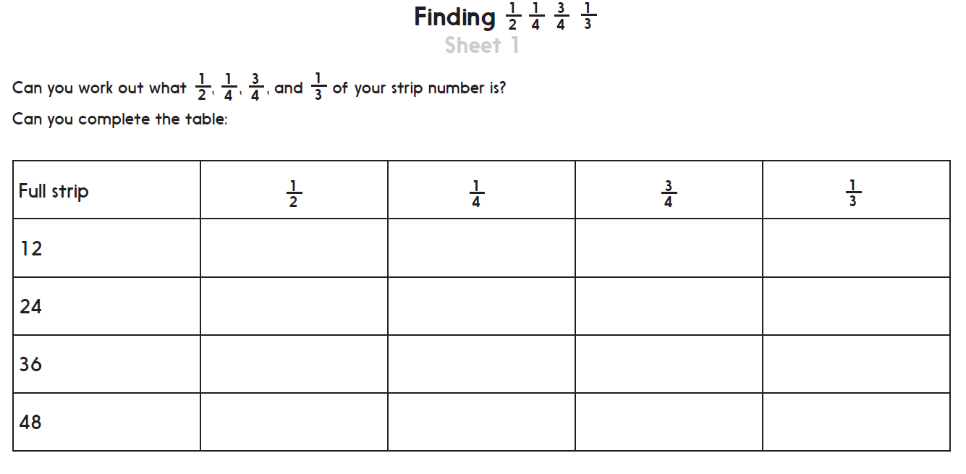
Challenge
Notes:
The Practice Sheet on this slide is suitable for most children.
Differentiated PRACTICE WORKSHEETS are available on Hamilton’s website in this unit’s PROCEDURAL FLUENCY box.
WT/ARE/GD: Sheet 1&2: Find ¹/₂, ¹/₄, ³/₄ and ¹/₃ of 12, 24, 36 and 48, using number facts or strips of shapes and pictures.

Slide 51
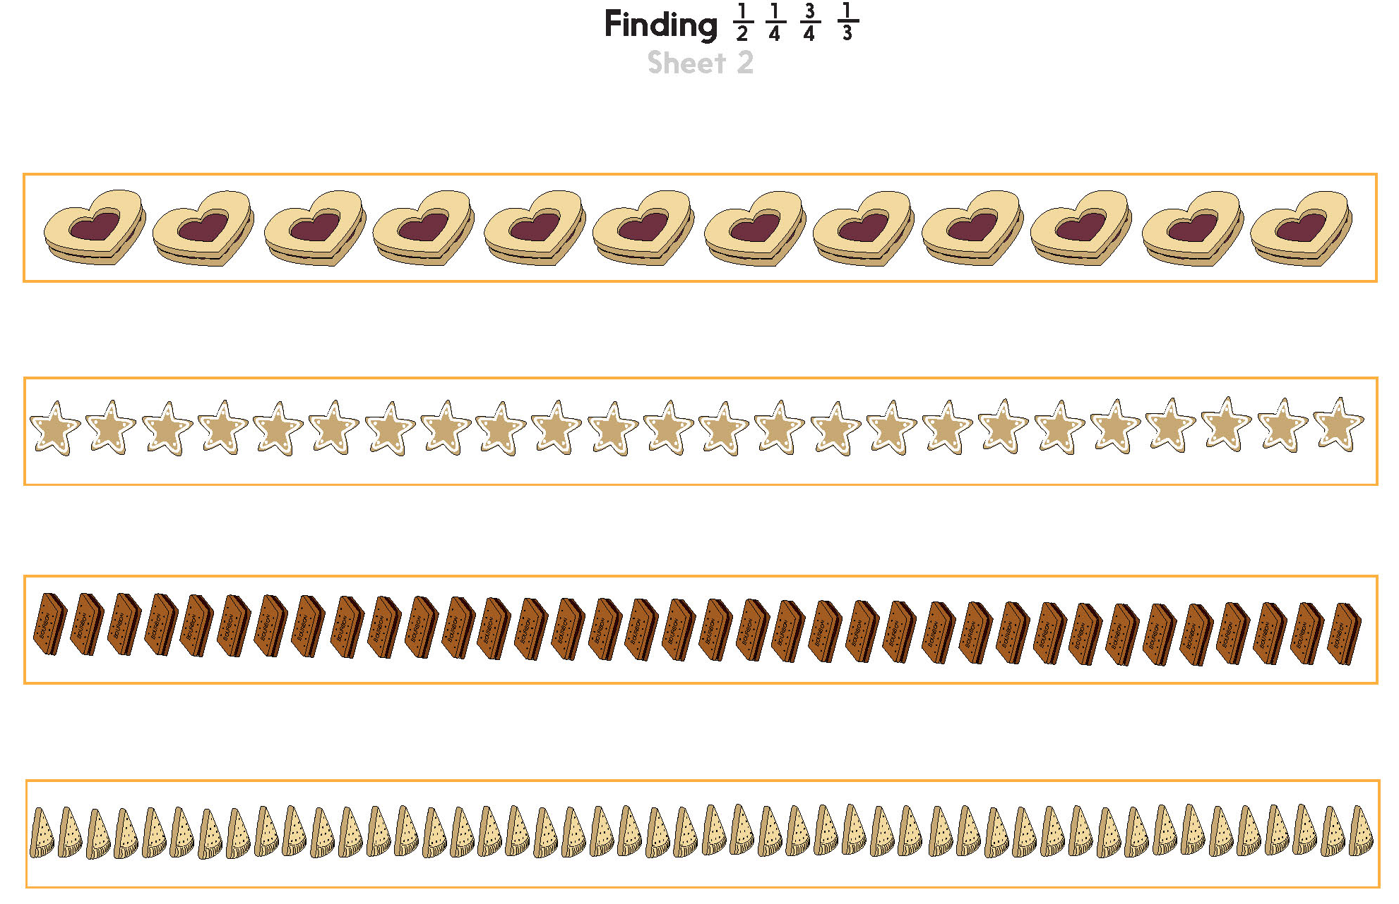

Slide 52
Number, Fractions, Money
Counting in ¹/₂s and ¹/₄s
Finding fractions of amounts
Well Done! You’ve completed this unit.
Objectives
Day 1
Count on in fraction steps.
Day 2
Find ¹/₂, ¹/₃, ¹/₄ and ³/₄ of amounts using sharing and number facts.
Day 3
Find ¹/₂, ¹/₃, ¹/₄ and ³/₄ of amounts using sharing and number facts.
Notes:
You can now use the Mastery: Reasoning and Problem-Solving questions to assess children’s success across this unit. Go to the next slide.

Slide 53
Problem solving and reasoning questions
Write the missing numbers in each sequence.
2¹/₄ 2¹/₂ 2³/₄
4¹/₂ 4¹/₄ 4
¹/₃ ²/₃ 1
Find ¹/₄ of each quantity:
(a) 24 stickers
(b) 16 pennies
(c) 28 crisps
Use your answers to find ³/₄ of each quantity.
True or false?
• ¹/₃ of 12p is the same as ¹/₂ of 8p
• ¹/₃ of 24p is the same as ¹/₂ of 16p
• ¹/₄ of 28p is the same as ³/₄ of 16p

Slide 54
Problem solving and reasoning: Answers
Write the missing numbers in each sequence.
2¹/₄ 2¹/₂ 2³/₄ 3 3¹/₄ 3¹/₂
4¹/₂ 4¹/₄ 4 3³/₄ 3¹/₂ 3¹/₄
¹/₃ ²/₃ 1 1 1¹/₃ 1²/₃ 2
Find ¹/₄ of each quantity:
(a) 24 stickers 6
(b) 16 pennies 4
(c) 28 crisps 7
Use your answers to find ³/₄ of each quantity. 18, 12, 21 respectively. Either by finding 3 times the first number or subtracting 1/4 from the original quantity
True or false?
• ¹/₃ of 12p is the same as ¹/₂ of 8p True – both equal 4p
• ¹/₃ of 24p is the same as ¹/₂ of 16p True – both equal 8p.
• ¹/₄ of 28p is the same as ³/₄ of 16p False, they equal 7p and 12p respectively

