Slide 1
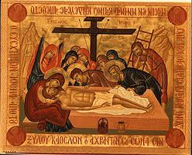
Holy week

Slide 2
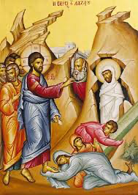
Lazarus Saturday

Slide 3
Jesus did not immediately go to Bethany, the town where Lazarus lived with his sisters. Instead He remained in the place where He was staying for two more days. After this time, He told his disciples that they were returning to Judea (John 10:31).

Slide 4
Jesus told his disciples that Lazarus had fallen asleep and that He was going there to wake him. The disciples wondered why He would go to wake Lazarus, since it was good for him to sleep if he was ill. Jesus, however, was referring to the death of Lazarus, and thus told the disciples directly that Lazarus was dead (vv. 11-14).

Slide 5
When Jesus arrived at Bethany, Lazarus had already been in the tomb four days. Jesus told her that her brother will rise again. Martha said that she knew he would rise again in the resurrection on the last day. Jesus replied, “I am the resurrection and the life. Those who believe in me, even though they die, will live, and everyone who lives and believes in me will never die.” Jesus asked Martha if she believed this. She said to Him, “Yes, Lord, I believe that you are the Messiah, the Son of God, the one coming into the world” (vv. 17-27).

Slide 6
Martha returned to tell Mary that Jesus had come and was asking for her. Mary went to meet Him and when she came to Jesus, she fell at His feet and said, “Lord, if you had been here, my brother would not have died.” Jesus saw her weeping and those who were with her, and He was deeply moved. He asked to be taken to the tomb of Lazarus. As Jesus wept for Lazarus the Jews said, “See how He loved him.” Others wondered that if Jesus could open the eyes of the blind, He certainly could have kept Lazarus from dying (vv. 28-37).

Slide 7
Jesus came to the tomb and asked that the stone that covered the door be taken away. Martha remarked that Lazarus had now been in the tomb for four days and that there would be a stench. Jesus replied, “Did I not tell you that if you believed, you would see the glory of God?” The stone was taken away, and Jesus looked toward heaven and said, “Father, I thank you for having heard me, but I have said this for the sake of the crowd standing here, so that they may believe that you sent me.” When He had said this, He called out with a loud voice, “Lazarus, come out!” Lazarus walked out of the tomb, bound with the strips of burial cloth, and Jesus said, “Unbind him, and let him go” (vv. 38-44).

Slide 8
How did Mary, Martha, Jesus and Lazarus feel before and after the event?

Slide 9
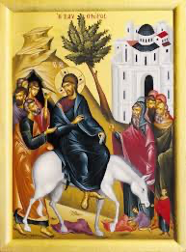
Palm Sunday

Slide 10
1 As they approached Jerusalem and came to Bethphage and Bethany at the Mount of Olives, Jesus sent two of his disciples, ² saying to them, “Go to the village ahead of you, and just as you enter it, you will find a colt tied there, which no one has ever ridden. Untie it and bring it here. ³ If anyone asks you, ‘Why are you doing this?’ say, ‘The Lord needs it and will send it back here shortly.’

Slide 11
They went and found a colt outside in the street, tied at a doorway. As they untied it, ⁵ some people standing there asked, “What are you doing, untying that colt?” ⁶ They answered as Jesus had told them to, and the people let them go. ⁷ When they brought the colt to Jesus and threw their cloaks over it, he sat on it. ⁸ Many people spread their cloaks on the road, while others spread branches they had cut in the fields. ⁹ Those who went ahead and those who followed shouted,
“Hosanna!^{[a]}”
“Blessed is he who comes in the name of the Lord!”^{[b]}
¹⁰ “Blessed is the coming kingdom of our father David!”
“Hosanna in the highest heaven!”

Slide 12
Palm Sunday was the day that Jesus travelled into Jerusalem.
He went to Jerusalem on a donkey.
People put palm leaves on the floor in front of Him because He was their King.

Slide 13
Jesus' purpose in riding into Jerusalem was to make public His claim to be their Messiah and King of Israel in fulfilment of Old Testament prophecy. Matthew tells us that the King coming on the foal of a donkey was an exact fulfilment of
Zechariah 9:9-10 Shout, Daughter Jerusalem! See, your king comes to you, righteous and victorious, lowly and riding on a donkey, on a colt, the foal of a donkey. ¹⁰ I will take away the chariots from Ephraim and the warhorses from Jerusalem, and the battle bow will be broken. He will proclaim peace to the nations. His rule will extend from sea to sea and from the River^{[a]} to the ends of the earth.

Slide 14
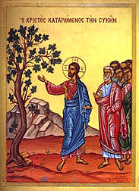
Holy Monday

Slide 15
Jesus Goes to the Temple
¹² Jesus went into the Temple and drove out all those who were buying and selling there. He overturned the tables of the moneychangers and the stools of those who sold pigeons, ¹³ and said to them, “It is written in the Scriptures that God said, ‘My Temple will be called a house of prayer.’ But you are making it a hideout for thieves!”
¹⁴ The blind and the crippled came to him in the Temple, and he healed them. ¹⁵ The chief priests and the teachers of the Law became angry when they saw the wonderful things he was doing and the children shouting in the Temple, “Praise to David's Son!” ¹⁶ So they asked Jesus, “Do you hear what they are saying?”
“Indeed I do,” answered Jesus. “Haven't you ever read this scripture? ‘You have trained children and babies to offer perfect praise.’”
¹⁷ Jesus left them and went out of the city to Bethany, where he spent the night.

Slide 16
¹⁸ On his way back to the city early next morning, Jesus was hungry. ¹⁹ He saw a fig tree by the side of the road and went to it, but found nothing on it except leaves. So he said to the tree, “You will never again bear fruit!” At once the fig tree dried up.
²⁰ The disciples saw this and were astounded. “How did the fig tree dry up so quickly?” they asked.
²¹ Jesus answered, “I assure you that if you believe and do not doubt, you will be able to do what I have done to this fig tree. And not only this, but you will even be able to say to this hill, ‘Get up and throw yourself in the sea,’ and it will. ²² If you believe, you will receive whatever you ask for in prayer.”

Slide 17
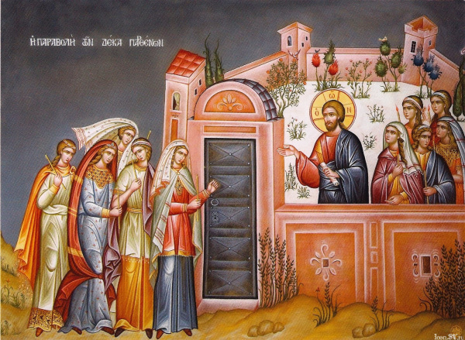
Holy Tuesday

Slide 18
On Holy Tuesday we remember this story that Jesus told:
Matthew 25 “At that time the Kingdom of heaven will be like this. Once there were ten young women who took their oil lamps and went out to meet the bridegroom. ² Five of them were foolish, and the other five were wise. ³ The foolish ones took their lamps but did not take any extra oil with them, ⁴ while the wise ones took containers full of oil for their lamps. ⁵ The bridegroom was late in coming, so they began to nod and fall asleep.

Slide 19
⁶ “It was already midnight when the cry rang out, ‘Here is the bridegroom! Come and meet him!’ ⁷ The ten young women woke up and trimmed their lamps. ⁸ Then the foolish ones said to the wise ones, ‘Let us have some of your oil, because our lamps are going out.’ ⁹ ‘No, indeed,’ the wise ones answered, ‘there is not enough for you and for us. Go to the store and buy some for yourselves.’ ¹⁰ So the foolish ones went off to buy some oil; and while they were gone, the bridegroom arrived. The five who were ready went in with him to the wedding feast, and the door was closed.
¹¹ “Later the others arrived. ‘Sir, sir! Let us in!’ they cried out. ¹² ‘Certainly not! I don't know you,’ the bridegroom answered.”
¹³ And Jesus concluded, “Watch out, then, because you do not know the day or the hour.

Slide 20
What do you think the foolish maidens represent?
What do you think the wise maidens represent?

Slide 21
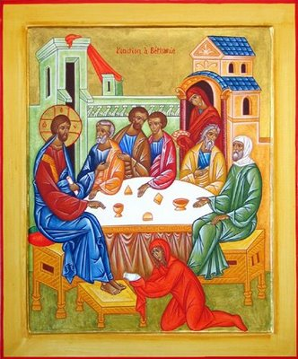
Holy Wednesday

Slide 22
Luke Chapter 7: Jesus at the Home of Simon the Pharisee
³⁶ A Pharisee invited Jesus to have dinner with him, and Jesus went to his house and sat down to eat. ³⁷ In that town was a woman who lived a sinful life. She heard that Jesus was eating in the Pharisee's house, so she brought an alabaster jar full of perfume ³⁸ and stood behind Jesus, by his feet, crying and wetting his feet with her tears. Then she dried his feet with her hair, kissed them, and poured the perfume on them. ³⁹ When the Pharisee saw this, he said to himself, “If this man really were a prophet, he would know who this woman is who is touching him; he would know what kind of sinful life she lives!”
⁴⁰ Jesus spoke up and said to him, “Simon, I have something to tell you.”

Slide 23
“Yes, Teacher,” he said, “tell me.”
⁴¹ “There were two men who owed money to a moneylender,” Jesus began. “One owed him five hundred silver coins, and the other owed him fifty. ⁴² Neither of them could pay him back, so he cancelled the debts of both. Which one, then, will love him more?”
⁴³ “I suppose,” answered Simon, “that it would be the one who was forgiven more.”
“You are right,” said Jesus. ⁴⁴ Then he turned to the woman and said to Simon, “Do you see this woman? I came into your home, and you gave me no water for my feet, but she has washed my feet with her tears and dried them with her hair. ⁴⁵ You did not welcome me with a kiss, but she has not stopped kissing my feet since I came. ⁴⁶ You provided no olive oil for my head, but she has covered my feet with perfume. ⁴⁷ I tell you, then, the great love she has shown proves that her many sins have been forgiven. But whoever has been forgiven little shows only a little love.”
⁴⁸ Then Jesus said to the woman, “Your sins are forgiven.”
⁴⁹ The others sitting at the table began to say to themselves, “Who is this, who even forgives sins?”
⁵⁰ But Jesus said to the woman, “Your faith has saved you; go in peace.”

Slide 24
Why did the woman pour her precious oil over Jesus?
How do you think it made the people feel?

Slide 25
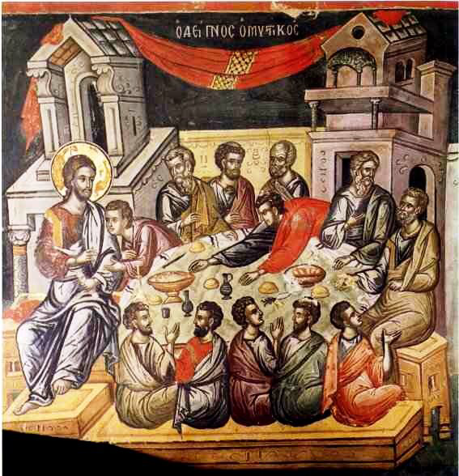
Holy Thursday

Slide 26
22 Now the Festival of Unleavened Bread, called the Passover, was approaching, ² and the chief priests and the teachers of the law were looking for some way to get rid of Jesus, for they were afraid of the people. ³ Then Satan entered Judas, called Iscariot, one of the Twelve. ⁴ And Judas went to the chief priests and the officers of the temple guard and discussed with them how he might betray Jesus. ⁵ They were delighted and agreed to give him money. ⁶ He consented, and watched for an opportunity to hand Jesus over to them when no crowd was present.
The Last Supper
⁷ Then came the day of Unleavened Bread on which the Passover lamb had to be sacrificed. ⁸ Jesus sent Peter and John, saying, “Go and make preparations for us to eat the Passover.”
⁹ “Where do you want us to prepare for it?” they asked.
¹⁰ He replied, “As you enter the city, a man carrying a jar of water will meet you. Follow him to the house that he enters, ¹¹ and say to the owner of the house, ‘The Teacher asks: Where is the guest room, where I may eat the Passover with my disciples?’ ¹² He will show you a large room upstairs, all furnished. Make preparations there.”

Slide 27
¹³ They left and found things just as Jesus had told them. So they prepared the Passover.
¹⁴ When the hour came, Jesus and his apostles reclined at the table. ¹⁵ And he said to them, “I have eagerly desired to eat this Passover with you before I suffer. ¹⁶ For I tell you, I will not eat it again until it finds fulfillment in the kingdom of God.”
¹⁷ After taking the cup, he gave thanks and said, “Take this and divide it among you.¹⁸ For I tell you I will not drink again from the fruit of the vine until the kingdom of God comes.”
¹⁹ And he took bread, gave thanks and broke it, and gave it to them, saying, “This is my body given for you; do this in remembrance of me.”
²⁰ In the same way, after the supper he took the cup, saying, “This cup is the new covenant in my blood, which is poured out for you.^{[a]} ²¹ But the hand of him who is going to betray me is with mine on the table. ²² The Son of Man will go as it has been decreed. But woe to that man who betrays him!” ²³ They began to question among themselves which of them it might be who would do this

Slide 28
The Last Supper
¹⁷ On the first day of the Festival of Unleavened Bread, the disciples came to Jesus and asked, “Where do you want us to make preparations for you to eat the Passover?”
¹⁸ He replied, “Go into the city to a certain man and tell him, ‘The Teacher says: My appointed time is near. I am going to celebrate the Passover with my disciples at your house.’” ¹⁹ So the disciples did as Jesus had directed them and prepared the Passover.
²⁰ When evening came, Jesus was reclining at the table with the Twelve. ²¹ And while they were eating, he said, “Truly I tell you, one of you will betray me.”
²² They were very sad and began to say to him one after the other, “Surely you don’t mean me, Lord?”
²³ Jesus replied, “The one who has dipped his hand into the bowl with me will betray me. ²⁴ The Son of Man will go just as it is written about him. But woe to that man who betrays the Son of Man! It would be better for him if he had not been born.”
²⁵ Then Judas, the one who would betray him, said, “Surely you don’t mean me, Rabbi?”
Jesus answered, “You have said so.”
²⁶ While they were eating, Jesus took bread, and when he had given thanks, he broke itand gave it to his disciples, saying, “Take and eat; this is my body.”
²⁷ Then he took a cup, and when he had given thanks, he gave it to them, saying,“Drink from it, all of you. ²⁸ This is my blood of the^{[b]} covenant, which is poured out for many for the forgiveness of sins. ²⁹ I tell you, I will not drink from this fruit of the vine from now on until that day when I drink it new with you in my Father’s kingdom.”
³⁰ When they had sung a hymn, they went out to the Mount of Olives.

Slide 29
Why do you think there are differences in each version?
What is the same in all of them?
Why is this important?

Slide 30
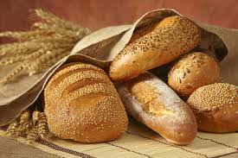
What does the bible say about the bread?
What does it say about the wine?
Why does Jesus say his body and blood were ‘given for us’?

Slide 31
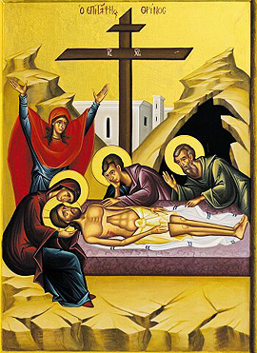
Good Friday

Slide 32
In Greek Orthodox churches on Holy Thursday night Jesus is put on a wooden cross. The women stay in church all night and decorate the epitaphion with flowers. On Holy Friday the priest takes Jesus' body down from the cross and puts Him in the epitaphion. The men then hold the epitaphion up and carry it around the church. People walk under it to show love and respect to Jesus.
It is the day when we remember The Passion Of Jesus Christ. On this day, Our Lord went to the cross and died to take away our sins. The power of death and the reality of evil rule the world on this dreadful day. Yet, Jesus' death marks the beginning of His and ours victory over death's power.

Slide 33
As they were going out, they met a man from Cyrene, named Simon, and they forced him to carry the cross. ³³ They came to a place called Golgotha (which means “the place of the skull”). ³⁴ There they offered Jesus wine to drink, mixed with gall; but after tasting it, he refused to drink it. ³⁵ When they had crucified him, they divided up his clothes by casting lots. ³⁶ And sitting down, they kept watch over him there. ³⁷ Above his head they placed the written charge against him: this is jesus, the king of the jews.
³⁸ Two rebels were crucified with him, one on his right and one on his left. ³⁹ Those who passed by hurled insults at him, shaking their heads ⁴⁰ and saying, “You who are going to destroy the temple and build it in three days, save yourself! Come down from the cross, if you are the Son of God!” ⁴¹ In the same way the chief priests, the teachers of the law and the elders mocked him. ⁴² “He saved others,” they said, “but he can’t save himself! He’s the king of Israel! Let him come down now from the cross, and we will believe in him. ⁴³ He trusts in God. Let God rescue him now if he wants him, for he said, ‘I am the Son of God.’” ⁴⁴ In the same way the rebels who were crucified with him also heaped insults on him.

Slide 34
The Death of Jesus
⁴⁵ From noon until three in the afternoon darkness came over all the land. ⁴⁶ About three in the afternoon Jesus cried out in a loud voice, “Eli, Eli,^{[c]} lema sabachthani?” (which means “My God, my God, why have you forsaken me?”).^{[d]}
⁴⁷ When some of those standing there heard this, they said, “He’s calling Elijah.”
⁴⁸ Immediately one of them ran and got a sponge. He filled it with wine vinegar, put it on a staff, and offered it to Jesus to drink. ⁴⁹ The rest said, “Now leave him alone. Let’s see if Elijah comes to save him.”
⁵⁰ And when Jesus had cried out again in a loud voice, he gave up his spirit.
⁵¹ At that moment the curtain of the temple was torn in two from top to bottom. The earth shook, the rocks split ⁵² and the tombs broke open. The bodies of many holy people who had died were raised to life. ⁵³ They came out of the tombs after Jesus’ resurrection and^{[e]} went into the holy city and appeared to many people.
⁵⁴ When the centurion and those with him who were guarding Jesus saw the earthquake and all that had happened, they were terrified, and exclaimed, “Surely he was the Son of God!”
⁵⁵ Many women were there, watching from a distance. They had followed Jesus from Galilee to care for his needs. ⁵⁶ Among them were Mary Magdalene, Mary the mother of James and Joseph,^{[f]} and the mother of Zebedee’s sons.

Slide 35
Why do we make an Epitaphion?
When we fast throughout lent, how does it remind us of Jesus sacrifice?

Slide 36
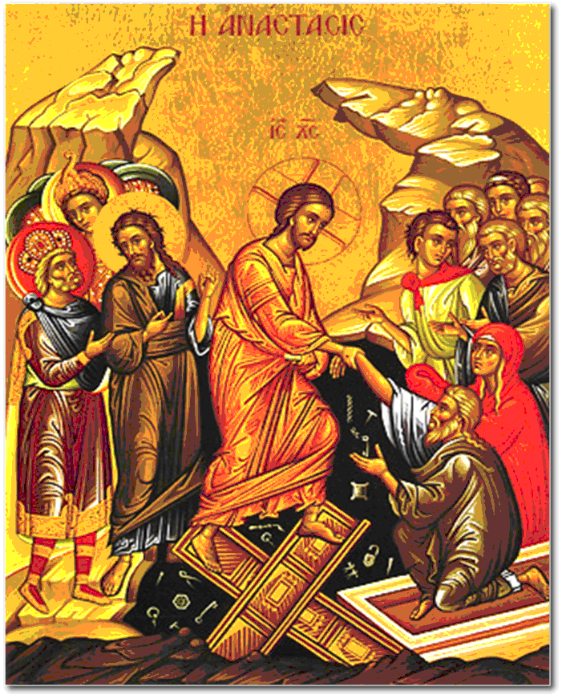
Great Saturday/Easter Sunday

Slide 37
After the Sabbath, at dawn on the first day of the week, Mary Magdalene and the other Mary went to look at the tomb.
² There was a violent earthquake, for an angel of the Lord came down from heaven and, going to the tomb, rolled back the stone and sat on it. ³ His appearance was like lightning, and his clothes were white as snow. ⁴ The guards were so afraid of him that they shook and became like dead men.
⁵ The angel said to the women, “Do not be afraid, for I know that you are looking for Jesus, who was crucified. ⁶ He is not here; he has risen, just as he said. Come and see the place where he lay. ⁷ Then go quickly and tell his disciples: ‘He has risen from the dead and is going ahead of you into Galilee. There you will see him.’ Now I have told you.”
⁸ So the women hurried away from the tomb, afraid yet filled with joy, and ran to tell his disciples. ⁹ Suddenly Jesus met them. “Greetings,” he said. They came to him, clasped his feet and worshiped him. ¹⁰ Then Jesus said to them, “Do not be afraid. Go and tell my brothers to go to Galilee; there they will see me.”
How does this story bring hope to Christians?

