Slide 1
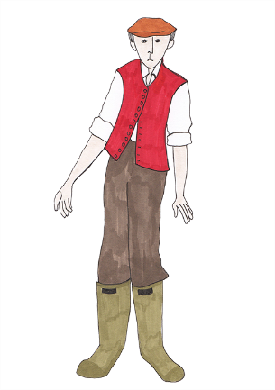
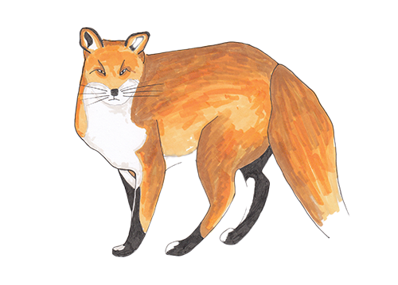
Verbs
Verbs tell us that someone or something is
doing, feeling or being.
Usually verbs have the name of a person or thing or a pronoun in front of them.
Boggis munches.
Bunce grumbles.
Bean thinks.
They are dreadful.
Verbs have tense. They tell us when the action happened.
In the present
In the past
He is too clever.
He was too clever.
He creeps outside.
He crept outside.

Slide 2
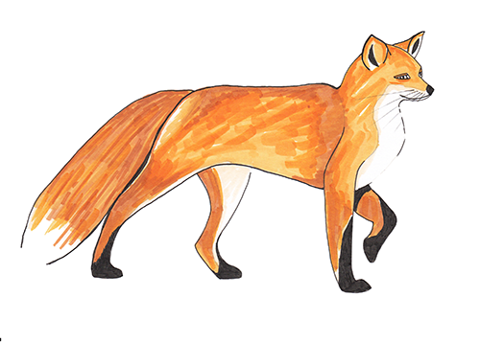
Perfect form
Perfect form describes an action completed in the past.
It also uses the verb has/have in front .
They have hidden behind the jars.
It uses the past participle of the verb.
She has taken two jars.
The present perfect form of the past tense suggests that
a past action is still affecting the present.it.
Simple past | Perfect form
I finished the feast.
I have finished the feast.
He lost his tail.
He has lost his tail.

Slide 3
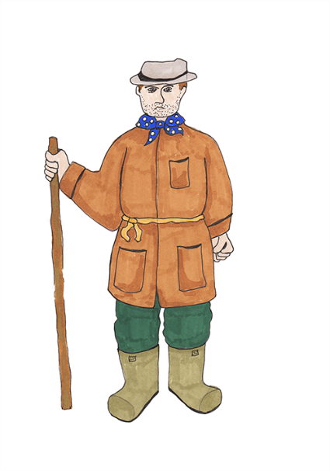
Which are in the present perfect form?
She has collected the jars.
Present Perfect Form
has/have + past participle
She collected the jars.
We have finished collecting the cider.
We finished collecting the cider.
They stood very still behind the jars.
They have stood very still behind the jars.

Slide 4
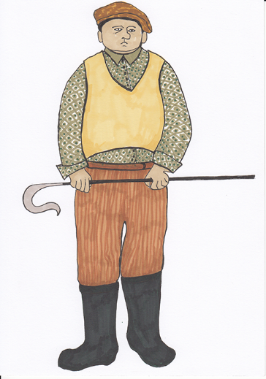
Present perfect form
Remember: the present perfect form describes an action completed in the past which is still affecting the present.
Present Perfect Form
has/have + past participle
Perfect form describes an action completed in the past.
Perfect form
also uses the verb has/have in front.
The animals have enjoyed the feast.
Mr Fox has succeeded in his mission.
Now try writing five sentences of your own about Fantastic Mr Fox using the present perfect form.

