Slide 1


Article 24: “You have the right to the best healthcare possible, safe water to drink, nutritious food, a clean and safe environment, and information to help you stay well.”
–
Parents/Carers & Pupils:
This lesson works best in “Full Screen” mode – click the icon at the bottom right of your screen or use the “F5” key to start from the beginning. Use the space bar, mouse or arrow keys to click through!

Slide 2

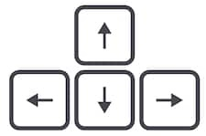




How to use this lesson…
Use these buttons to get the most out of your lesson.
Find this button in the bottom right of you screen to start your lesson.
Use the arrow keys to go forwards and backwards through your lesson.
To go back to your normal screen, press the esc key on your keyboard.
–
Learning from home?
Here are some ideas of how to get the most out of this lesson at home.
Ask an adult to arrange a video call so you can do some
of the activities with a friend.
Explore the topic with a parent or caregiver: how is their opinion
different to yours?
Teach a younger sibling or relative
about how
VotesforSchools works!
In the classroom?
Look out for these boxes to see how to make the most of the activities!
Parents’ & Carers’ Note:
Please see the Notes section below each slide for any further guidance.
Don’t forget to vote…
You can find the link to do this on the final slide. Get your whole household involved!
Notes:
Images:
https://icons8.com/

Slide 3





Feedback: “Should young people earn pocket money?”
“They shouldn't just be given it. They should have to earn it by doing chores.”
St John’s School
“We discussed this and decided that kids should do chores around the house because they are part of the family team, not to earn money. However, we do get pocket money as mum and dad want us to learn about the value of money.”
Telferscot Primary School
“My mum and dad both have to go to work to earn their money so it’s teaching me that if you want something you have to earn it.”
Ryders Hayes School
82.4%
17.6%
“They would buy things they don't need.”
Godolphin Junior Academy
“Children will need to use money when they are older. It is a important skill needed in life.”
Royal Alexandra and Albert School
Whether you’re at home or school, make your voice heard by voting! You can find a link on the last slide of this lesson, or by searching for this hashtag on social media!
Notes:
Parent/Carer Note: This slide shows the feedback to the question pupils answered two weeks ago. Check back in two weeks to see if the comment you make at the end of this lesson is featured!
To record your child’s vote, use the survey link on the last slide or use the hashtag #VotesatHome on social media to browse other children’s responses and share your own.

Slide 4


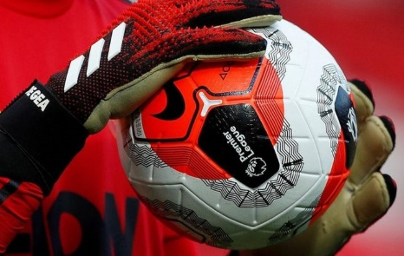
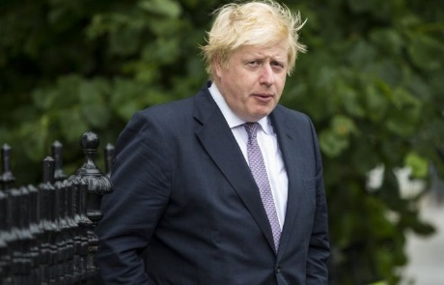



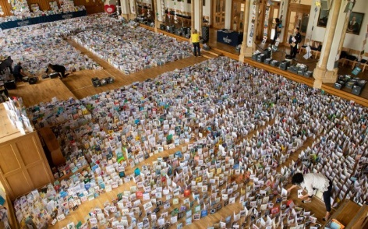

Be informed!
Here’s what’s been in the news this week...
Hope for the Premier League…
Boris makes his return
The Premier League football season was cancelled on 13th March, but they are hoping to train again in May!
Prime Minister Boris Johnson returned to week last Monday after recovering from COVID-19. Days later, his new baby was born!
Captain Tom Moore received over 125,000 cards for his 100th birthday last week. The cards filled a whole school hall!
TikTok star Charli D'Amelio has told fans not to discuss her body after some fans started talking about her weight.
Captain Tom* celebrates 100th birthday
Stop talking about me!
Notes:
*He has now also been made an honorary Corporal: https://www.bbc.co.uk/news/uk-england-beds-bucks-herts-52472132
Parent/Carer Note: Use this slide to learn about headlines around the world. Using the presentation in Slide Show mode, you will be able to click on the highlighted pictures to follow links to websites and videos.
Alternative video link: https://www.bbc.co.uk/newsround/52228461
Images/Stories:
Premier League: https://www.bbc.co.uk/newsround/52453064
TikTok: https://www.bbc.co.uk/newsround/52354393
Charlie D’Amelio: https://www.bbc.co.uk/newsround/52442542
Tom’s Birthday: https://metro.co.uk/2020/04/28/captain-tom-moore-sent-125000-cards-100th-birthday-12620263/

Slide 5

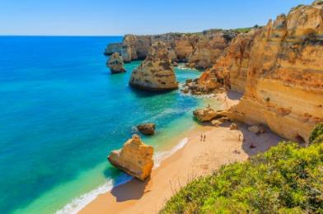
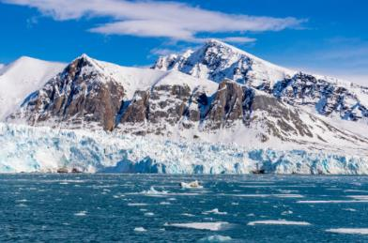
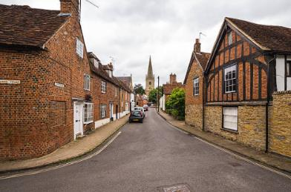

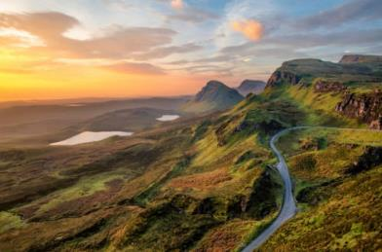

Where in the world… (2 mins)
If you could live anywhere in the world, where would it be?
Starter: Where in the world…
Somewhere hot and sunny?
Or cold and snowy?
Somewhere quiet?
Somewhere urban?
Or somewhere rural?
Challenge:
Does the current Coronavirus pandemic affect where you choose?
Or somewhere busy?
Notes:
Parent/Carer Note: Throughout this lesson you will see activity bubbles like this. Each one has a dedicated time limit, allowing you to keep this lesson between 30 and 60 minutes long.
Images:
iStock

Slide 6
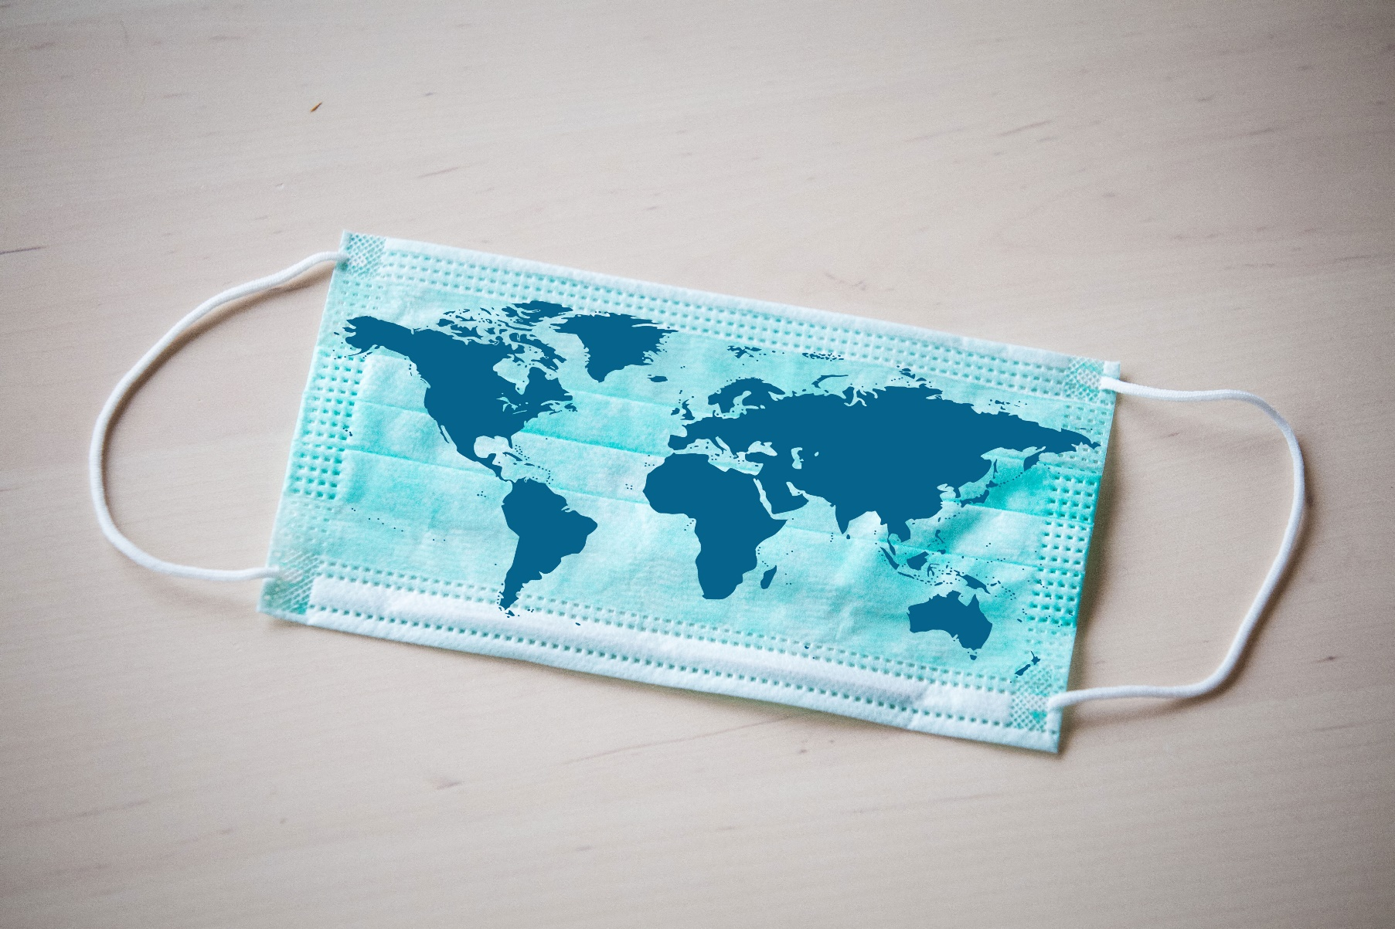
Should every country follow the same Coronavirus advice?
Notes:
Parent/Carer Note: Each week, your child completes this lesson in school before recording their vote on an online platform. Temporarily, we have created a platform you can use at home. Please see the last slide for details.
Images:
iStock

Slide 7

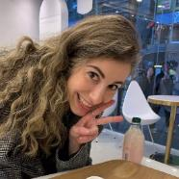
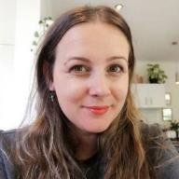

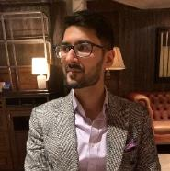
Starter: Where in the world…
Why are we talking about this?
What’s going on around the world?
Just following advice?
Does one size fit all?
Vote!
Ext: Hear more stories!
Notes:
Images:
iStock

Slide 8

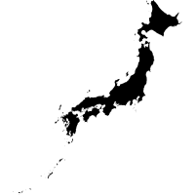
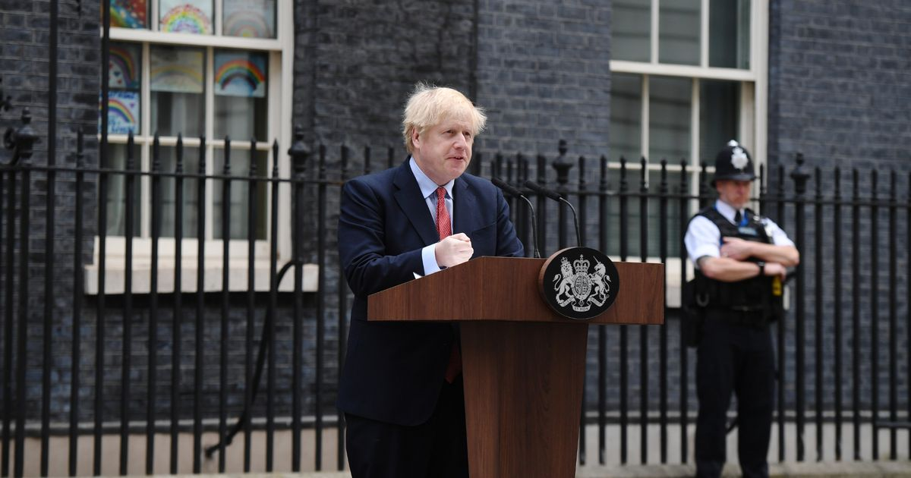
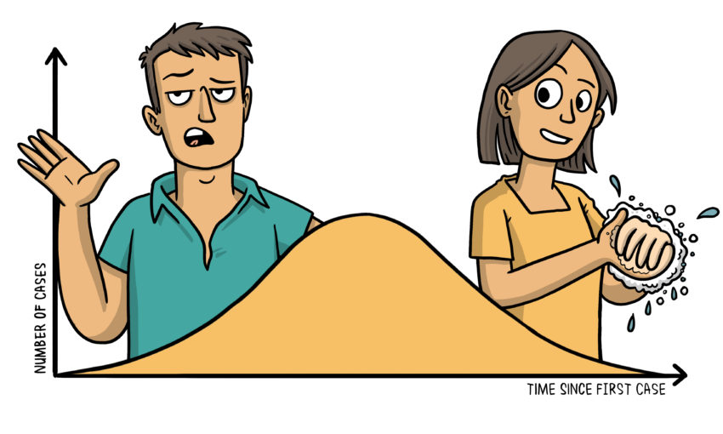
Why are we talking about this?
All around the world, every country is trying to slow down the spread of Coronavirus. But as you will see in this lesson, they’re all doing it in a different way!
Here in the UK, the Government currently have a “Daily Briefing” where they update British people on what’s currently happening here and what they want to do next.
On 27th April, Boris Johnson gave his first speech after spending time in hospital for Coronavirus. Click the image to hear it².
But would it make sense for everywhere to follow the same advice? Around the world there is a lot of debate about who’s doing the best job and what other countries could learn from them. You will be exploring these today.
https://safeshare.tv/x/xk-i9923Qfg
Notes:
Parent/Carer Note: This slide provides context for the lesson this week.
Alternative video link: https://www.youtube.com/watch?v=xk-i9923Qfg
Images:
1) iStock

Slide 9
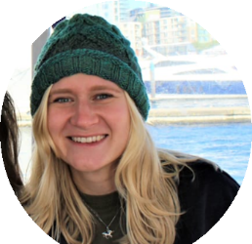
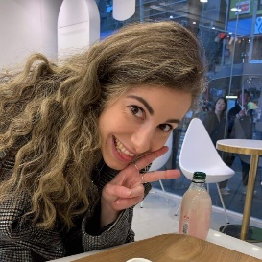
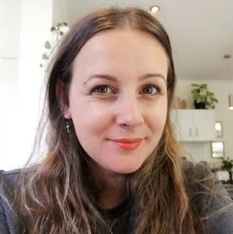

Starter: Where in the world…
Why are we talking about this?
What’s going on around the world?
Just following advice?
Does one size fit all?
Vote!
Ext: Hear more stories!
Notes:
Images:
Courtesy of speakers throughout lesson

Slide 10







What’s going on around the world?
The new Coronavirus has been called a pandemic. This means that it is affecting every country in the world.
The UK
Spain
Japan
Israel
Brazil
Hong Kong
In this lesson, you are going to find out more about what has been happening in six different countries around the world.
Challenge:
Can you match these countries to the correct place on the map?
Notes:
Parent/Carer Note: There are a total of 15 videos from around the world that can be watched in the final activity.
Images:
iStock

Slide 11







What’s going on around the world?
The United Kingdom (UK)
The UK is made up of England, Scotland, Wales and Northern Ireland. More than 66 million people live here.
There have been more than 150,000 Coronavirus cases in the UK and more than 25,000 deaths¹.
Before you see how COVID-19 has affected different countries around the world, think about how it has affected us here in the UK.
Travel
Shopping
Discuss (5 mins)
Discuss with a friend or create a mind map showing all the ways that Coronavirus has changed the way we live. Use the categories to help you.
Socialising
Education
Community
Leisure
Notes:
Images:
1) icons8

Slide 12
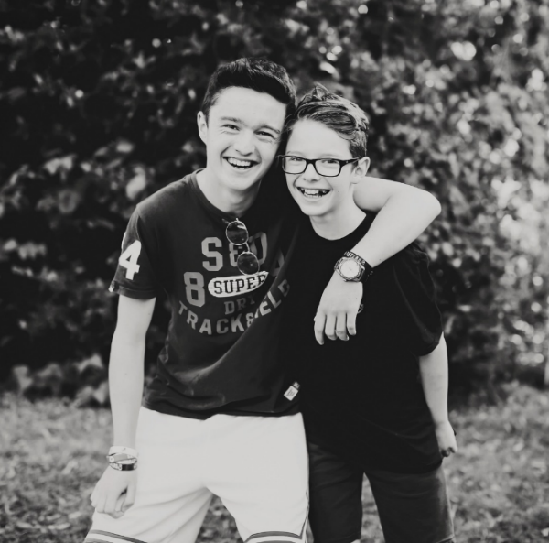




What’s going on around the world?
0:00-1:57
Spain
Spain is a country in Europe. Nearly 47 million people live there.
There have been more than 230,000 cases of COVID-19 there, and nearly 25,000 deaths¹.
Watch (2-5 mins)
Click the picture to hear from Wilf and Rufus, who live in Spain. Can you answer these questions?
How has Spain’s lockdown been similar to here in the UK?
How has Spain’s lockdown been different to here in the UK?
Video trouble?
If you’re not using full screen mode, try pressing the CTRL button on your keyboard while you click on the image!
How often would you be allowed out if you lived in Spain?
https://safeshare.tv/x/PSQYuiA802A
Notes:
Parent/Carer Note: Statistics are generalised to aid parents and teachers in delivering accurate information. For the most up-to-date figures please use this website: https://www.worldometers.info/coronavirus/
References:
https://worldpopulationreview.com/countries/spain-population/
Video link: https://safeshare.tv/x/PSQYuiA802A
Alternative video link: https://youtu.be/PSQYuiA802A

Slide 13
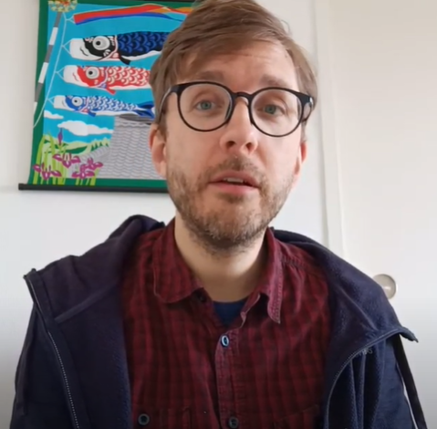

What’s going on around the world?
0:00-1:46
Japan
Japan is a country near to China, in Asia. 126 million people live here.
There have been nearly 14,000 cases of COVID-19 here, and less than 500 deaths¹.
Watch (2-5 mins)
Click the picture to hear from Ben, who lives in Japan. Can you answer these questions?
How has Japan’s lockdown been similar to here in the UK?
How has Japan’s lockdown been different to here in the UK?
Challenge:
Why might Japan have fewer cases of COVID-19 than other countries?
Would you prefer to have a less strict lockdown like Japan?
https://safeshare.tv/x/d24OMvdWAsg
Notes:
Parent/Carer Note: Statistics are generalised to aid parents and teachers in delivering accurate information. For the most up-to-date figures please use this website: https://www.worldometers.info/coronavirus/
References:
https://worldpopulationreview.com/countries/japan-population/
Video link: https://safeshare.tv/x/d24OMvdWAsg
Alternative video link: https://youtu.be/d24OMvdWAsg

Slide 14
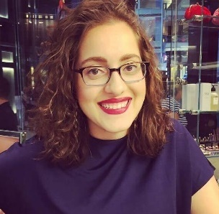

What’s going on around the world?
0:00-2:10
Israel
Israel is a country in the Middle East, close to Egypt. 8.6 million people live here.
There have been nearly 16,000 cases of COVID-19 here, and more than 200 deaths¹.
Watch (2-5 mins)
Click the picture to hear from Jessica, who lives in Israel. Can you answer these questions?
How has Israel’s lockdown been similar to here in the UK?
How has Israel’s lockdown been different to here in the UK?
Challenge:
How has lockdown affected religion here in the UK?
How is lockdown affecting religion in Israel?
https://safeshare.tv/x/_VLcX56B39A
Notes:
Parent/Carer Note: Statistics are generalised to aid parents and teachers in delivering accurate information. For the most up-to-date figures please use this website: https://www.worldometers.info/coronavirus/
References:
https://worldpopulationreview.com/countries/israel-population/
Video link: https://safeshare.tv/x/_VLcX56B39A
Alternative video link: https://youtu.be/_VLcX56B39A

Slide 15
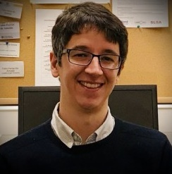

What’s going on around the world?
0:00-2:54
Brazil
Brazil is a country in South America. 212 million people live here.
There have been nearly 80,000 cases of COVID-19 here, and more than 5,000 deaths¹.
Watch (2-5 mins)
Click the picture to hear from Fabio, who lives in Brazil. Can you answer these questions?
How has Brazil’s lockdown been different to here in the UK?
What did Brazil’s Government say about COVID-19?
Challenge:
Do you think we should wear masks here in the UK?
How many people could be in one room in a house in Brazil?
https://safeshare.tv/x/b25UJXfjvSI
Notes:
Parent/Carer Note: Statistics are generalised to aid parents and teachers in delivering accurate information. For the most up-to-date figures please use this website: https://www.worldometers.info/coronavirus/
References:
https://worldpopulationreview.com/countries/brazil-population/
Video link: https://safeshare.tv/x/b25UJXfjvSI
Alternative video link: https://www.youtube.com/watch?v=b25UJXfjvSI

Slide 16
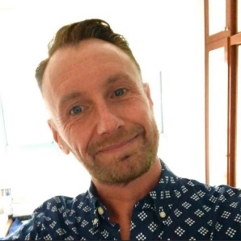

What’s going on around the world?
0:00-1:57
Hong Kong
Hong Kong is an area close to China in Asia. 7.5 million people live here.
They have had more than 1,000 cases of COVID-19 here, and less than 10 deaths¹.
Watch (2-5 mins)
Click the picture to hear from Neil, who lives in Hong Kong. Can you answer these questions?
How has Hong Kong’s lockdown been similar to the UK’s?
How has Hong Kong’s lockdown been different to here in the UK?
Challenge:
Why do you think fewer people have died in Hong Kong?
Why does Neil think Hong Kong is good at dealing with viruses?
https://safeshare.tv/x/WXx6bMAXU3g
Notes:
Parent/Carer Note: Statistics are generalised to aid parents and teachers in delivering accurate information. For the most up-to-date figures please use this website: https://www.worldometers.info/coronavirus/
References:
https://worldpopulationreview.com/countries/hong-kong-population/
Video link: https://safeshare.tv/x/WXx6bMAXU3g
Alternative video link: https://youtu.be/WXx6bMAXU3g

Slide 17
Starter: Where in the world…
Why are we talking about this?
What’s going on around the world?
Just following advice?
Does one size fit all?
Vote!
Ext: Hear more stories!
Notes:
Images:
Courtesy of speakers throughout lesson

Slide 18
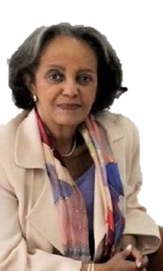
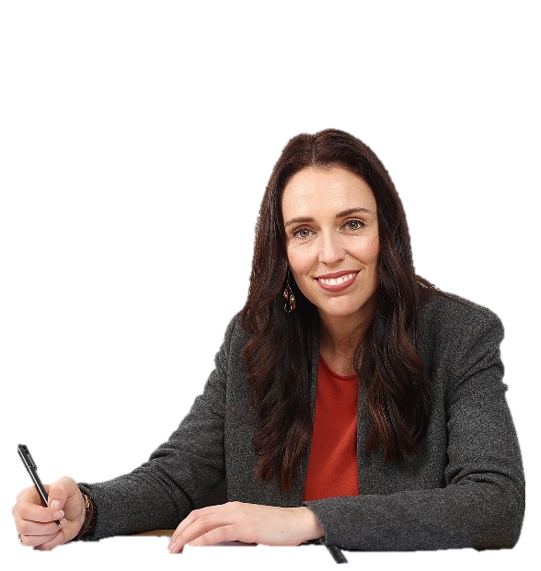


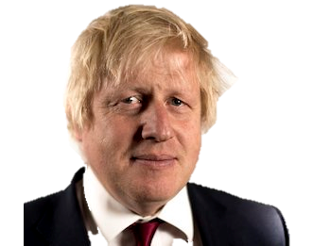



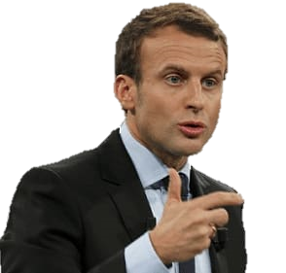
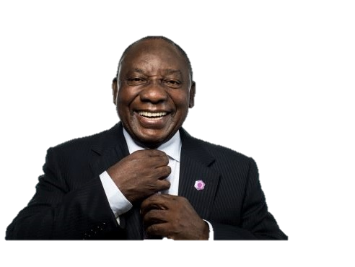
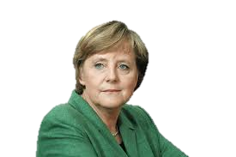
Just following advice?
What would you do? (10-15 mins)
Imagine that you are the leader of a country. On the next few slides, you are going to hear from some “experts” about how different lockdowns could affect your country. For each one, decide if you will listen to their advice or not.
Bad advice!
I’m not sure
We should follow this!
Challenge:
How many of these world leaders can you name? You can find the answers in the notes section!
Notes:
World leaders (from top to bottom):
Sahle-Work Zewde, Ethiopia
Imran Khan, Pakistan
Jacinda Ardern, New Zealand
Boris Johnson, UK
Donald Trump, USA
Emmanuel Macron, France
Angela Merkel, Germany
Cyril Ramaphosa, South Africa
Images:
iStock
https://emojipedia.org/apple/
https://en.wikipedia.org/wiki/Sahle-Work_Zewde
https://www.clipart.email/clipart/transparent-background-donald-trump-clipart-320271.html
https://www.desmogblog.com/boris-johnson
https://drunmgreln1.live/?utm_campaign=QPF8euu28II5lw7O2iHhCugVqK5RzfdNsTpLaMM91qY1&t=main9_25263c3c2a033c4afd
https://www.iconspng.com/image/142677/angela-merkel-side-view
https://www.bloemfonteincourant.co.za/south-africans-rate-cyril-ramaphosa/
https://time.com/4931076/new-zealands-rising-star-puts-election-in-play/
https://www.representwomen.org/weekend_reading_on_women_s_representation_october_26_2018
https://www.pngguru.com/free-transparent-background-png-clipart-vhwzv

Slide 19

Just following advice?
If we stop a lockdown too early, the virus will spread quickly again, taking us back to the beginning. We must stay locked down until we know how to cure the virus.
What would you do?
Would you follow this advice?
Bad advice!
I’m not sure
We should follow this!
Notes:
Parent/Carer Note: Encourage children to explain why they agree or disagree with each piece of advice. Draw their attention to the difference in each opinion, and that they cannot follow every piece of advice.
Images:
iStock
https://emojipedia.org/apple/

Slide 20

Just following advice?
Stopping businesses will cost the country a lot of money. Many people will lose jobs and some families won’t be able to afford their rent, so we mustn’t lockdown for too long.
What would you do?
Would you follow this advice?
Bad advice!
I’m not sure
We should follow this!
Notes:
Parent/Carer Note: Encourage children to explain why they agree or disagree with each piece of advice. Draw their attention to the difference in each opinion, and that they cannot follow every piece of advice.
Images:
iStock
https://emojipedia.org/apple/

Slide 21

Just following advice?
If too many people get the virus at the same time, we won’t have enough space in hospital to treat them. A “medium” lockdown is the best way to do this.
What would you do?
Would you follow this advice?
Bad advice!
I’m not sure
We should follow this!
Notes:
Parent/Carer Note: Encourage children to explain why they agree or disagree with each piece of advice. Draw their attention to the difference in each opinion, and that they cannot follow every piece of advice.
Images:
iStock
https://emojipedia.org/apple/

Slide 22

Just following advice?
A full lockdown will slow the spread of the virus. This is why people shouldn't leave their house unless they need food or they are a key worker.
What would you do?
Would you follow this advice?
Bad advice!
I’m not sure
We should follow this!
Notes:
Parent/Carer Note: Encourage children to explain why they agree or disagree with each piece of advice. Draw their attention to the difference in each opinion, and that they cannot follow every piece of advice.
Images:
iStock
https://emojipedia.org/apple/

Slide 23
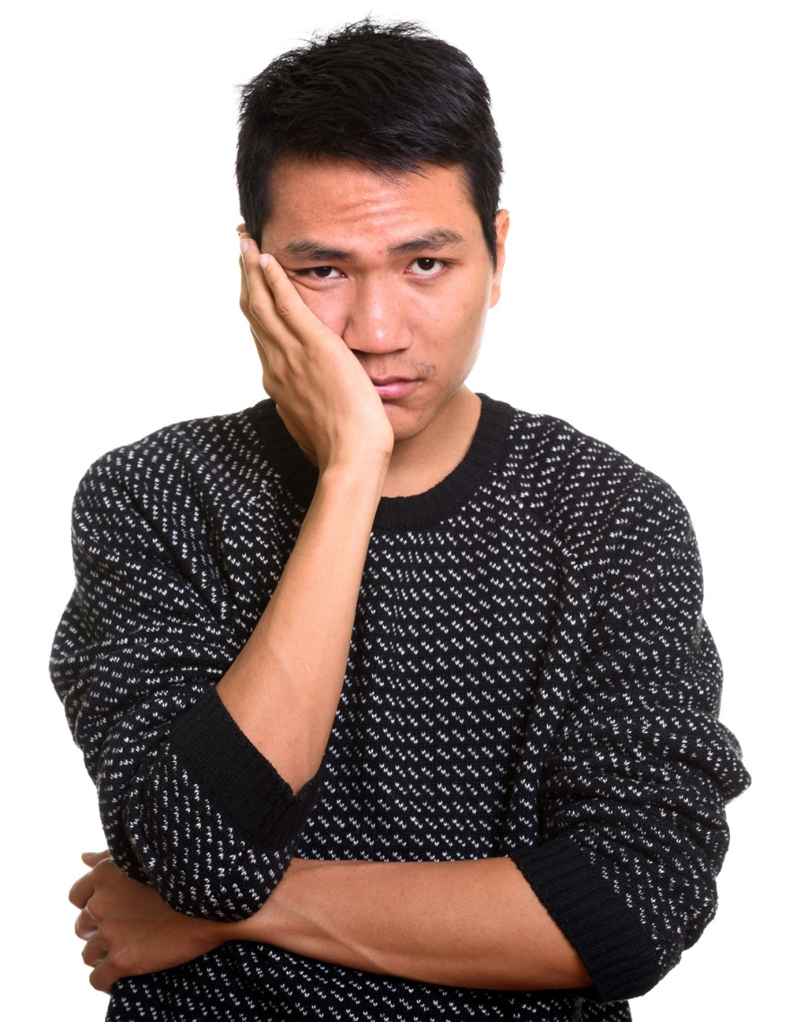
Just following advice?
Many people will complain about lockdown. They won’t want to stay inside their houses and not go to work or school. We shouldn’t lockdown at all.
What would you do?
Would you follow this advice?
Bad advice!
I’m not sure
We should follow this!
Notes:
Parent/Carer Note: Encourage children to explain why they agree or disagree with each piece of advice. Draw their attention to the difference in each opinion, and that they cannot follow every piece of advice.
Images:
iStock
https://emojipedia.org/apple/

Slide 24

Just following advice?
The more people in a country, the more easily the virus can spread, so bigger countries need stricter lockdowns than smaller ones.
What would you do?
Would you follow this advice?
Bad advice!
I’m not sure
We should follow this!
Notes:
Parent/Carer Note: Encourage children to explain why they agree or disagree with each piece of advice. Draw their attention to the difference in each opinion, and that they cannot follow every piece of advice.
Images:
iStock
https://emojipedia.org/apple/

Slide 25
Starter: Where in the world…
Why are we talking about this?
What’s going on around the world?
Just following advice?
Does one size fit all?
Vote!
Ext: Hear more stories!
Notes:
Images:
Courtesy of speakers throughout lesson

Slide 26






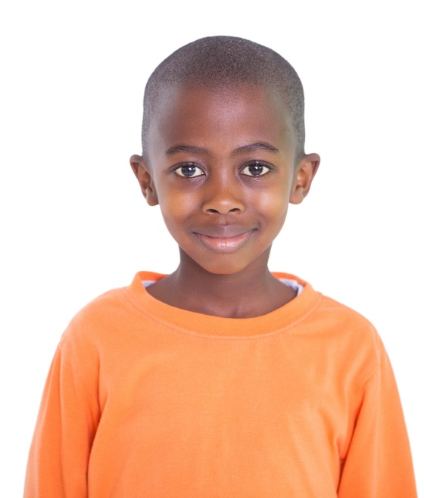
Does one size fit all?
Vote with your thumbs (3-10 mins)
On the next few slides you are going to see some different opinions about how the world should respond to the Coronavirus. If you agree, put your thumb up. If you disagree put your thumb down.
I agree!
I disagree!
Notes:
Alternative video link: https://www.youtube.com/watch?v=TFkqG7owORs&t=4s (00:20 onwards)
References:
https://www.majestic-models.com/news/1481589/casting-auditions-what-to-expect
Images:
iStock
https://www.pinterest.co.uk/pin/297096906645510239/

Slide 27

Does one size fit all?
Every country is different, so what works in one country won’t always work in a different one. They should do what’s best for their people.
Vote with your thumbs
If you agree, put your thumb up. If you disagree put your thumb down.
I agree!
I disagree!

Slide 28

Does one size fit all?
If every country does a different thing it will only take us longer to get back to normal. We should all work together as a team.
Vote with your thumbs
If you agree, put your thumb up. If you disagree put your thumb down.
I agree!
I disagree!

Slide 29

Does one size fit all?
We should all be learning from each other, otherwise we’ll keep making the same mistakes and it will take longer to stop the virus.
Vote with your thumbs
If you agree, put your thumb up. If you disagree put your thumb down.
I agree!
I disagree!

Slide 30

Does one size fit all?
Even if one country gets rid of the virus and goes back to normal, no one will be able to travel in or out of that country in case they bring the virus back again. That’s why we need to all do the same thing.
Vote with your thumbs
If you agree, put your thumb up. If you disagree put your thumb down.
I agree!
I disagree!

Slide 31

Does one size fit all?
More people in a country means that the virus can spread more easily, so the countries with the most people should have a stricter lockdown than smaller ones.
Vote with your thumbs
If you agree, put your thumb up. If you disagree put your thumb down.
I agree!
I disagree!

Slide 32
Starter: Where in the world…
Why are we talking about this?
What’s going on around the world?
Just following advice?
Does one size fit all?
Vote!
Ext: Hear more stories!
Notes:
Images:
Courtesy of speakers throughout lesson

Slide 33
Should every country follow the same Coronavirus advice?
We are all facing this virus together. Different rules for different countries just makes things confusing.
We cannot go back to life as normal until every country has brought the virus under control. The best way to do that is to all follow the same rules.
Countries should learn from each other. If leaders see something working in another country, we should all do it.
There will be more problems in the future if we don’t follow the same rules.
Every country is different, and what works in one place might not work in another.
Many countries cannot afford to follow the same rules as others. For example, poorer countries can’t afford to lockdown for a long time.
The situation keeps changing, so our rules need to keep changing too. If we all had the same rules then we couldn’t adapt to changes.
The long-term effects might be very bad for some countries if they have to do the same as everyone else.
Notes:
Parent/Carer Note: Use this slide to review the arguments before voting.

Slide 34
Starter: Where in the world…
Why are we talking about this?
What’s going on around the world?
Just following advice?
Does one size fit all?
Vote!
Ext: Hear more stories!
Notes:
Images:
Courtesy of speakers throughout lesson

Slide 35
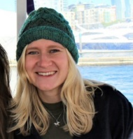

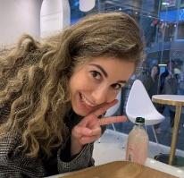
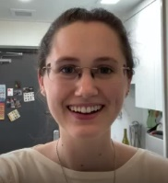

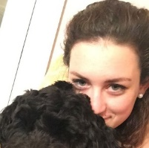

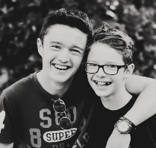



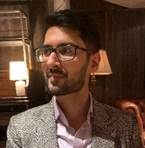
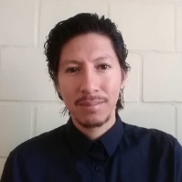
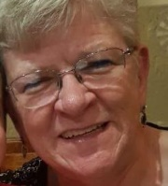
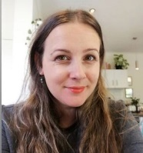
Canada: http://safesha.re/marievideo
Germany: https://safesha.re/e46
Norway: https://safesha.re/e47
SK: https://safesha.re/e48
Ext.: Hear more stories!
Extra time? Listen to a few more!
0:59
0:50
0:50
1:14
1:46
Japan: https://safesha.re/e3z
Canada
Germany
Norway
South Korea
Japan
Spain: https://safesha.re/e45
2:38
1:00
1:57
Taiwan: https://safesha.re/e42
USA
Taiwan
USA: https://safesha.re/e3u
2:54
Spain
1:57
HK: https://safesha.re/e3x
2:10
1:47
Brazil
1:04
Hong Kong
Brazil: https://safesha.re/e4w
1:24
0:58
Israel
Pakistan
Chile
NZ: http://safesha.re/bekavideo
Click the image to hear what’s happening in their country!
South Africa
New Zealand
Chile: https://safesha.re/e3w
Israel: https://safesha.re/e43
SA: https://safesha.re/e40
Pakistan: https://safesha.re/e3v
Notes:
Note: if you’re not using full screen, hold down ctrl + click the image.
Alternative video links
Canada: https://www.youtube.com/watch?v=cs_37sHyzuE
New Zealand: https://www.youtube.com/watch?v=5Iu7q3MLsMU
Norway: https://www.youtube.com/watch?v=KA-msJennW0
South Korea: https://www.youtube.com/watch?v=PtnaDP-zEBo
Germany: https://www.youtube.com/watch?v=58l7GtgXbAA
USA: https://www.youtube.com/watch?v=WdeZE1WjHo0&feature=youtu.be&t=5
Pakistan: https://www.youtube.com/watch?v=87LwUD_Z4q8
Chile: https://www.youtube.com/watch?v=9yDMb2XMWNE
Hong Kong: https://www.youtube.com/watch?v=WXx6bMAXU3g
Japan: https://www.youtube.com/watch?v=d24OMvdWAsg
South Africa: https://www.youtube.com/watch?v=gGO4x8lRufk
Taiwan: https://www.youtube.com/watch?v=tc7xrEp5Alg
Israel: https://www.youtube.com/watch?v=_VLcX56B39A
Spain: https://youtu.be/PSQYuiA802A
Brazil: https://www.youtube.com/watch?v=b25UJXfjvSI
Images
iStock
Provided by speakers
References

Slide 36
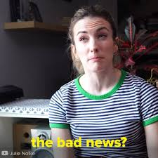
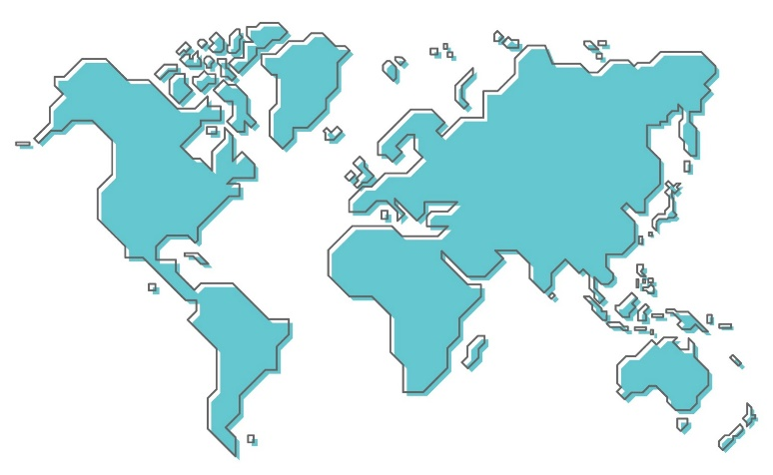
Call to Action
Quick idea
To my past self…
How would you explain this situation to your past self? What would you say/advise? Click to watch the video of comedian Julie Nolke describing the pandemic to her past self.
0:00-3:00
Get in touch!
Do you know anyone who lives in a different country, city or area to you? Why not get in touch and find out what’s happening over there and how it might be different to your own experiences?
Big idea
Notes:
Alternative video link: https://www.youtube.com/watch?v=Ms7capx4Cb8
Images:
iStock

Slide 37
You can vote from home at… https://www.surveymonkey.co.uk/r/vfs-primary-countries-coronavirus
To have your voice heard!
If you have any issues, feedback or comments, email amy@votesforschools.com!
Notes:
Teacher’s Note: Please log your class’ vote the usual way!
Parent/Carer Note: The link provided allows your child to record their vote online. Find it here: https://www.surveymonkey.co.uk/r/vfs-primary-child-actors

