Slide 1
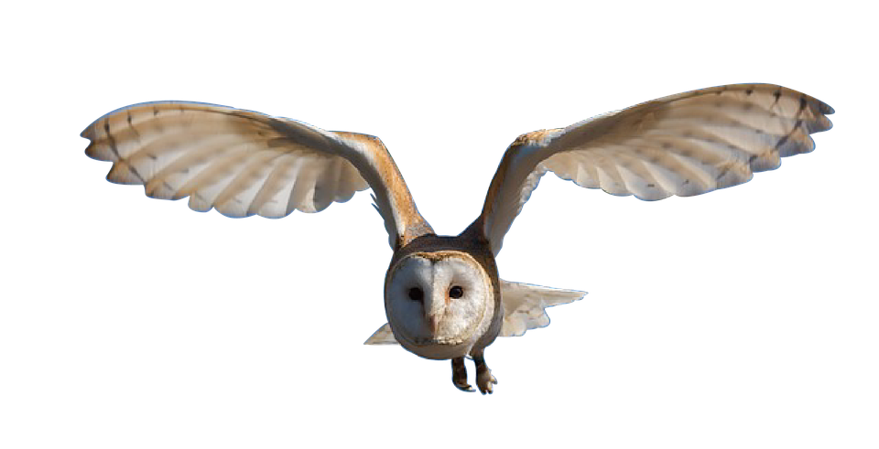
Clauses and Conjunctions

Slide 2
Clauses
Clauses are groups of words with an active verb and a subject; they make sense.
Harry looked around in amazement.
They stepped through the archway.
The sun shone brightly on a stack of cauldrons.
A cobbled street twisted out of sight.
The subject is ‘the doer’ of the verb; it can be a noun or pronoun.

Slide 3
Conjunctions are joining words
They help add more detail by joining new clauses…
explaining when, why or where something happened.
A main clause
A new clause
before
until
Harry looked around in amazement
when
they stepped through the archway
The choice of conjunction will change the meaning.
When?
before
after
when
while
as
until
We can join a new clause, to add this detail, using a conjunction.
When?

Slide 4
Different conjunctions help us add different types of information
When?
before
after
when
while
as
until
Why?
because
as
so
Where?
where
wherever
I am worn…
I am worn where students are judged.
I am worn because I can sense where you belong.
I am worn until I declare which house a student should join.

Slide 5
Add more detail by adding an extra clause
Can you match up the clauses?
These main clauses make sense but don’t tell us much.
Some other combinations will also work.
Which conjunction will you use?
Which of these clauses could add extra information to them?
Some combinations will not make sense.
Hermione found a new spell book
Ron dropped his wand
he was surprised by a house elf
Harry hung on to the broomstick
she was in the library
Professor McGonagall appeared
a cat had been sitting moments before
until
when
he caught the snitch
where
because
Conjunctions can join the clauses.

Slide 6
Does it matter which conjunction you choose?
Malfoy grinned
before
Gryffindor won the cup
Malfoy grinned
until
Gryffindor won the cup
Malfoy grinned
after
Gryffindor won the cup
Do these all have the same meaning?

Slide 7
Has this changed the impact of the sentence? How?
Order of Clauses
When we add an extra clause,
it adds information to the main clause.
Subordinate clause
Main clause
Subordinate clause
Main clause
Harry looked around in amazement
when
they stepped through the archway
The main clause can go at the beginning of the sentence…
or go at the end of it.

Slide 8
Order of Clauses – When to use a Comma
If you add a clause after a main clause, you don’t usually need a comma.
If the added clause (subordinate) is first, separate it with a comma.
The comma tells you to say the first clause differently. Try it.
Harry’s broomstick snapped.
Harry’s broomstick snapped as he crashed into the tree.
As he crashed into the tree, Harry’s broomstick snapped.
The comma tells your reader or listener that the main bit is coming.

Slide 9
Order of Clauses – When to use a Comma
Read these sentences. Which clauses need a comma?
Answers
Harry’s broomstick snapped where it struck the branch.
The class cheered when they heard the lesson was cancelled.
Because he was nervous Ron’s hands trembled.
Before she sneaked out of the dormitory Hermione listened carefully.
Where it struck the branch Harry’s broomstick snapped.
When they heard the lesson was cancelled the class cheered.
Ron’s hands trembled because he was nervous.
Hermione listened carefully before she sneaked out of the dormitory.

Slide 10
Order of Clauses – When to use a Comma
Read these sentences. Which clauses need a comma?
Answers
Harry’s broomstick snapped where it struck the branch.
The class cheered when they heard the lesson was cancelled.
Because he was nervous, Ron’s hands trembled.
Before she sneaked out of the dormitory, Hermione listened carefully.
Where it struck the branch, Harry’s broomstick snapped.
When they heard the lesson was cancelled, the class cheered.
Ron’s hands trembled because he was nervous.
Hermione listened carefully before she sneaked out of the dormitory.

Slide 11
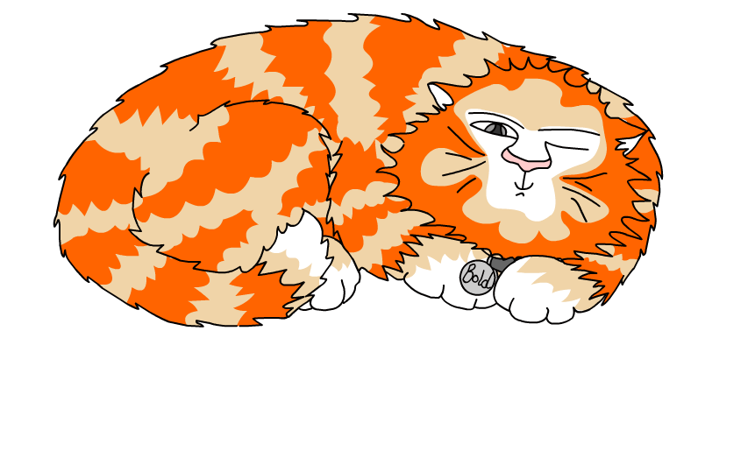
Explore more Hamilton Trust Learning Materials at https://wrht.org.uk/hamilton/ .

