Slide 2
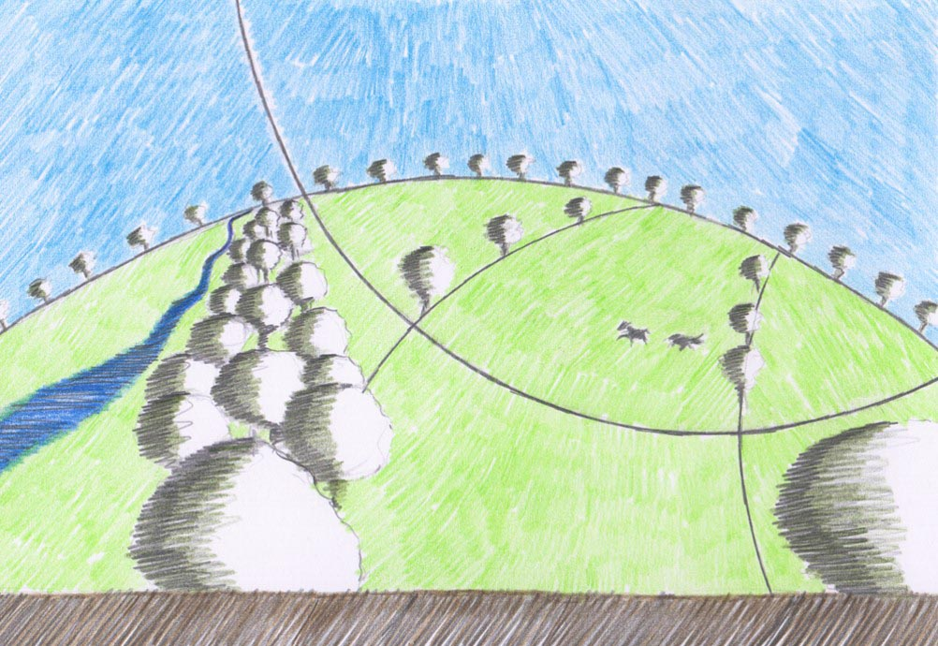

Slide 3
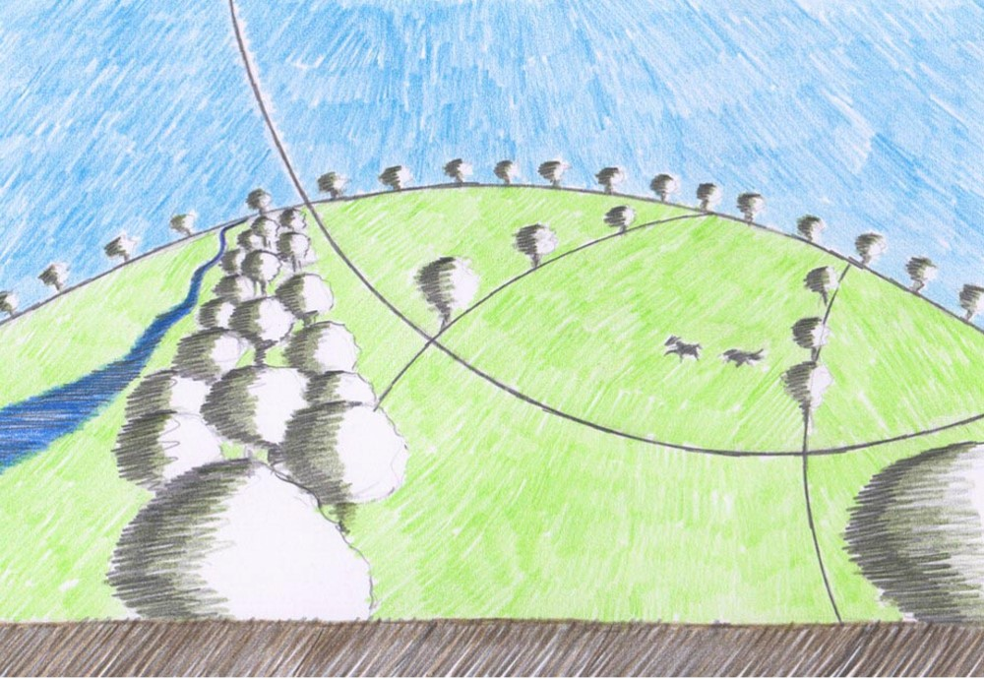
How do you like to go up in a swing,
Up in the air so blue?
Oh, I do think it the pleasantest thing
Ever a child can do!
Up in the air and over the wall,
Till I can see so wide,
River and trees and cattle and all
Over the countryside--
Till I look down on the garden green,
Down on the roof so brown--
Up in the air I go flying again,
Up in the air and down!

Slide 4
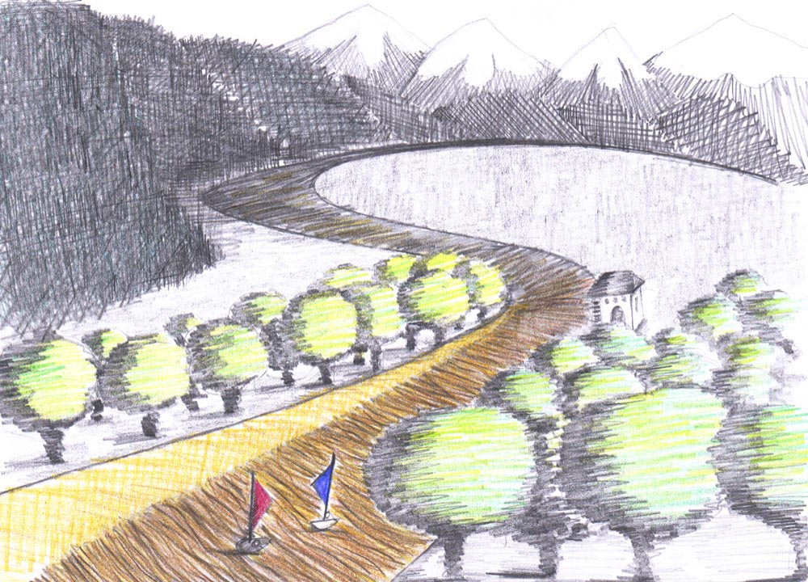
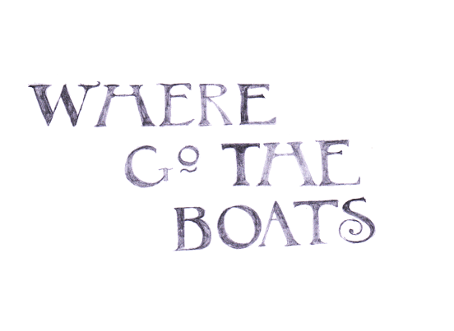

Slide 5
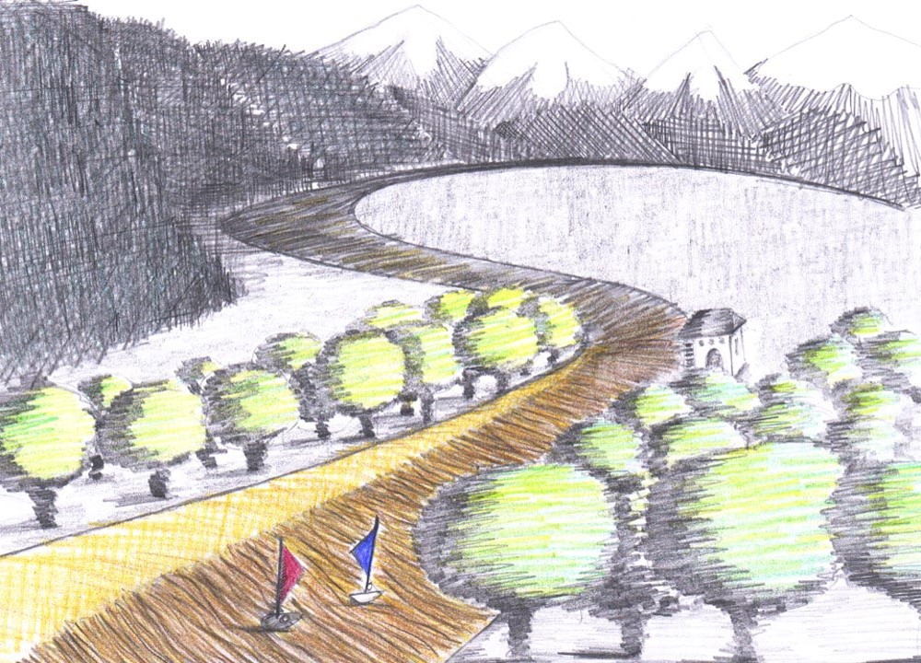
Dark brown is the river,
Golden is the sand.
It flows along for ever,
With trees on either hand.
Green leaves a-floating,
Castles of the foam,
Boats of mine a-boating--
Where will all come home?
On goes the river
And out past the mill,
Away down the valley,
Away down the hill.
Away down the river,
A hundred miles or more,
Other little children
Shall bring my boats ashore.

Slide 6
Robert Louis Stevenson
1850-1894

Slide 7
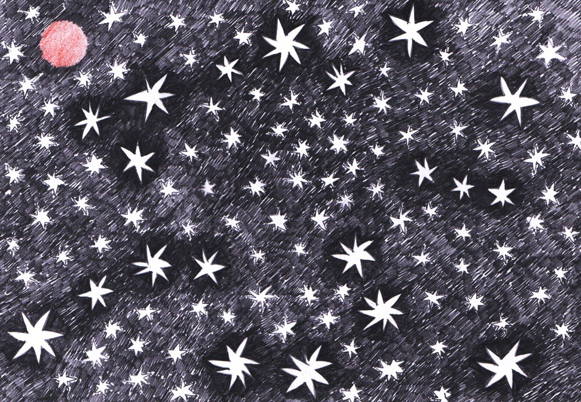
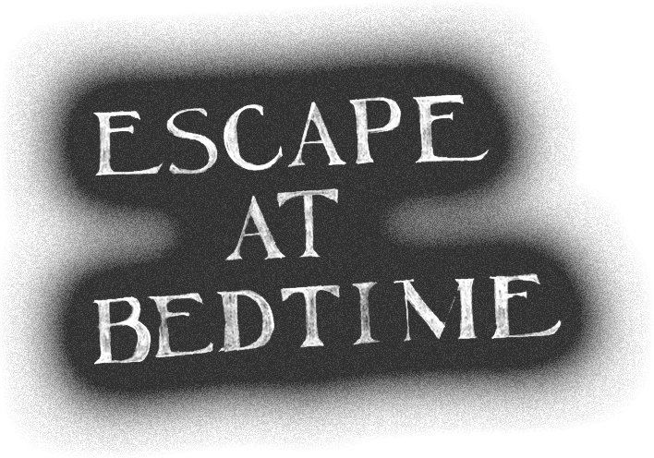

Slide 8
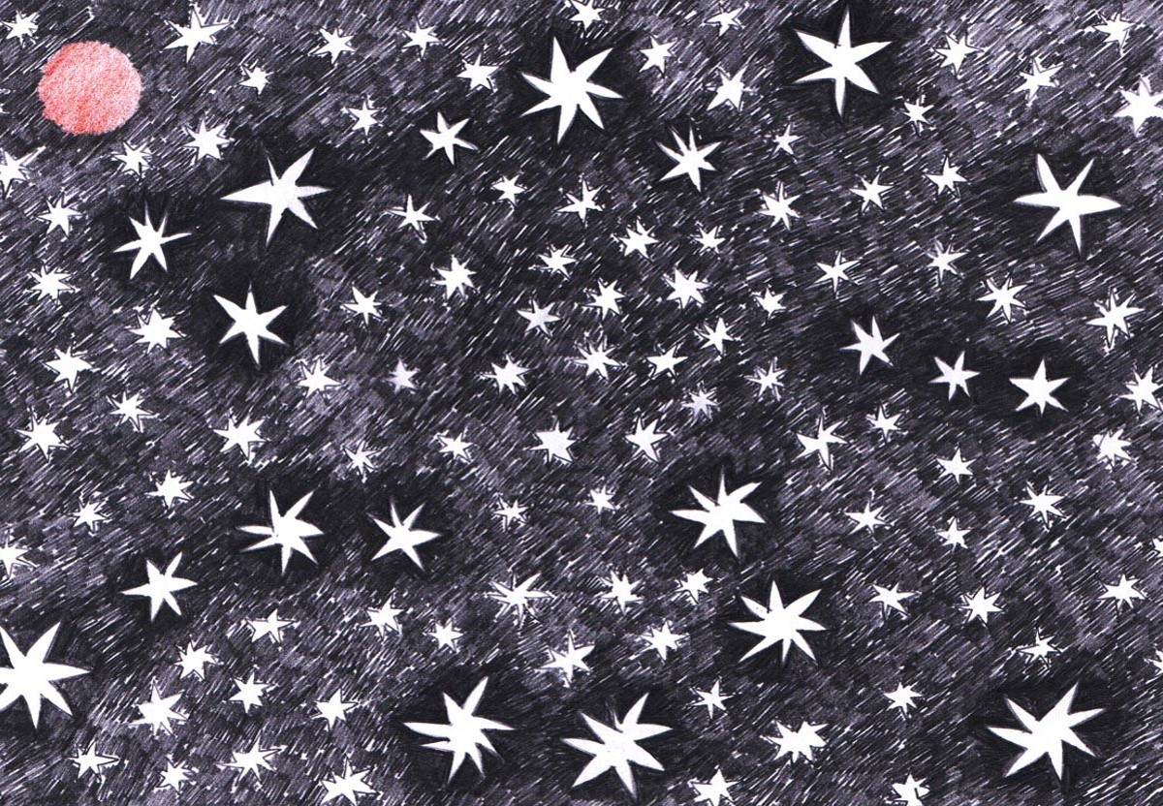
The lights from the parlour and kitchen shone out
Through the blinds and the windows and bars;
And high overhead and all moving about,
There were thousands of millions of stars.
There ne'er were such thousands of leaves on a tree,
Nor of people in church or the Park,
As the crowds of the stars that looked down upon me,
And that glittered and winked in the dark.
The Dog, and the Plough, and the Hunter, and all,
And the star of the sailor, and Mars,
These shone in the sky, and the pail by the wall
Would be half full of water and stars.
They saw me at last, and they chased me with cries,
And they soon had me packed into bed;
But the glory kept shining and bright in my eyes,
And the stars going round in my head.

Slide 9
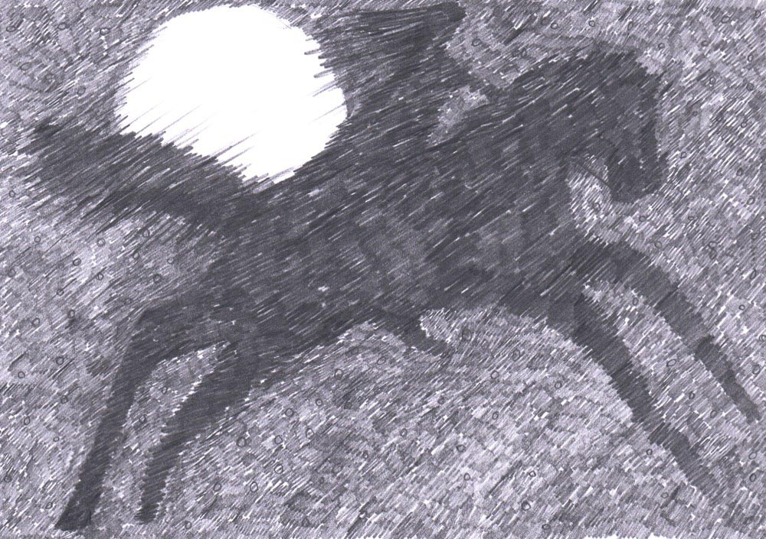

Slide 10
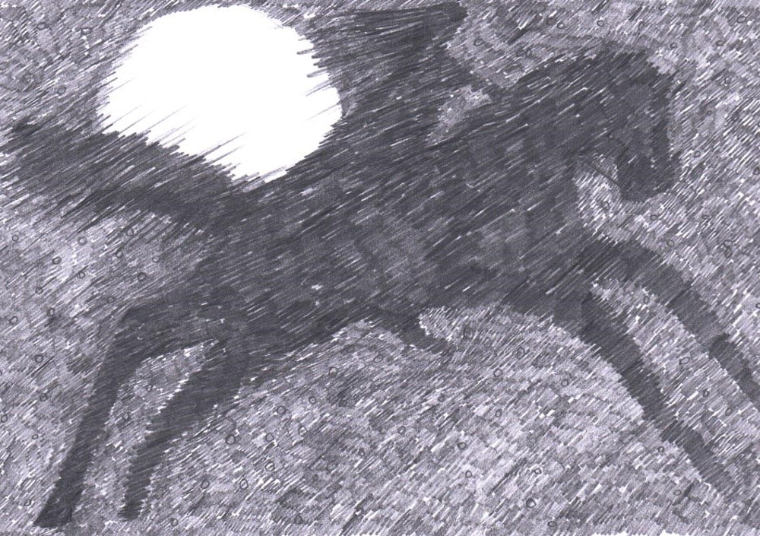
Whenever the moon and stars are set,
Whenever the wind is high,
All night long in the dark and wet,
A man goes riding by.
Late in the night when the fires are out,
Why does he gallop and gallop about?
Whenever the trees are crying aloud,
And ships are tossed at sea,
By, on the highway, low and loud,
By at the gallop goes he.
By at the gallop he goes, and then
By he comes back at the gallop again.

Slide 11
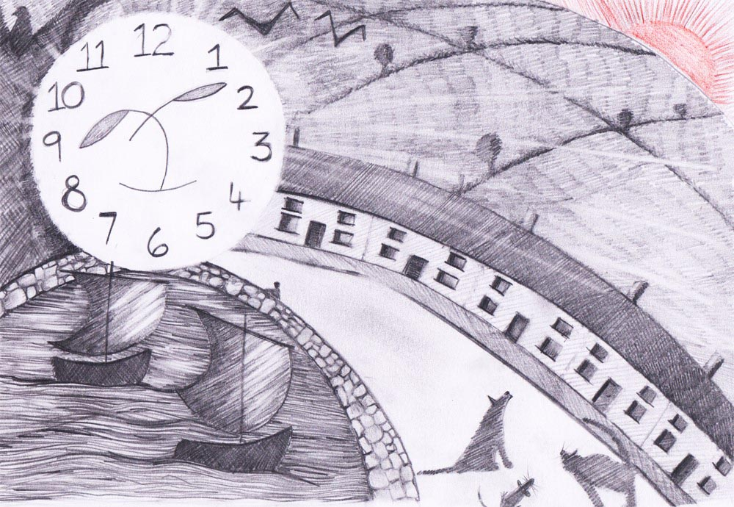

Slide 12
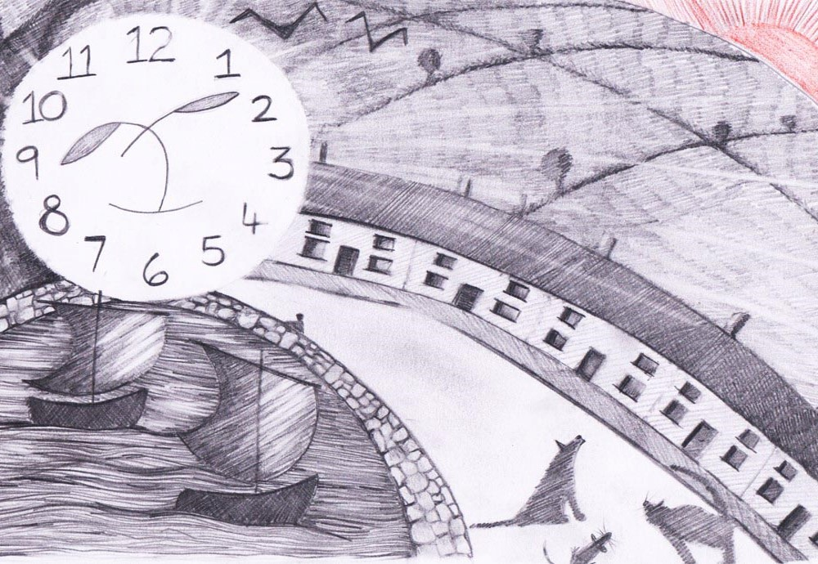
The moon has a face like the clock in the hall;
She shines on thieves on the garden wall,
On streets and fields and harbour quays,
And birdies asleep in the forks of the trees.
The squalling cat and the squeaking mouse,
The howling dog by the door of the house,
The bat that lies in bed at noon,
All love to be out by the light of the moon.
But all of the things that belong to the day
Cuddle to sleep to be out of her way;
And flowers and children close their eyes
Till up in the morning the sun shall arise.

Slide 13
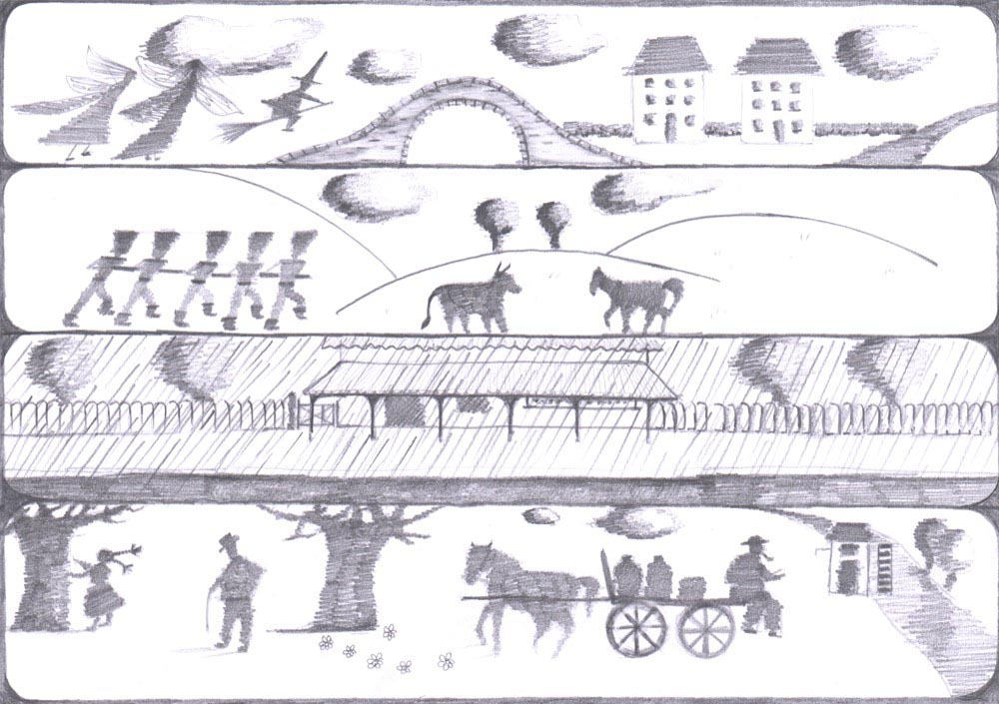

Slide 14
Faster than fairies, faster than witches,
Bridges and houses, hedges and ditches;
And charging along like troops in a battle
All through the meadows the horses and cattle:
All of the sights of the hill and the plain
Fly as thick as driving rain;
And ever again, in the wink of an eye,
Painted stations whistle by.
Here is a child who clambers and scrambles,
All by himself and gathering brambles;
Here is a tramp who stands and gazes;
And here is the green for stringing the daisies!
Here is a cart runaway in the road
Lumping along with man and load;
And here is a mill, and there is a river:
Each a glimpse and gone forever!

Slide 15
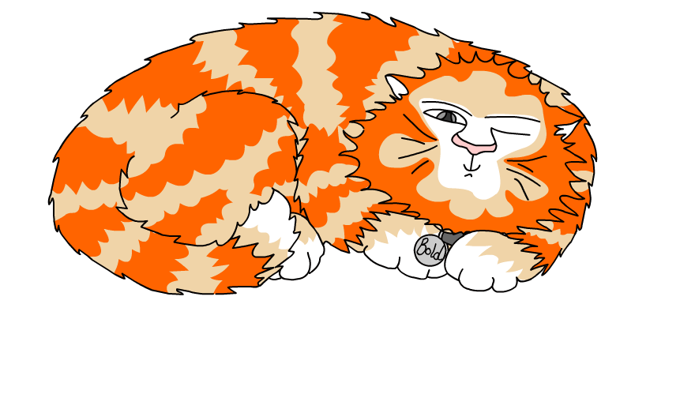
Explore more Hamilton Trust Learning Materials at https://wrht.org.uk/hamilton/ .

