Slide 1
VE Day Activity Pack
We would like to extend a special thank you to the staff & pupils at S. Anselm’s Prep School for providing some great inspiration & ideas for this pack!
Notes:
Images:
Icons8
iStock

Slide 2
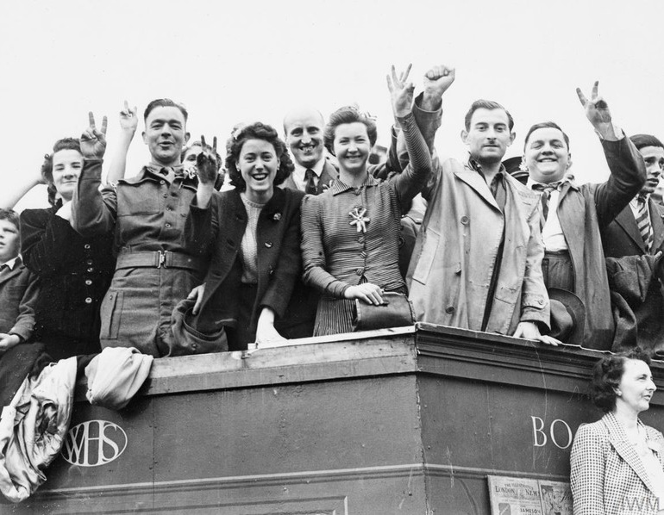
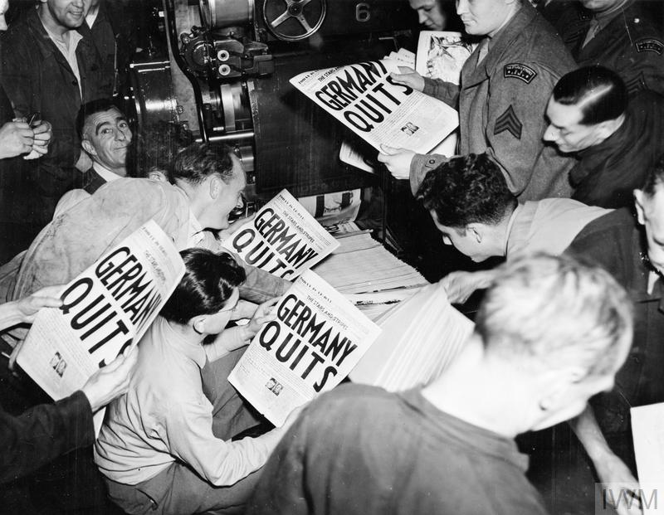
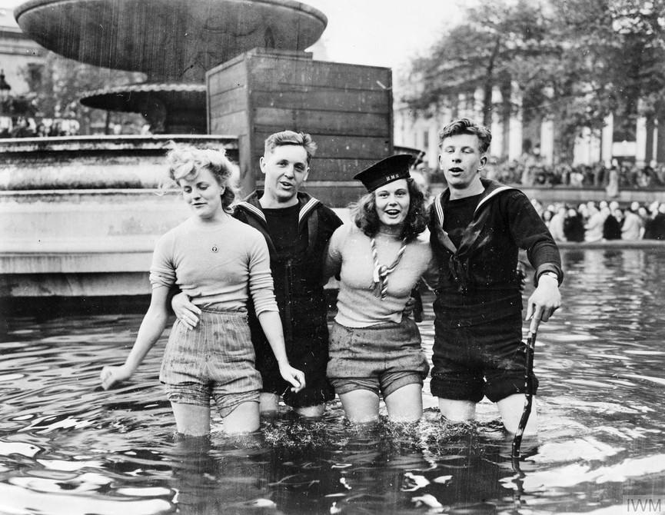
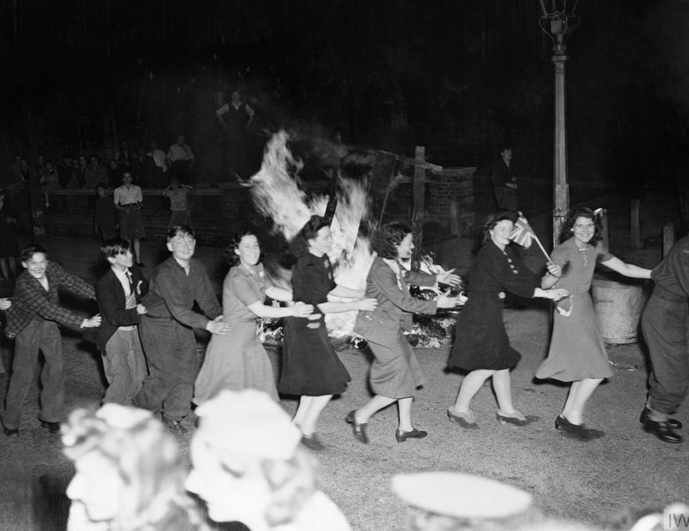
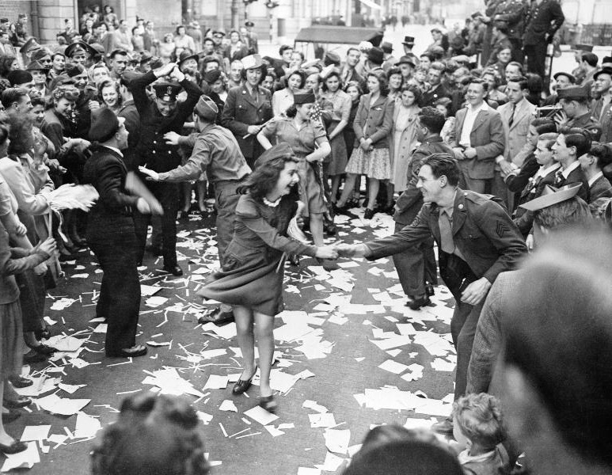
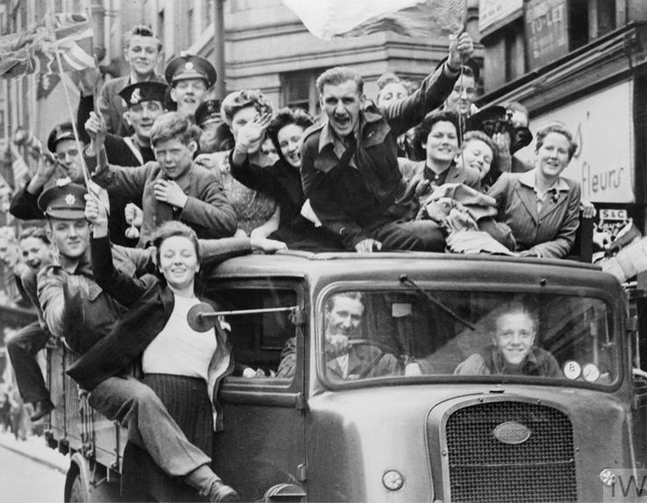
Starter: What’s it all about?
Outside the Houses of Parliament
Trafalgar Square Fountains
What do you think happened in London on VE Day and why? Use the pictures to help you!
East Acton
The Strand
Notes:
Images:
The Imperial War Museum

Slide 3
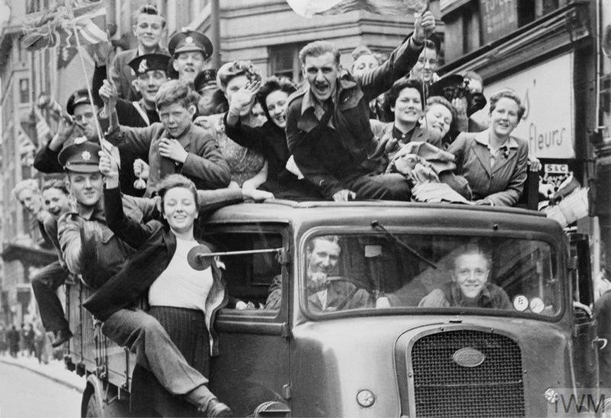
How can I celebrate VE Day 2020?
Notes:
Images:
1) The Imperial War Museum

Slide 4
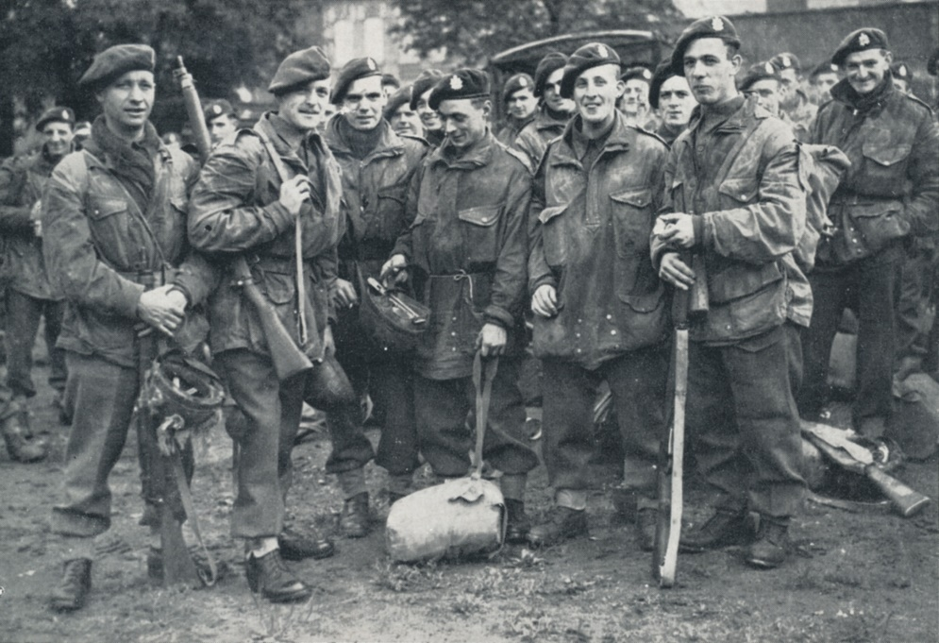
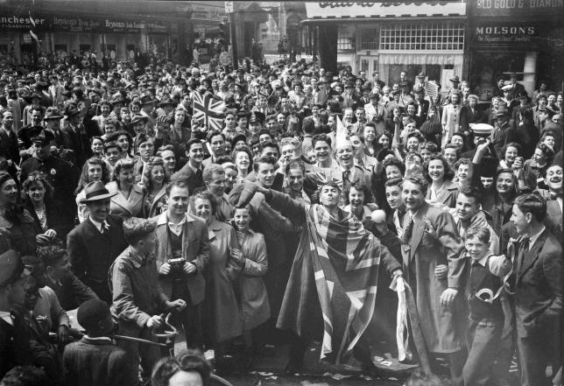
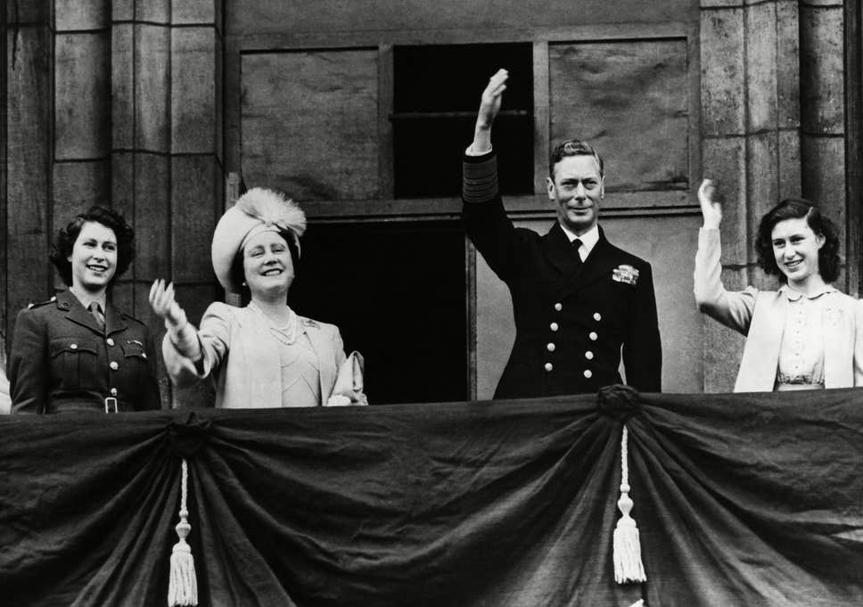
Why are we talking about this?
You might be wondering why there is a bank holiday coming up this Friday…
The reason is very special: 8th May marks 75 years since VE Day – “VE” stands for “Victory in Europe”. The Government decided to have the bank holiday on a Friday instead of a Monday to mark this significant anniversary¹.
On this day in 1945, the Second World War was officially ended after six years (and one day) of fighting. As you can imagine, there was quite the celebration, with over a million people taking to the streets¹!
0:00-4:51
Click the bottom image to find out a bit more about VE Day and WW2²!
Notes:
References:
https://www.telegraph.co.uk/news/0/ve-day-2020-celebrate-75th-anniversary-lockdown/
https://www.bbc.co.uk/teach/class-clips-video/history-ks2-ve-day/z7xtmfr
Images:
https://www.forces-war-records.co.uk/galleries/world-war-two-army-personnel/2320
https://metro.co.uk/2015/05/08/ve-day-2015-back-in-1945-this-is-what-you-ate-to-celebrate-5185160/
https://www.independent.co.uk/life-style/royal-family/queen-elizabeth-ve-day-75-princess-margaret-celebrate-london-crowds-king-a9490676.html
Icons8

Slide 5
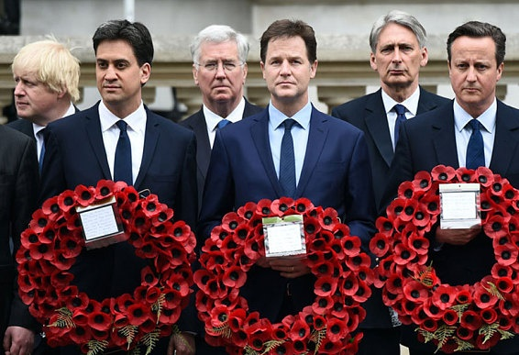
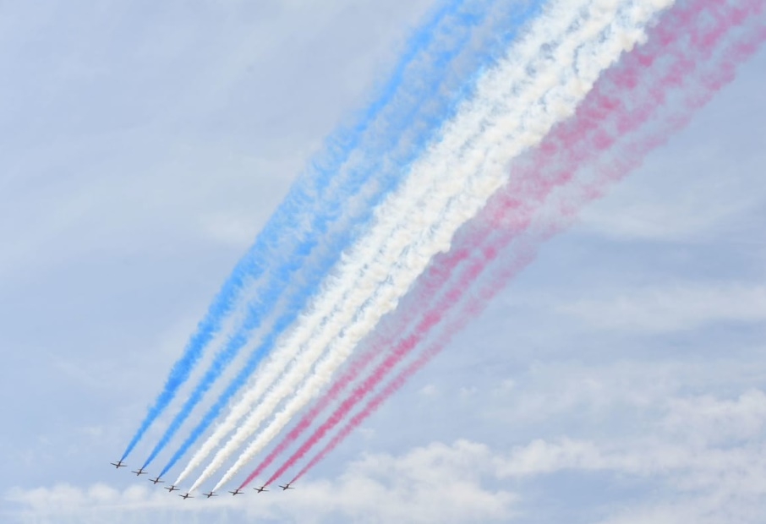
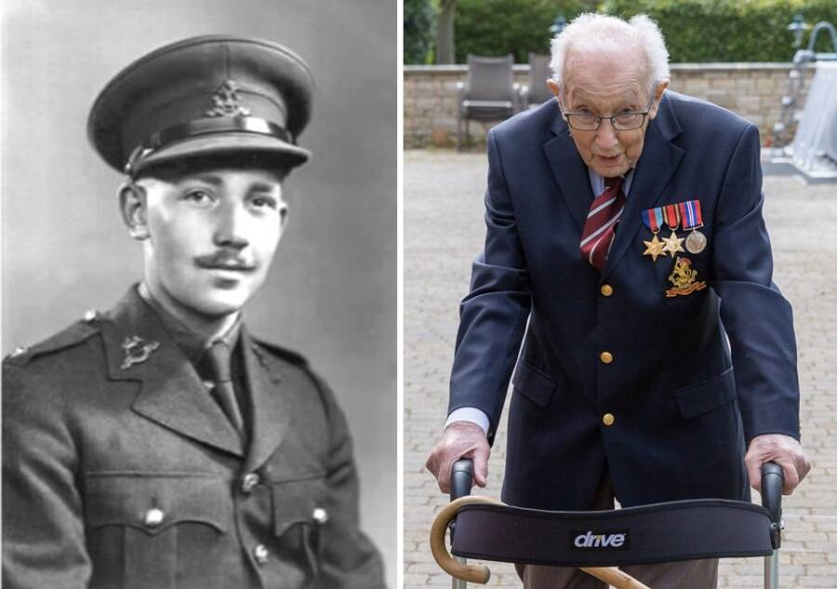
Why are we talking about this?
Nowadays, the celebrations include things like street parties, displays from the armed forces and people from around the country coming together to mark the occasion. In 2015, the Red Arrows did a very special flypast and political party leaders laid wreaths¹.
This year, things will be a little different as we are currently unable to get together for parties or community celebrations. But, in the spirit of keeping calm and carrying on, you are going to find out a bit more about alternative ways you can celebrate.
0:00-4:45
Did you know Captain Tom Moore served in World War II? Click the image to watch the RAF flypast for his 100th birthday²!
https://safeshare.tv/x/vxmYsd8srFY
Notes:
Alternative Video Link: https://www.youtube.com/watch?v=vxmYsd8srFY
References:
https://www.telegraph.co.uk/news/0/ve-day-2020-celebrate-75th-anniversary-lockdown/
https://www.youtube.com/watch?v=vxmYsd8srFY
Images:
https://www.telegraph.co.uk/news/general-election-2015/11593338/Election-2015-Miliband-and-Clegg-perform-their-final-duties-at-VE-Day-Cenotaph-ceremony.html
https://www.telegraph.co.uk/news/0/ve-day-2020-celebrate-75th-anniversary-lockdown/
https://allthatsinteresting.com/captain-tom-moore
Icons8

Slide 6
Get creative!
0:00-2:23
Did you know?
On VE Day in 1945, 19-year old Princess Elizabeth and her sister Margaret secretly left Buckingham Palace and joined the crowds celebrating the end of the war!
Queen Elizabeth later described it as “one of the most memorable nights of my life!”
In 2015, a film was made about it! Click the image to see the trailer.
Just imagine…
What do you think it was like? Write a diary entry imagining you were at the original VE Day celebrations!
The war has been raging for 6 long years…
To know it’s finally over makes me feel…
The sound of bombs and silence has been replaced with…
Now, the streets are filled with…
Want to know more?
Click the image to explore more photos and facts about VE Day!
https://safeshare.tv/x/oaF-HdgZVU8
Notes:
Alternative video link: https://www.youtube.com/watch?v=oaF-HdgZVU8

Slide 7
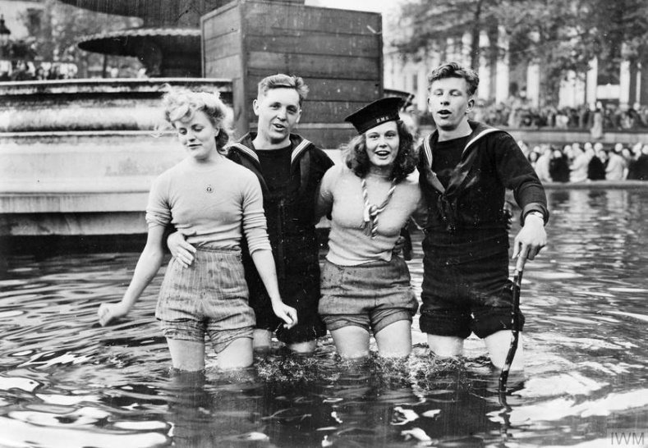
Get creative!
Tommy:
WWI slang for an English soldier¹.
Feeling arty?
Here’s a few things you could do over the next few days to get ready for VE Day!
A Tommy in your window!
The Royal British Legion is encouraging people to put a silhouette of a British soldier in their window to celebrate. Why not have a go at making your own?
Great British Bunting!
Recreate the moment!
You can’t have a Great British party without a bit of bunting! The BBC are offering instructions on how to make Great British bunting which you can decorate however you like. Click to get started!
Try recreating some of the VE Day photos from 1945 by setting you camera to “black and white” to get the original effect!
Remember to share your creations on social media using the hashtag #votesathome!
Notes:
References:
https://www.mentalfloss.com/article/58233/21-slang-terms-world-war-I
https://www.dailymail.co.uk/news/article-8281139/Put-Tommy-silhouette-window-Friday-mark-75th-anniversary-VE-Day.html
https://www.bbc.co.uk/programmes/articles/4TrqYDyf4PMdLypxzyTwGDg/great-british-bunting

Slide 8
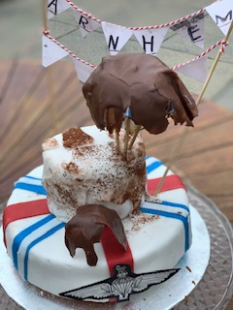
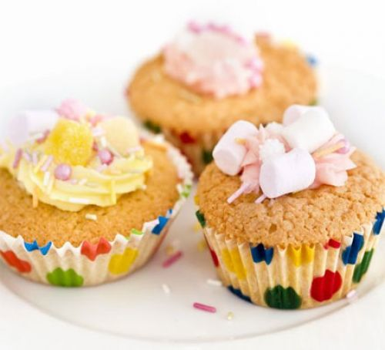
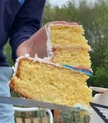
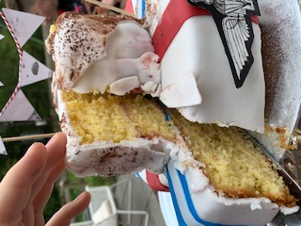
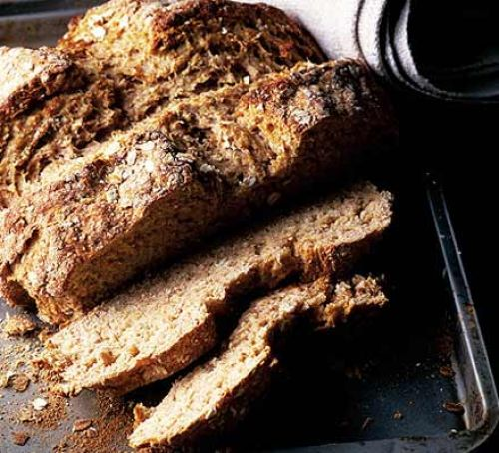
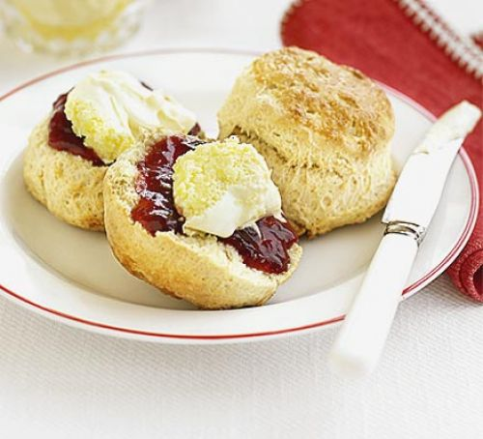
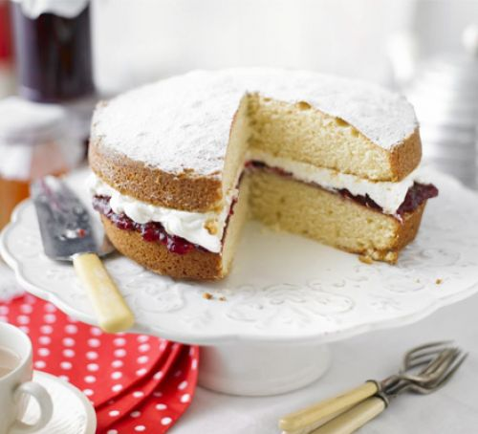
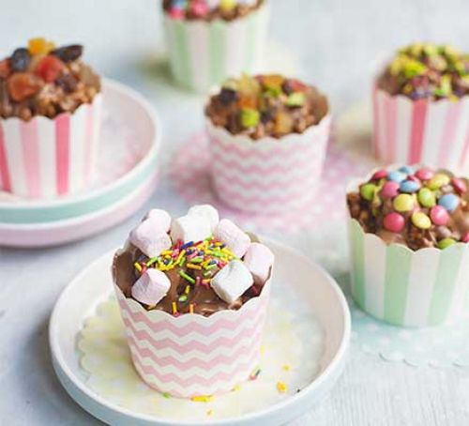
Get creative!
Here’s a cake one of our voters made earlier…
Is there anything more British than a really good cake, bun or tart? Get your baker’s hats on and try out some British recipes!
British Bake off!
Click the pictures to see the recipes!
Yum!
Who would you make a cake for?
Fairy Cakes
Victoria Sponge
Rice Krispie Cakes
Irish Soda Bread
Scones
Notes:
Recipes & Images:
https://www.bbcgoodfood.com/recipes/chocolate-rice-krispie-cakes
https://www.bbcgoodfood.com/recipes/classic-scones-jam-clotted-cream
https://www.bbcgoodfood.com/recipes/grannys-victoria-sponge
https://www.bbcgoodfood.com/recipes/irish-soda-bread
https://www.bbcgoodfood.com/recipes/iced-fairy-cakes
Icons8

Slide 9
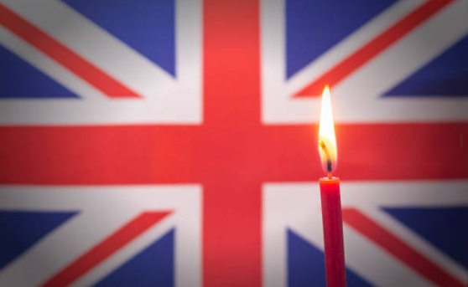
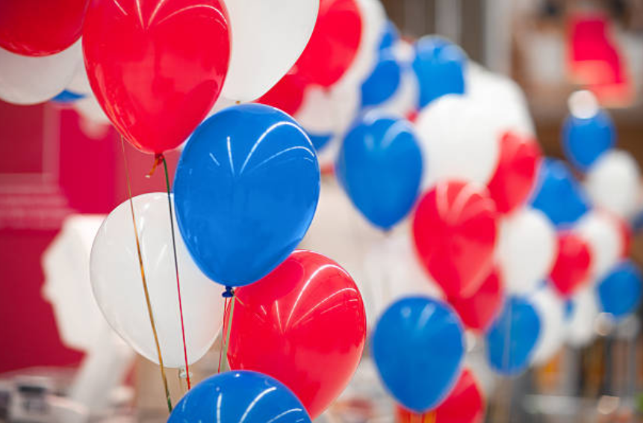
What can I do on the day?
A very British Bank Holiday
Friday 8th May is VE Day, and there’s lots of things you can do to make this day one to remember, while still staying safe & well!

Slide 10
What can I do on the day?
9pm: Queen’s Speech
The Queen will be giving a speech at 9pm on the BBC – the exact time her father, King George VI, addressed the nation on 8th May 1945.
11am: Two-minute silence
At 11am, there will be a two-minute silence to remember the lives lost in the war.
3pm: Raise your glass
0:00-1:24
With the “Nation’s Toasts to the Heroes of WWII”, raise a glass to those who kept us safe back then, and the one keeping us safe now. You could do this as part of your VE Day party. Feel free to share your photos!
Followed by:
A national sing-along
Afternoon: VE Day party!
Have a look at the next slide for ideas on how to celebrate VE Day 2020!
After the Queen’s speech, there will be a national sing-along to wartime favourite “We’ll Meet Again” – click the image to learn the words!
https://safeshare.tv/x/oaF-HdgZVU8
Notes:
References:
https://www.telegraph.co.uk/news/0/ve-day-2020-celebrate-75th-anniversary-lockdown/

Slide 11
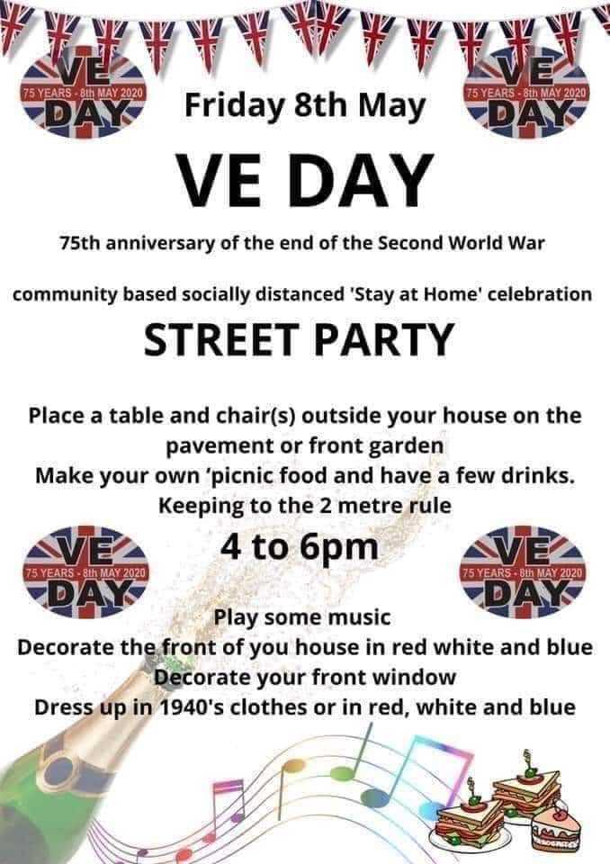
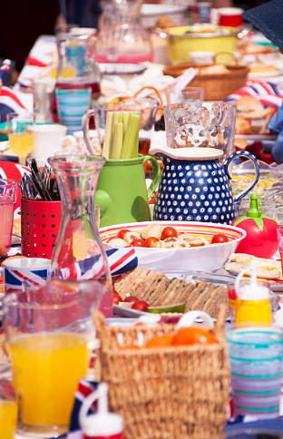
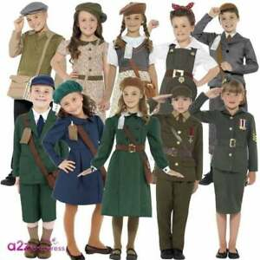
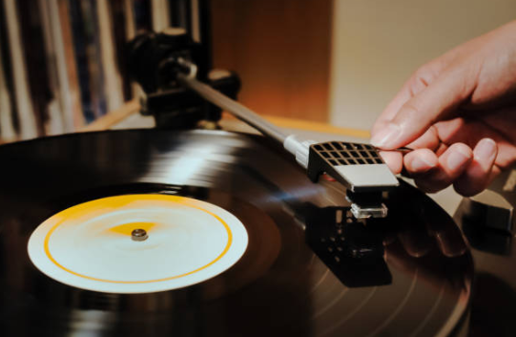
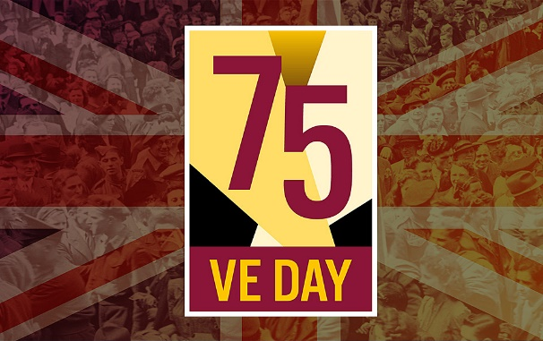
What can I do on the day?
Have a 1940s-style picnic with sandwiches, sausage rolls, scones, cakes, tea, lemonade and more!
Get dressed up in 1940s clothes, or in red, white & blue. You could also take black & white photos!
Listen to music and have an old-fashioned singalong!
Organise a socially- distanced street party, like this one in Stoke!
Want some downloadable decorations?
Click the image to get bunting, posters and more!
Decorate your home in red, white and blue!

Slide 12
You can find more of our resources at: votesforschools.com/downloads
Be informed. Be curious. Be heard!
If you have any issues, feedback or comments, email amy@votesforschools.com!

