Slide 1


Article 31: “You have the right to play & rest.”
–
Parents/Carers & Pupils:
This lesson works best in “Full Screen” mode – click the icon at the bottom right of your screen or use the “F5” key to start from the beginning. Use the space bar, mouse or arrow keys to click through!

Slide 2

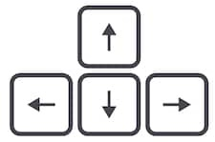




How to use this lesson…
Use these buttons to get the most out of your lesson.
Find this button in the bottom right of you screen to start your lesson.
Use the arrow keys to go forwards and backwards through your lesson.
To go back to your normal screen, press the esc key on your keyboard.
–
Learning from home?
Here are some ideas of how to get the most out of this lesson at home.
Ask an adult to arrange a video call so you can do some
of the activities with a friend.
Explore the topic with a parent or caregiver: how is their opinion
different to yours?
Teach a younger sibling or relative
about how
VotesforSchools works!
In the classroom?
Look out for these boxes to see how to make the most of the activities!
Parents’ & Carers’ Note:
Please see the Notes section below each slide for any further guidance.
Don’t forget to vote…
You can find the link to do this on the final slide. Get your whole household involved!
Notes:
Images:
https://icons8.com/

Slide 3
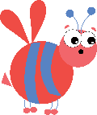






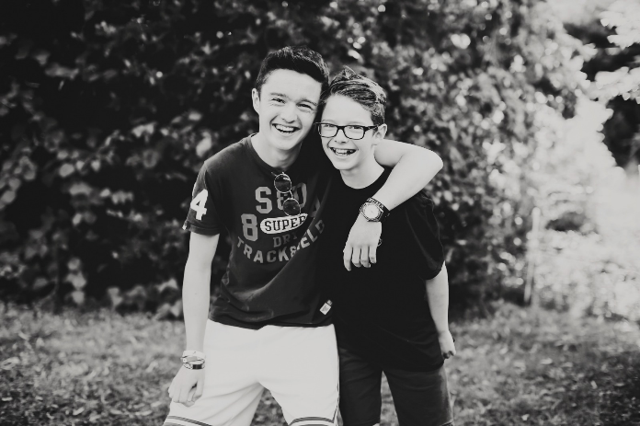
Feedback: “Should every country follow the same Coronavirus advice?”
“I think that all countries should follow the same Coronavirus advice because if we didn’t and one of the advices is advanced and one is less advanced, then the country with the less advanced one might have way more people with Coronavirus.”
Lea Forest School
“Different countries have different care systems and are run in different ways so how one country does it may not be good for a different country.”
Royal Alexandra & Albert School
44.8%
55.2%
0:00-1:44
Remember Wilf & Rufus? They starred in the original lesson all the way from Barcelona, Spain! Click the image to hear what they had to say about this week’s results!
Notes:
Alternative video link: https://www.youtube.com/watch?v=PD_G4WLzABk&t=38s
Parent/Carer Note: This slide shows the feedback to the question pupils answered two weeks ago. Check back in two weeks to see if the comment you make at the end of this lesson is featured!
To record your child’s vote, use the survey link on the last slide or use the hashtag #VotesatHome on social media to browse other children’s responses and share your own.

Slide 4


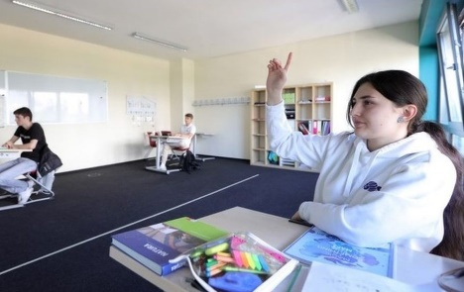




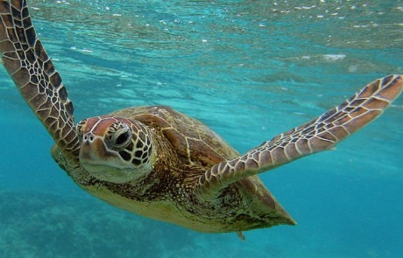

Be informed!
Here’s what’s been in the news this week...
Back to school?
A hopeful new book…
The Government has announced that some of you will go back to school next month, but what will be different? Click the image to hear from some children at school in Denmark.
More than 100 authors and illustrators have joined up to make this completely free eBook for children during the pandemic! Click the image to read the book online.
Endangered turtles are on the rise, as fewer people are going to beaches and disturbing their habitats. They lay their eggs on beaches in the spring, and it is important that they are not disturbed!
Some scientists think that Coronavirus antibodies could help us leave lockdown. Special tests will show who has already had the virus, so that they can stop isolating.
Turtles love lockdown!
COVID-19: Are antibodies the answer?
Notes:
Parent/Carer Note: Use this slide to learn about headlines around the world. Using the presentation in Slide Show mode, you will be able to click on the highlighted pictures to follow links to websites and videos.
Alternative video link: https://www.bbc.co.uk/newsround/52228461
Images/Stories:
Back to School: https://www.bbc.co.uk/newsround/52653333
Book of hopes: https://www.bbc.co.uk/newsround/52651310
Turtles: https://www.bbc.co.uk/newsround/52618038
Antibodies: https://www.bbc.co.uk/newsround/52658671

Slide 5

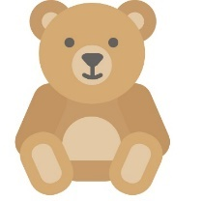



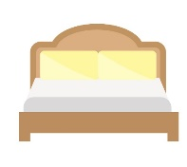

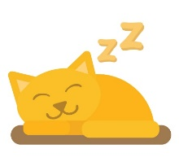
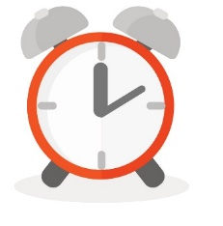
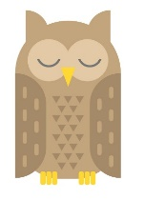
Starter: Put a finger down…
Put a finger down…
(5 mins)
Read through the following statements. Put a finger down for each one that applies to you!
If you can’t sleep without a toy or teddy.
If you have ever stayed up past midnight!
If you like a snack before bed.
If you play on a tablet or phone in bed.
If you share a bedroom with
someone else.
If you’ve been so tired that
you’ve had to take a nap.
If you’ve ever slept through your alarm and been late.
If you’ve ever fallen asleep at school.
Notes:
Parent/Carer Note: This quick activity aims to encourage children to think about their own sleep habits and preferences.
Images:
iStock
https://icons8.com/

Slide 6
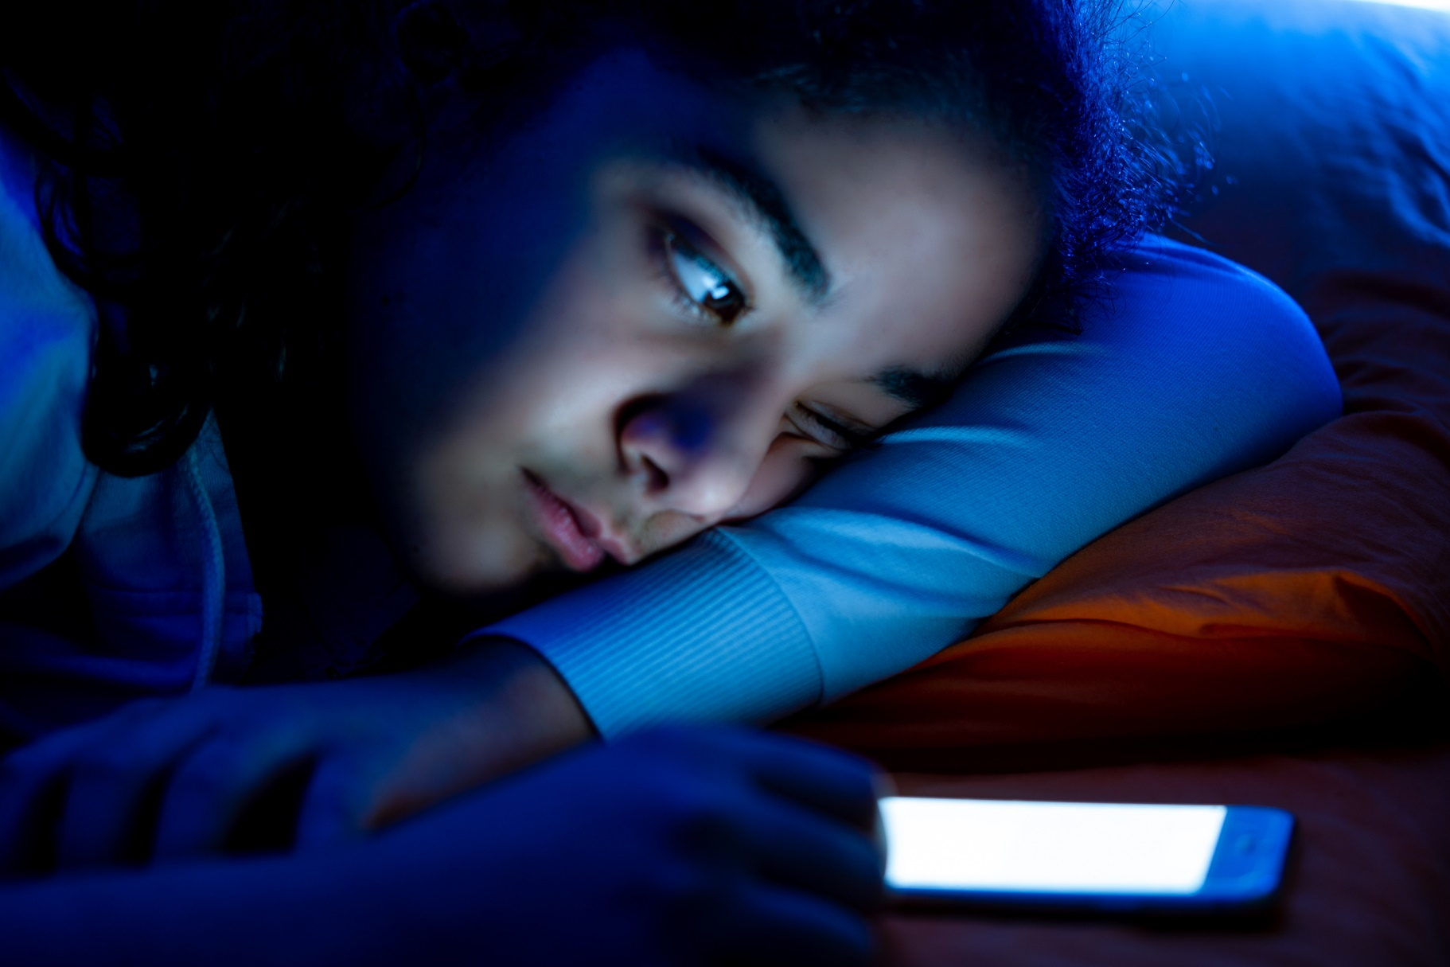
Do you get enough sleep?
Please Note:
If you are concerned about anything discussed in this lesson, you can find some useful resources on the last slide.
Notes:
Parent/Carer Note: Each week, your child completes this lesson in school before recording their vote on an online platform. Temporarily, we have created a platform you can use at home. Please see the last slide for details.
Images:
iStock

Slide 7
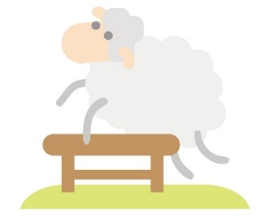



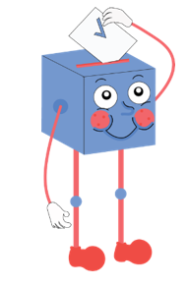
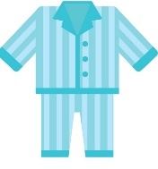
Starter: Put a finger down…
Why are we talking about this?
Why do we sleep?
Doctor, doctor! I’m tired!
How can I catch more zzz’s?
Vote!
Ext: Conduct a sleep study!
Notes:
Images:
iStock

Slide 8
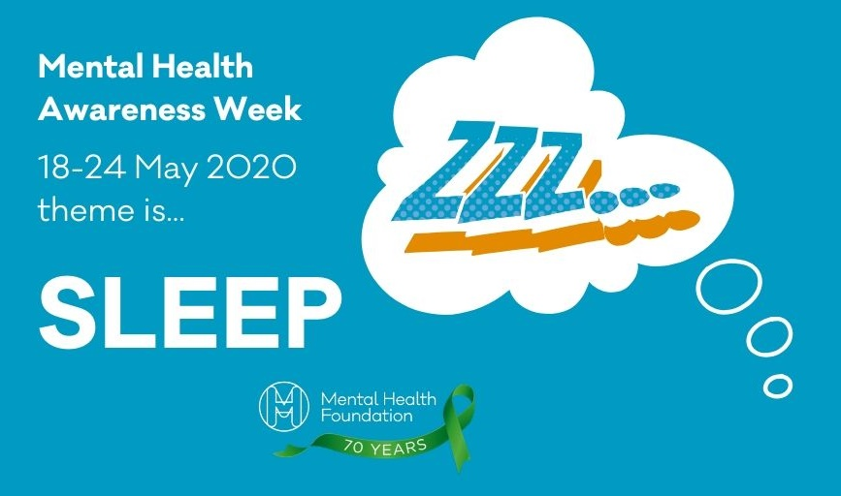
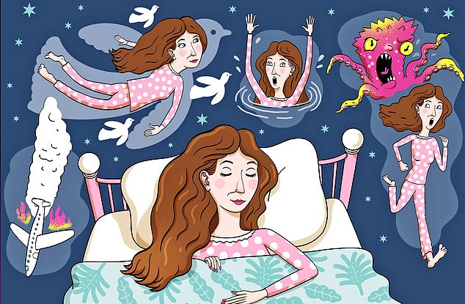
Why are we talking about this?
This week is Mental Health Awareness Week!
The theme this year was going to be “Sleep” but due to the Coronavirus, it has been changed to “Kindness”.
But did you know that sleep is extremely important for your mental health?
Being locked down has been affecting many people’s sleep – from finding it harder than usual to fall asleep to having strong, powerful dreams when they do!
Have you had any strange dreams during lockdown?
Notes:
Parent/Carer Note: This week’s home learning pack contains additional resources about Mental Health Awareness.
Images:
iStock
Mental Health Awareness Week

Slide 9
Starter: Put a finger down…
Why are we talking about this?
Why do we sleep?
Doctor, doctor! I’m tired!
How can I catch more zzz’s?
Vote!
Ext: Conduct a sleep study!
Notes:
Images:
iStock

Slide 10
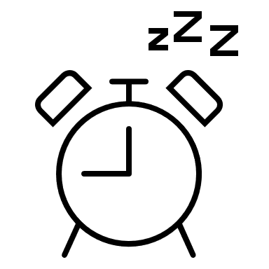
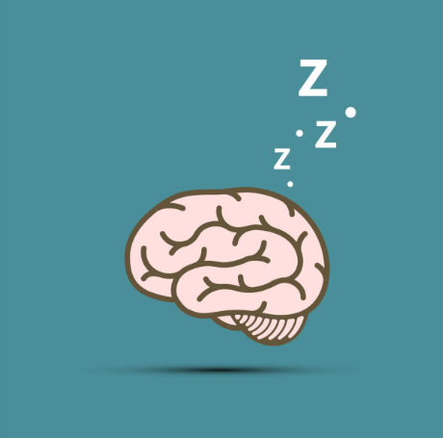

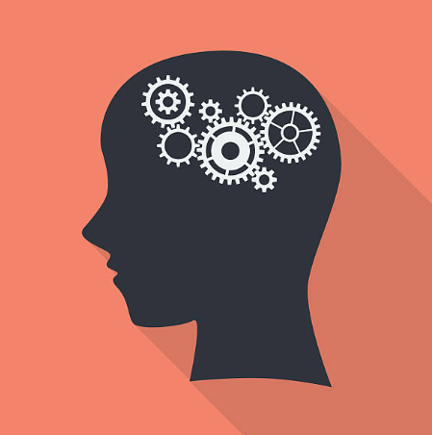

Why do we sleep?
Every night we go to sleep, but have you ever wondered why?
When you go to sleep, it can feel like your brain just switches off for the night, a bit like switching off a computer. However, this isn’t true!
Your brain actually works just as hard when you’re asleep as it does when you’re awake, and without it you wouldn’t feel very good at all.
Discuss (2 mins)
Think of a time when you have not had enough sleep. How did you feel afterwards?
Notes:
Parent/Carer Note: It’s a good idea to share your own sleep experiences with children throughout this lesson, to both remind them of their own and reassure of them that it is normal.
Images:
1) iStock

Slide 11
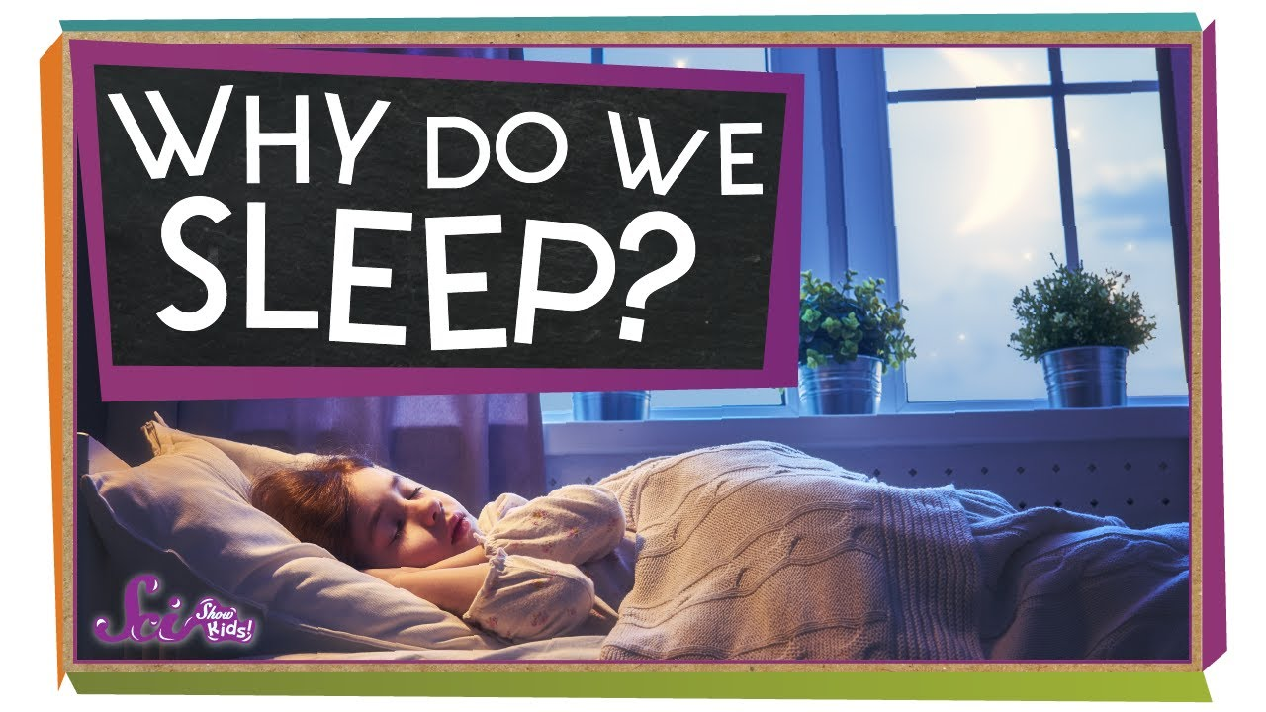






Why do we sleep?
0:00-4:08
Watch (5-8 mins)
Click the image to watch a video all about why we sleep. Once you’ve done that, can you answer the questions below?
Video not working?
Try pressing CTRL and clicking at the same time!
What happens to your breathing and heart rate while you sleep?
What happens to your memory while you sleep?
Are humans the only animals to have dreams?
Why do scientists think that we
have dreams?
What does REM Sleep mean?
What’s the strangest dream you have ever had?
https://safeshare.tv/x/ss5eba7a3966f75
Notes:
Parent/Carer Note: You may wish to replay the video after writing down the questions, and look for the answers together in the video.
Alternative video link: https://www.youtube.com/watch?v=jYu966AONZI&t=15s

Slide 12





Why do we sleep?
As sleep is so important, how much of it do you need?
Guess (1 min)
Before you find out, take a guess at how much sleep you think you need!
14 hours
0-3 years old
10-12 hours
4-12 years old
Scientists believe that you need more sleep when you are younger. This is because you are still growing and your brain is developing every day.
8-9 hours
13-18 years old
7-9 hours
In fact, an NHS study found that by going to bed at 2am for just one night affected children’s movement, thinking and concentration skills!
19-64 years old
7-8 hours
Challenge:
Work out exactly how much you slept last night. Was it enough?
65+ years old
Notes:
Parent/Carer Note: This chart has been simplified for the purpose of this lesson. Please use the references below for more exact figures.
References:
https://www.nhs.uk/live-well/sleep-and-tiredness/how-much-sleep-do-kids-need/
https://www.nhs.uk/news/neurology/lack-of-sleep-may-disrupt-development-of-a-childs-brain/

Slide 13
Starter: Put a finger down…
Why are we talking about this?
Why do we sleep?
Doctor, doctor! I’m tired!
How can I catch more zzz’s?
Vote!
Ext: Conduct a sleep study!
Notes:
Images:
iStock

Slide 14

Doctor, doctor! I’m tired!
Doctor, doctor! (5-10 mins)
Imagine that you are a Sleep Doctor. On the next few slides you are going to meet some of your patients. Your job? Decide if they need more sleep!
–
Parents/Carers & Pupils:
This lesson works best in “Full Screen” mode – click the icon at the bottom right of your screen now!
Challenge:
As you read about each person, ask yourself if you or anyone you know is suffering from the same problem. Will more sleep help them too?
Notes:
Parent/Carer Note: We recommend discussing each of these scenarios with children and highlighted times where you/they have felt this way.

Slide 15

Doctor, doctor! I’m tired!
I just can’t concentrate! Every time I go to do my school work I get distracted, and afterwards I completely forget what I’ve learned. Help me!
Does this person need more sleep?
Yes! When you are asleep your brain turns what you have learned into memories, which is how you remember things. If you don’t get enough sleep, it stops this from happening and makes it much harder to concentrate!
Notes:
Parent/Carer Note: We recommend discussing each of these scenarios with children and highlighted times where you/they have felt this way.
References:
https://www.medicalnewstoday.com/articles/307334#effects
https://www.ncbi.nlm.nih.gov/pmc/articles/PMC5449130/
Images:
iStock

Slide 16

Doctor, doctor! I’m tired!
Doctor, I can’t stop eating junk food! All I want is sweets and chocolate, even though I usually like fruit and vegetables. What’s wrong with me?
Does this person need more sleep?
Yes! When you don’t get enough sleep, your body tries to get more energy through food. “Junk” foods trick your brain into thinking you have more energy, but it doesn’t last long before you want more!
Notes:
Parent/Carer Note: We recommend discussing each of these scenarios with children and highlighted times where you/they have felt this way.
References:
https://www.medicalnewstoday.com/articles/307334#effects
https://www.ncbi.nlm.nih.gov/pmc/articles/PMC5449130/
Images:
iStock

Slide 17

Doctor, doctor! I’m tired!
Hi Doc! I seem to be very clumsy at the moment. I tripped up the stairs this morning, and then I dropped a cup on the floor this afternoon. This is very unlike me. Can you help?
Does this person need more sleep?
Yes! Not getting enough sleep can affect your coordination, making you clumsy and forgetful. In fact, scientists say that people who do not have enough sleep can start to act like they’ve drunk alcohol!
Notes:
Parent/Carer Note: We recommend discussing each of these scenarios with children and highlighted times where you/they have felt this way.
References:
https://www.medicalnewstoday.com/articles/307334#effects
https://www.ncbi.nlm.nih.gov/pmc/articles/PMC5449130/
Images:
iStock

Slide 18

Doctor, doctor! I’m tired!
I’m miserable. I just feel sad all the time. When my brother asks to play I shout at him, and I can’t be bothered to do my school work either. I just feel grumpy and sad today.
Does this person need more sleep?
Yes! Not getting enough sleep can affect your moods too, making you feel sad, angry and even emotional. The less sleep you have, the worse this feeling can get!
Notes:
Parent/Carer Note: We recommend discussing each of these scenarios with children and highlighted times where you/they have felt this way.
References:
https://www.medicalnewstoday.com/articles/307334#effects
https://www.ncbi.nlm.nih.gov/pmc/articles/PMC5449130/
Images:
iStock

Slide 19
Starter: Put a finger down…
Why are we talking about this?
Why do we sleep?
Doctor, doctor! I’m tired!
How can I catch more zzz’s?
Vote!
Ext: Conduct a sleep study!
Notes:
Images:
iStock

Slide 20



How can I catch more zzz’s?
What works for you? (5-10 mins)
On the next few slides you are going to find out about some techniques that can be used to help you to sleep. For each one, use the emojis to show how you feel about them.
This wouldn’t work for me!
I’m not sure. It’s worth a go!
This would work for me!
Challenge:
If you see a suggestion you would like to try, why not write it down on a piece of paper and test it out tonight!
Notes:
Images:
iStock
https://emojipedia.org/apple/

Slide 21
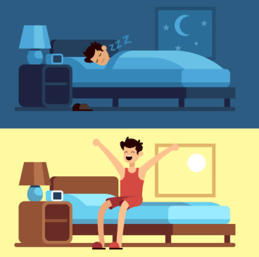
How can I catch more zzz’s?
One of the best ways to make sure that you get enough sleep is to wake up and go to the sleep at the same time every day.
If you do this, your body will get used to the time that you go to sleep and you will find it much easier to fall asleep and to wake up in the morning!
Question (1 min)
Would you try this?
This wouldn’t work for me!
I’m not sure. It’s worth a go!
This would work for me!
Notes:
Images:
iStock
https://emojipedia.org/apple/

Slide 22
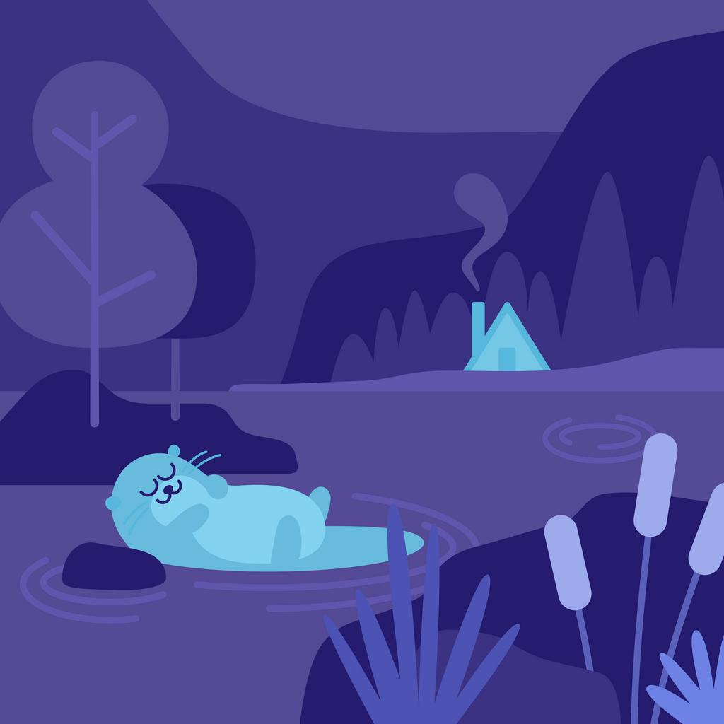
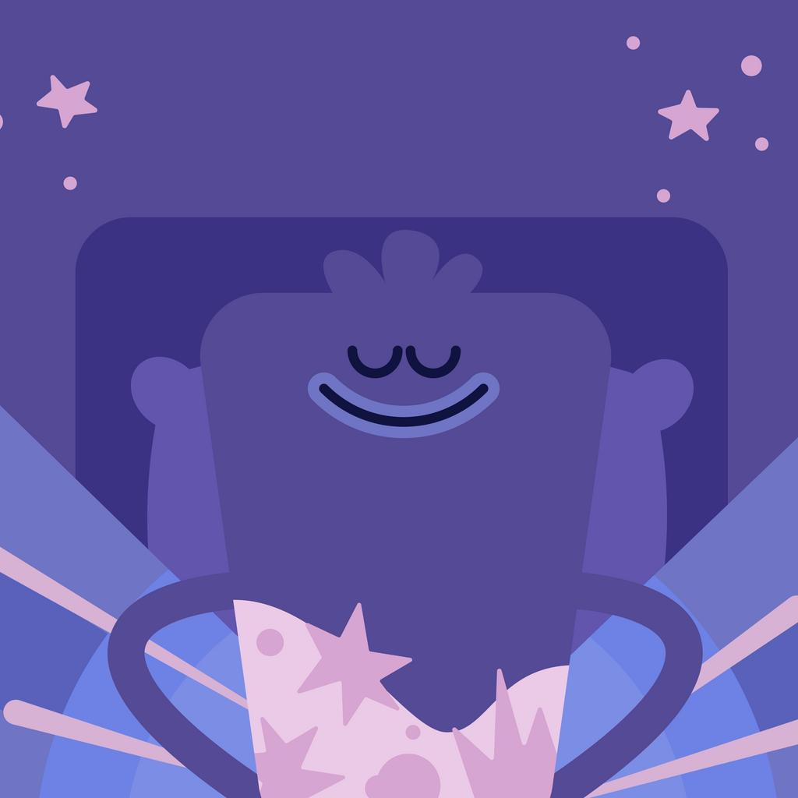
How can I catch more zzz’s?
Some people use meditation or relaxing sounds to help them fall asleep at night. They can help you to relax and to wind down ready for sleep.
0:00-1:00
0:00-1:25
Watch (2-5 mins)
Click on the images to hear some of these “sleep sounds”. Would you use any of them?
This wouldn’t work for me!
I’m not sure. It’s worth a go!
This would work for me!
https://safeshare.tv/x/4V8pZaD9tgg
https://safeshare.tv/x/ss5eb957e891936
Notes:
Parent/Carer Note: The second video was taken from Headspace – a mobile phone app with some limited free audio tapes.
Alternative video links:
Nature: https://www.youtube.com/watch?v=4V8pZaD9tgg&t=32s
Headspace: https://www.youtube.com/watch?v=3o9etQktCpI&t=16s
Images:
Headspace
iStock
https://emojipedia.org/apple/

Slide 23
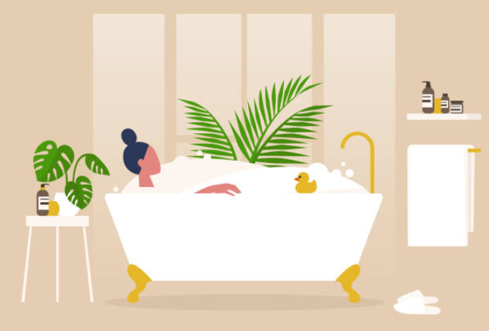
How can I catch more zzz’s?
Another way of winding down before bed is having a warm bath (not hot!) to help get your temperature just right for sleep.
If you’re already clean, you could try having a warm drink instead, like a glass of milk!
Question (1 min)
Would you try any of these things?
This wouldn’t work for me!
I’m not sure. It’s worth a go!
This would work for me!
Notes:
Images:
iStock
https://emojipedia.org/apple/

Slide 24
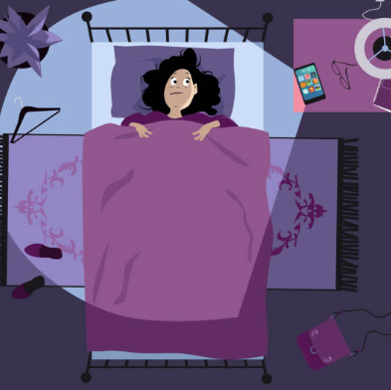
How can I catch more zzz’s?
Using a phone or tablet in bed can trick your brain into thinking that it is still day time! The bright lights can make it harder to fall asleep, and even give you headaches.
Most people make sure that they stop using screens at least one hour before they go to sleep. This helps them to relax and wind down for the day.
Question (1 min)
Would you try this?
This wouldn’t work for me!
I’m not sure. It’s worth a go!
This would work for me!
Notes:
Images:
iStock
https://emojipedia.org/apple/

Slide 25
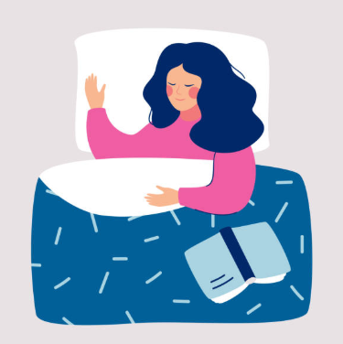
How can I catch more zzz’s?
Sometimes you might get into bed and not be able to sleep! This is frustrating but there’s things you can do to help yourself.
A good idea is to read a book in bed, or to listen to the radio. This helps distract you while making you feel sleepy!
Question (1 min)
Would you try this?
This wouldn’t work for me!
I’m not sure. It’s worth a go!
This would work for me!
Notes:
Images:
iStock
https://emojipedia.org/apple/

Slide 26
Starter: Put a finger down…
Why are we talking about this?
Why do we sleep?
Doctor, doctor! I’m tired!
How can I catch more zzz’s?
Vote!
Ext: Conduct a sleep study!
Notes:
Images:
iStock

Slide 27
Do you get enough sleep?
I know how important sleep is and I always get enough of it.
I used the chart at the beginning of the lesson and found that I get enough sleep.
I already use some of the things talked about in this lesson to help me get to sleep.
My parents help me get enough sleep by making sure I go to bed and wake up at the right time.
…
I often get distracted and stay up late, so I don’t get enough sleep.
I used the chart at the beginning of the lesson and found that I don’t get enough sleep.
I find it really difficult to fall asleep and need to practise some of the things I learned in this lesson.
I wake up in the night often which stops me from getting enough sleep and makes waking up difficult.
…
Notes:
Parent/Carer Note: Use this slide to review the arguments before voting.

Slide 28



















Want to find out more?
Links not working?
Go into “Full Screen Mode” and click the images to visit the relevant webpages.
Mental Health Awareness Week
Sleep & sleep disorders
General information
Notes:
Parent/Carer Note: In full screen mode, clicking each of these logos will take you to the relevant webpage. Alternatively, copy and paste the links you would like to explore further from the list below. Please be aware not all of these links will be suitable for younger children.
References:
Mental Health Awareness Week:
Mental Health Foundation: https://www.mentalhealth.org.uk/events/take-action-get-active-2020
SMHAF: http://www.mhfestival.com/
Every Mind Matters: https://www.nhs.uk/oneyou/every-mind-matters/coronavirus-covid-19-staying-at-home-tips/
BBC: https://www.bbc.co.uk/mediacentre/latestnews/2020/mental-health-season#heading-bbc-childrens-and-education
Time to Change: https://www.time-to-change.org.uk/get-involved/get-involved-workplace/make-impact-your-workplace/mental-health-calendar/mental-health
Sleep & sleep disorders:
Mind: https://www.mind.org.uk/information-support/types-of-mental-health-problems/sleep-problems/sleep-problems/
The Brain Charity: https://www.thebraincharity.org.uk/how-we-can-help/practical-help/information-advice/living-with-a-condition/problems-sleeping
Sleep Council: https://sleepcouncil.org.uk/advice-support/sleep-tools/sleep-calculator/
Headspace: https://www.headspace.com/
YoungMinds: https://youngminds.org.uk/find-help/feelings-and-symptoms/sleep-problems/
Sleepio: https://www.bighealth.com/sleepio
NHS: https://www.nhs.uk/live-well/sleep-and-tiredness/
3) General Information:
Rethink: https://www.rethink.org/advice-and-information/
Samaritans: https://www.samaritans.org/how-we-can-help/contact-samaritan/
Children’s Society: https://www.childrenssociety.org.uk/advice-hub/emotional-resilience
Calm: https://www.thecalmzone.net/help/get-help/
Childline: https://www.childline.org.uk/info-advice/
Heads Together: https://www.headstogether.org.uk/60-second-support/
Images:
https://www.mentalhealth.org.uk/our-work
http://www.mhfestival.com/
https://www.pharmacy.biz/every-mind-matters-phe-launches-new-mental-health-support-platform/
https://www.pinterest.co.uk/pin/228698487304510326/
https://mediatrust.org/resource-hub/four-ways-to-boost-your-social-media-content/ttc_rgb_pos_logo_1/
https://www.mind.org.uk/about-us/what-we-do/
https://www.thebraincharity.org.uk/how-we-can-help/practical-help/information-advice/living-with-a-condition/problems-sleeping
https://sleepcouncil.org.uk/advice-support/sleep-advice/still-not-sleeping/
https://www.headspace.com/philanthropy
https://socialsolihull.org.uk/localoffer/family-information-service-directory/4532/youngminds/
https://www.bighealth.com/sleepio
https://en.wikipedia.org/wiki/File:NHS-Logo.svg
https://twitter.com/rethink_
https://www.samaritans.org/
https://www.childrenssociety.org.uk/
https://www.thecalmzone.net/help/get-help/
http://lbforum.org.uk/services/childline/logo-childline/
https://www.headstogether.org.uk/60-second-support/

Slide 29
Starter: Put a finger down…
Why are we talking about this?
Why do we sleep?
Doctor, doctor! I’m tired!
How can I catch more zzz’s?
Vote!
Ext: Conduct a sleep study!
Notes:
Images:
iStock

Slide 30
Ext: Conduct a sleep study!
Sleep Study
Using this chart to help you, can you conduct a sleep study on your family and friends? Use the hints below to help you.
14 hours
0-3 years old
10-12 hours
4-12 years old
1
Try to find as many people as
possible to take part in your study.
8-9 hours
Start by asking them how many hours of sleep they get each night. Make
sure you write down all their answers!
2
13-18 years old
7-9 hours
Give them a tick if they get the right amount of hours for their age.
3
19-64 years old
Challenge:
If someone doesn’t get enough sleep, can you give them some advice to help them based on what you’ve learned?
7-8 hours
65+ years old
Notes:
Parent/Carer Note: This is an Extension activity, so children can carry it out if they wish, and spend as much or as little time on it as desired!

Slide 31


Call to Action
Quick idea
What time should I sleep?
Want to know more about your personal sleep cycle? Use this calculator to help you work out what your ideal bedtime is!
Mental Health Awareness Week
The theme this year was recently changed to “kindness”. They believe that just one small act of kindness can lead to many more, so why not see how many kind acts you can do this week?
Big idea
Notes:
Link 1:
https://sleepcouncil.org.uk/advice-support/sleep-tools/sleep-calculator/
Images:
iStock

Slide 32
You can vote from home at…
https://www.surveymonkey.co.uk/r/vfs-primary-sleep
To have your voice heard!
If you have any issues, feedback or comments, email amy@votesforschools.com!
Notes:
Teacher’s Note: Please log your class’ vote the usual way!
Parent/Carer Note: The link provided allows your child to record their vote online. Find it here: https://www.surveymonkey.co.uk/r/vfs-primary-child-actors

