Slide 1
Primary KS1

Slide 2
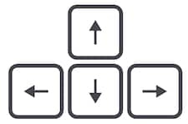
Learning from home?
Here are some ideas of how to get the most out of this lesson at home.
Share your thoughts with the parent, family member or caregiver who’s helping you!
Talk to someone else in your family, like a brother or sister, and find out their opinions!
For some of the activities, you might need a pen & paper as you get creative!
How to use this lesson…
Use these buttons to get the most out of your lesson.
Find this button in the bottom right of you screen to start your lesson.
Use the arrow keys to go forwards and backwards through your lesson.
To go back to your normal screen, press the esc key on your keyboard.
In the classroom?
You need the same things, but will need to swap the parent for a partner!
Parents’ & Carers’ Note:
Please see the Notes section below each slide for any further guidance.
Don’t forget to vote…
You can find the link to do this on the final slide. Get your whole household involved!
Notes:
Images:
https://icons8.com/

Slide 3
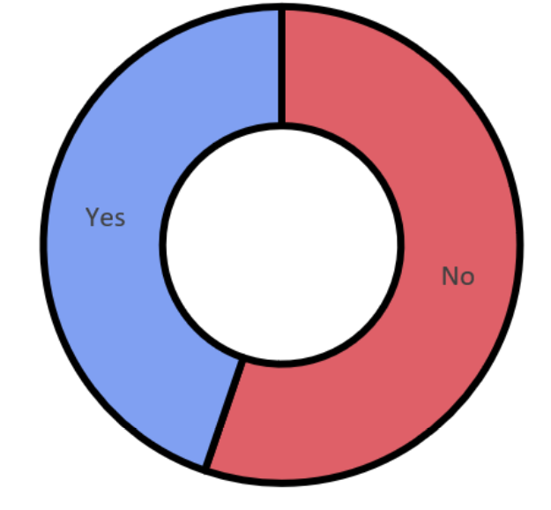
Last week’s vote:
Should every country follow the same Coronavirus advice?
55%
45%
Primary national vote result
Notes:
Images
iStock

Slide 4
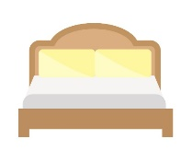
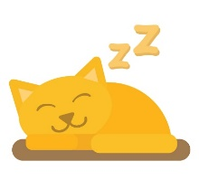
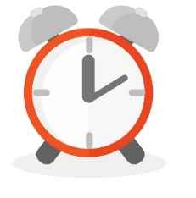
Starter: Put a finger down…
Put a finger down…
(3-5 mins)
Hold 10 fingers up! Read each statement and put a finger down for each one that applies to you!
If you can’t sleep without a toy or teddy.
If you have ever stayed up past midnight.
If you like a snack before bed.
If you play on a tablet or phone in bed.
If you share a bedroom with
someone else.
If you’ve been so tired that
you’ve had to take a nap.
If you’ve ever been late because you overslept.
If you’ve ever fallen asleep at school.
Notes:
Parent/Carer note: this activity works best in full screen.
Images:
iStock

Slide 5
Do you get enough sleep?
Notes:
Images:
iStock

Slide 6
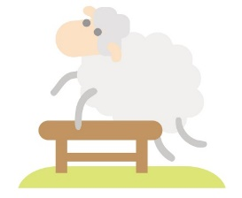
Our learning journey for this week!
Starter: Put a finger down…
Why are we talking about this?
How much sleep do we need?
How do we know?
Are they getting enough?
Vote!
Extension:
Top-tips!
Notes:
Images:
iStock

Slide 7
Why are we talking about this?
Remembering things
Staying healthy
Guess! (2-3 mins)
Which of these do you think sleep helps with?
Having lots of energy
Keeping fit
Learning new things
Feeling happy
The answer is: all of them! But do you think you’re getting enough sleep to get all these benefits? This is what you’ll be thinking about today.
Notes:
Parent/Carer Note: This activity works best in full screen.
Images:
iStock
References:

Slide 8
Our learning journey for this week!
Starter: Put a finger down…
Why are we talking about this?
How much sleep do we need?
How do we know?
Are they getting enough?
Vote!
Extension:
Top-tips!
Notes:
Images:
iStock

Slide 9
How much sleep do we need?
14 hours
Guess (2 mins)
Before you find out, take a guess at how many hours of sleep you think you need!
0-3 years old
10-12 hours
4-12 years old
8-9 hours
13-18 years old
7-9 hours
Scientists believe that you need more sleep when you are younger. This is because you (and your brain!) are still growing.
19-64 years old
7-8 hours
65+ years old
Notes:
Parent/Carer Note: This chart has been simplified for the purpose of this lesson. Please use the references below for more exact figures.
This activity works best in full screen.
References:
https://www.nhs.uk/live-well/sleep-and-tiredness/how-much-sleep-do-kids-need/
https://www.nhs.uk/news/neurology/lack-of-sleep-may-disrupt-development-of-a-childs-brain/

Slide 10
How much sleep do we need?
Work it out! (3-5 mins)
Using this clock, can you count how many hours of sleep you get?
I go to bed at..
12
11
1
10
2
1
What time do you go to bed?
9
3
2
What time do you wake up in the morning?
8
4
3
Count how many hours are in between!
7
5
6
Challenge:
Is it different at the weekend?
I wake up at..
So I sleep for…
Notes:
Images:
iStock

Slide 11
Our learning journey for this week!
Starter: Put a finger down…
Why are we talking about this?
How much sleep do we need?
How do we know?
Are they getting enough?
Vote!
Extension:
Top-tips!
Notes:
Images:
iStock

Slide 12
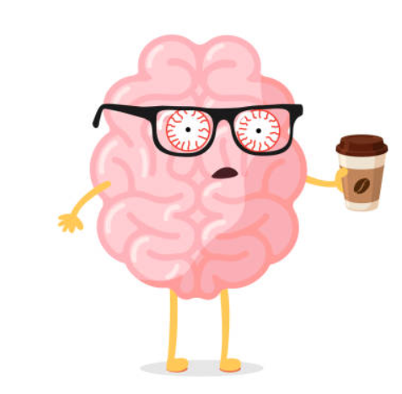
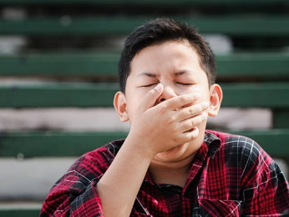
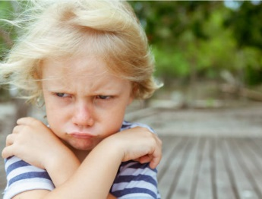
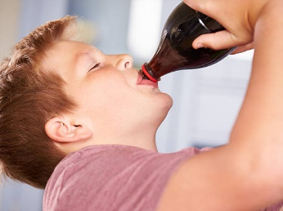
How do we know?
But I get 9 hours of sleep and I feel fine!
I’m tired!
Every person is different and some might need a bit more or a bit less, but there is a lot of other ways your brain lets you know you’re tired!
Think (2-3 mins)
How do you know you’re tired? How do you feel? Use the images to help you!
Notes:
Parent’s note: this activity works best in full screen.
Images:
iStock
References:

Slide 13
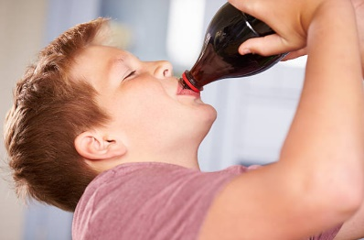
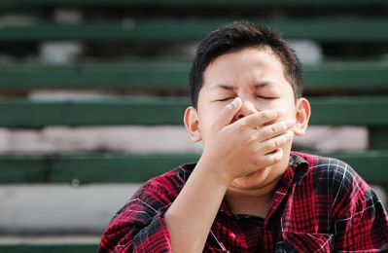
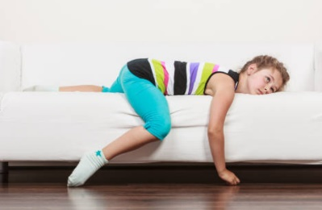
How do we know?
Show (3-5 mins)
What happens to your body when you’re tired? Have a look at the signs on the next few slides. Does this happen to you when you’re tired? Use your fingers to show your answers!
1
2
3
4
5
No
Not really
A bit
Sometimes
Yes
Notes:
Parent/Carer note: this activity works best in full screen.
Images:
iStock
References:
References:
https://www.nhs.uk/live-well/sleep-and-tiredness/how-much-sleep-do-kids-need/
https://www.nhs.uk/news/neurology/lack-of-sleep-may-disrupt-development-of-a-childs-brain/

Slide 14
How do we know?
You might find it difficult to concentrate and find learning more difficult than usual.
You might feel grumpy or be in a bad mood.
Does this happen when you’re tired?
1
2
3
4
5
No
Not really
A bit
Sometimes
Yes
Notes:
Parent/Carer note: this activity works best in full screen.
Images:
iStock
References:
References:
https://www.nhs.uk/live-well/sleep-and-tiredness/how-much-sleep-do-kids-need/
https://www.nhs.uk/news/neurology/lack-of-sleep-may-disrupt-development-of-a-childs-brain/

Slide 15
How do we know?
Your body might want more sugary drinks or food than normal.
You might do BIG yawns as your body tries to stay awake!
Does this happen when you’re tired?
1
2
3
4
5
No
Not really
A bit
Sometimes
Yes
Notes:
Parent’s note: this activity works best in full screen.
Images:
iStock
References:

Slide 16
How do we know?
You might feel quite lazy, and just want to lie around or put your head on the desk.
You might get a headache or feel unwell.
Does this happen when you’re tired?
1
2
3
4
5
No
Not really
A bit
Sometimes
Yes
Notes:
Parent/Carer note: this activity works best in full screen.
Images:
iStock
References:
References:
https://www.nhs.uk/live-well/sleep-and-tiredness/how-much-sleep-do-kids-need/
https://www.nhs.uk/news/neurology/lack-of-sleep-may-disrupt-development-of-a-childs-brain/

Slide 17
How do we know?
Reflect (2-3 mins)
Based on this, do you think you get enough sleep?
1
2
3
4
5
No
Not really
Sometimes
Mostly
Yes
Notes:
Images:
iStock
References:

Slide 18
Our learning journey for this week!
Starter: Put a finger down…
Why are we talking about this?
How much sleep do we need?
How do we know?
Are they getting enough?
Vote!
Extension:
Top-tips!
Notes:
Images:
iStock

Slide 19
Are they getting enough?
Can you spot the signs of someone who isn’t getting enough sleep?
Discuss (5-10 mins)
Read the different situations and decide if it looks like they’re getting enough sleep or not. If you think they are, put your thumbs up, if they’re not, put your thumbs down. Remember to explain your reasons why!
They’ve had enough sleep!
They’ve not had enough sleep!
Notes:
Parent/Carer note: this activity works best in full screen.
Images:
iStock
References:

Slide 20
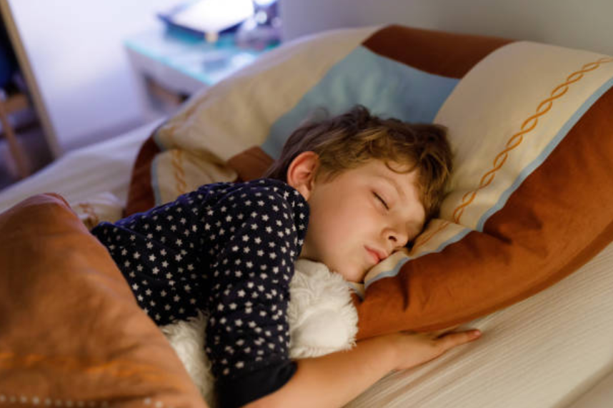
Are they getting enough?
Johan goes to bed at the same time every night. First, he has a bath and reads with his dad, which helps him relax. He falls straight to sleep!
Johan is getting enough sleep! He’s got some good habits before bed which are helping him get a good night’s sleep. Well done, Johan!
In the morning, he feels refreshed, happy and ready to learn!
He’s getting enough sleep!
He’s not getting enough sleep!
Notes:
Parent/Carer note: this activity works best in full screen.
Images:
iStock
References:

Slide 21
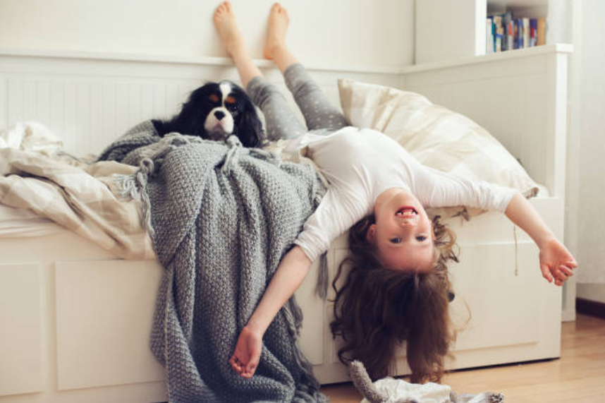
Are they getting enough?
Amy goes to bed at 8pm, but she gets up a lot to get a glass of water or play with her dog!
Amy is doing too much after bedtime, so she isn’t getting enough sleep, which is making her tired and moody! You need to do those things before bedtime, Amy!
When she wakes up in the morning, she doesn’t want to get out of bed! She’s yawning and feeling grumpy all day.
She’s getting enough sleep!
She’s not getting enough sleep!
Notes:
Parent/Carer note: this activity works best in full screen.
Images:
iStock
References:

Slide 22
Are they getting enough?
Georgie goes to be at 8.30pm. Sometimes, she finds it hard to sleep, so she might read her book for 20 mins and then turn the lights out.
Georgie is getting enough sleep! If you find it difficult to sleep, read a book for a bit or count sheep to help you dose off! Great idea, Georgie!
Sometimes Georgie is tired when she wakes up, but once she has her breakfast, she feels fine and enjoys the rest of the day!
She’s getting enough sleep!
She’s not getting enough sleep!
Notes:
Parent/Carer note: this activity works best in full screen.
Images:
iStock
References:

Slide 23
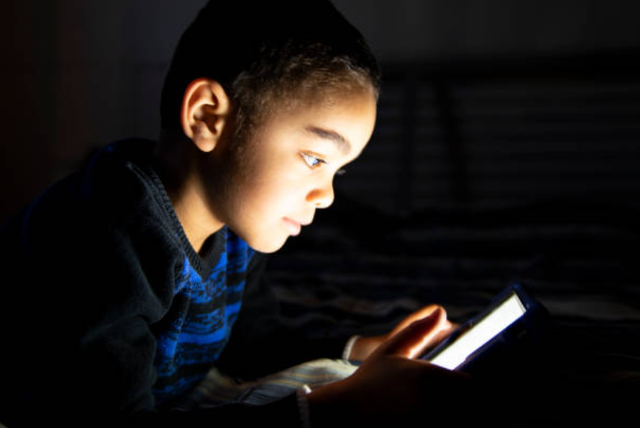
Are they getting enough?
Rasheed’s mum will turn the lights off at 7.30pm, but Rasheed sneaks the iPad under his pillow and plays games for hours and hours!
The next day at school, he has trouble completing his work, and sometimes puts his head on the desk and falls asleep!
Rasheed’s not getting enough sleep, which means he’s tired in class! Sleeping is much more important than playing games, Rasheed, so put the iPad away!
He’s getting enough sleep!
He’s not getting enough sleep!
Notes:
Parent/Carer note: this activity works best in full screen.
Images:
iStock
References:

Slide 24
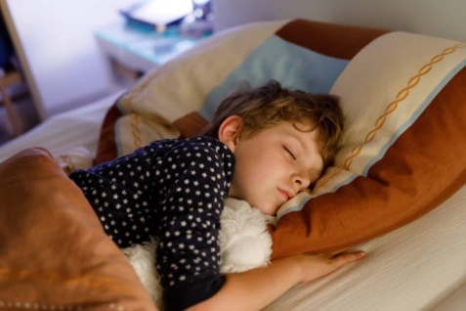
Are they getting enough?
Reflect (2-3 mins)
Discuss with your partner: are you more like Amy and Rasheed or Georgie and Johan? Do you think you get enough sleep?
I get enough sleep!
I don’t get enough sleep!
Notes:
Parent/Carer note: this activity works best in full screen.
Images:
iStock
References:

Slide 25
Our learning journey for this week!
Starter: Put a finger down…
Why are we talking about this?
How much sleep do we need?
How do we know?
Are they getting enough?
Vote!
Extension:
Top-tips!
Notes:
Images:
iStock

Slide 26
Do you get enough sleep?
Yes
No
I know how important sleep is and I always get enough of it.
I used the chart at the beginning of the lesson and found that I get enough sleep.
My parents help me get enough sleep by making sure I go to bed and wake up at the right time.
I often get distracted and stay up late, so I don’t get enough sleep.
I used the chart at the beginning of the lesson and found that I don’t get enough sleep.
I find it really difficult to fall asleep.
Calling all voters!
You can still vote at home! Just follow the link: https://www.surveymonkey.co.uk/r/vfs-primary-sleep

Slide 27
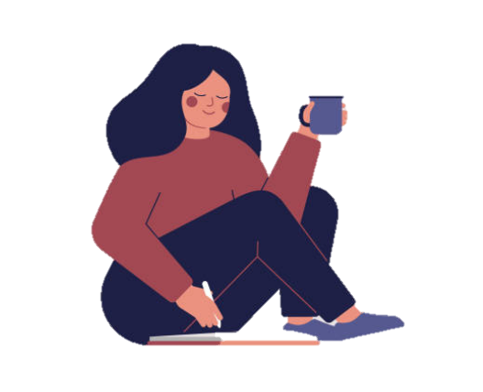
Extension: Dear Ollie...
Ollie has been have trouble sleeping recently – he’s been staying up all night!
Yawn!
Dear Ollie,
I hear you’ve had trouble sleeping, so this is my advice:
You could….
Always…
Don’t…
Have you tried…?
Most importantly…
Good luck!
Advise! (10-15 mins)
What could Ollie do that would help him get to sleep? Write him a letter or a video with all the advice!
Notes:
Images
iStock
References

Slide 28
You can vote from home at… https://www.surveymonkey.co.uk/r/vfs-primary-sleep
To have your voice heard!
If you have any issues, feedback or comments, email amy@votesforschools.com
Notes:
Alternative video link: https://youtu.be/FoQ45XPO_WQ

