Slide 1


Begin to calculate time intervals in hours and minutes.
Mr. Clockman’s day | Time | 5 minutes late…
Wake up | 7:16am
Breakfast | 8:30am
Got on bus | 9:40am
Get to work | 10:12am
Lunch break | 12:55pm
Leave work | 5:25pm
Mr.Clockman is always
5 minutes late!
Rewrite the timetable to show each of the times
5 minutes later.

Slide 2
Begin to calculate time intervals in hours and minutes.
Mr. Clockman’s day | Time | 5 minutes late…
Wake up | 7:16am
Breakfast | 8:30am
Got on bus | 9:40am
Get to work | 10:12am
Lunch break | 12:55pm
Leave work | 5:25pm
7:21am
8:35am
9:45am
10:17am
1:00pm
5:30pm
Let’s check those…
What did you do to find the times 5 minutes later?

Slide 3
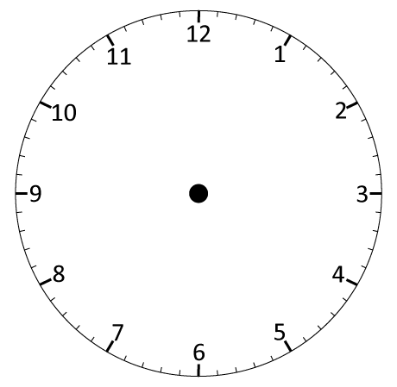
Begin to calculate time intervals in hours and minutes.
Now let’s try that on an analogue clock…
Get up at 7:16am.
Let’s move the hands to show 5 minutes later…
The minute hand moves on five minutes to show 21 minutes past...
The hour hand moves a small amount too…

Slide 4
Begin to calculate time intervals in hours and minutes.
We have to be careful if adding minutes takes us into the next hour.
The bus leaves at 9:40am.
But it is 30 minutes late!
If we just add 30 minutes we get 9:70.
Why is that impossible?
Let’s show 9:40 on the analogue clock and move the hands forward 30 minutes (that’s 6 lots of 5 minutes).
The hands have
passed through the next hour, so the bus now leaves at 10:10am.

Slide 5
Begin to calculate time intervals in hours and minutes.
Lunch break is 12:55pm.
What time is it
30 minutes later?
Can we just add 30 to the minutes?
Make 12:55 on the analogue clock and move the hands forward
30 minutes.
The hands have
passed through the next hour, so it is now 1:25pm.

