Slide 1

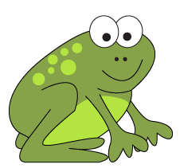
Use counting up to subtract.
Frog is back!
RIBBIT!
How can Frog
help us with subtraction?
Frog starts at the smaller number, then counts up to the bigger number.
Frog jumps on a number line, to find differences.
We add his jumps to find the answer to the subtraction.
He first jumps to the next 10.

Slide 2



Use counting up to subtract.
Let’s see how Frog counts up on the bead line to find 72 - 37.
… and another 30 in tens to jump from 40 to 70...
… then 2 to hop from 70 to 72.
Count 3 beads to 40.
3
30
2
37
72
Add the jumps, largest number first:
30 + 3 + 2 = ?
72 - 37 = 35

Slide 3
Use counting up to subtract.
Mark 37 and 72 on a number line.
Let’s try that without the beads…
… and another 30 to 70...
Frog starts at 37 and jumps to the next 10.
… then 2 to 72.
3
30
2
37
72
Add the jumps, largest number first.
30 + 3 + 2 = ?
72 - 37 = 35

Slide 4
Use counting up to subtract.
Mark 55 and 38 on the number line.
Let’s try 55 - 38.
… and another 10 to 50...
Frog starts at 38 and jumps to the next 10.
… then 5 to 55.
2
10
5
38
55
Add the jumps, largest number first.
10 + 5 + 2 = ?
55 - 38 = 17

Slide 5

Use counting up to subtract.
Now let’s try 78 - 44 and 54 - 23.
How will Frog calculate 78 - 44?
6
20
8
78 - 44 = 34
44
78
How will Frog calculate 54 - 23?
7
20
4
54 - 23 = 31
23
54

