Slide 1
French
Family and Friends
Year One
French | Year 3 | Family and Friends | Alphabet | Lesson 3

Slide 3
Aim
I can recognise and repeat sounds and words with increasing accuracy.
I can use songs or rhymes to help me remember new language.
Success Criteria
I can listen carefully to modelled pronunciation.
I can copy what I hear.
I can use a familiar tune to recall new sounds.
I can join in with a song to practise new language

Slide 4
Je M’Appelle…

Slide 5
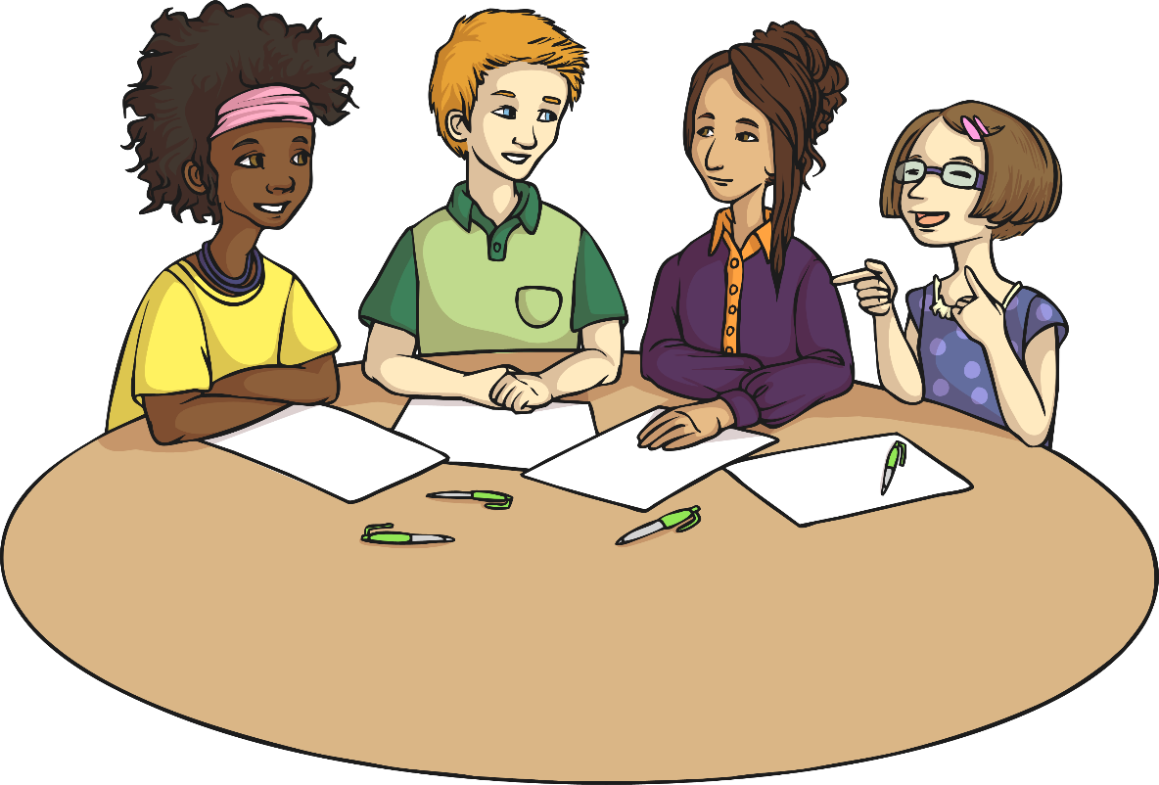
Our Names
Etienne
Brigitte
Nicole
Aimée

Slide 6
Je M’Appelle…

Slide 7
Les Lettres

Slide 8
Les Lettres
Did any letters sound familiar to you?
Which ones?

Slide 9
Set One

Slide 10
Set One

Slide 11
Set One

Slide 12
Set One

Slide 13
Set One

Slide 14
Set One

Slide 15
Set One

Slide 16
Set One
What sound did you hear in each of those letters?
ey

Slide 17
Allons-Y!

Slide 18
Allons-Y!
Let’s practice ey letters:

Slide 19
Set Two

Slide 20
Set Two

Slide 21
Set Two

Slide 22
Set Two

Slide 23
Set Two

Slide 24
Set Two

Slide 25
Set Two

Slide 26
Set One
What sound did you hear in each of those letters?
eh

Slide 27
Allons-Y!
Let’s practice ey letters:

Slide 28
Allons-Y!
Let’s practice ey letters:
Let’s practice eh letters:

Slide 29
Set Three

Slide 30
Set Three

Slide 31
Set Three

Slide 32
Set One
What sound did you hear in each of those letters?
ah

Slide 33
Allons-Y!

Slide 34
Allons-Y!
Let’s practice ah letters:

Slide 35
Set Four

Slide 36
Set Four

Slide 37
Set Four

Slide 38
Set Four

Slide 39
Set One
What sound did you hear in each of those letters?
ee

Slide 40
Allons-Y!

Slide 41
Allons-Y!
Let’s practice ee letters:

Slide 42
Set Five

Slide 43
Set Five

Slide 44
Set One
OO Sound file missing
What sound did you hear in each of those letters?
oo

Slide 45
Allons-Y!

Slide 46
Allons-Y!
Let’s practice oo letters:

Slide 47
Qu’est-ce Qui Manque? (Who’s This?)
Put the letters you have in order, saying their names in French.
Which letters of the alphabet are left?
e
o

Slide 48
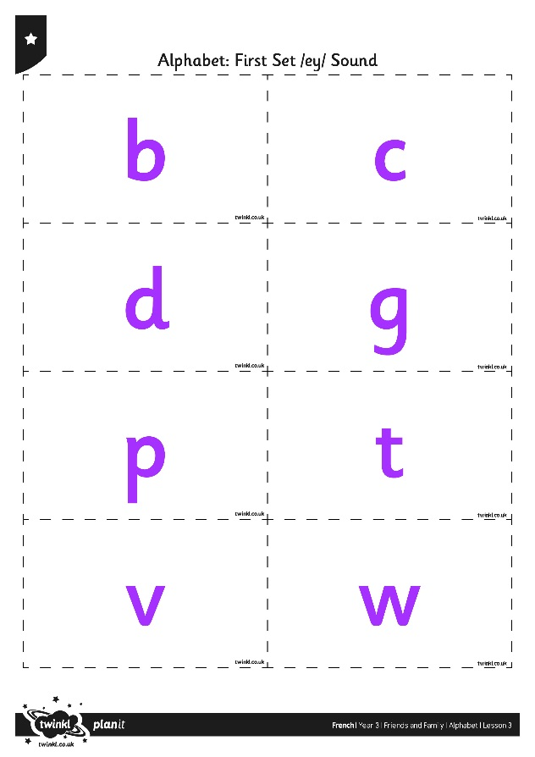
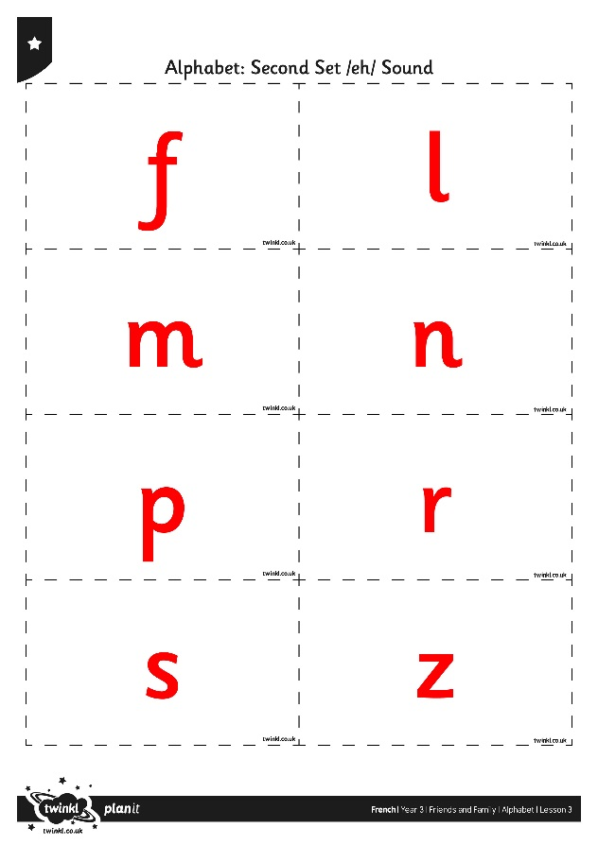
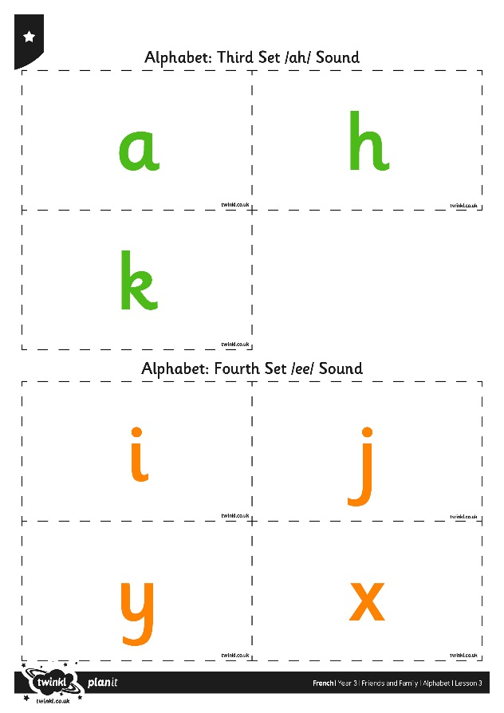
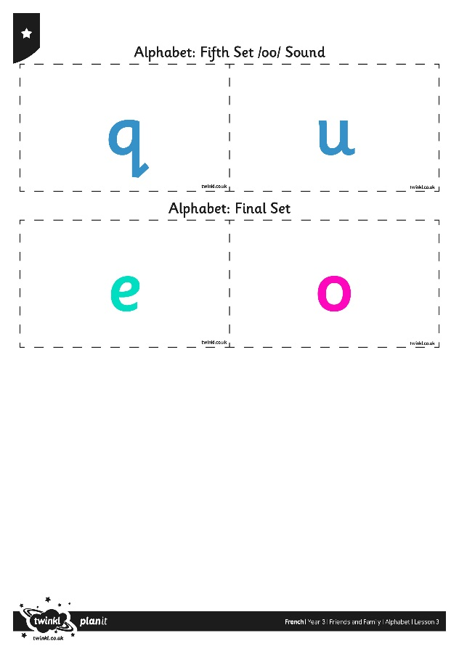
Allons Jour! (Let’s Play a Game!)

Slide 49
Aim
I can recognise and repeat sounds and words with increasing accuracy.
I can use songs or rhymes to help me remember new language.
Success Criteria
I can listen carefully to modelled pronunciation.
I can copy what I hear.
I can use a familiar tune to recall new sounds.
I can join in with a song to practise new language

