Slide 1
French
All About Me
Year One
French | Year 3 | All About Me | Clothes 2 | Lesson 6

Slide 3
Aim
To use simple conjunctions to link vocabulary for clothes and accessories.
To can have a simple conversation about clothes.
Success Criteria
To use et to join words in a list.
To name clothes and accessories in French.
To say what I am wearing.
To ask someone else what they are wearing.

Slide 4
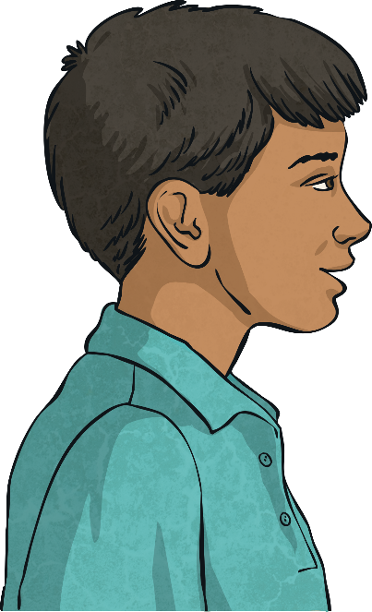
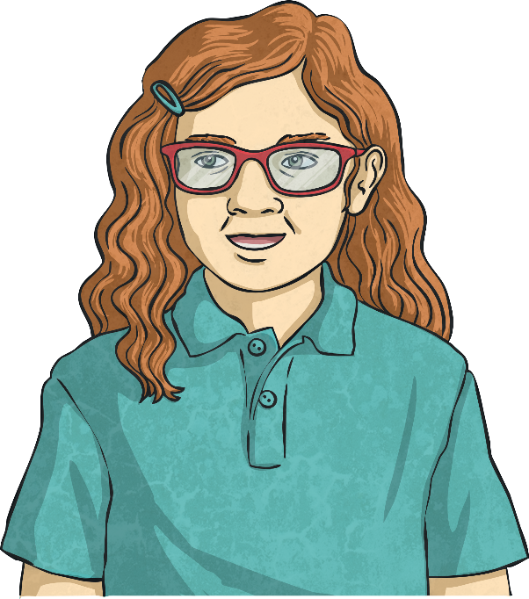
What Can You Remember?
What can you remember from last lesson?
Ask your talking partner “Comment dit-on en français?” to see how much they remember.
Comment
dit-on skirt
en français?
Une jupe.

Slide 5
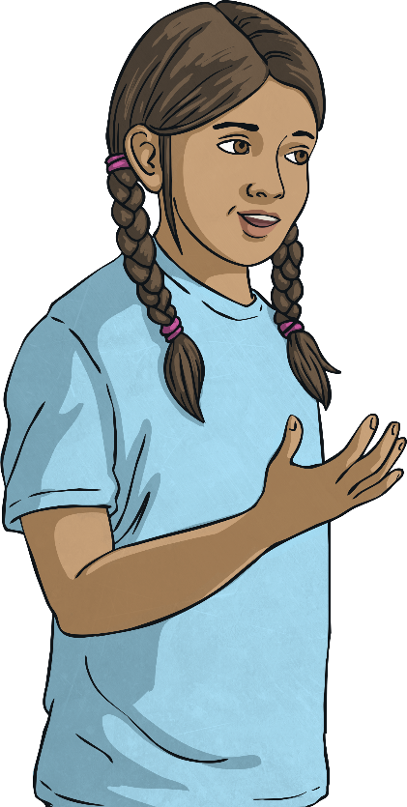
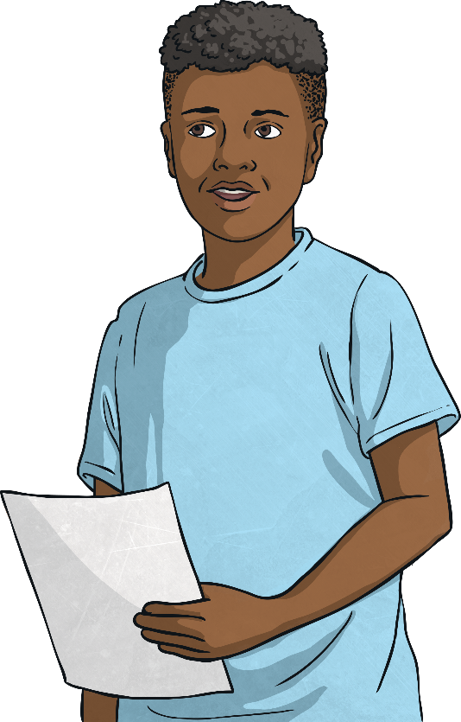
Click play buttons throughout to hear phrases and words.
Qu’est-ce que tu portes?
Qu’est-ce que tu portes?
Je porte…

Slide 6
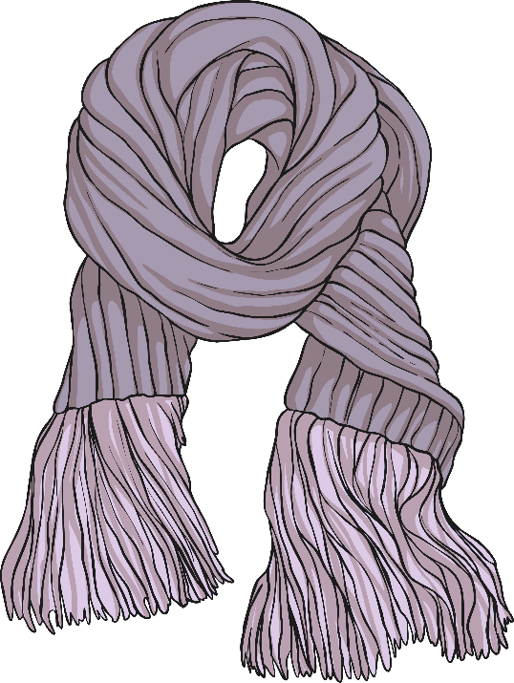
Qu’est-ce que tu portes?
Je porte…
…une écharpe.

Slide 7
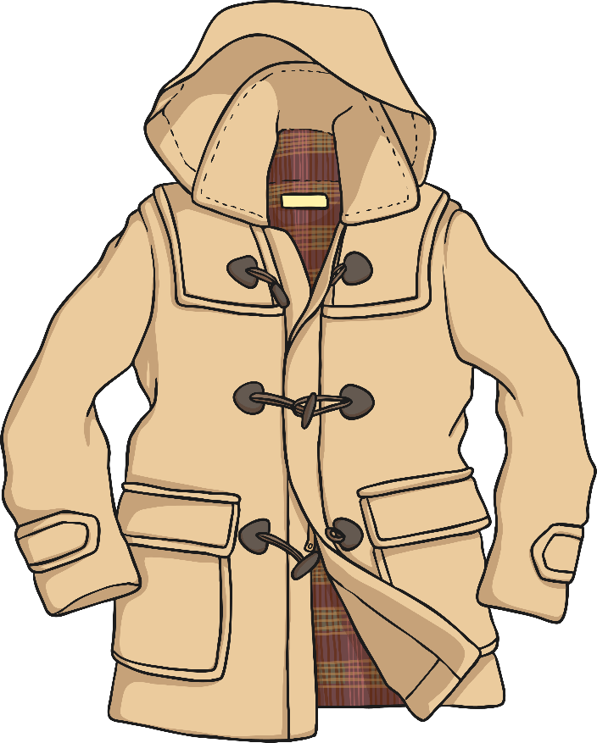
Qu’est-ce que tu portes?
Je porte…
…un manteau.

Slide 8
Qu’est-ce que tu portes?
Je porte…
…des lunettes.

Slide 9
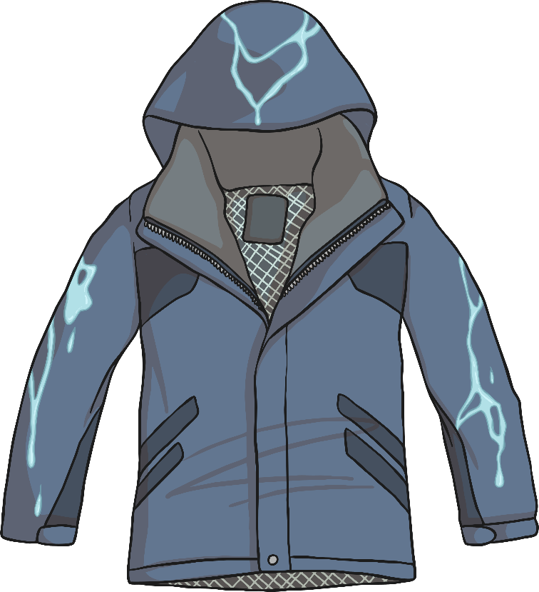
Qu’est-ce que tu portes?
Je porte…
…un imperméable.

Slide 10
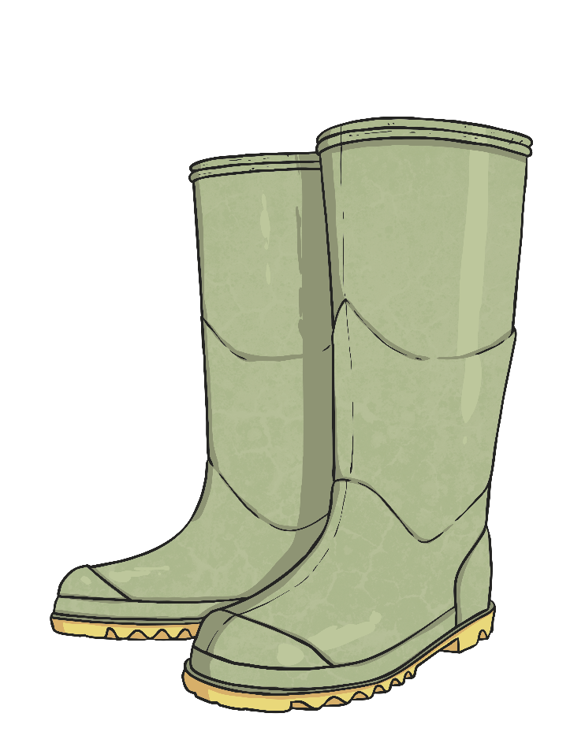
Qu’est-ce que tu portes?
Je porte…
…des bottes.

Slide 11
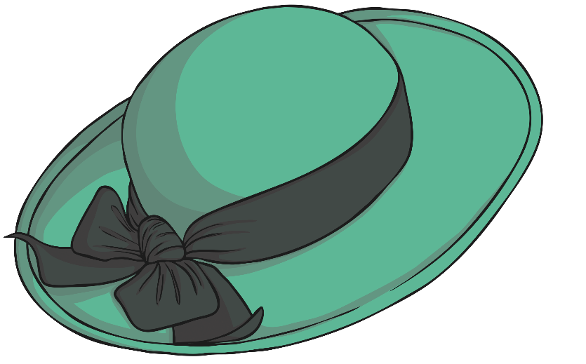
Qu’est-ce que tu portes?
Je porte…
…un chapeau.

Slide 12
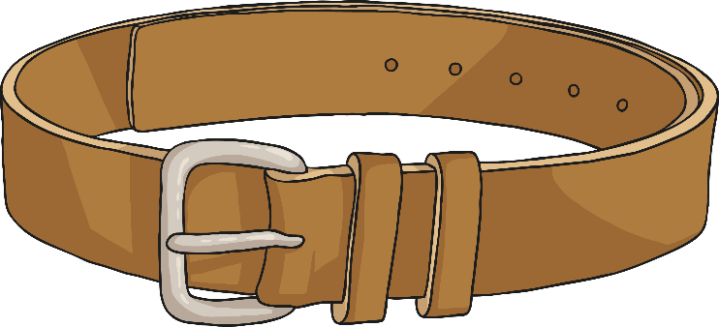
Qu’est-ce que tu portes?
Je porte…
…une ceinture.

Slide 13
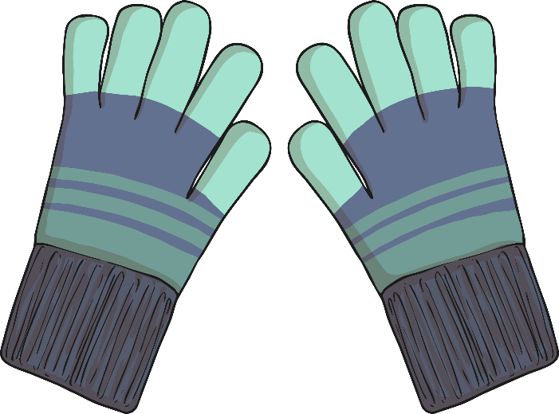
Qu’est-ce que tu portes?
Je porte…
…des gants.

Slide 14
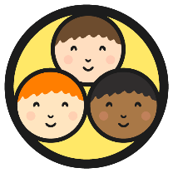
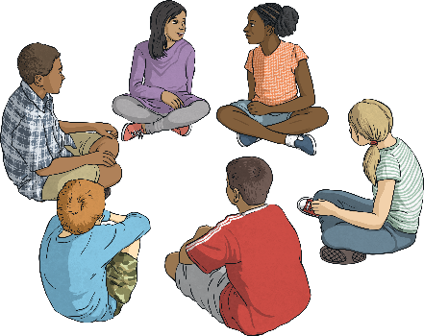
Allons jouer!
(Let’s Play!)
Sit in a circle around a pile of clothing.
des gants
des lunettes
While the music is playing pass around the envelope with the game cards in.
un manteau
When the music stops, everyone calls “Qu’est-ce que tu portes?” The player with the envelope draws out a card, puts on that item of clothing as quickly as possible and calls out “Je porte…”

Slide 15
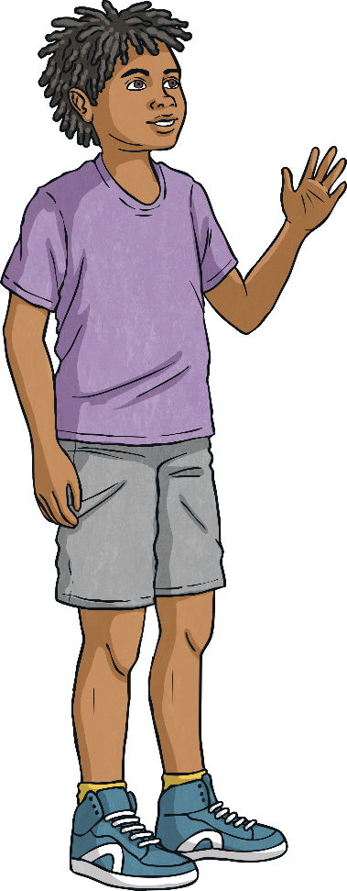
Something More
Can you add another item of clothing to your “Je porte…” sentence?
Use the word “et” to tell your partner two things that you are wearing.
Qu’est-ce que tu portes?
Je porte et .

Slide 16
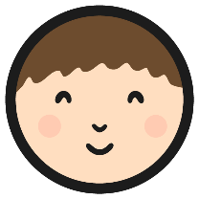
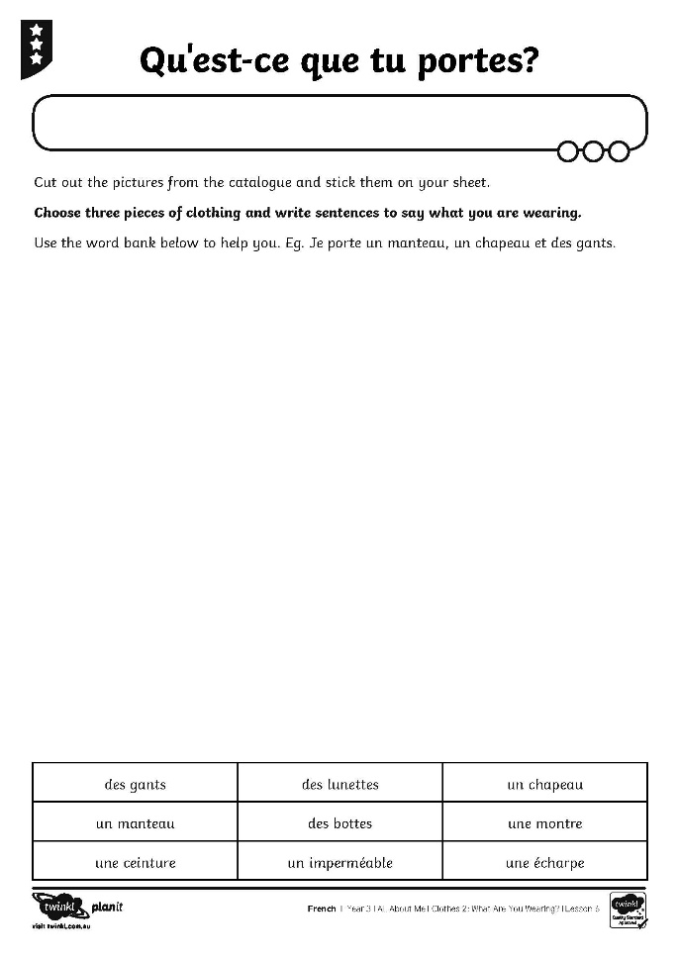
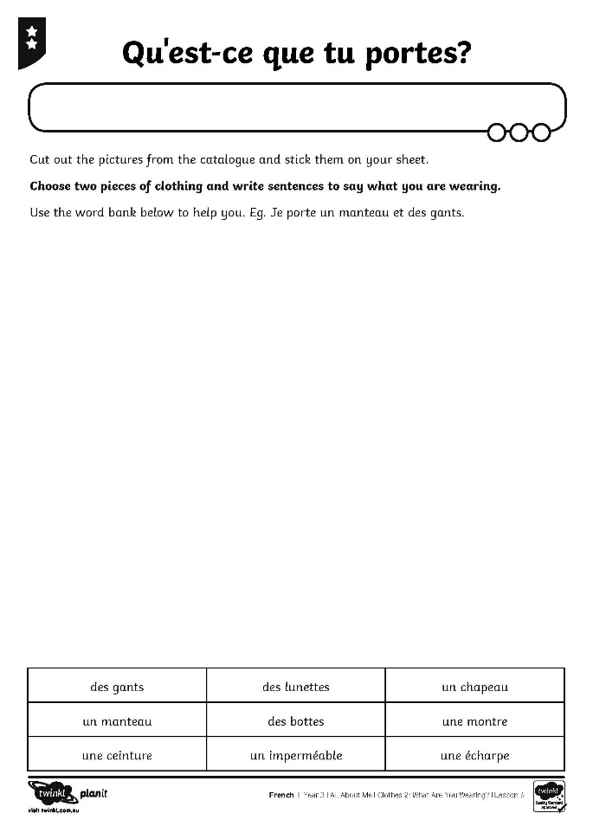
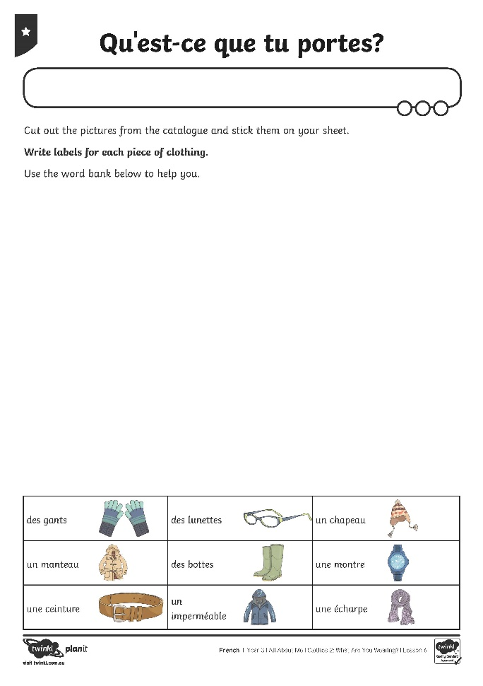
Allez-y!
Off you go!

Slide 17
Aim
To use simple conjunctions to link vocabulary for clothes and accessories.
To have a simple conversation about clothes.
Success Criteria
To use et to join words in a list.
To name clothes and accessories in French.
To say what I am wearing.
To ask someone else what they are wearing.

