Slide 1
French
All About Me
Year One
French | Year 3 | All About Me | Colours | Lesson 4

Slide 3
Aim
To listen to and copy pronunciation of colour words accurately.
Success Criteria
I can name different colours in French.
I listen to and repeat words carefully.

Slide 4
What Do You Know?

Slide 5
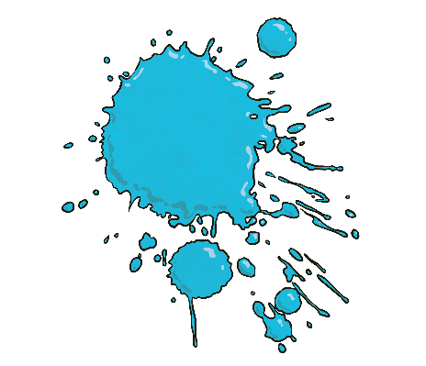
C’est de quelle couleur?
Click play buttons throughout to hear phrases and words.
(What colour is this?)
C’est bleu
Notes:
“Comment Dit-On ______ En Français?” means “How do you say _______ in French?”

Slide 6
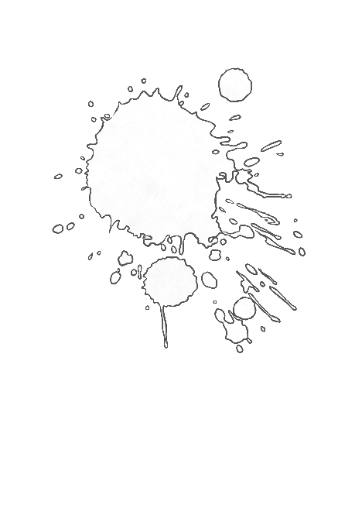
C’est de quelle couleur?
Click play buttons throughout to hear phrases and words.
(What colour is this?)
C’est blanc
Notes:
“Comment Dit-On ______ En Français?” means “How do you say _______ in French?”

Slide 7
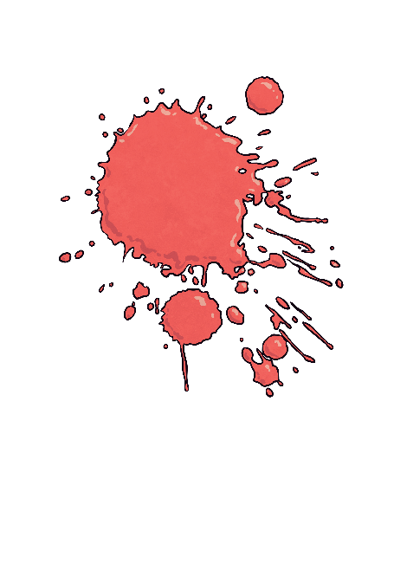
C’est de quelle couleur?
Click play buttons throughout to hear phrases and words.
(What colour is this?)
C’est rouge
Notes:
“Comment Dit-On ______ En Français?” means “How do you say _______ in French?”

Slide 8
C’est de quelle couleur?
Click play buttons throughout to hear phrases and words.
(What colour is this?)
C’est noir
Notes:
“Comment Dit-On ______ En Français?” means “How do you say _______ in French?”

Slide 9
C’est de quelle couleur?
Click play buttons throughout to hear phrases and words.
(What colour is this?)
C’est jaune
Notes:
“Comment Dit-On ______ En Français?” means “How do you say _______ in French?”

Slide 10
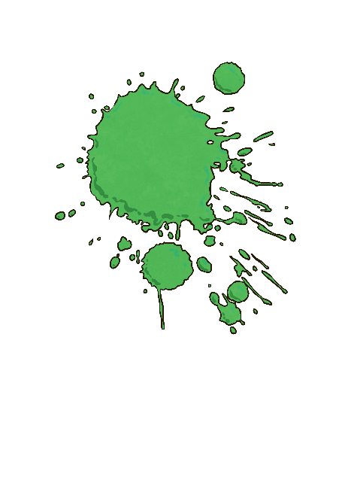
C’est de quelle couleur?
Click play buttons throughout to hear phrases and words.
(What colour is this?)
C’est vert
Notes:
“Comment Dit-On ______ En Français?” means “How do you say _______ in French?”

Slide 11
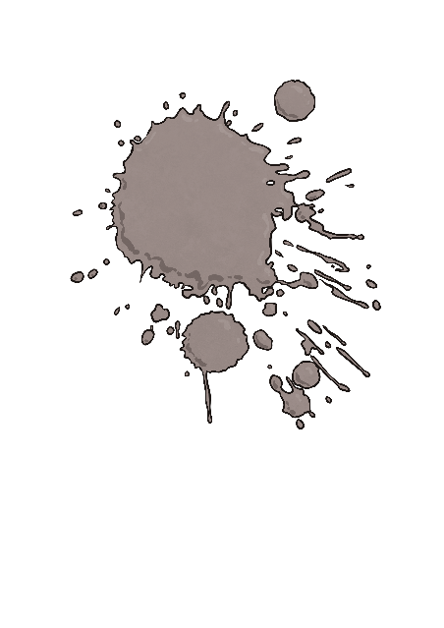
C’est de quelle couleur?
Click play buttons throughout to hear phrases and words.
(What colour is this?)
C’est gris
Notes:
“Comment Dit-On ______ En Français?” means “How do you say _______ in French?”

Slide 12
C’est de quelle couleur?
Click play buttons throughout to hear phrases and words.
(What colour is this?)
C’est marron
Notes:
“Comment Dit-On ______ En Français?” means “How do you say _______ in French?”

Slide 13
C’est de quelle couleur?
Click play buttons throughout to hear phrases and words.
(What colour is this?)
C’est orange
Notes:
“Comment Dit-On ______ En Français?” means “How do you say _______ in French?”

Slide 14
C’est de quelle couleur?
Click play buttons throughout to hear phrases and words.
(What colour is this?)
C’est violet
Notes:
“Comment Dit-On ______ En Français?” means “How do you say _______ in French?”

Slide 15
C’est de quelle couleur?
Click play buttons throughout to hear phrases and words.
(What colour is this?)
C’est rose
Notes:
“Comment Dit-On ______ En Français?” means “How do you say _______ in French?”

Slide 16
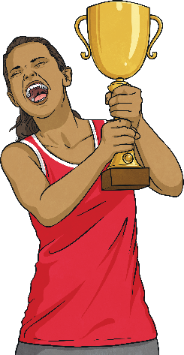
Un, deux, trois, montrez-moi !
(One, Two, Three, Show Me!)
Marron…
Listen to the colour word when it is called out.
?
?
?
In pairs, decide which of your objects is this colour.
When you hear “Un, deux, trois…montrez-moi!” hold up your choice of object.
Un, deux, trois…montrez-moi!
The quickest pair to hold up the correct coloured object wins a point!

Slide 17
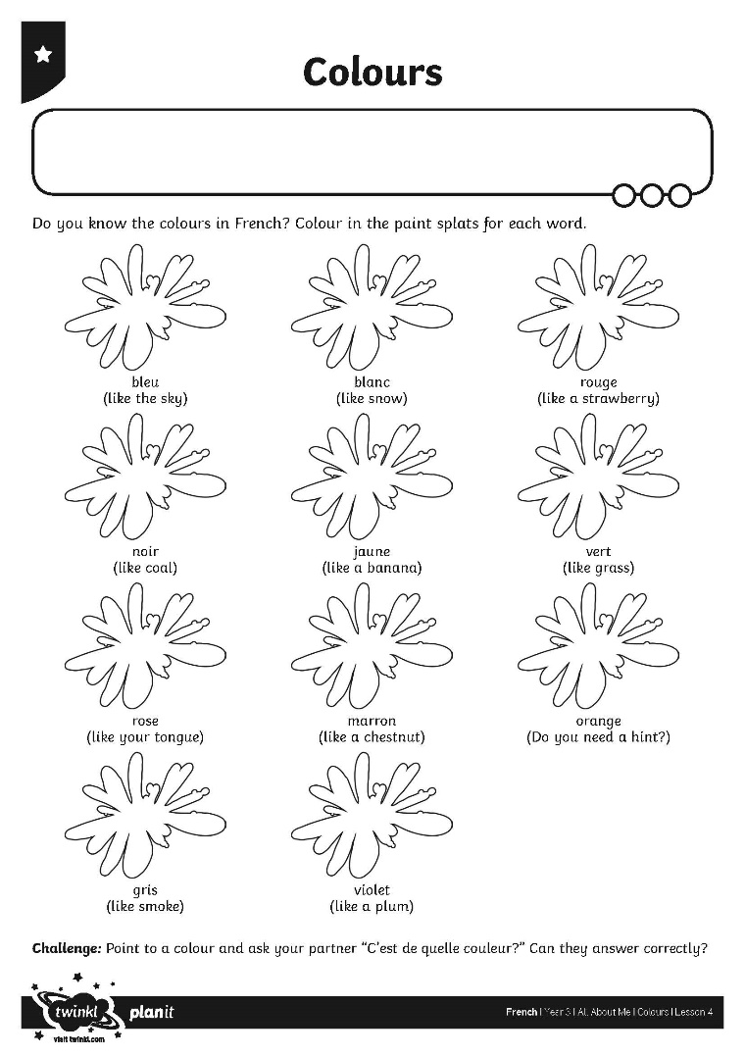
Allez-y!
Off you go!

Slide 18
Cache-cache
(Hide and Seek)
Take it in turns to put a colour vocabulary flashcard into the Cache-cache! envelope.
Slowly begin to reveal the word whilst asking “C’est de quelle couleur?”
The rest of the group guesses the colour.
If the group is correct, reply with “Oui!” If the group is incorrect, reply with “Non!” until they get the right answer!

Slide 19
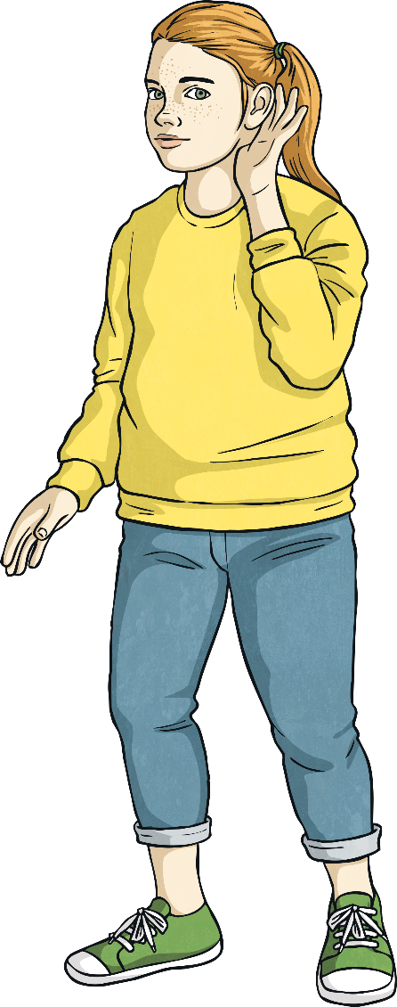
Jeu des couleurs
(Colours Game)
Listen to the action word and set off around the room when you hear “Allez-y!”
On your teacher’s signal, stop and listen for what to do.
Only do the action if the teacher mentions your team colour!
For example “Levez les mains les bleus!” means all the blues raise their hands.

Slide 20
Aim
To listen to and copy pronunciation of colour words accurately.
Success Criteria
I can name different colours in French.
I listen to and repeat words carefully.

