Slide 1
French
Time
Year One
French | Year Three | Time | Days of the Week1 Lesson 2

Slide 2
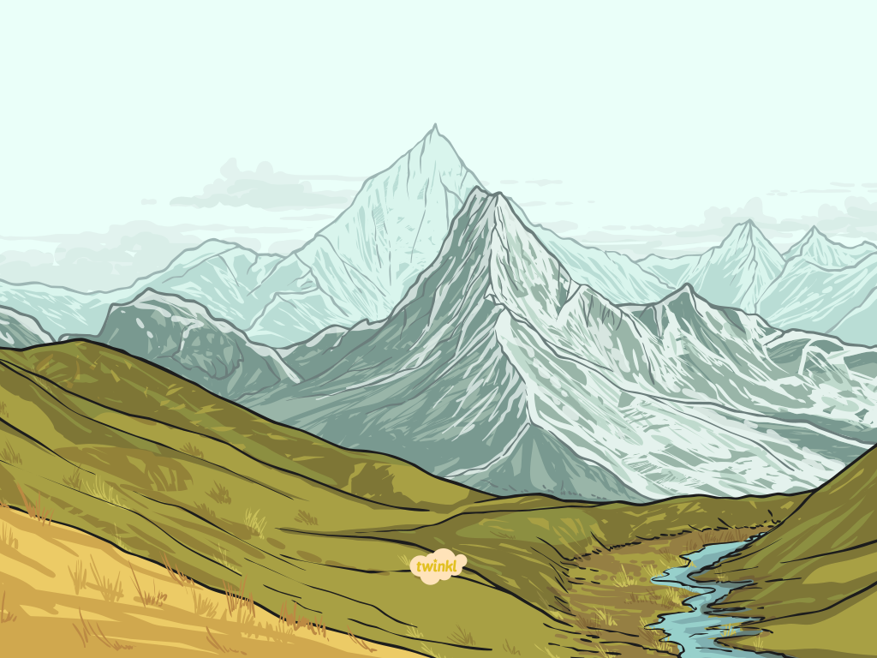
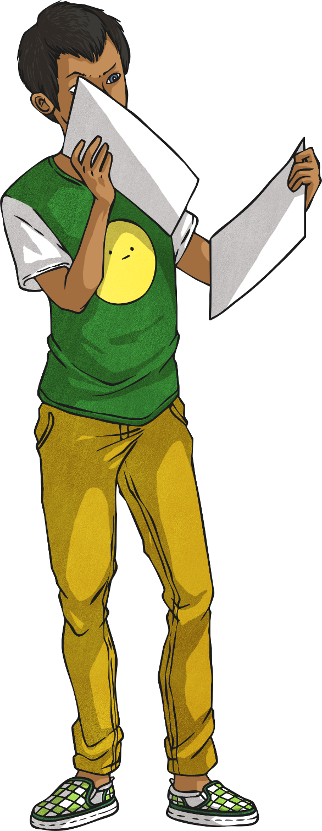
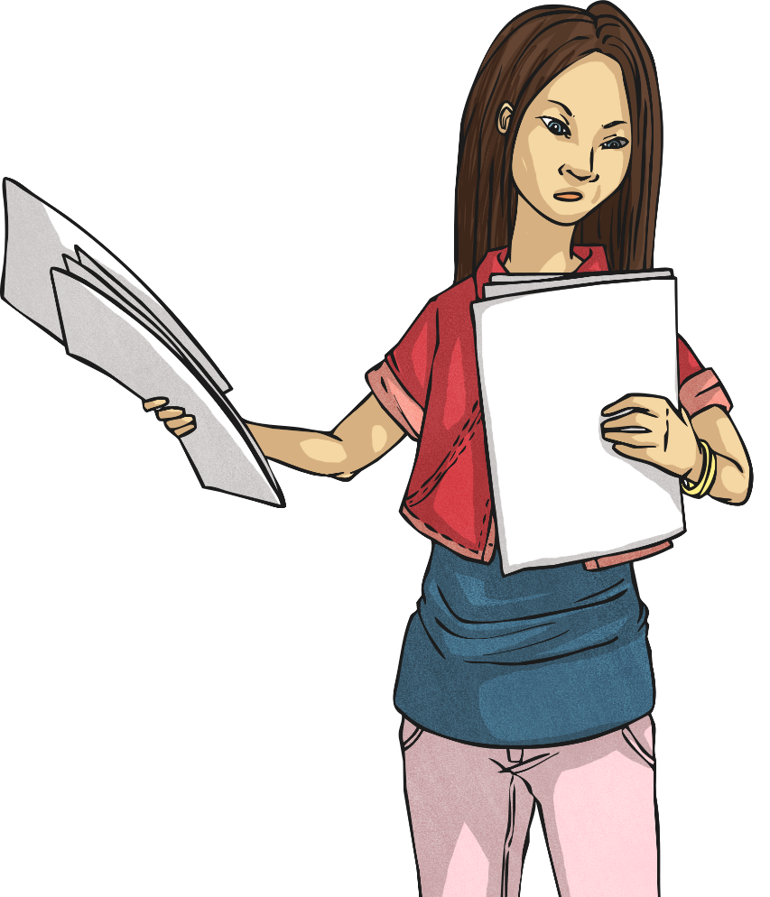
Les jours de la semaine (Days of the Week)

Slide 3
Aim
I can recognise, say and respond to a set of vocabulary.
Success Criteria
I can listen carefully to a set of vocabulary.
I can understand, say and order the days of the week.

Slide 4
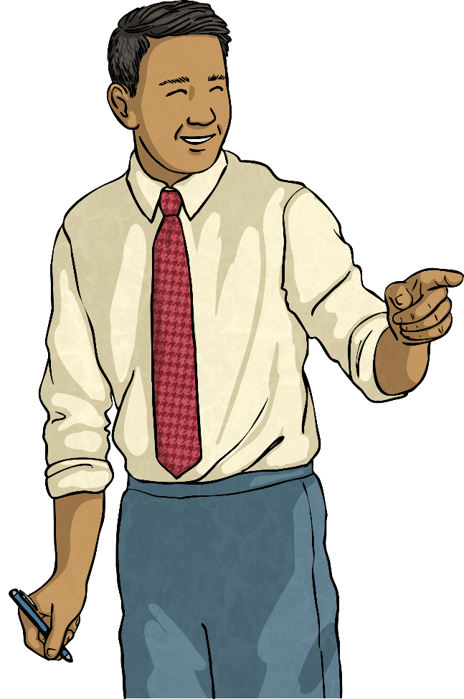
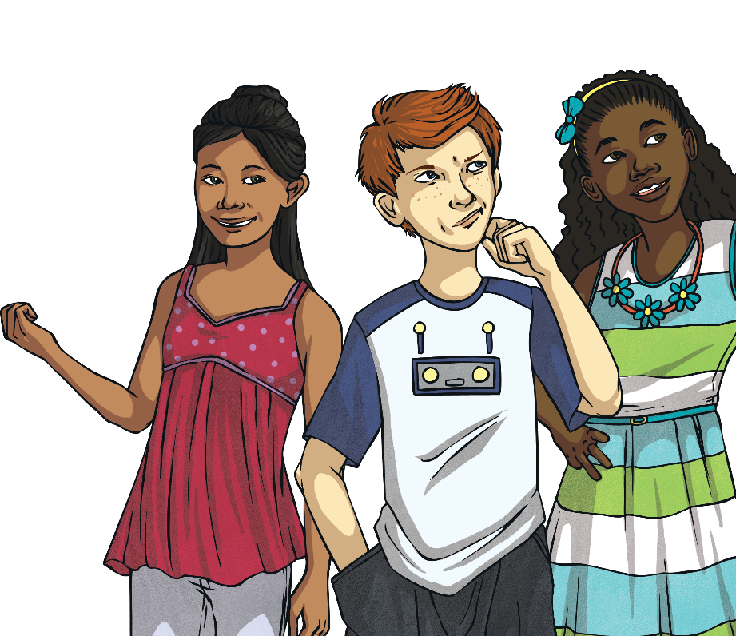
Number Fun!
quatorze !
Can you remember the numbers 0-31?
deux ?
How many days in a fortnight?
trente-et-un ?

Slide 5
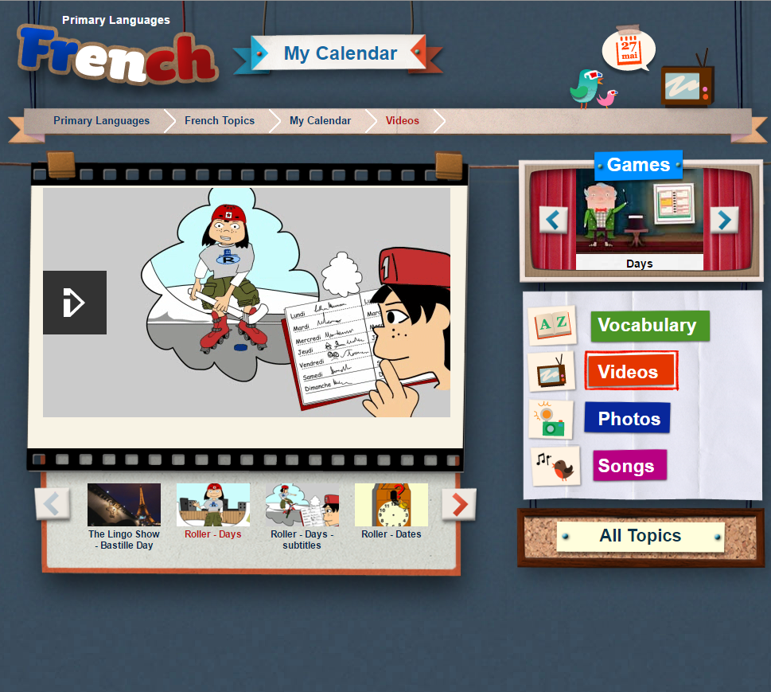
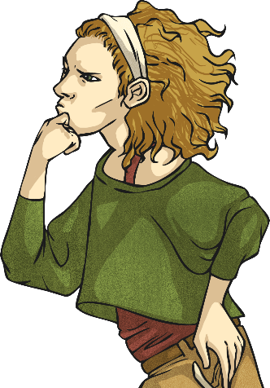
C’est quel jour ? (What Day Is It?)
Listen to Roller going through his sports diary for each day. What does he like doing?

Slide 6
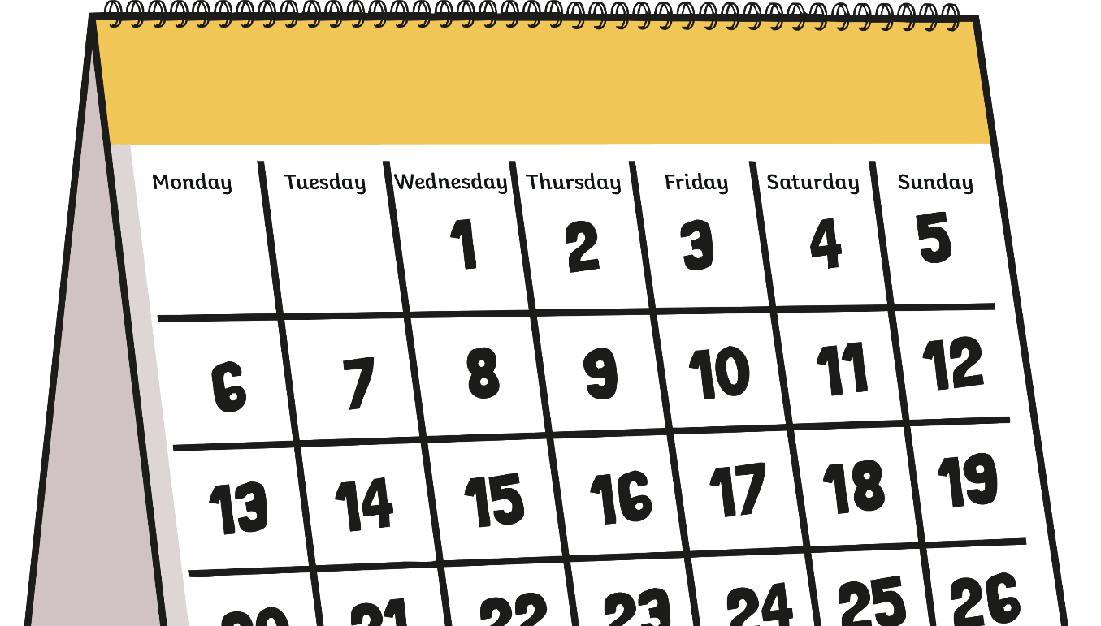
C’est quel jour ? (What Day Is It?)
C’est quel jour ?
C’est lundi.

Slide 7
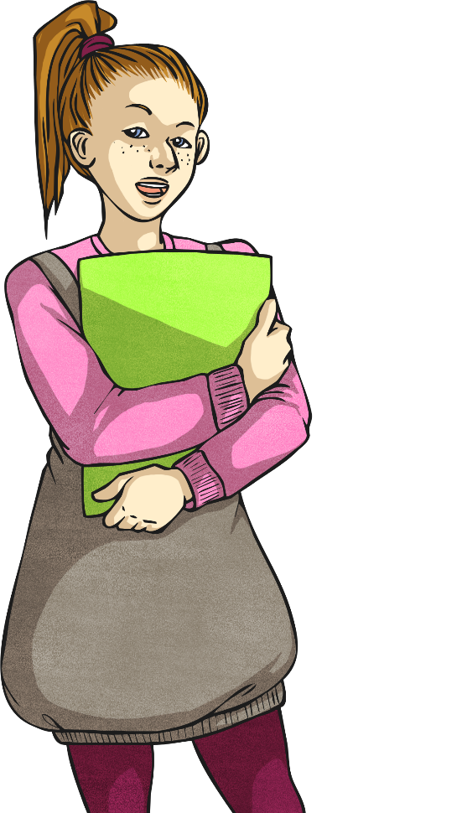
C’est quel jour ? (What Day Is It?)
C’est quel jour ?
C’est mardi.

Slide 8
C’est quel jour ? (What Day Is It?)
C’est quel jour ?
C’est mercredi.

Slide 9
C’est quel jour ? (What Day Is It?)
C’est quel jour ?
C’est jeudi.

Slide 10
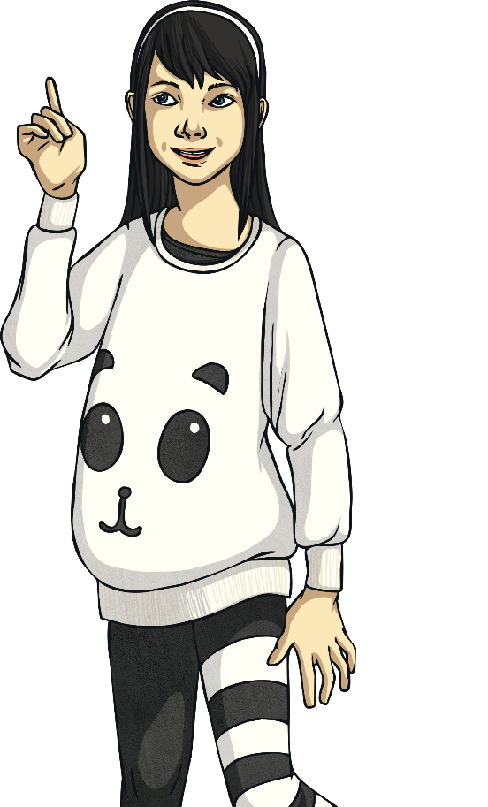
C’est quel jour ? (What Day Is It?)
C’est quel jour ?
C’est vendredi.

Slide 11
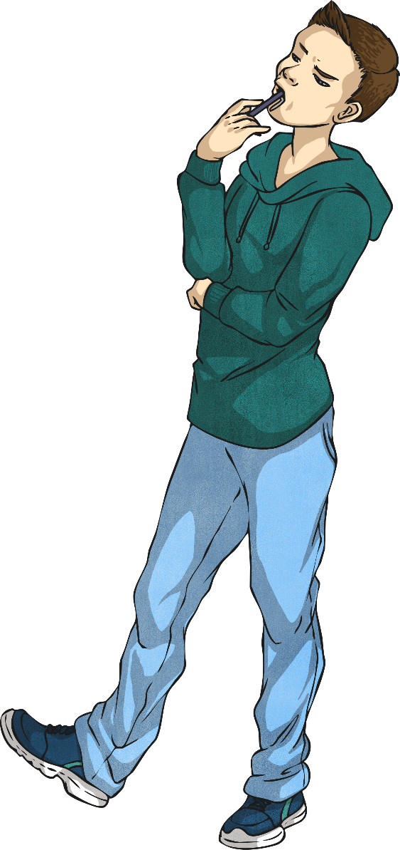
C’est quel jour ? (What Day Is It?)
C’est quel jour ?
C’est samedi.

Slide 12
C’est quel jour ? (What Day Is It?)
C’est quel jour ?
C’est dimanche.

Slide 13
C’est quel jour ? (What Day Is It?)
lundi
mardi
mercredi
jeudi
vendredi
samedi
dimanche

Slide 14
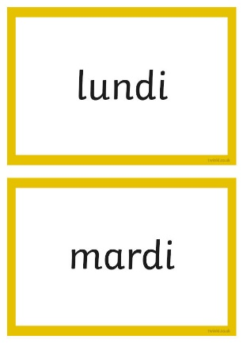
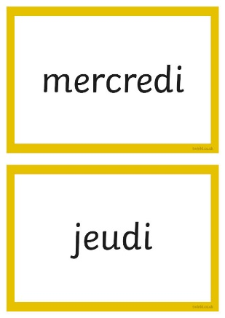
C’est quel jour ? (What Day Is It?)
Sing along with Roller!

Slide 15
What Can You Remember?
Click here to reveal the answers!
lundi
?
vendredi
?
samedi
?
?
Monday
Tuesday
?
mercredi
?
mardi
?
?
Sunday
Thursday
?
?
Saturday
dimanche
?
jeudi
?
?
Friday
?
Wednesday

Slide 16
La semaine (the week)
Qu’est-ce que c’est ?
C’est la semaine.

Slide 17
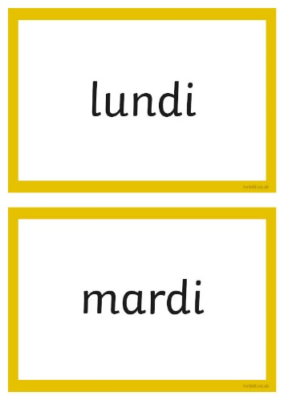
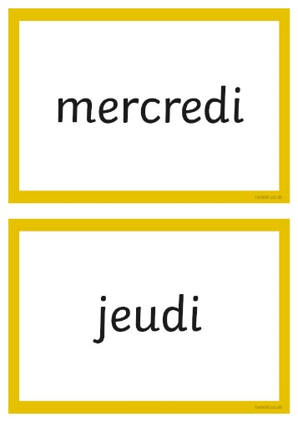
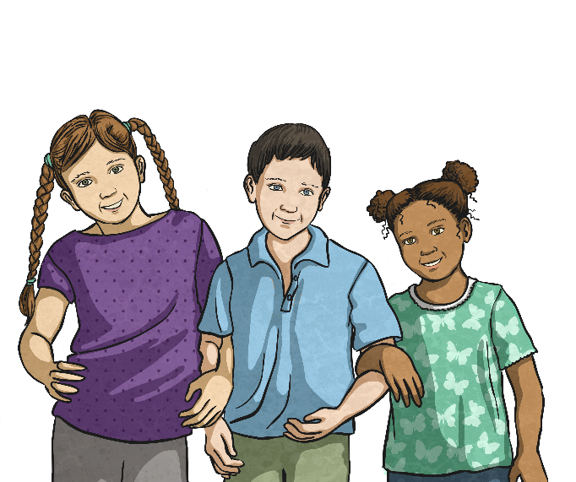
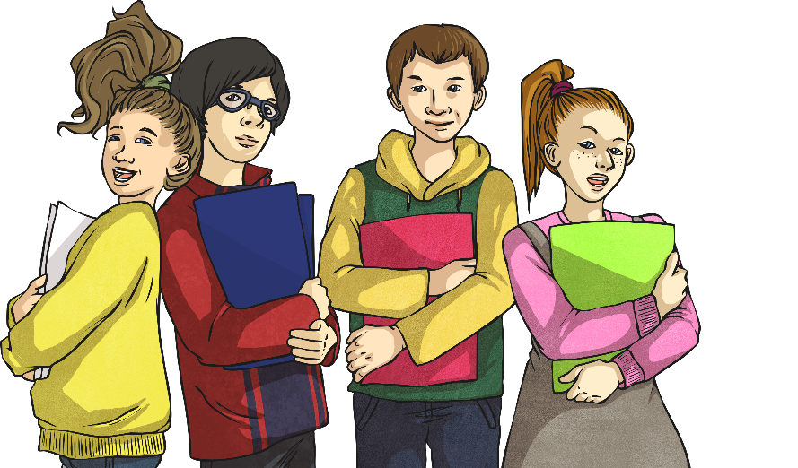
Faites la semaine (Make a Week)

Slide 18
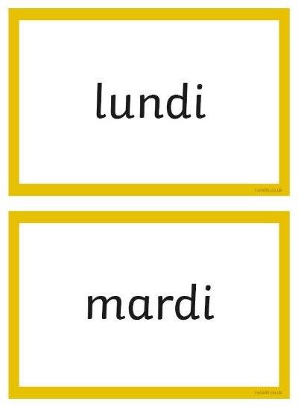
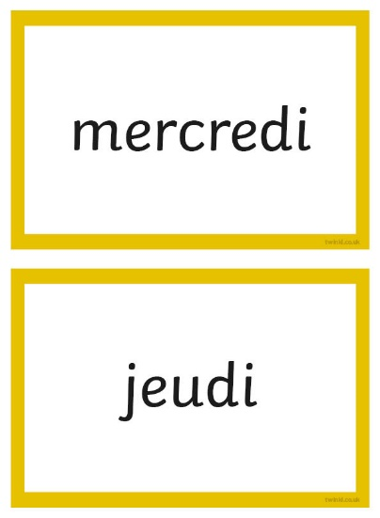
Changez de place ! (Swap Places!)

Slide 19
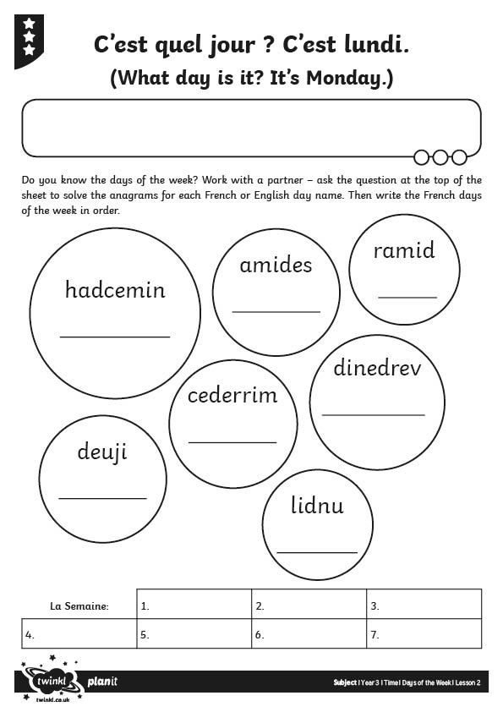
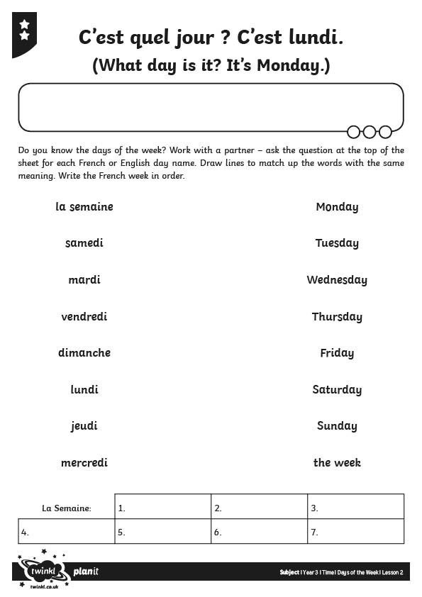
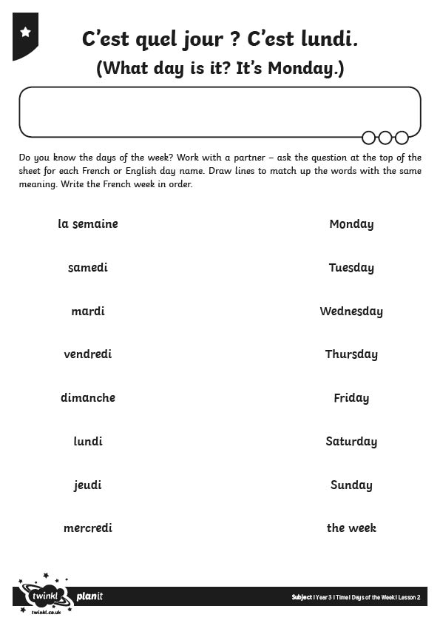
Allez-y! (Off You Go!)

Slide 20
Aim
I can recognise, say and respond to a set of vocabulary.
Success Criteria
I can listen carefully to a set of vocabulary.
I can understand, say and order the days of the week.

