Slide 1
French
Family and Friends
Year One
French | Year 3 | Family and Friends | How Do You Spell? | Lesson 5

Slide 3
Aim
I can use French pronunciation of the alphabet to spell words.
Success Criteria
I can say letters of the French alphabet with good pronunciation.
I can ask for and give spellings using the French alphabet.

Slide 4
What Can You Remember?
Click play buttons throughout to hear phrases and words.

Slide 5
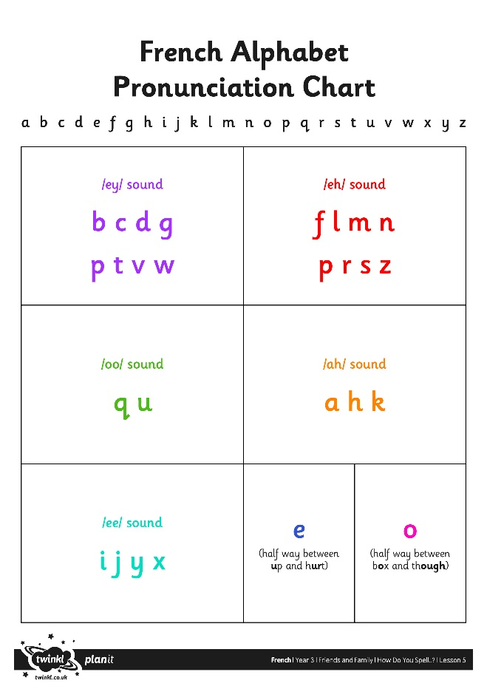
What Can You Remember?

Slide 6
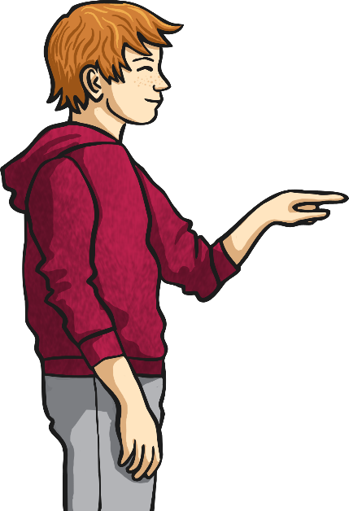
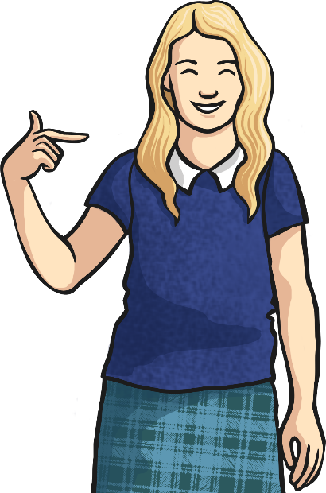
Comment T’Appelles-Tu?
What was he/she saying?
How do you know?
Comment t’appelles-tu?
What new word did we hear at the start of his/her name and surname?
What do you think it means?
Je m’appelle….

Slide 7
Comment T’Appelles-Tu?
Comment t’appelles-tu?
Can you spell out your own name using French pronunciation of the letters?
Have a go with your
talk partner.
Je m’appelle Shannon: es-majuscule, ash, ah, en, en oh, en.

Slide 8
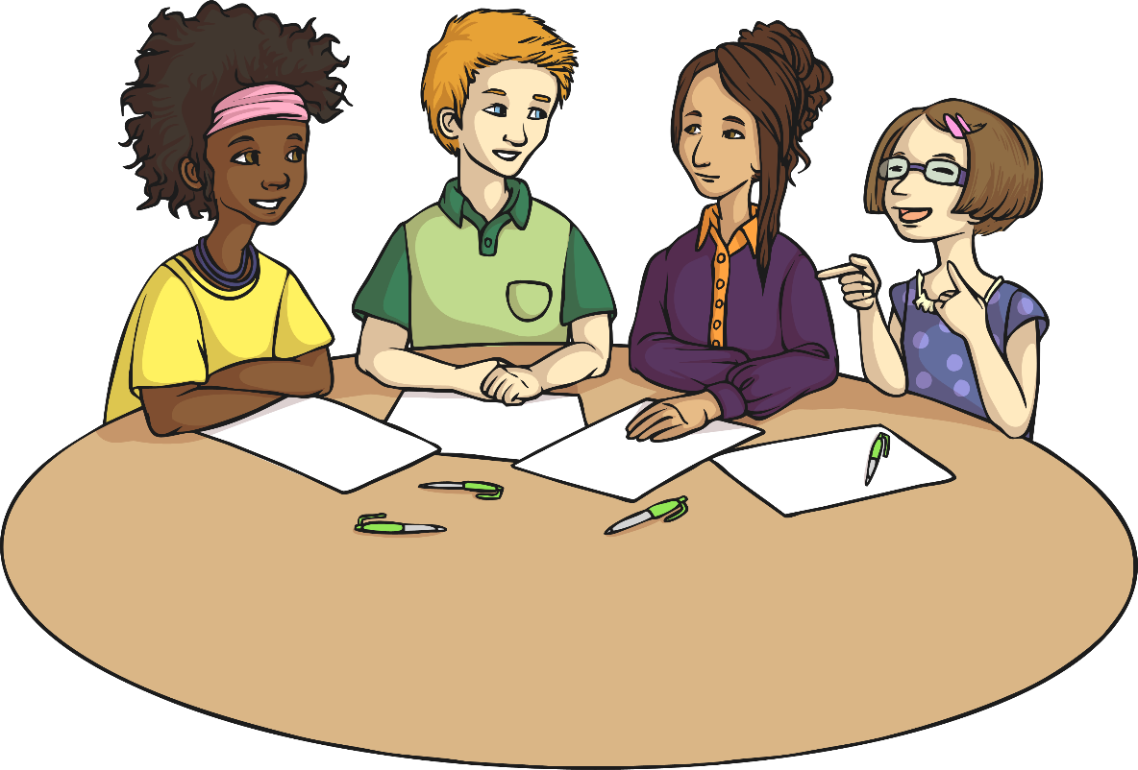
Our Names
Practise spelling out your names around your group.
Etienne
Nicole
Brigitte
Karen
Je m’appelle Karen: kah-majuscule, ah, aer, euh, en.
Comment t’appelles-tu?

Slide 9
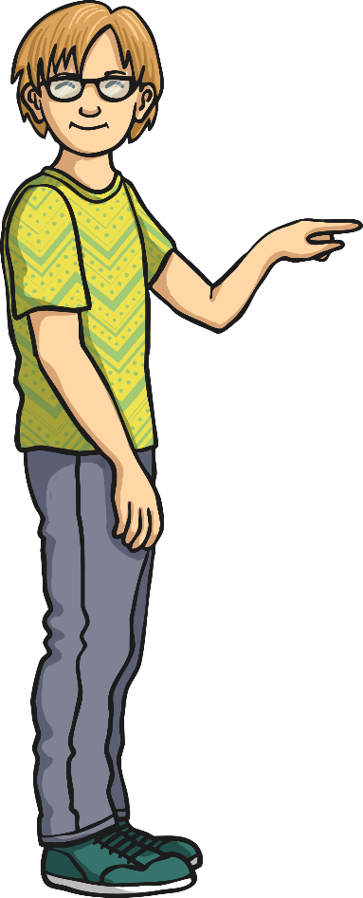
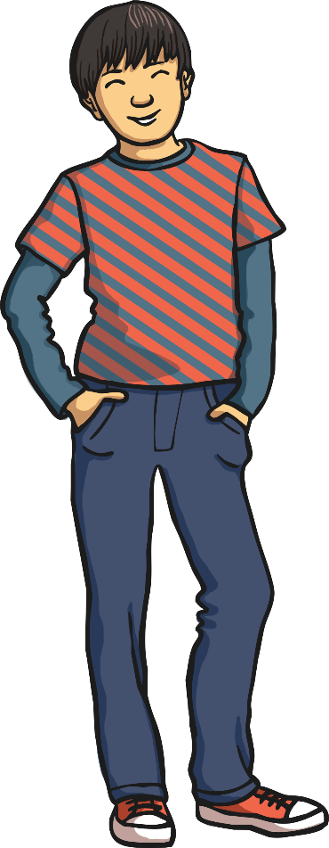
Double It Up
Il s’appelle Maddie. em-majuscule, ah, deh, deh, ee, euh.
Comment t’appelles-til?

Slide 10
What Question Do We Need?
What do you think the missing question means?
Comment
ça
s’écrit?
???
Je m’appelle Sayed: es-majuscule, ah, eegrek, euh, deh.

Slide 11
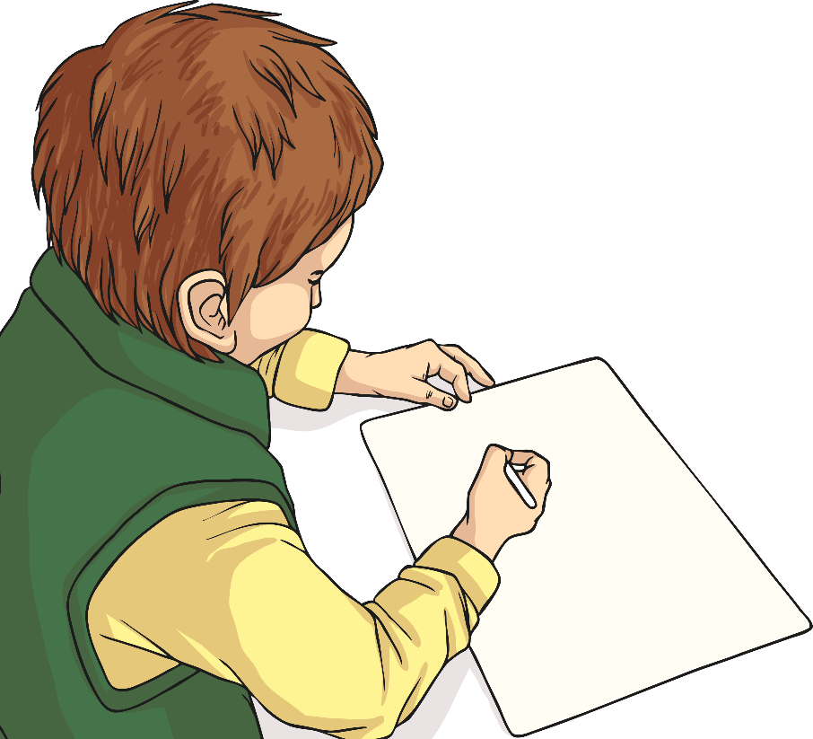
Allez-Y!
Ask your friends to spell out their name.
Comment ça s’écrit?
Listen carefully and write it down!

Slide 12
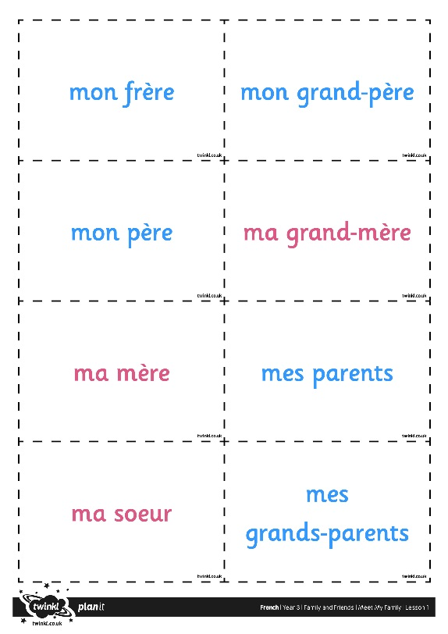
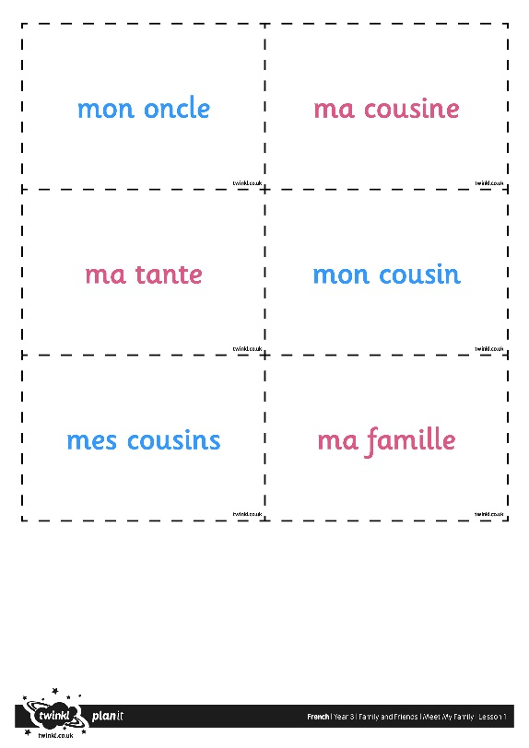
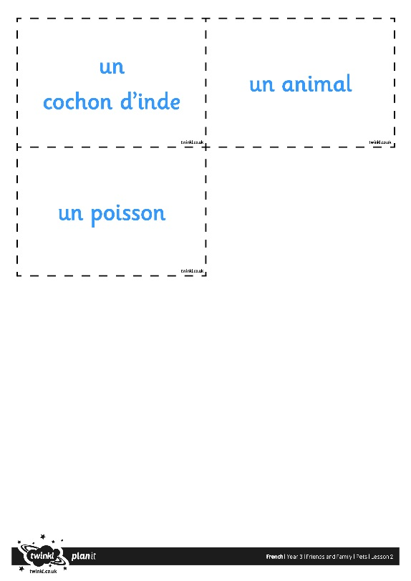
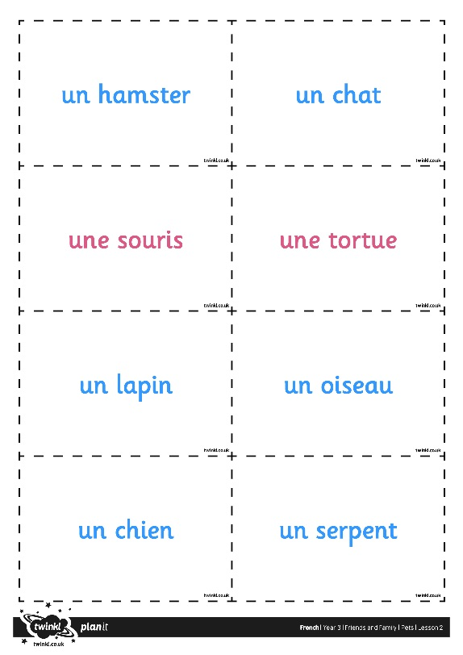
Allons Jouer! (Let’s Play a Game!)
Comment ça s’écrit?

Slide 13
Aim
I can use French pronunciation of the alphabet to spell words.
Success Criteria
I can say letters of the French alphabet with good pronunciation.
I can ask for and give spellings using the French alphabet.

