Slide 1
French
Our School
Year One
French | Year 3 | Our School | PE Lesson | Lesson 4

Slide 3
Aim
I can listen to commands and follow instructions.
Success Criteria
I can demonstrate my understanding of instructions in French.
I can follow instructions when I hear them.

Slide 4
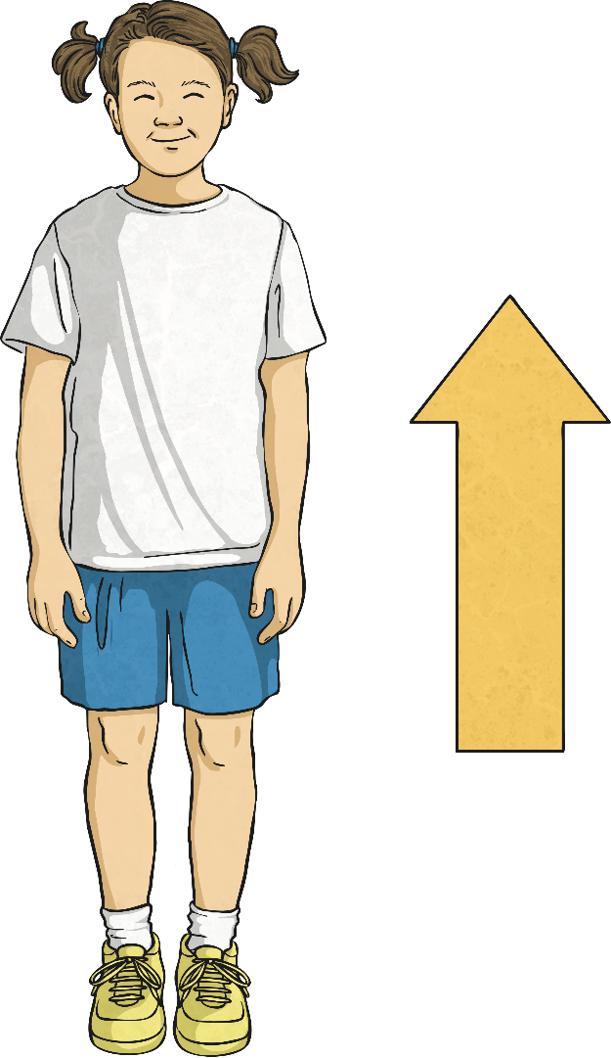
Levez-vous

Slide 5
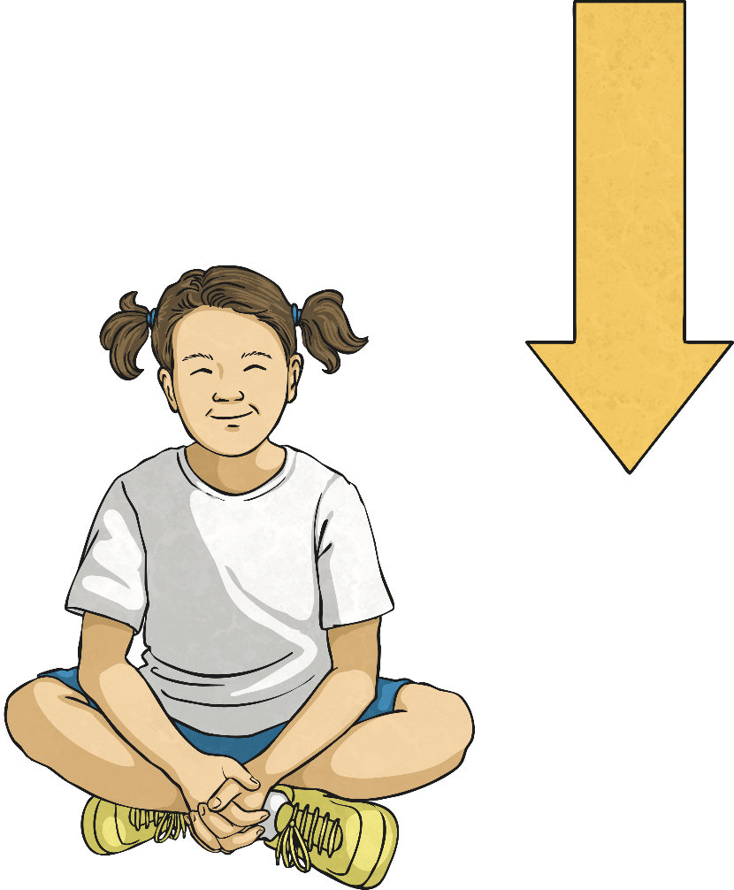
Asseyez-vous

Slide 6
Arrêtez

Slide 7
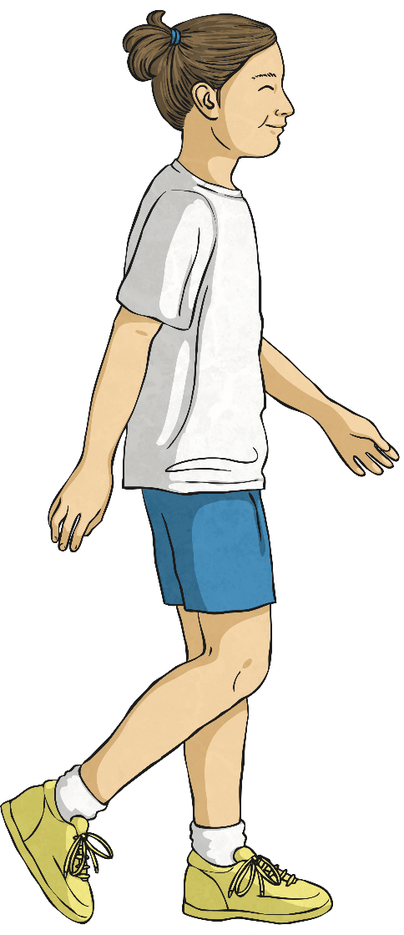
Marchez

Slide 8
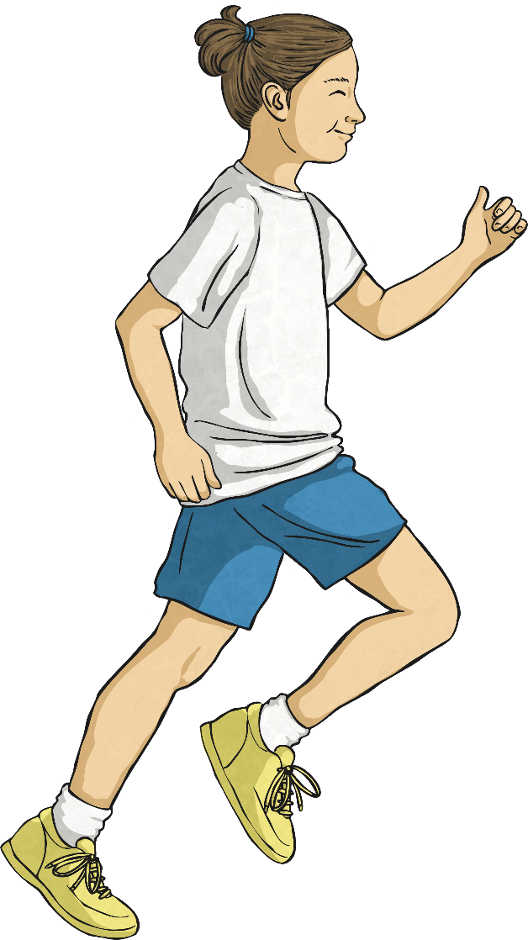
Courez

Slide 9
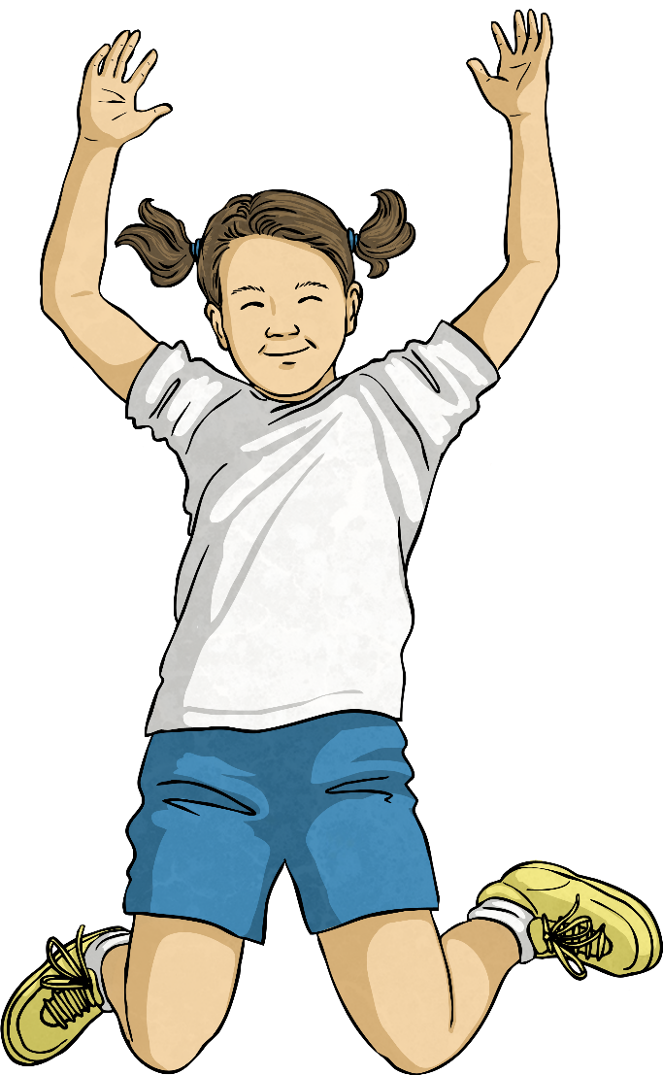
Sautez

Slide 10
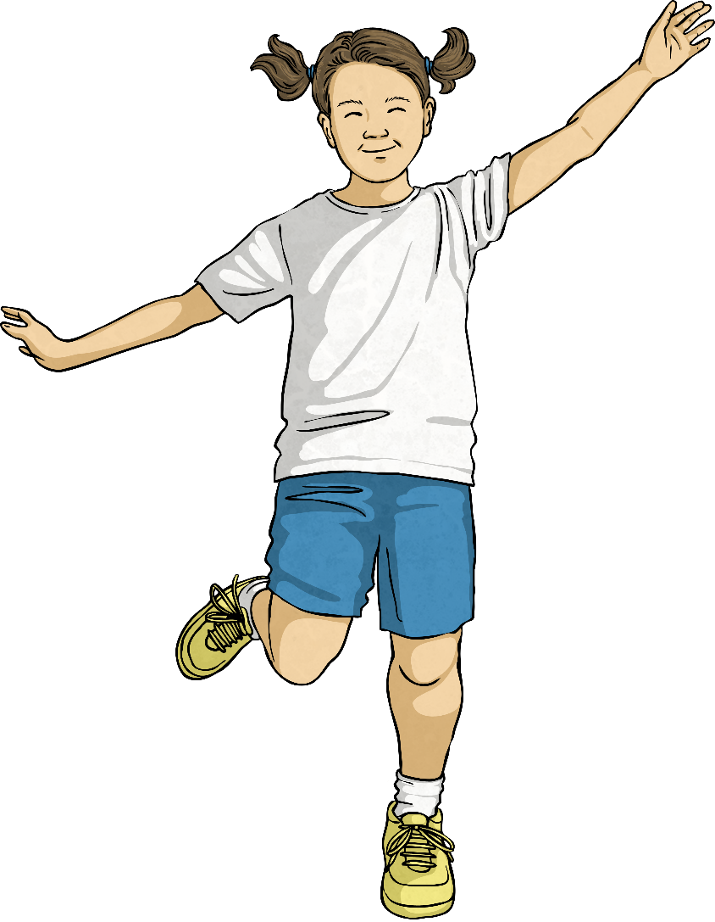
Sautez à cloche-pied

Slide 11
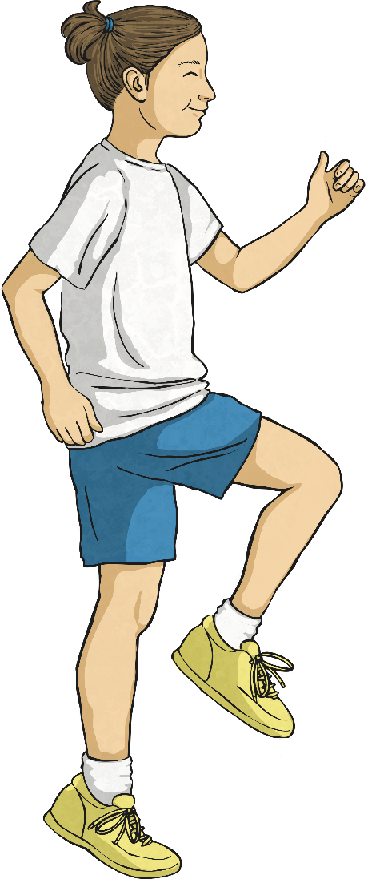
Courez sur place

Slide 12
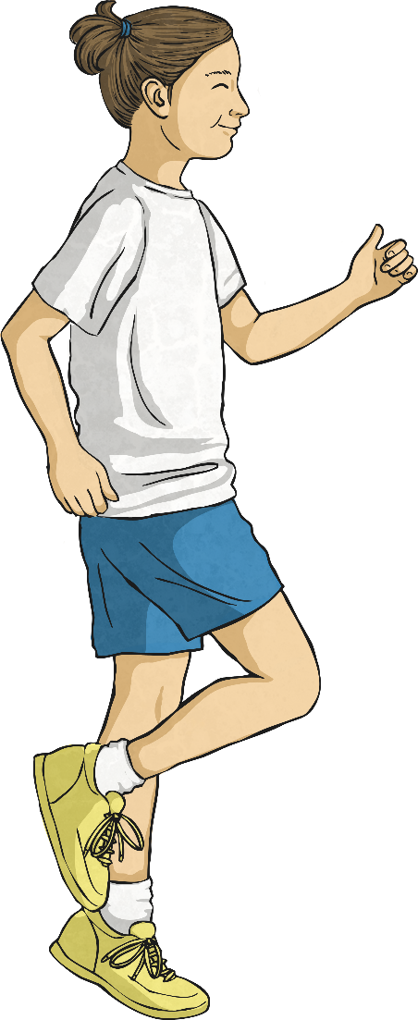
Sautillez

Slide 13
Aim
I can listen to commands and follow instructions.
Success Criteria
I can demonstrate my understanding of instructions in French.
I can follow instructions when I hear them.

