Slide 1
French
Getting to Know You
Year One
Subject | Year 3 | Getting to Know You | What’s Your Name? Lesson 2

Slide 3
Aim
To exchange names in French.
Success Criteria
I can introduce myself to someone else.
I can ask another person their name.
I can use gestures to support my conversation.

Slide 4
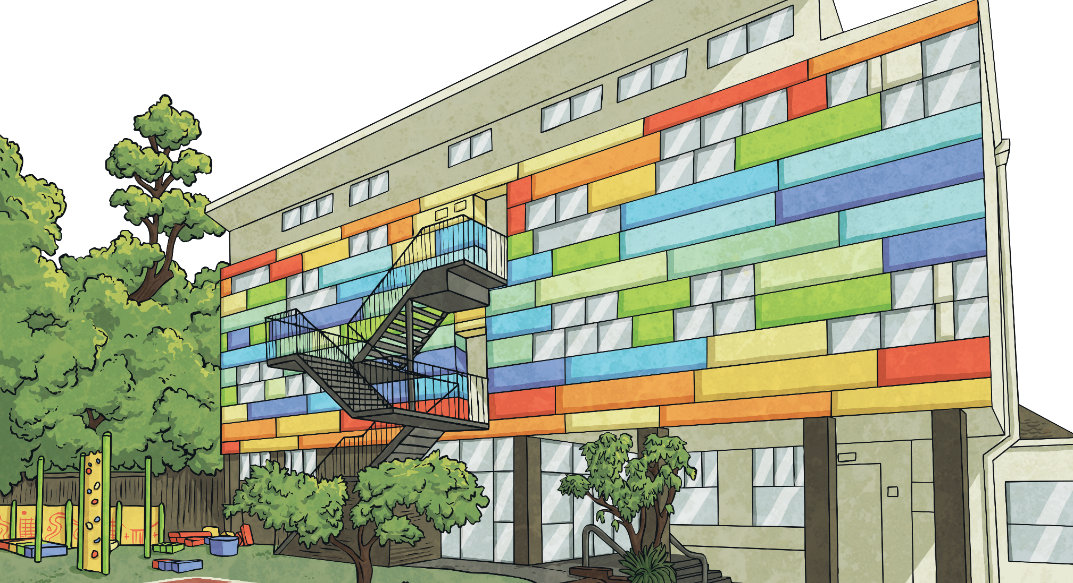
Asking Questions
There’s a new boy / girl in the school. What would you like to find out about him / her?
Talk in your group and think of questions you could ask.

Slide 5
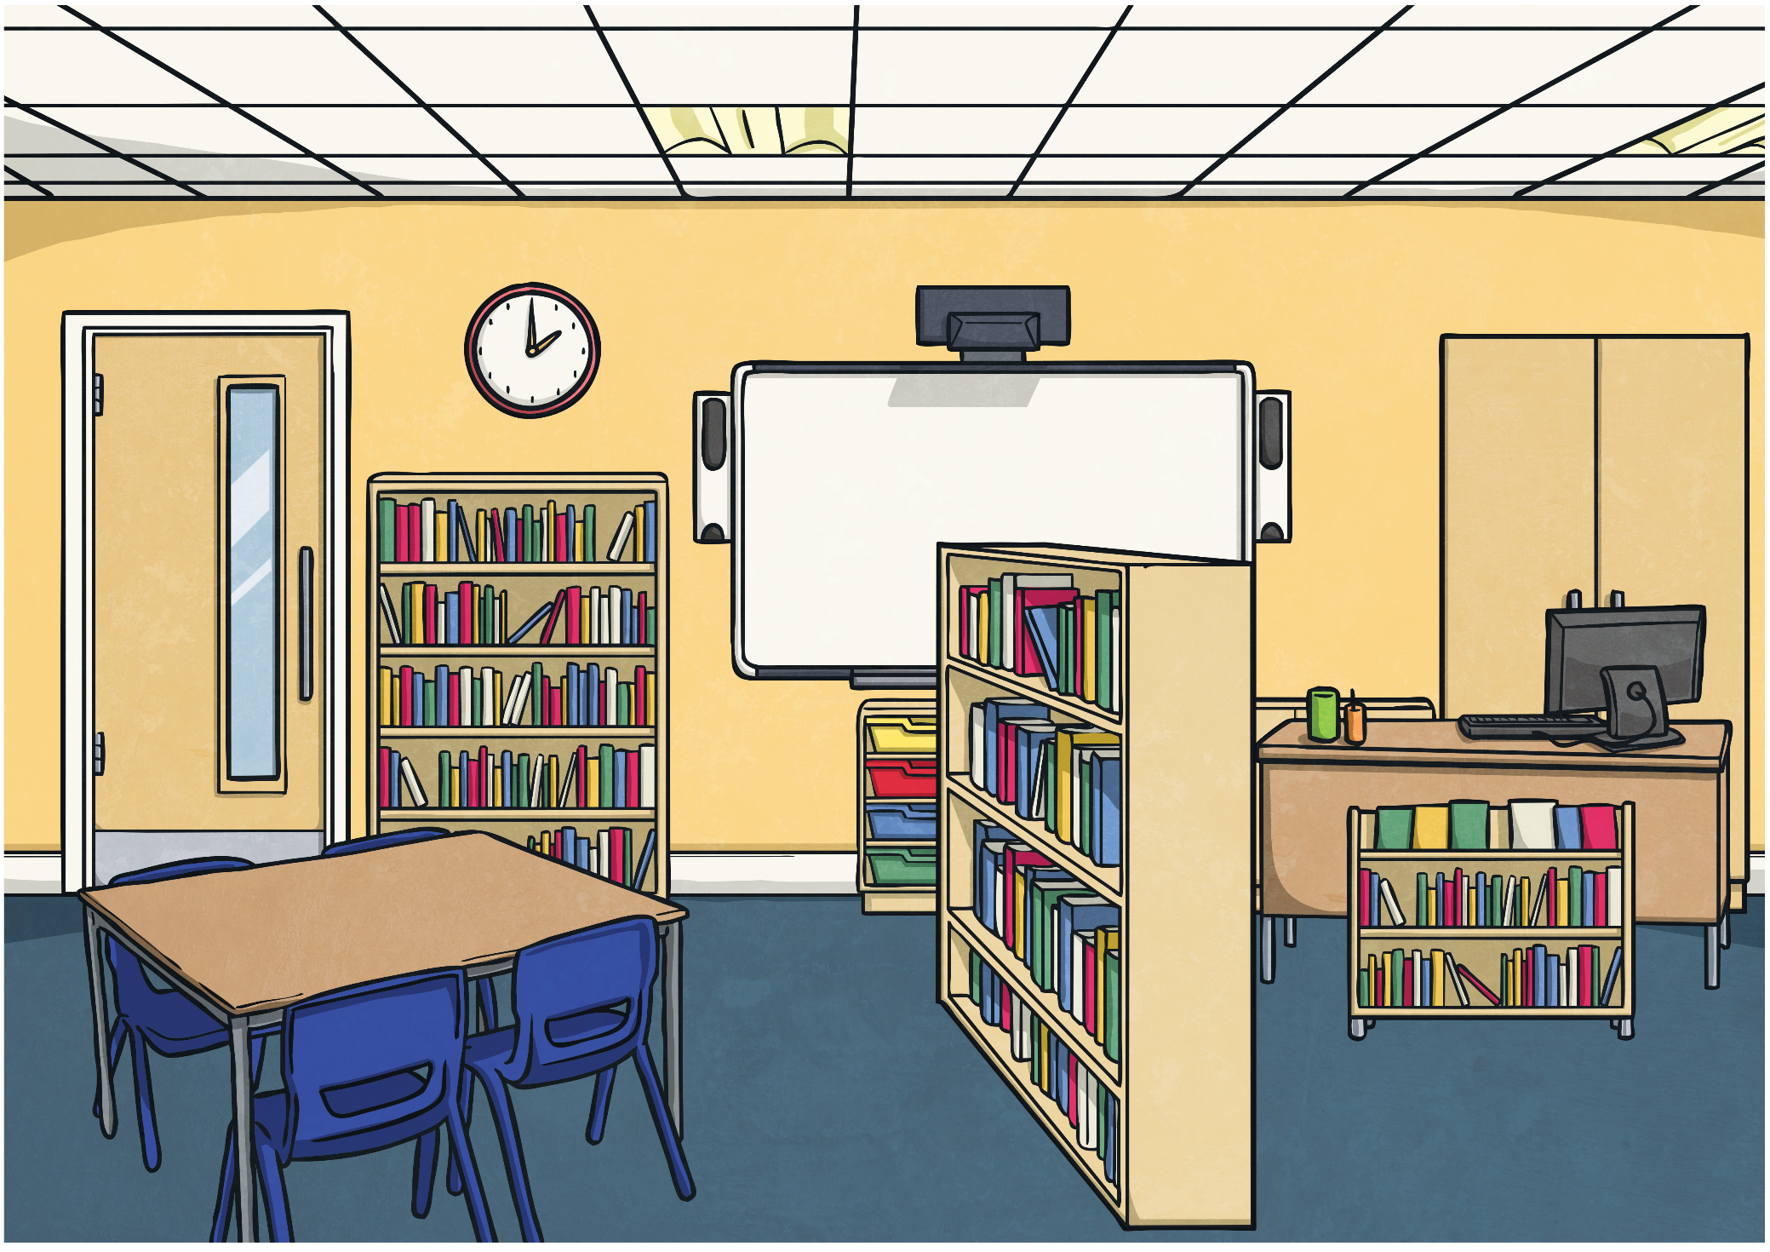
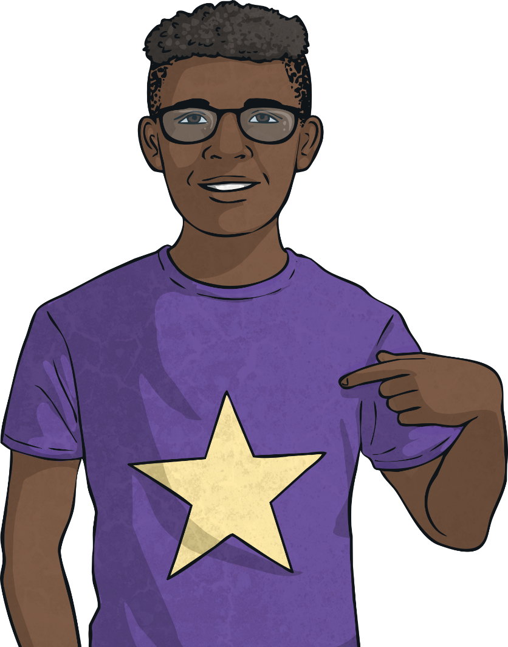
Click play buttons throughout to hear phrases and words.
Je m’appelle…
Bonjour!
Je m’appelle Luc

Slide 6
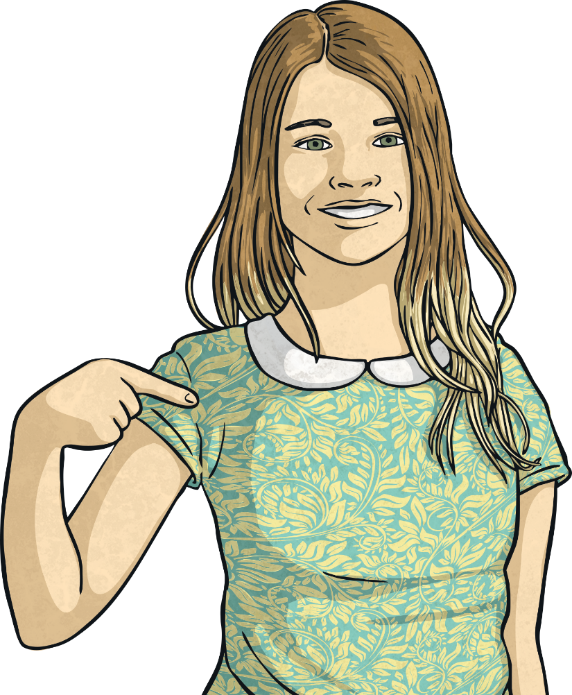
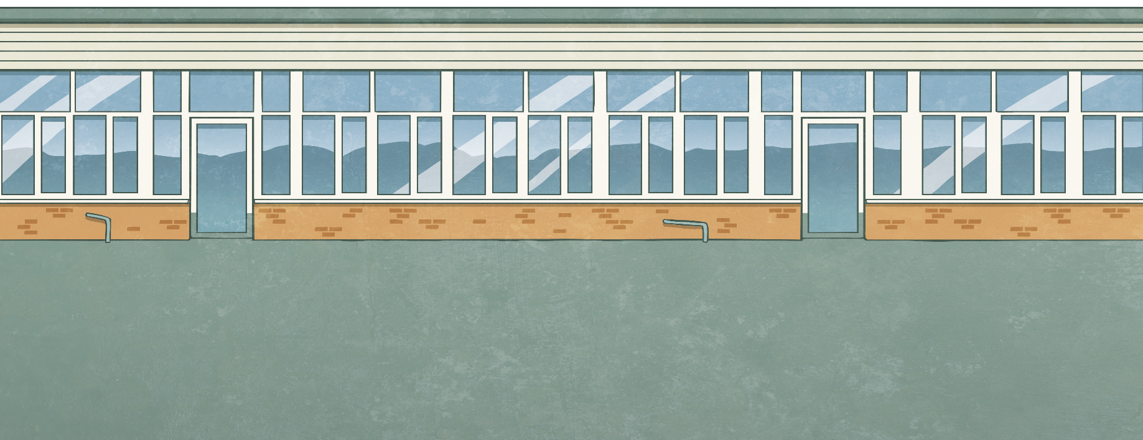
Je m’appelle…
Bonjour!
Je m’appelle Alliyah.

Slide 7
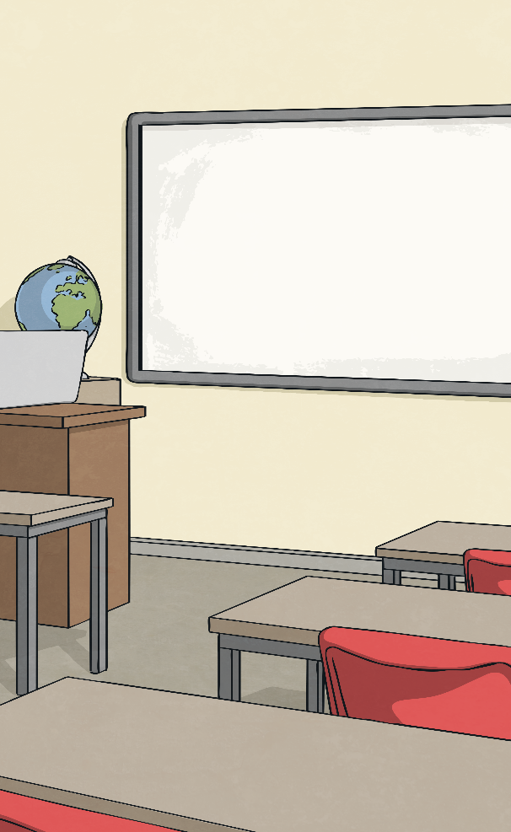
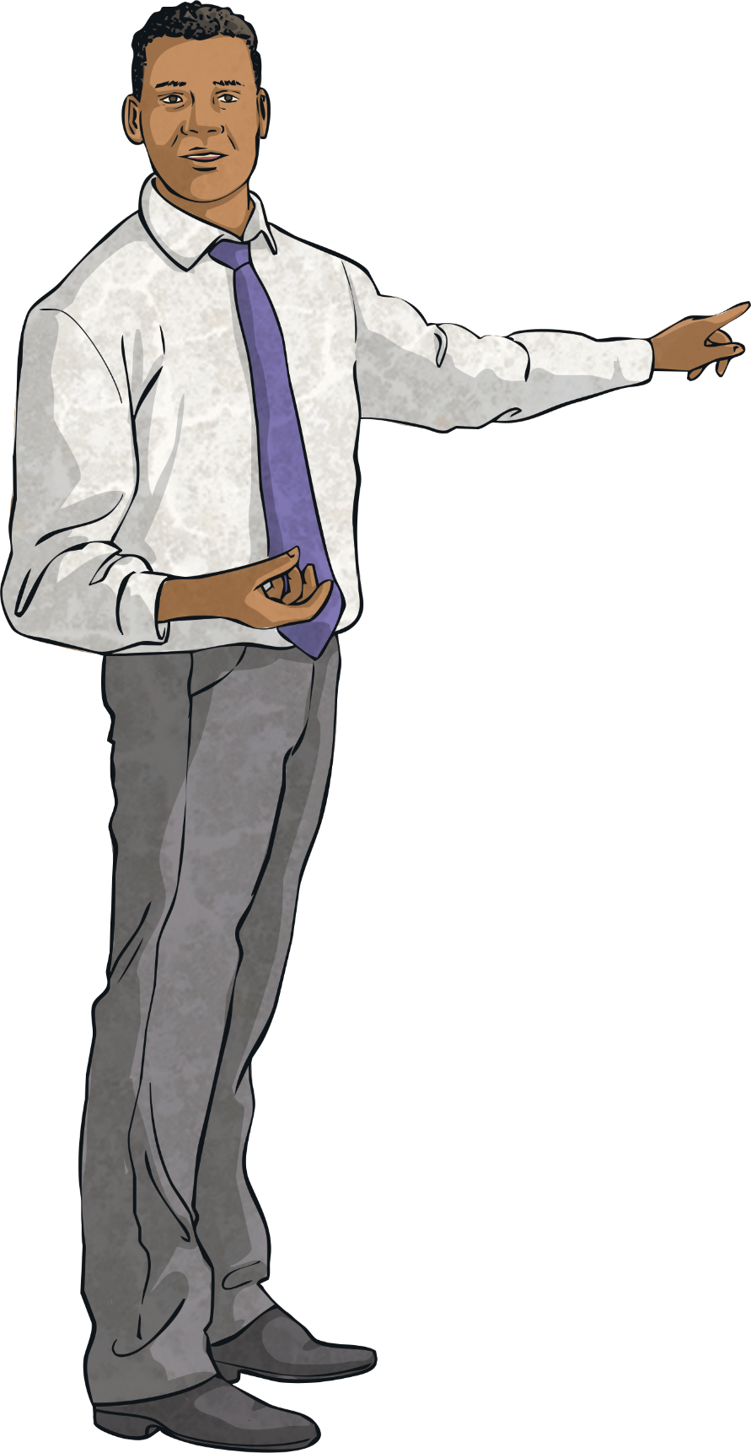
Saying Adults’ Names
Which words do you need for saying an adult’s name?
Je m’appelle Monsieur Durand.
Je m’appelle Mademoiselle Fleurot.
Je m’appelle Madame Cassou.

Slide 8
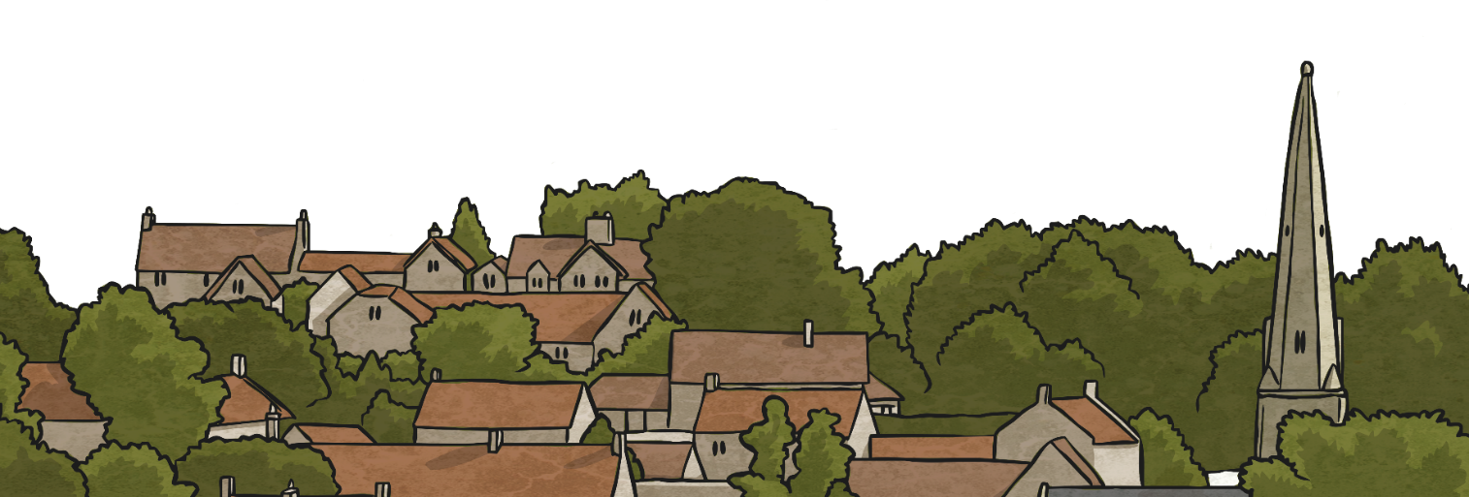
Madame
Je m’appelle Madame Cassou.

Slide 9
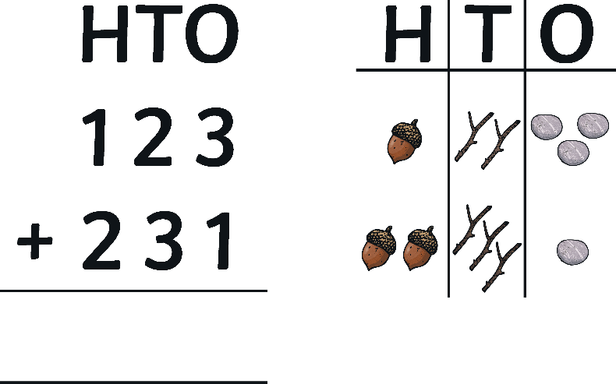
Monsieur
Je m’appelle Monsieur Durand.

Slide 10
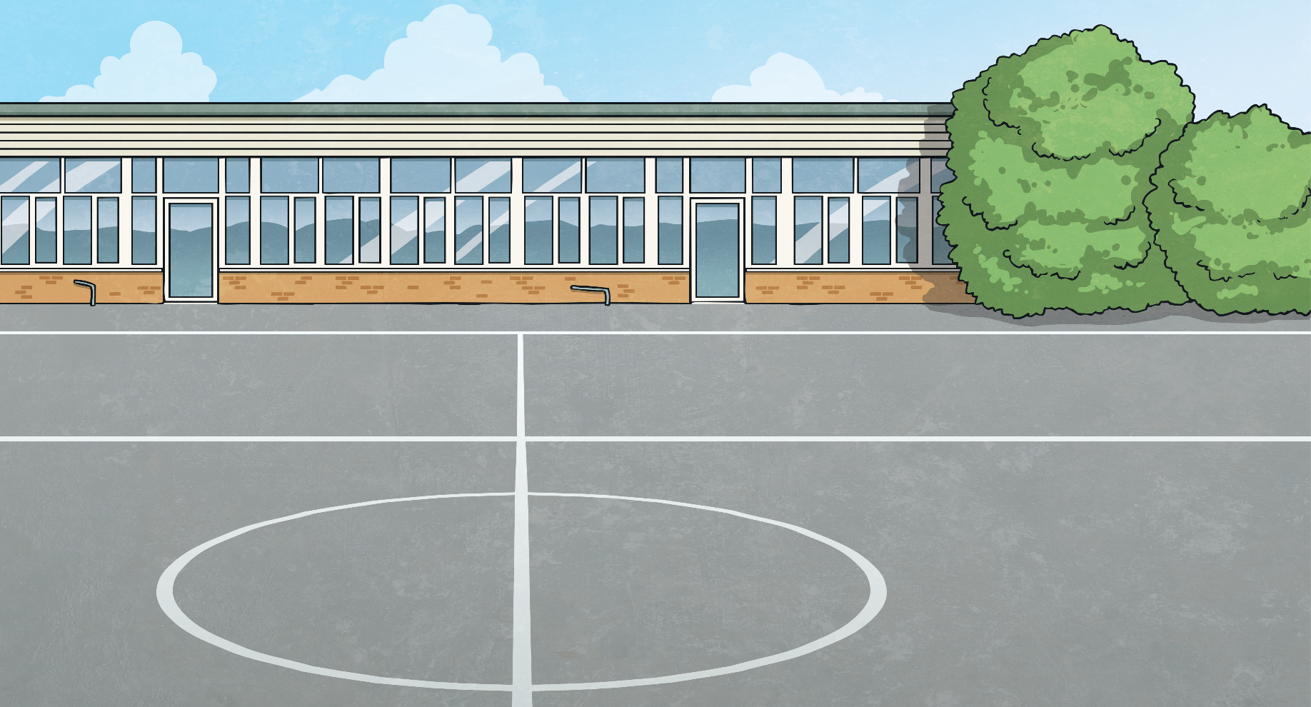
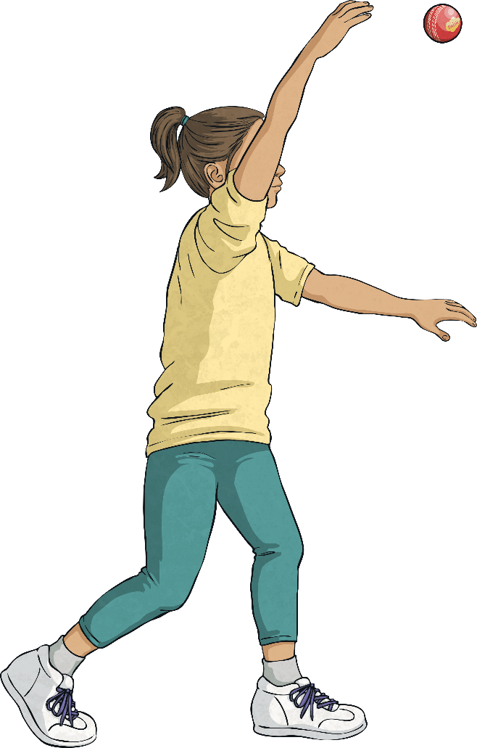
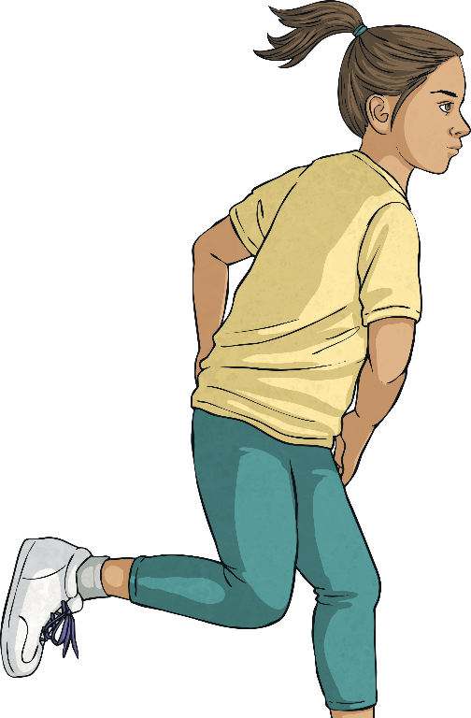
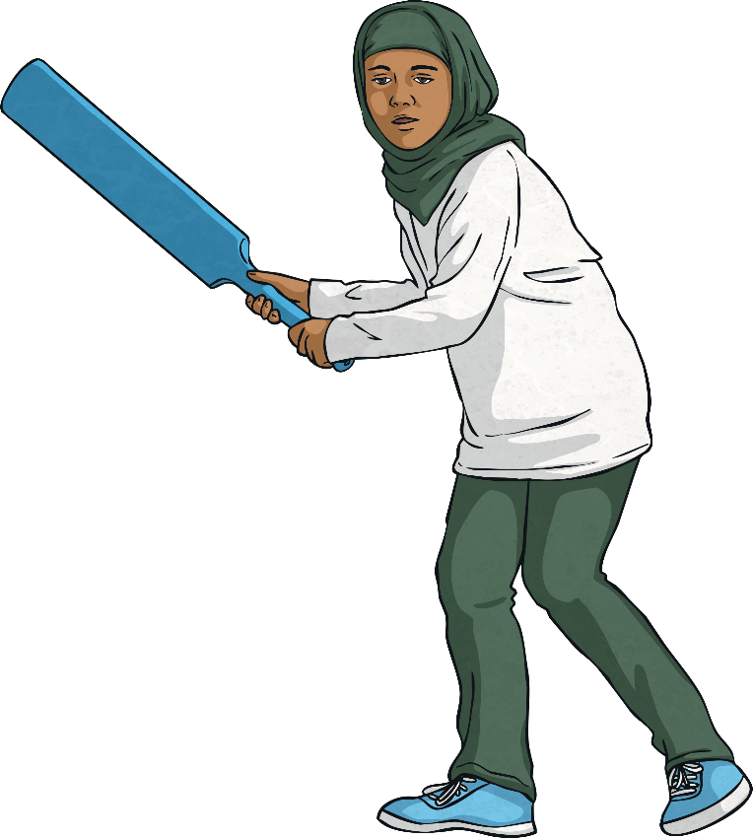
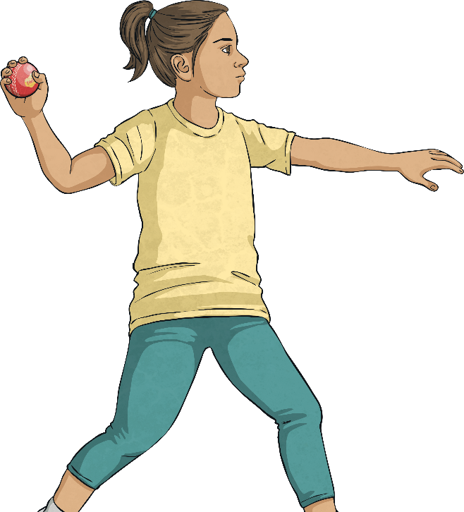
Mademoiselle
Je m’appelle Mademoiselle Fleurot.

Slide 11
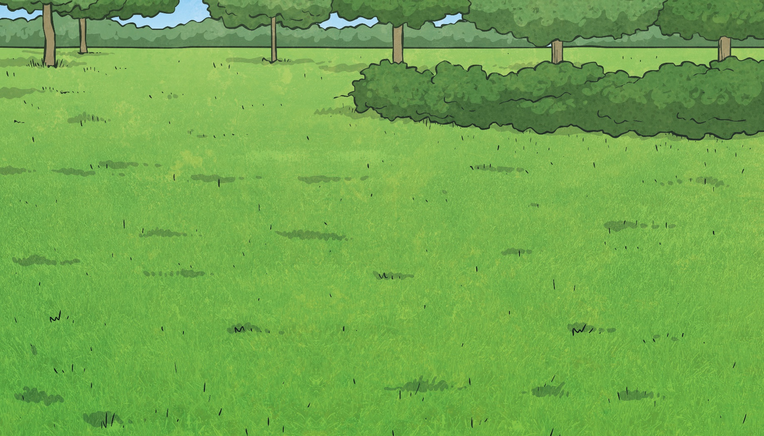
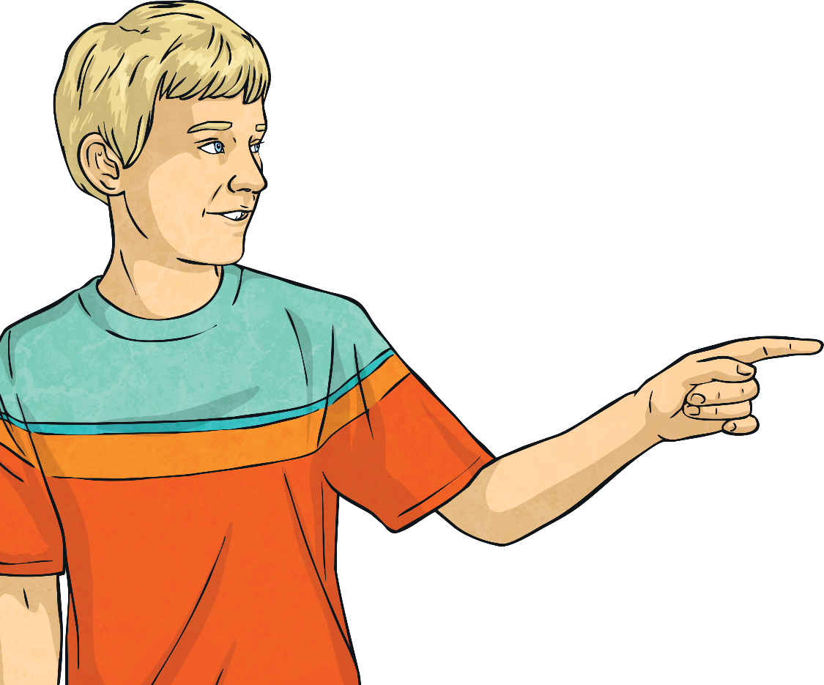
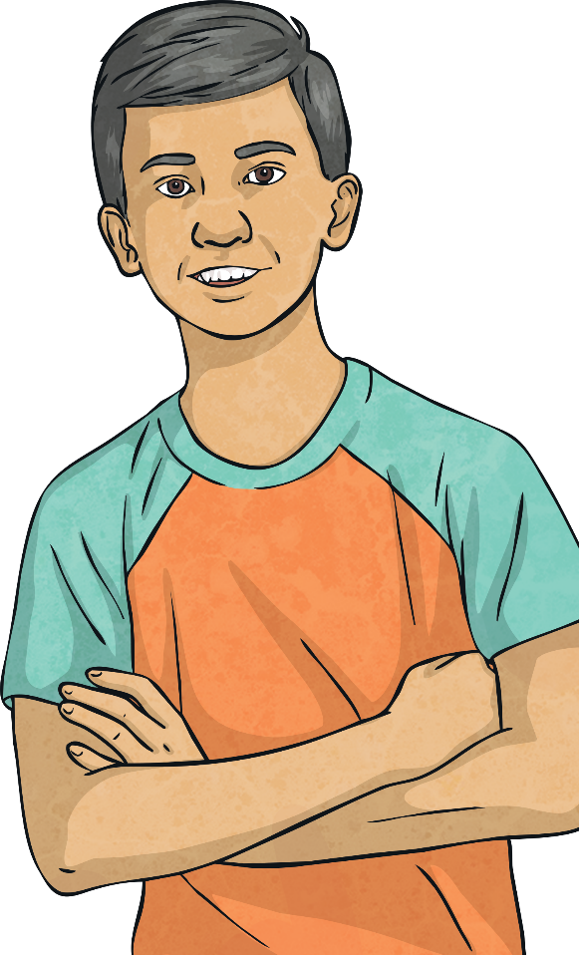
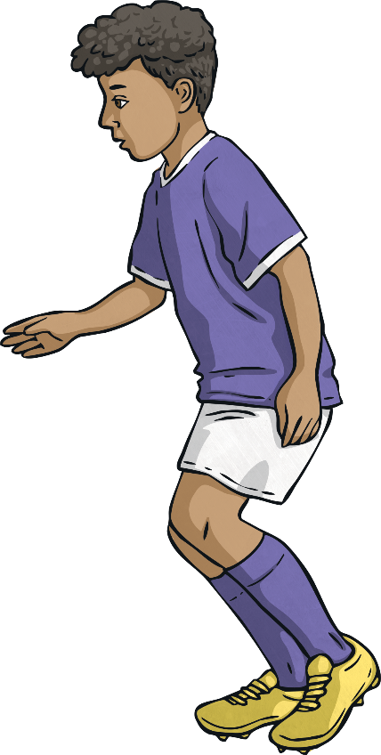
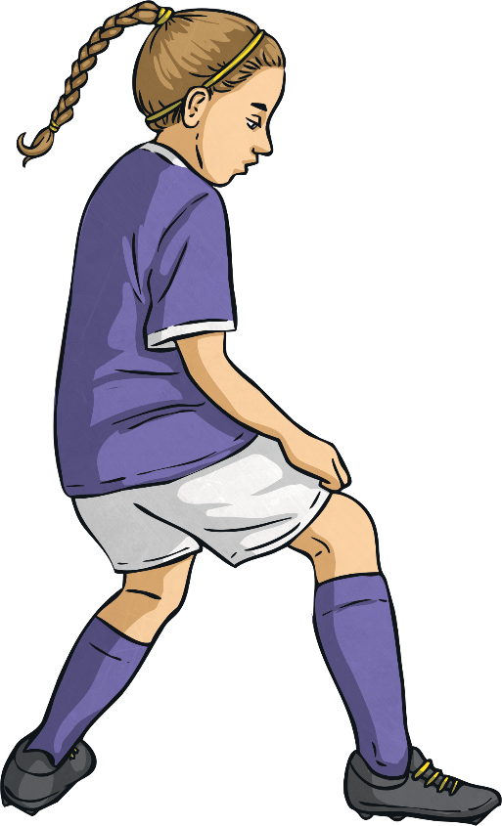
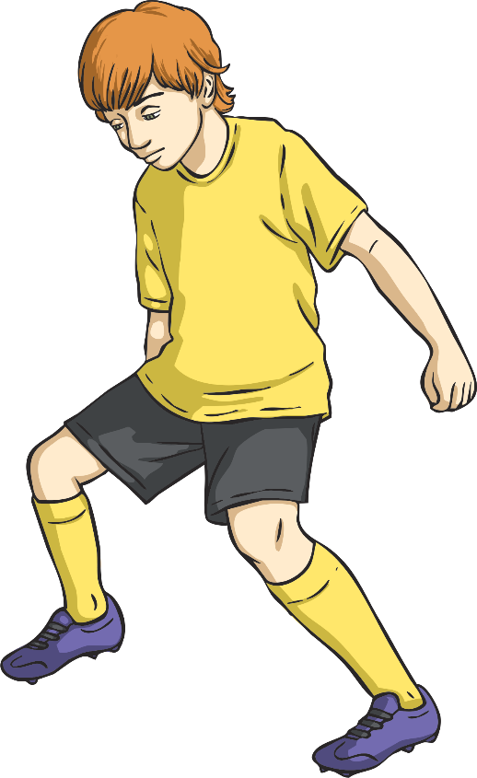
Introduce Yourself
Bonjour!
Je m’appelle John.
Bonjour!
Je m’appelle Rayyan.

Slide 12
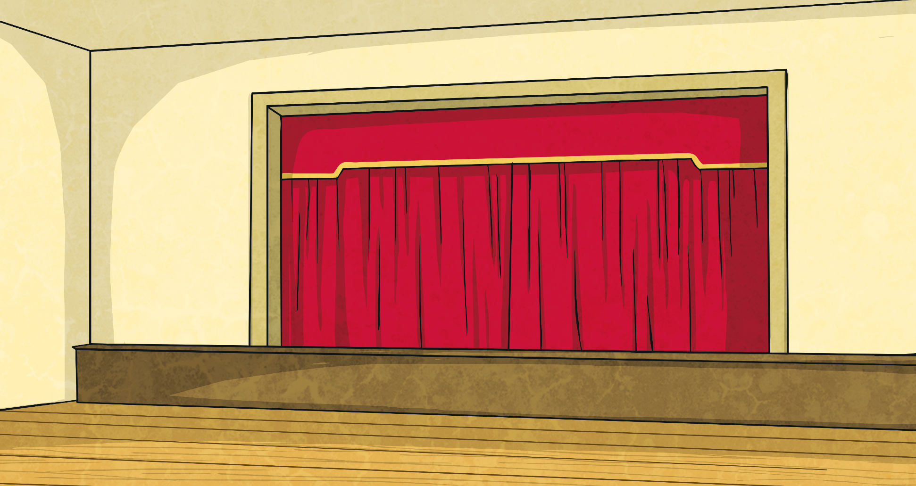
Comment t’appelles-tu?
Bonjour! Comment t’appelles-tu?
Je m’appelle Lucille.

Slide 13
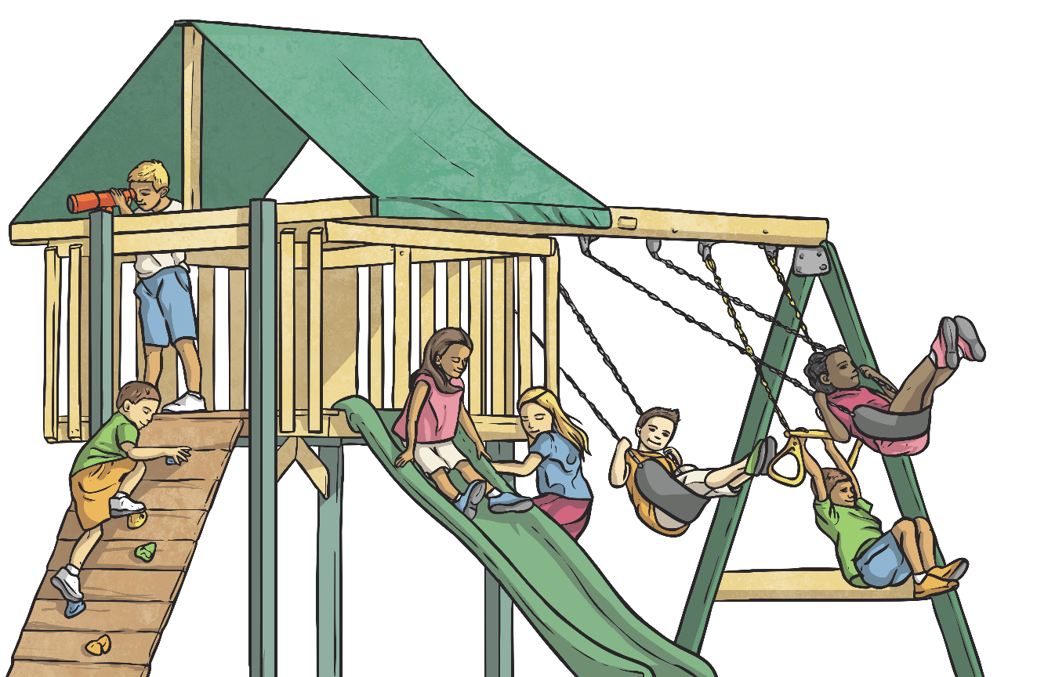
Comment t’appelles-tu?
Bonjour! Comment t’appelles-tu?
Je m’appelle Rayyan.

Slide 14
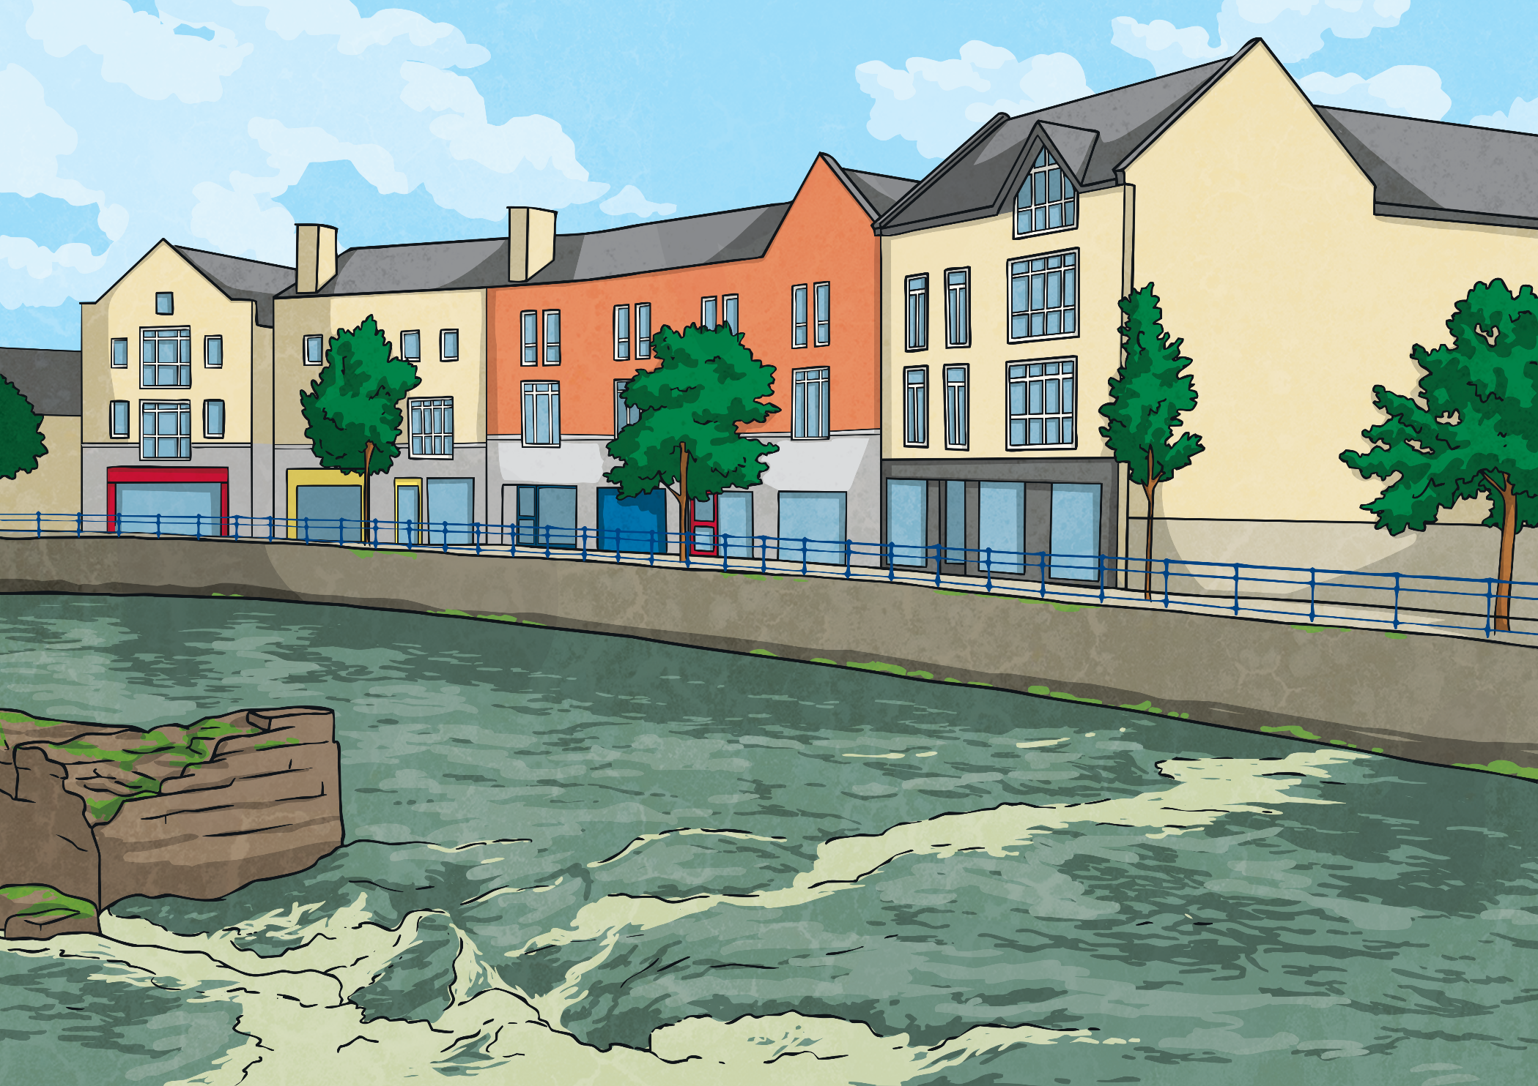
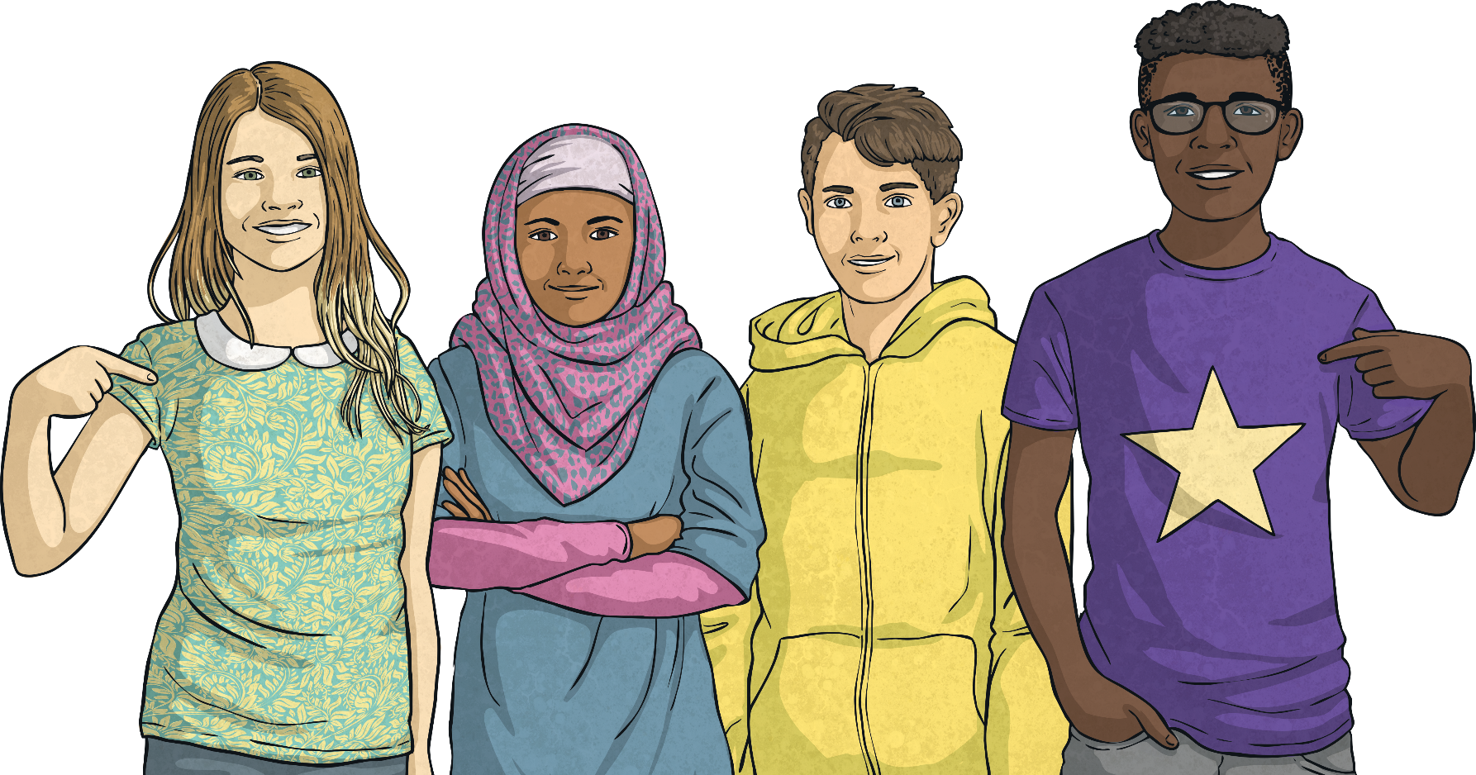
Meet and Greet Song
Listen carefully to the Meet and Greet Song.
Listen out for these phrases:
Comment t’appelles tu?
Monsieur
Mademoiselle
Je m’appelle…
Madame
Sing along when you have got the hang of it.

Slide 15
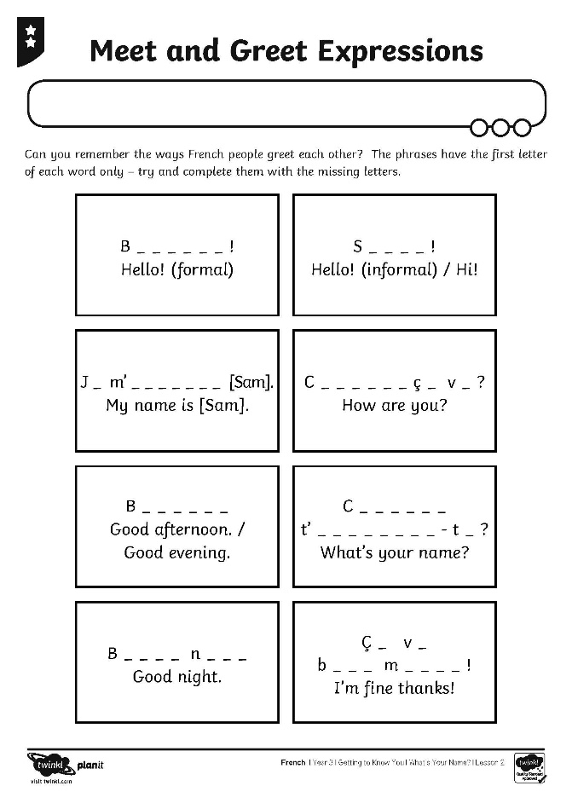
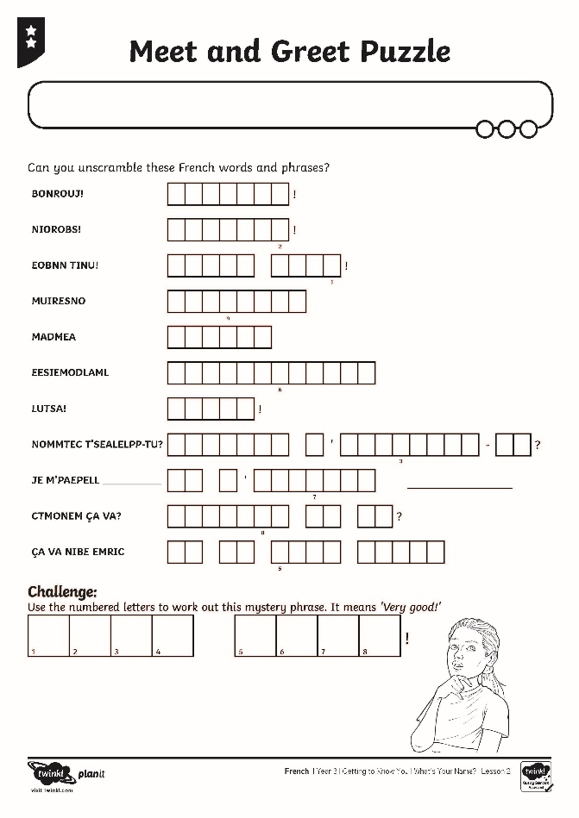
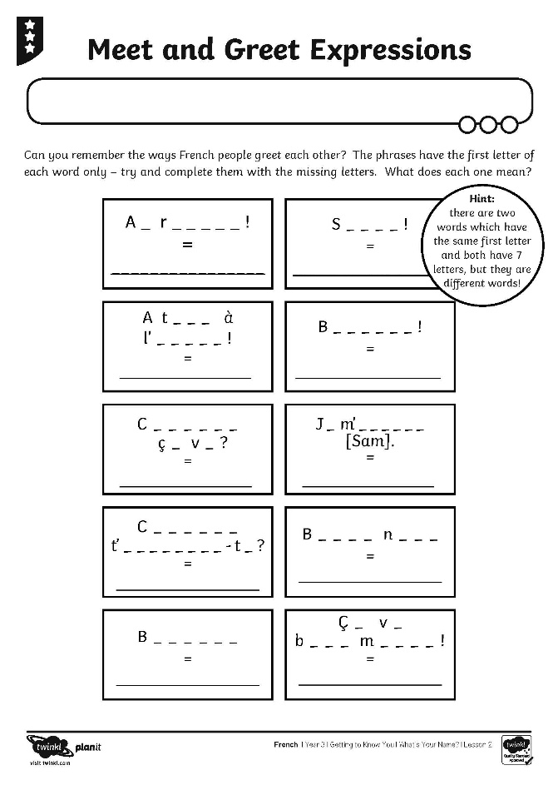
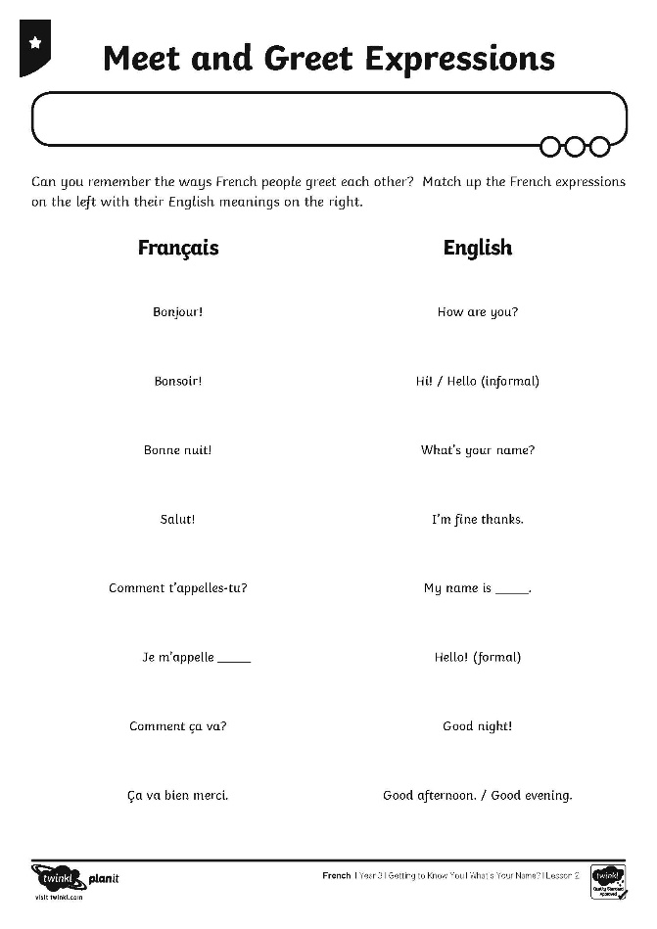
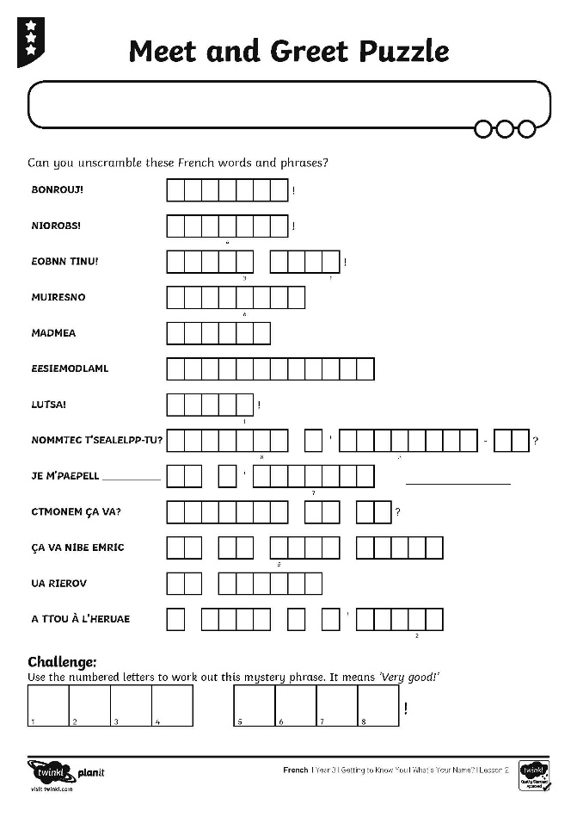
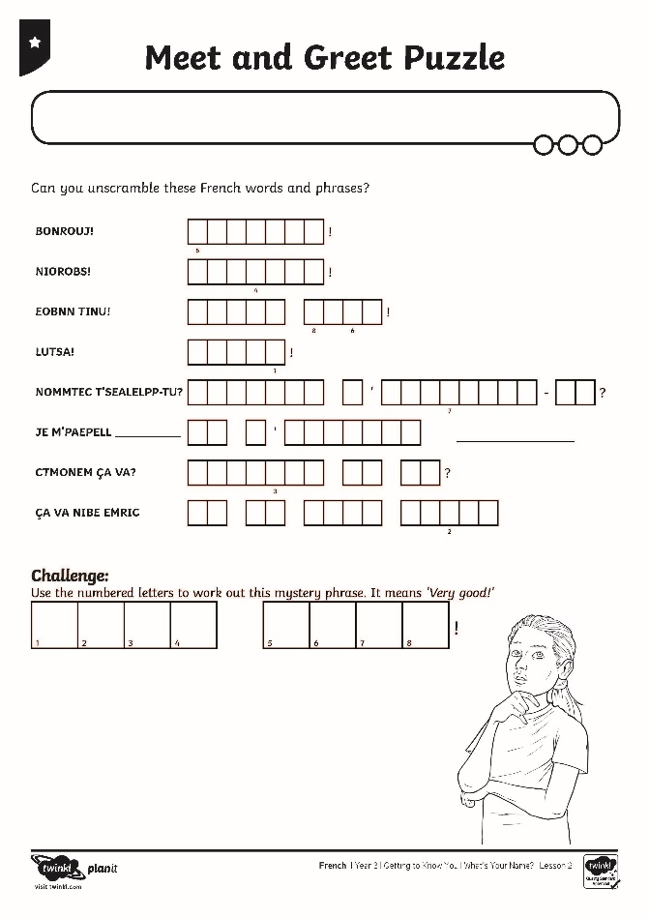
Meet and Greet Activities

Slide 16
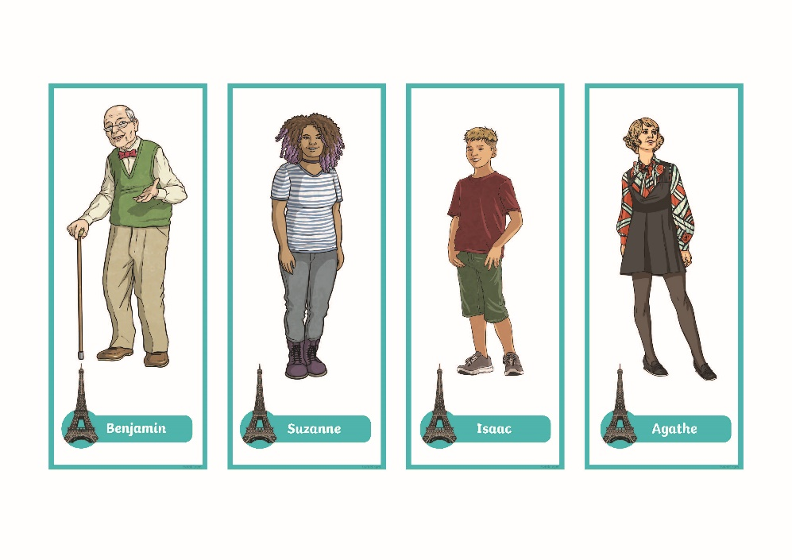
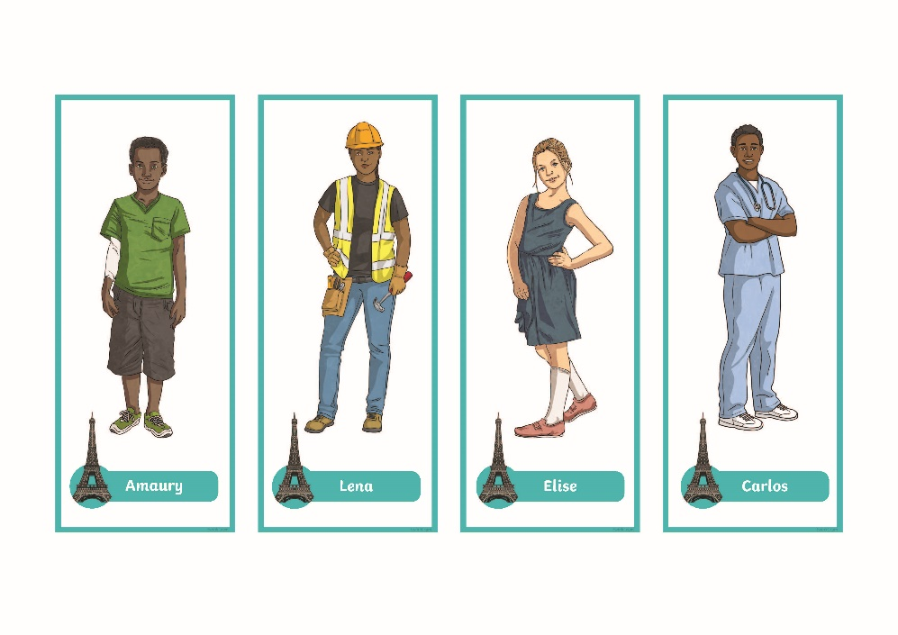
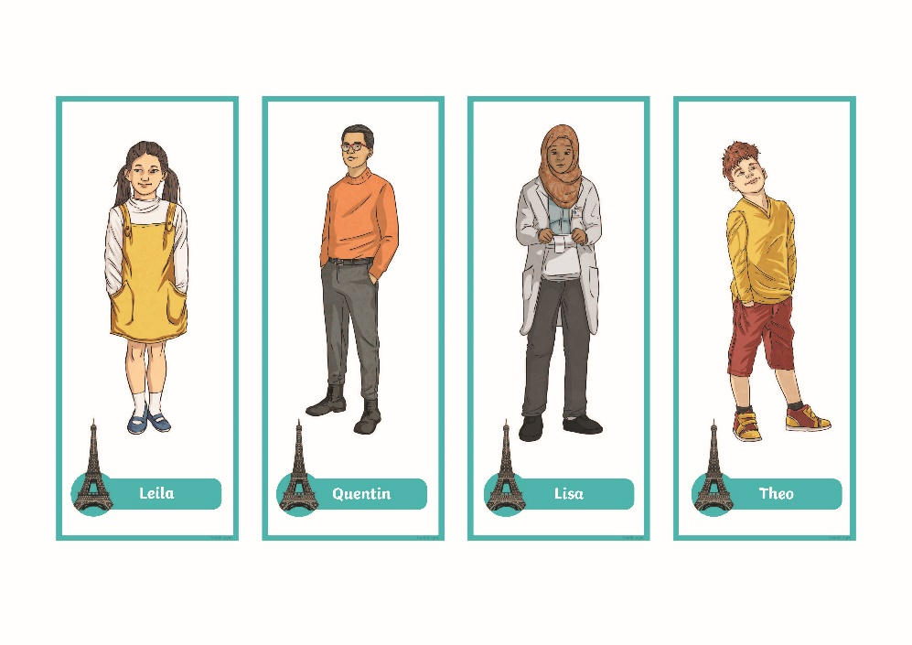
What’s Your Name?

Slide 17
Question and Answer
What is similar between the question sentence and the answer?
Je m’appelle .
Je m’appelle .
Comment t’appelles-tu?
Comment t’appelles-tu?

Slide 18
Aim
To exchange names in French.
Success Criteria
I can introduce myself to someone else.
I can ask another person their name.
I can use gestures to support my conversation.

