Slide 1
Article 29: “Your education should help you use and develop your talents and abilities. It should also help you learn to live peacefully, protect the environment and respect other people.”
–
Parents/Carers & Pupils:
This lesson works best in “Full Screen” mode – click the icon at the bottom right of your screen or use the “F5” key to start from the beginning. Use the space bar, mouse or arrow keys to click through!

Slide 2
How to use this lesson…
Use these buttons to get the most out of your lesson.
Find this button in the bottom right of you screen to start your lesson.
Use the arrow keys to go forwards and backwards through your lesson.
To go back to your normal screen, press the esc key on your keyboard.
–
Learning from home?
Here are some ideas of how to get the most out of this lesson at home.
Ask an adult to arrange a video call so you can do some
of the activities with a friend.
Explore the topic with a parent or caregiver: how is their opinion
different to yours?
Teach a younger sibling or relative
about how
VotesforSchools works!
In the classroom?
Look out for these boxes to see how to make the most of the activities!
Parents’ & Carers’ Note:
Please see the Notes section below each slide for any further guidance.
Don’t forget to vote…
You can find the link to do this on the final slide. Get your whole household involved!
Notes:
Images:
https://icons8.com/

Slide 3
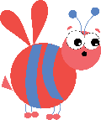
Feedback: “Could you be a first settler on Mars?”
“Because I want to be world famous and I’ll be the first kid to go in space!”
Godolphin Junior School
“We should be focusing on saving our own planet before ruining another. If you go you would never come back and I would miss my family and friends. Also it could be very dangerous and I wouldn’t want to be the first person to land and die on Mars.”
Telferscot Primary School
“If the Earth is destroyed I would create a new world for people who would need to come and escape from Earth.”
Wellbourne Primary School
34%
66%
“I would not be the first settler on Mars because of the weather and it takes years to prepare for things like this.”
Beam County Primary School
“This topic has really inspired me!”
Orchards Church of England Academy
Notes:
Parent/Carer Note: This slide shows the feedback to the question pupils answered two weeks ago. Check back in two weeks to see if the comment you make at the end of this lesson is featured!
To record your child’s vote, use the survey link on the last slide or use the hashtag #VotesatHome on social media to browse other children’s responses and share your own.

Slide 4
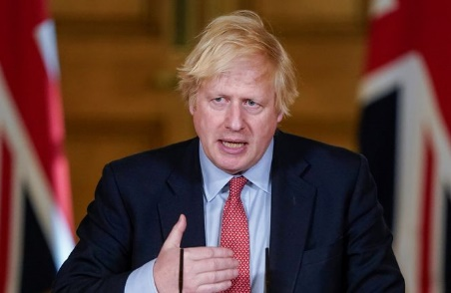
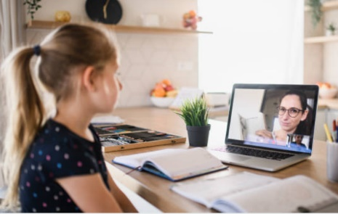
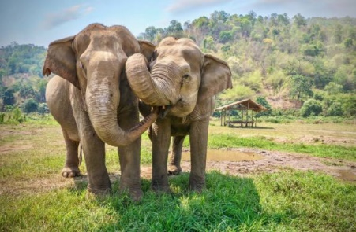
Be informed!
Here’s what’s been in the news this week...
Easing of lockdown
Back to school?
Last week, the Government announced that they will be easing lockdown measures in England with many shops opening in a few weeks.
Some year groups across the country have gone back to school this week, after lots of discussions from the Government, schools and teachers.
Hundreds of elephants that were kept in zoos in Thailand have been taken “home” to their village. The elephants were very happy to return.
Harry Potter author JK Rowling is releasing chapters of a new book online each day. Click the image to read the story so far…
Elephants “going home”
JK Rowling releases a free book!
Notes:
Parent/Carer Note: Use this slide to learn about headlines around the world. Using the presentation in Slide Show mode, you will be able to click on the highlighted pictures to follow links to websites and videos.
Alternative video link: https://www.bbc.co.uk/newsround/52228461
Images/Stories:
Lockdown:
Schools: https://www.bbc.co.uk/newsround/52653333
Ickabog: https://www.theickabog.com/home/
Elephants: https://www.sciencetimes.com/articles/25808/20200526/hundreds-captive-elephants-freed-biggest-migration-thailands-history-heres-why.htm

Slide 5
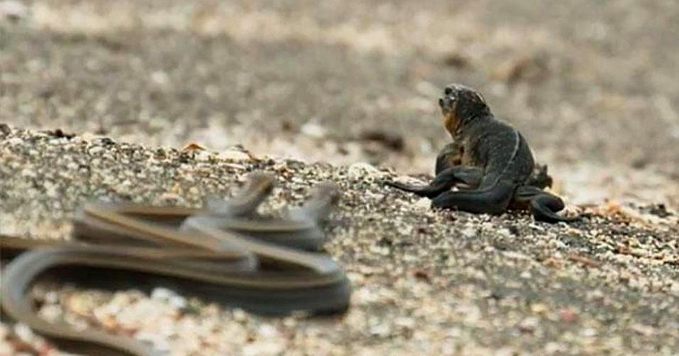
Starter: Iguana vs snakes
0:00-2:17
Video task (3-4 mins)
Click the image to watch the video and consider or discuss:
How did you feel while watching?
Who were you rooting for: the snakes or the iguana? Why?
Do you think that the person filming should’ve done something to help?
https://safeshare.tv/x/ss5eccdd2d5b477
Notes:
Alternative video link: https://www.youtube.com/watch?v=Rv9hn4IGofM
Images
https://www.unilad.co.uk/featured/iguana-vs-snakes-planet-earth/
References

Slide 6
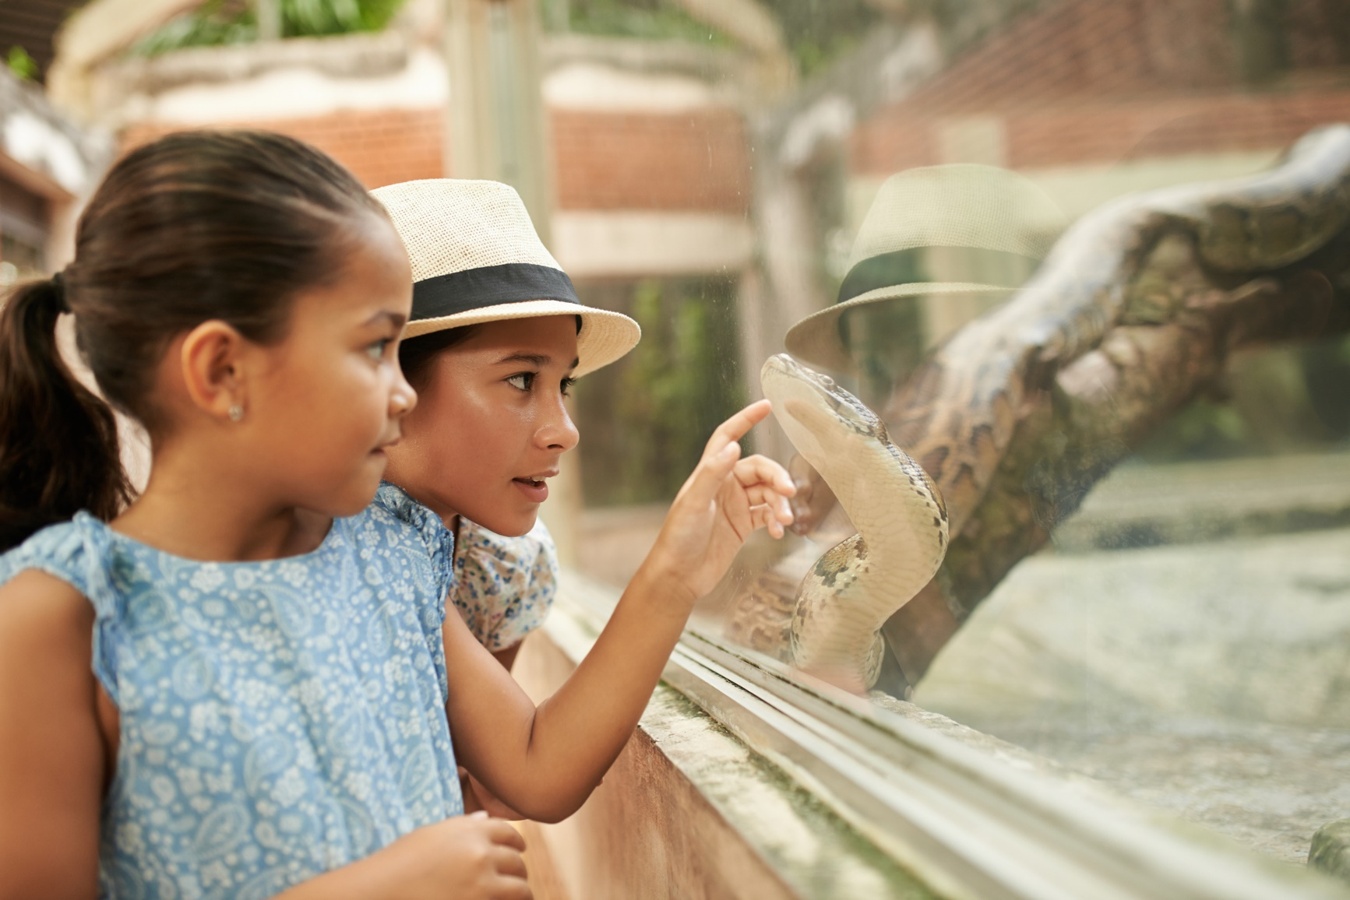
Should we shut down zoos?
Notes:
Parent/Carer Note: Each week, your child completes this lesson in school before recording their vote on an online platform. Temporarily, we have created a platform you can use at home. Please see the last slide for details.
Images:
iStock

Slide 7
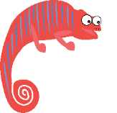
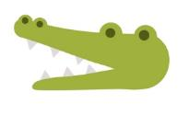
Starter: Iguanas vs snakes
Why are we talking about this?
In the wild or in a zoo?
Is every animal different?
What do you think?
Vote!
Ext: Design your own!
Notes:
Images:
iStock

Slide 8
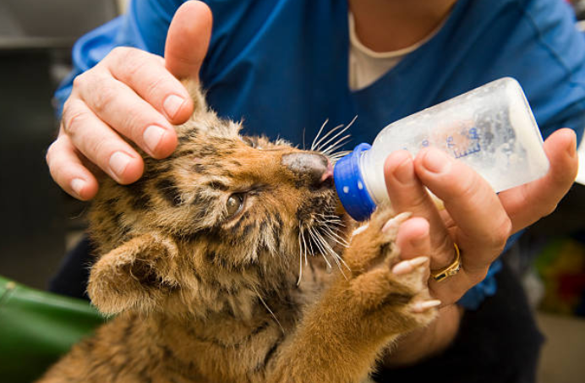
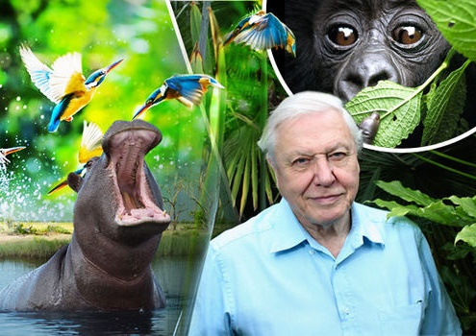
Why are we talking about this?
Right now, zoos across the country are closed due to lockdown.
With no one buying tickets to visit, zoos are running out of money that they need to feed and look after their animals. The Government has given them funding, but zookeepers are still very worried.
Meanwhile, many animal lovers at home have been watching live zoo cameras and catching up on the many documentaries about the natural world.
But what will happen in the future? Should zoos reopen, or is it time to shut them permanently? This is what you will be discussing today…
Notes:
Parent/Carer Note: Use this slide to understand the context behind this week’s lesson.
Images:
iStock
https://www.express.co.uk/news/nature/738385/Planet-Earth-2-Sir-David-Attenborough-blockbuster-success

Slide 9
Starter: Iguanas vs snakes
Why are we talking about this?
In the wild or in a zoo?
Is every animal different?
What do you think?
Vote!
Ext: Design your own!
Notes:
Images:
iStock

Slide 10
In the wild or in a zoo?
Zoos vs the wild (10-15 mins)
Over the next five slides you are going to learn more about animals living in zoos and in the wild. As you read through, create a tally chart showing which one you think is better!
Top tip:
To make a tally chart, add a line to award a point. When you get to four, add your fifth line diagonally, like this!
In the wild
In a zoo
Notes:
Parent/Carer Note: For younger pupils, you may wish to use points and not a tally chart. On each slide, discuss the points with children and ask their opinion on the facts. Do they have any of their own knowledge and opinions to add?

Slide 11
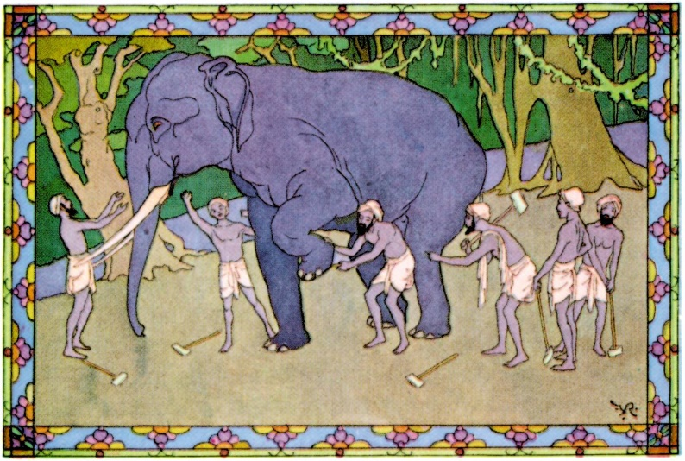
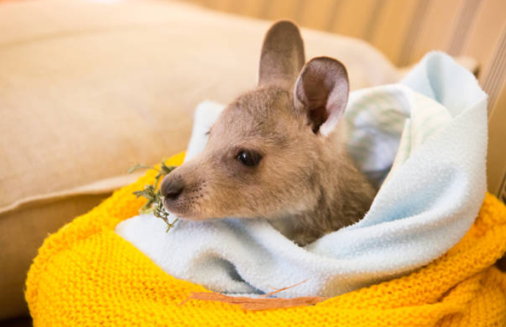
In the wild or in a zoo?
The first zoo opened in Ancient Egyptian times. The animals were given lots of land and were fed the best food Egyptians could find. People would come from all over Egypt to worship the animals.
Since then, zoos have always looked after animals. They often take sick or endangered animals from the wild and care for them, sometimes keeping them in the zoos and sometimes releasing them back into the wild when they are better.
In the wild
Based on this information, give a tally mark to the one you think is better.
In a zoo
Notes:
Parent/Carer Note: For younger pupils, you may wish to use points and not a tally chart. On each slide, discuss the points with children and ask their opinion on the facts. Do they have any of their own knowledge and opinions to add?
References:
https://timesofindia.indiatimes.com/Which-is-the-worlds-first-zoo/articleshow/1911504.cms
https://www.thoughtco.com/arguments-for-and-against-zoos-127639
Images:
Istock
https://www.australiazoo.com.au/about-us/the-irwins/
https://en.wikipedia.org/wiki/Killing_of_Harambe

Slide 12
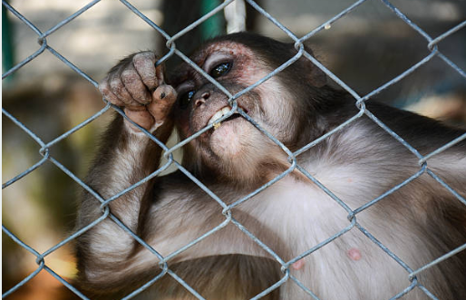
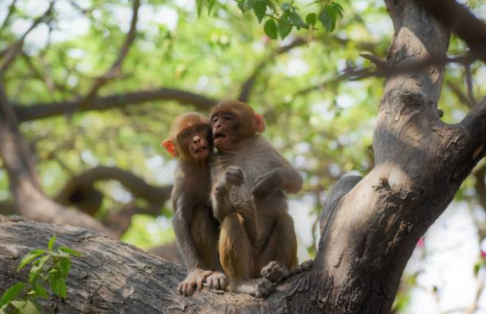
In the wild or in a zoo?
However, wild animals are not supposed to live in zoos. Lots of people say that it is not fair to take animals away from their habitat (home) and keep them in a different place.
Taking animals away from their habitats can also cause more problems for animals that are left behind, such as breaking up animal families or meaning that there is not enough food for other animals.
In the wild
Based on this information, give a tally mark to the one you think is better.
In a zoo
Notes:
Parent/Carer Note: For younger pupils, you may wish to use points and not a tally chart. On each slide, discuss the points with children and ask their opinion on the facts. Do they have any of their own knowledge and opinions to add?
References:
https://timesofindia.indiatimes.com/Which-is-the-worlds-first-zoo/articleshow/1911504.cms
https://www.thoughtco.com/arguments-for-and-against-zoos-127639
Images:
Istock
https://www.australiazoo.com.au/about-us/the-irwins/
https://en.wikipedia.org/wiki/Killing_of_Harambe

Slide 13
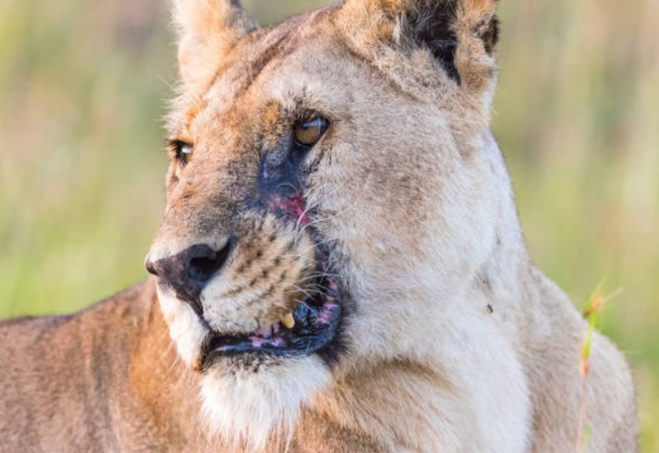
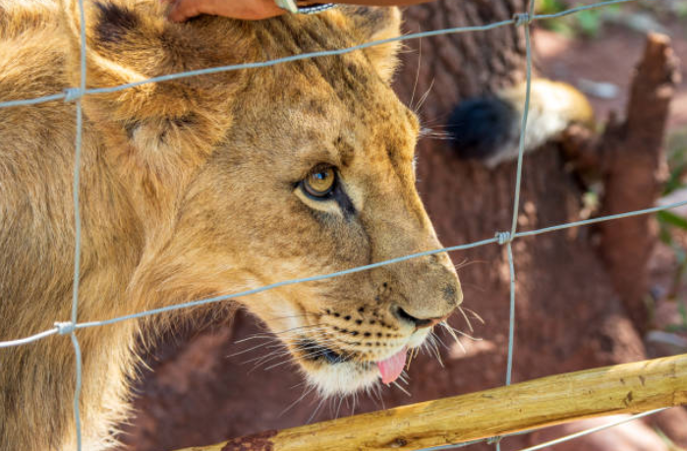
In the wild or in a zoo?
But is life in the wild really better? Wild animals can be hunted by humans and eaten by other animals. Plus, injured animals without care might not heal properly.
Some people argue that this is natural, and we shouldn’t get involved. They say that it is better to be in the wild than be kept in enclosures which can be too small or boring for an animal.
In the wild
Based on this information, give a tally mark to the one you think is better.
In a zoo
Notes:
Parent/Carer Note: For younger pupils, you may wish to use points and not a tally chart. On each slide, discuss the points with children and ask their opinion on the facts. Do they have any of their own knowledge and opinions to add?
References:
https://timesofindia.indiatimes.com/Which-is-the-worlds-first-zoo/articleshow/1911504.cms
https://www.thoughtco.com/arguments-for-and-against-zoos-127639
Images:
Istock
https://www.australiazoo.com.au/about-us/the-irwins/
https://en.wikipedia.org/wiki/Killing_of_Harambe

Slide 14
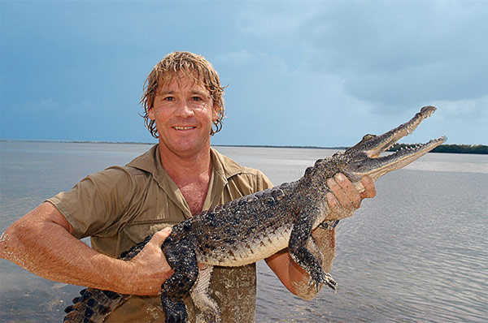
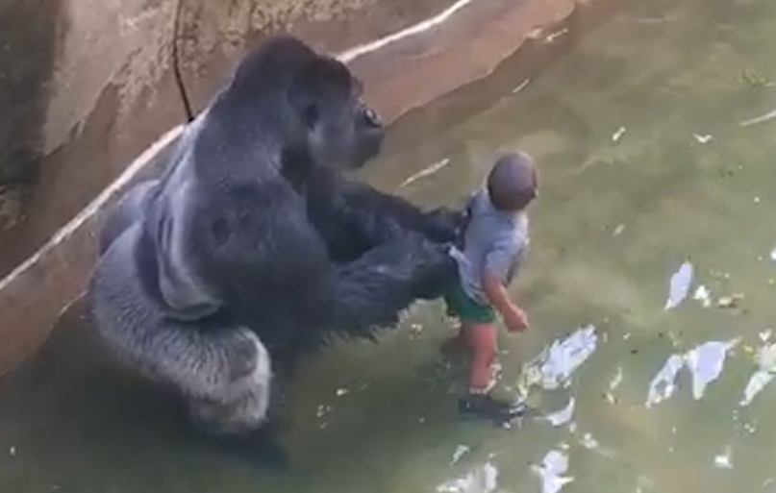
In the wild or in a zoo?
Zoos can also be dangerous to animals and humans. Steve Irwin was an Australian zookeeper who died after he was injured by a sting ray while filming his TV show about the animals.
In 2016, a 3-year old child climbed into a gorilla enclosure at a zoo. A gorilla, stressed by all the screaming and shouting, dragged the boy up a ladder. The zookeepers, who were worried about the boy’s safety, killed the gorilla.
In the wild
Based on this information, give a tally mark to the one you think is better.
In a zoo
Notes:
Parent/Carer Note: For younger pupils, you may wish to use points and not a tally chart. On each slide, discuss the points with children and ask their opinion on the facts. Do they have any of their own knowledge and opinions to add?
References:
https://timesofindia.indiatimes.com/Which-is-the-worlds-first-zoo/articleshow/1911504.cms
https://www.thoughtco.com/arguments-for-and-against-zoos-127639
Images:
Istock
https://www.australiazoo.com.au/about-us/the-irwins/
https://en.wikipedia.org/wiki/Killing_of_Harambe

Slide 15
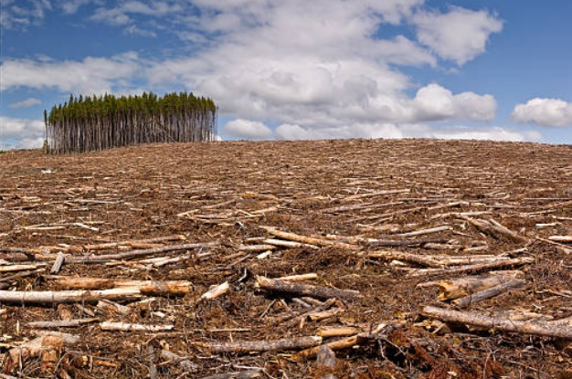
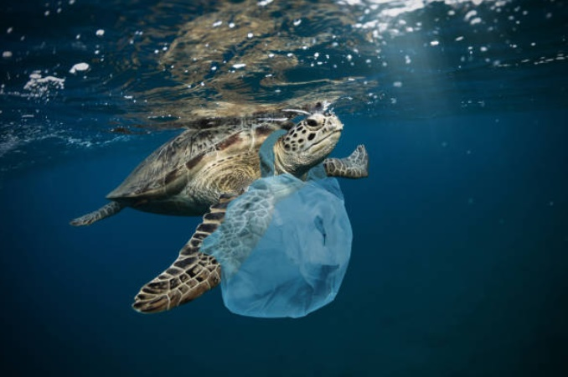
In the wild or in a zoo?
Finally, many people argue that humans have changed the wild through farming, cutting down forests and building cities, making it harder for wild animals to live.
There is also much more pollution and waste in the wild which can harm animals, whereas zoos create safe spaces for animals to live without these dangers.
In the wild
Based on this information, give a tally mark to the one you think is better.
In a zoo
Notes:
Parent/Carer Note: For younger pupils, you may wish to use points and not a tally chart. On each slide, discuss the points with children and ask their opinion on the facts. Do they have any of their own knowledge and opinions to add?
References:
https://timesofindia.indiatimes.com/Which-is-the-worlds-first-zoo/articleshow/1911504.cms
https://www.thoughtco.com/arguments-for-and-against-zoos-127639
Images:
Istock
https://www.australiazoo.com.au/about-us/the-irwins/
https://en.wikipedia.org/wiki/Killing_of_Harambe

Slide 16
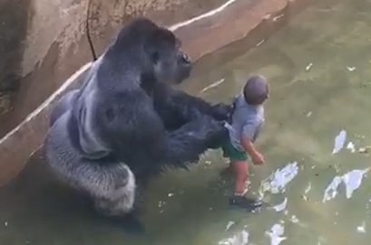
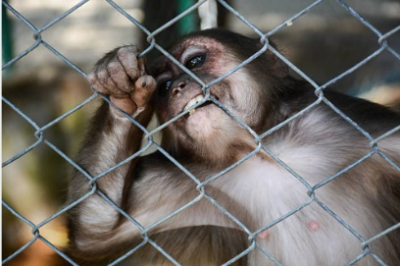
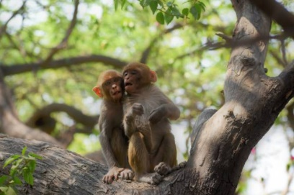
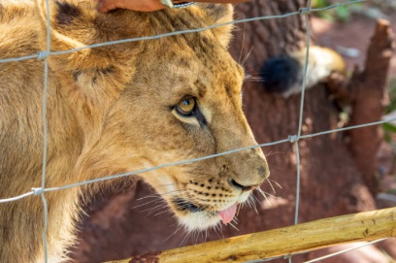
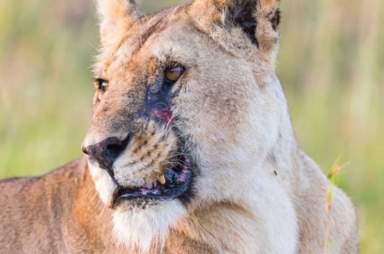
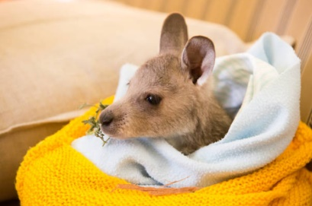
In the wild or in a zoo?
Final score? (2 mins)
Count up the score you gave to each category. Which one has more points? Do you agree that all animals should live here?
In the wild
In a zoo
Notes:
Images:
Istock
https://www.australiazoo.com.au/about-us/the-irwins/
https://en.wikipedia.org/wiki/Killing_of_Harambe

Slide 17
Starter: Iguanas vs snakes
Why are we talking about this?
In the wild or in a zoo?
Is every animal different?
What do you think?
Vote!
Ext: Design your own!
Notes:
Images:
iStock

Slide 18
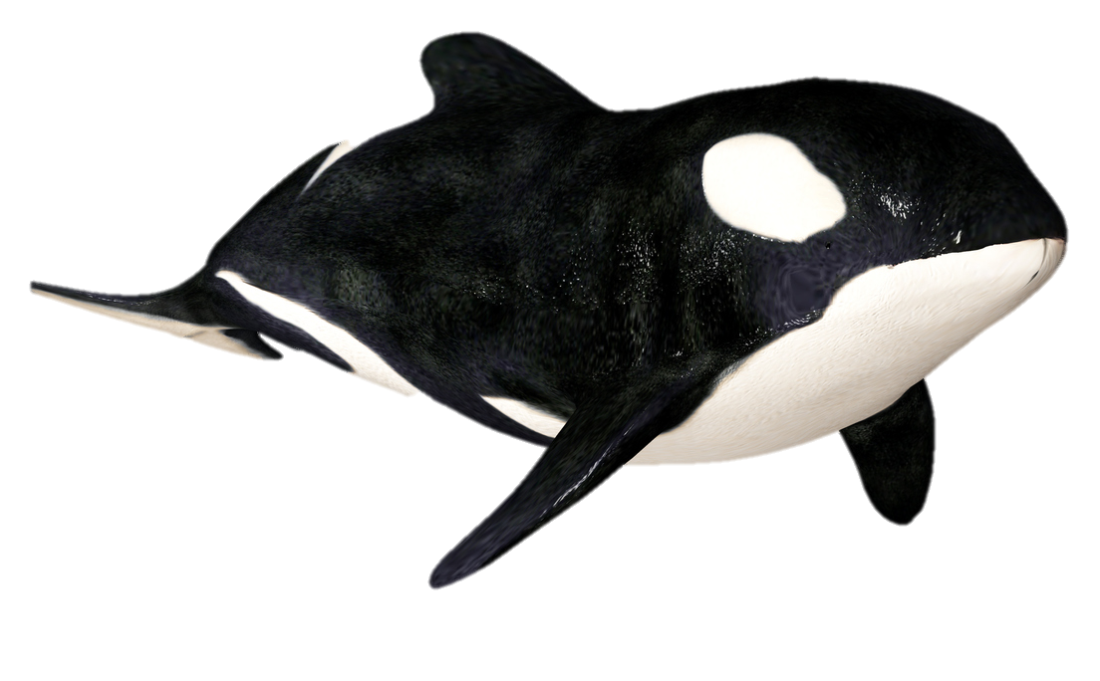
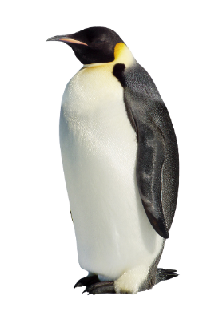
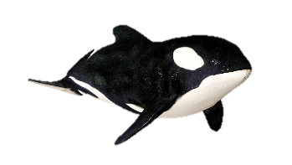
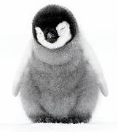
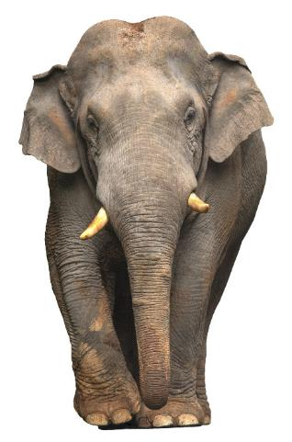
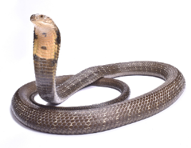
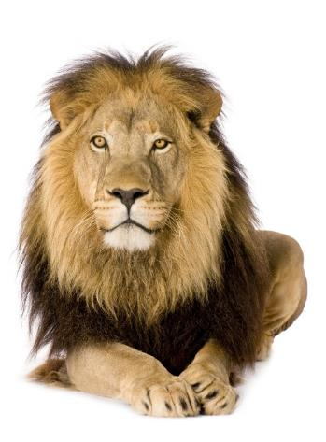
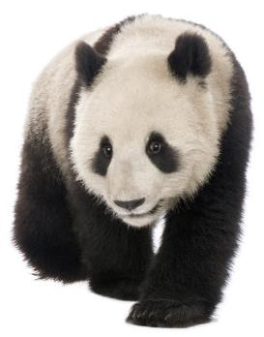
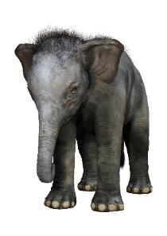
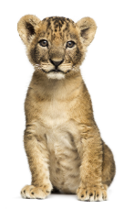
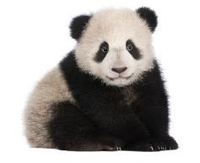
Is every animal different?
Where should they live?
(10-15 mins)
On the next few slides you are going to look at six different animals and learn more about them. For each one, can you decide the best place for each one to live?
Notes:
Parent/Carer Note: Encourage children to look closely at the information provided, particularly the differing life spans in captivity vs wild and the potential dangers of both living conditions.

Slide 19
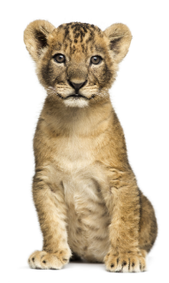
Is every animal different?
African Lion
Status: Vulnerable
Natural habitat: Grassy and open areas in warm countries
Food: Large animals such as zebras and deer
Sleep: 16-20 hours a day
Threats: Hunters, poachers and not enough food
Dangerous? Yes
Fact: They are the only cats to live in groups (call prides)
How long do they live?
In the wild:
12-15 years
In a zoo:
20 years
Should lions live in the wild or in a zoo? Why?
Size:
Notes:
Images
iStock
https://www.nationalgeographic.com/animals/mammals/a/african-lion/
References
https://animals.sandiegozoo.org/animals/lion
https://animalfactguide.com/animal-facts/lion/

Slide 20
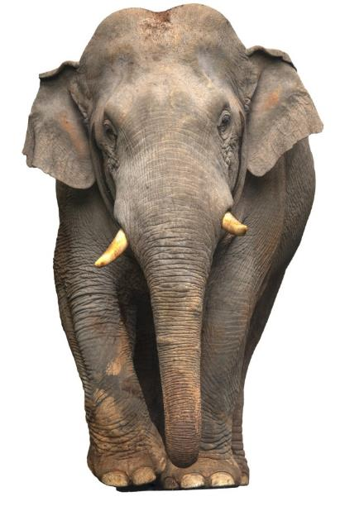
Is every animal different?
Asian Elephant
Status: Endangered
Natural habitat: Forests in warm countries
Food: Lots of leaves, branches, grass & fruit
Sleep: 3-7 hours in captivity but only 2 hours in the wild!
Threats: Deforestation and poachers Dangerous? No
Fact: Elephant populations have declined by 50% in the past 75 years
How long do they live?
Should elephants live in the wild or in a zoo? Why?
In the wild:
Up to 60 years
In a zoo:
17 years
Size:
Notes:
Images
iStock
https://www.nationalgeographic.com/animals/mammals/a/asian-elephant/
References
https://www.nationalgeographic.com/news/2008/12/wild-elephants-live-longer-than-their-zoo-counterparts/
htthttps://www.nationalgeographic.com/animals/mammals/a/asian-elephant/
https://www.bbc.co.uk/news/science-environment-39126993

Slide 21
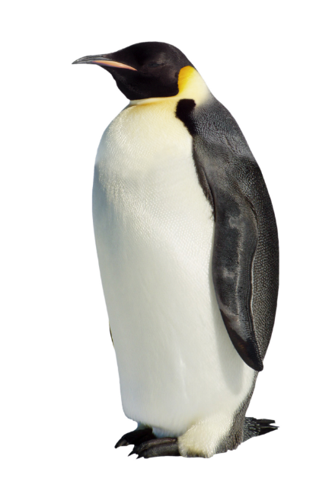
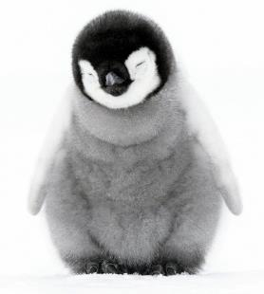
Is every animal different?
Emperor Penguin
Status: Near threatened
Natural habitat: Antarctic ice, where it’s sometimes as cold as -60°C!
Food: Fish, squid & krill
Sleep: Up to 21 hours
Threats: Not enough food or ice to live on, disease, eaten by other animals
Dangerous? No
Fact: They can dive up to 1,850 feet!
Should emperor penguins live in the wild or in a zoo? Why?
How long do they live?
In the wild:
15-20 years
In a zoo:
40 years
Size:
Notes:
Images
iStock
https://www.nationalgeographic.com/animals/mammals/a/african-lion/
References
https://www.penguins-world.com/penguins-in-captivity/
https://www.coolantarctica.com/Antarctica%20fact%20file/wildlife/Emperor-penguins.php
https://www.nationalgeographic.com/animals/birds/e/emperor-penguin/

Slide 22
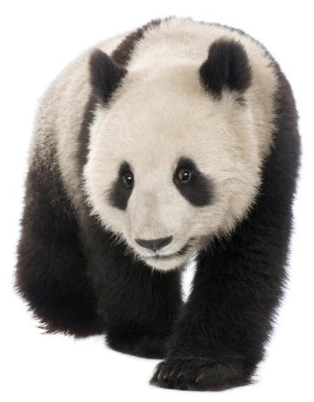
Is every animal different?
Giant Panda
Status: Vulnerable
Natural habitat: Mountains in China
Food: They love bamboo and can eat for 12 out of 24 hours!
Sleep: 10 hours a day
Threats: Loss of habitat, low birth rate
Dangerous? No
Fact: Most of our information on pandas come from studying ones in zoos, as wild ones are rare and hard to find
How long do they live?
Should giant pandas live in the wild or in a zoo? Why?
In the wild:
15-20 years
In a zoo:
30 years
Size:
Notes:
Images
iStock
References
https://www.travelchinaguide.com/tour/panda/facts.htm
https://www.nationalgeographic.com/animals/mammals/g/giant-panda/
https://wwf.panda.org/knowledge_hub/endangered_species/giant_panda/problems/

Slide 23
Is every animal different?
King Cobra
Status: Vulnerable
Natural habitat: Forests and grassy areas in China, India and Southeast Asia
Food: Lizards, eggs and small mammals
Threats: Deforestation, taken or killed by humans
Dangerous? Yes
Fact: They’re one of the most venomous snakes on the planet, but are also known to be very shy!
Should king cobras live in the wild or in a zoo? Why?
How long do they live?
In the wild:
20 years
In a zoo:
Unsure
Size:
Notes:
Images
iStock
References
https://animals.mom.me/king-cobras-life-span-6336.html

Slide 24
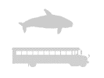
Is every animal different?
Orca
Status: Unknown
Natural habitat: Cold, coastal waters
Sleep: 1-6 hours a day
Food: Fish, penguins and marine mammals
Threats: Being kept in small enclosures
Dangerous? No
Fact: They can swim 40 miles a day and dive 100-500 feet!
How long do they live?
Should orcas live in the wild or in a zoo? Why?
In the wild:
50-80 years
In a zoo:
15-30 years
Size:
Notes:
Images
iStock
References

Slide 25
Starter: Iguanas vs snakes
Why are we talking about this?
In the wild or in a zoo?
Is every animal different?
What do you think?
Vote!
Ext: Design your own!
Notes:
Images:
iStock

Slide 26
What do you think?
Vote with your feet (6-12 mins)
Now you know some facts about zoos and different animals, it’s time to see what your opinion is. On the next few slides you are going to read some different points of view. For each one, use your feet to show whether you agree or disagree.
Notes:
Parent/Carer Note: To extend this activity play with all household members and create your own opinions for the debate.

Slide 27
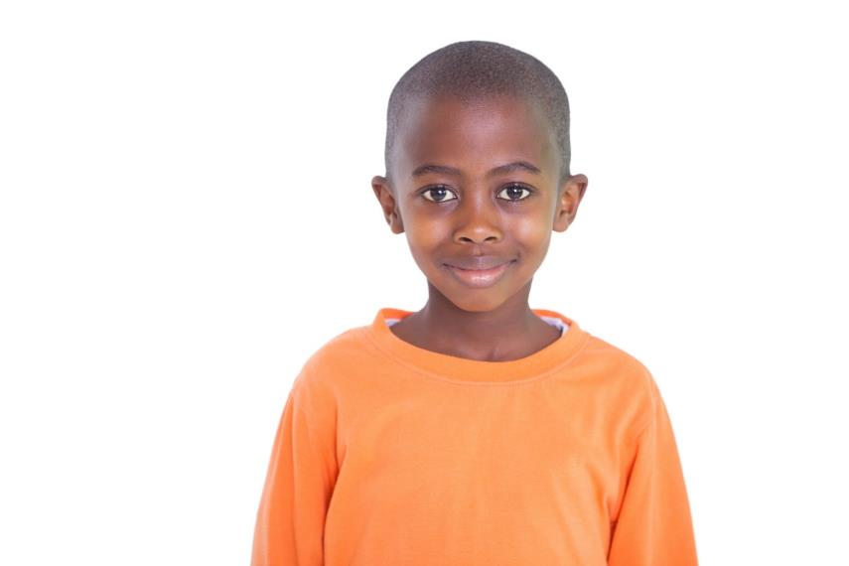
What do you think?
Zoos help look after animals that would die in the wild. We can’t shut them down!
It doesn’t matter where animals live, they will still need to eat each other to survive, so they should do it naturally.
Notes:
Parent/Carer Note: To extend this activity play with all household members and create your own opinions for the debate.
Images:
1) iStock

Slide 28
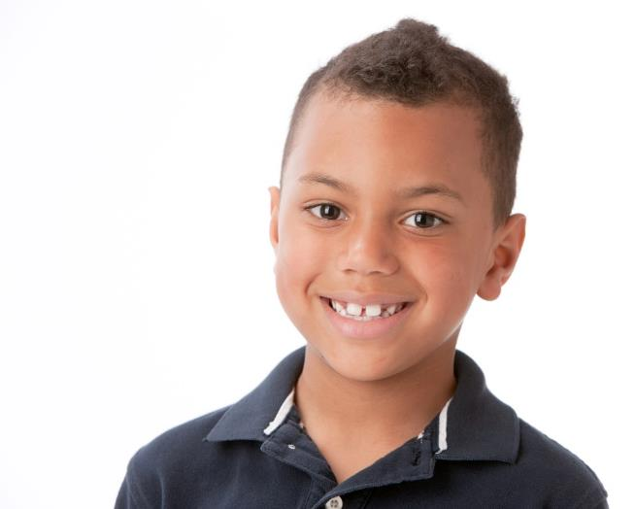
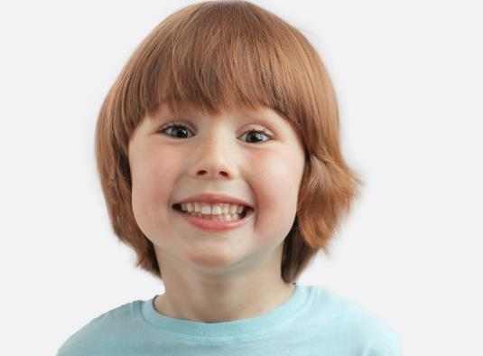
What do you think?
Humans have destroyed animals’ homes. It is our responsibility to look after them now, and zoos help do that.
To help look after animals we should stop destroying their habitats, not just create fake ones for them!
Notes:
Parent/Carer Note: To extend this activity play with all household members and create your own opinions for the debate.
Images:
1) iStock

Slide 29
What do you think?
Zoos are the best way to learn about and understand animals. We wouldn’t know all the things we do today if we didn’t keep them and study them.
You can’t just shut zoos down. The animals are used to living there and wouldn’t know how to survive in the wild now.
Notes:
Parent/Carer Note: To extend this activity play with all household members and create your own opinions for the debate.
Images:
1) iStock

Slide 30
Starter: Iguanas vs snakes
Why are we talking about this?
In the wild or in a zoo?
Is every animal different?
What do you think?
Vote!
Ext: Design your own!
Notes:
Images:
iStock

Slide 31
Should we shut down zoos?
Zoos can be too small and unnatural. Animals can get bored and not live a happy life in them.
Zoos can be dangerous to humans and to animals, as we have seen in stories in the news.
Removing endangered animals from the wild affects the other animals in the area too. Wild animals may not be able to find enough food or a mate.
…
Zoos teach us so much about animals that you cannot learn from reading and TV.
Zoos help to protect and breed many endangered animals which wouldn’t survive in the wild.
Zoos aren’t just educational places, lots of them also adopt unwanted pets and treat wild animals that are unwell. This is very important.
…
Notes:
Parent/Carer Note: Use this slide to review the arguments before voting.

Slide 32
You can vote from home at…
https://www.surveymonkey.co.uk/r/vfs-primary-zoos
To have your voice heard!
If you have any issues, feedback or comments, email amy@votesforschools.com!
Notes:
Teacher’s Note: Please log your class’ vote the usual way!
Parent/Carer Note: The link provided allows your child to record their vote online. Find it here: https://www.surveymonkey.co.uk/r/vfs-primary-child-actors

Slide 33
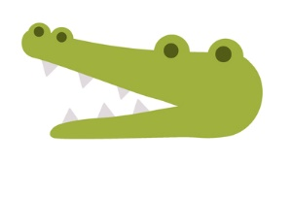
Starter: Iguanas vs snakes
Why are we talking about this?
In the wild or in a zoo?
Is every animal different?
What do you think?
Vote!
Ext: Design your own!
Notes:
Images:
iStock

Slide 34
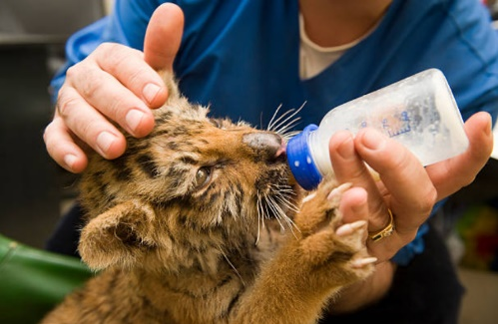
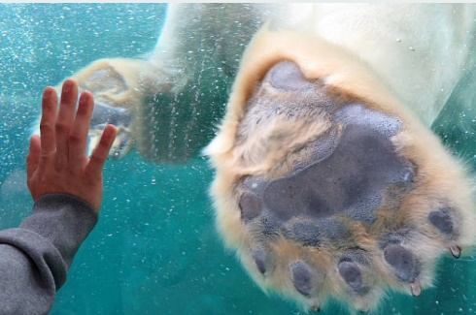
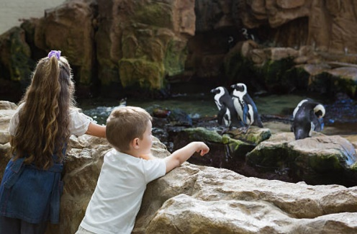
Ext: Design your own!
Create (5-15 mins)
On an A4 piece of paper, your task is to design your own zoo without any of the problems you have learned about today. Use the questions on the next slide to help you with your ideas!
Notes:
Images
iStock
https://icons8.com/icons/doodle
References

Slide 35
Ext: Design your own!
Think about…
What animals would you include?
What would be your “star attraction”?
How would you make the animals were safe?
How would you make sure the animals were happy?
What would you call it?
Where would it be?
Would you have an aim to help something?
Notes:
Images
iStock
https://icons8.com/icons/doodle
References

Slide 36
Career Launchpad!
Lean more… And explore!
Want to get up close to your favourite animals? Using explore.org, you can watch animals live in their natural habitat. There are live streams of birds, bears, African wildlife, and even live puppies and kittens! Click the image and take your pick.
0:00-2:28
Career Spotlight:
Ever fancied being a wildlife filmmaker? While the shots used in documentaries such as Dynasties may look effortless, there is a lot of waiting around in some very challenging conditions. Click the video to find out more and see if you might have what it takes!
https://safeshare.tv/x/zU8YbH0incc
Notes:
Parents/Caregivers: Please click each image to watch the respective videos.
Alternative Video Link: https://www.youtube.com/watch?v=zU8YbH0incc
Images:
explore.org
BBC Earth

