Slide 1
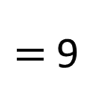
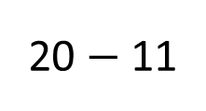
20 cm
20 $−$ 11
$=$ 9
11 cm
9 cm
?
9
The second piece is ____ cm long.

Slide 2
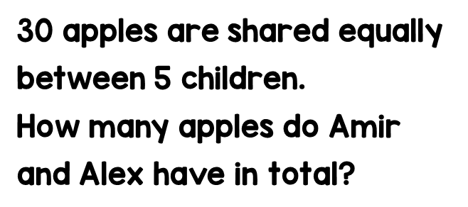
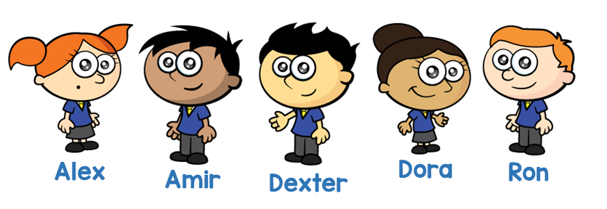
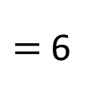
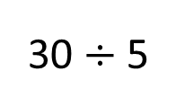
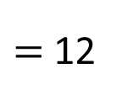

30
30 $÷$ 5
$=$ 6
6 $×$ 2
$=$ 12
6
6
6
6
6
12
?
12
Amir and Alex have ____ apples in total.

Slide 3
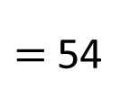
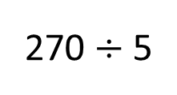
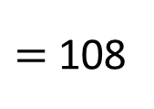
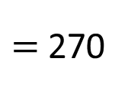

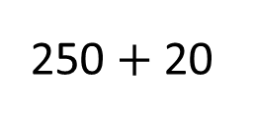
£108
?
Danni
54
54
250 $+$ 20
$=$ 270
£270
£20
270 $÷$ 5
$=$ 54
Esma
54
54
£250
54 $×$ 2
$=$ 108
Fiona
54
Danni receives _____
£108

Slide 4
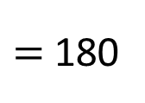

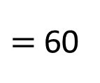
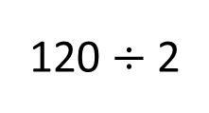
120 $÷$ 2
$=$ 60
60 $×$ 3
$=$ 180
60
60
60
60
60
60
120
left
180
Theo has ____ lollies left.

