Slide 1
Grammar Workout
Year 5 Autumn 2 Week 6
©Deepening Understanding LTD 2019

Slide 2
“Hello and welcome to Mr Copley’s farm, exclaimed the farmer, with a jolly ring to his voice.”
1. Rectify the errors in punctuation.
2. Explain your changes.
3. Identify the speech verb.
4. Add a missing capital letter. Explain why.
5. Identify the preposition.
6. Add a relative clause about the farmer.
Monday
©Deepening Understanding LTD 2019

Slide 3
“Hello and welcome to Mr Copley’s farm, exclaimed the farmer, with a jolly ring to his voice.”
1. “Hello and welcome to Mr Coplay’s farm,” exclaimed the farmer, with a jolly ring to his voice.
2. Inverted commas around speech only.
3. exclaimed
4. Farm → proper noun; name of the farm.
5. with
6. Various possibilities: exclaimed the farmer (who we presumed to be Mr Copley), with a jolly ring…
Monday
©Deepening Understanding LTD 2019

Slide 4
My new car, which I bought on Saturday, is already scratched! How irritating!
1. Identify the exclamation.
2. Identify the relative pronoun.
3. What other relative pronoun could have been used?
4. Identify the nouns.
5. Write an alternate exclamation.
6. Identify the possessive pronoun.
Tuesday
©Deepening Understanding LTD 2019

Slide 5
My new car, which I bought on Saturday, is already scratched! How irritating!
1. How irritating!
2. which
3. that
4. car, Saturday
5. Various possibilities: What a disaster!
6. my
Tuesday
©Deepening Understanding LTD 2019

Slide 6
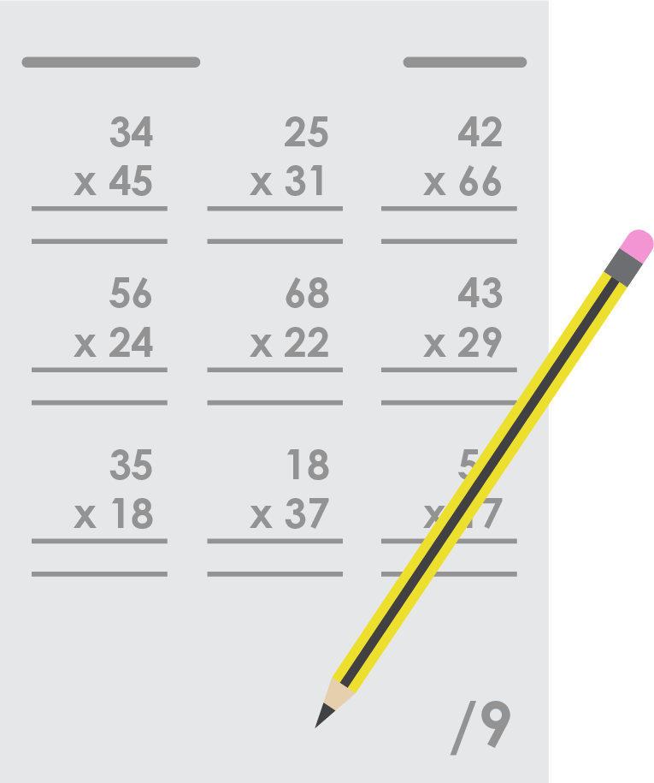
In maths I answered 5 questions on long multiplication but my teacher didn’t think it was enough.
1. Add a missing comma.
2. Add an adjective about your teacher.
3. Write an alternate fronted adverbial.
4. Write ‘didn’t’ in its expanded form.
5. Is the conjunction a subordinating or co-ordinating conjunction?
6. Replace with an alternate conjunction.
Wednesday
©Deepening Understanding LTD 2019

Slide 7
In maths I answered 5 questions on long multiplication but my teacher didn’t think it was enough.
1. In maths,
2. Various possibilities: my strict teacher
3. Various possibilities: In arithmetic,
4. did not
5. co-ordinating
6. Various possibilities: however, and, etc.
Wednesday
©Deepening Understanding LTD 2019

Slide 8
My friend is supporting me with my geography homework because he achieved highly in his test.
1. Identify part of the sentence in the present progressive tense. 2. Change one word to make the sentence in the past.
3. Identify the adverb.
4. Identify the main clause.
5. What word class is GCSEs.
6. Re-write the subordinate clause at the start.
Thursday
©Deepening Understanding LTD 2019

Slide 9
My friend is supporting me with my geography homework because he achieved highly in his test.
1. is supporting 2. is → was
3. highly
4. My friend is supporting me with my geography homework
5. noun
6. Because he achieved highly in his GCSEs, my friend is supporting me with my geography homework.
Thursday
©Deepening Understanding LTD 2019

Slide 10
Unfortunately we had to visit my nana in the care home because she was feeling under the weather.
1. Add a missing comma.
2. Explain its use.
3. Identify the subordinate clause.
4. Identify the preposition.
5. Use an apostrophe to contract two words.
6. Replace the subordinating conjunction with an alternate subordinating conjunction.
Friday
©Deepening Understanding LTD 2019

Slide 11
Unfortunately we had to visit my nana in the care home because she was feeling under the weather.
1. Unfortunately,
2. After a fronted adverbial
3. Because she was feeling under the weather.
4. in
5. we had → we’d
6. as
Friday
©Deepening Understanding LTD 2019

