Slide 1
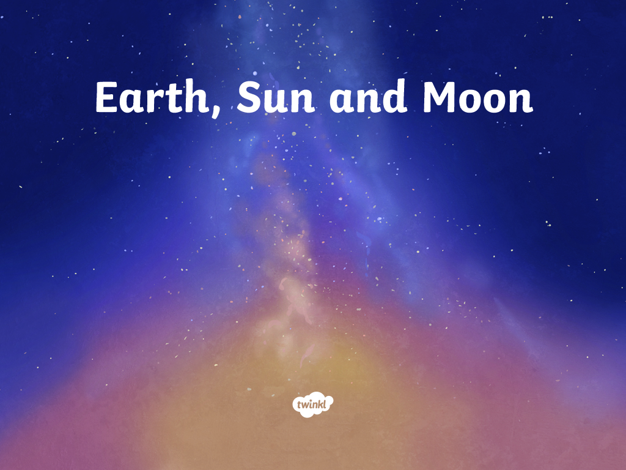

Slide 2
The Earth, Sun and Moon are…
A
Round and flat
B
Roughly spherical
C
Flat and square
Next

Slide 3
Which is the biggest?
A
The Sun
B
The Moon
C
The Earth
Next

Slide 4
How long does it take for the Earth to travel once around the sun?
A
28 days
B
24 hours
C
12 months
Next

Slide 5
How long does it take the Moon to travel around the Earth once?
A
28 days
B
24 hours
C
12 months
Next

Slide 6
How long does it take the Earth to turn once on its axis?
A
24 hours
B
48 hours
C
7 days
Next

Slide 7
At which part of the Earth is it night-time?
A
The part facing the Sun
B
The part facing away from the Sun
C
The part facing away from the Moon
Next

Slide 8
Which of these statements about the Sun is false?
A
Rises in the east and sets in the west
B
Is highest in the sky at midday
C
The Sun moves around the Earth
Next

Slide 9
Why does the moon look like it changes shape?
A
Because it grows and shrinks
B
Because it changes colour
C
Because we only see the part of the Moon that is lit by the Sun
Next

Slide 10
You are standing beneath a tree. When would the shadow of the tree be the shortest?
A
At sunrise
B
At midday
C
At sunset
Next

Slide 11
Why are some days longer in the summer than in the winter?
A
Because the Earth spins slower than usual in the summer
B
Because the Earth is tilted as it moves around the Sun
C
Because the Sun gets extra bright during the summer
Finish

Slide 12
