Slide 1
WALT: understand that a moon is a celestial body that orbits a planet.
https://spaceplace.nasa.gov/how-many-moons/en/
What is a celestial body/satellite?
What other planets have moons? Give details.

Slide 2
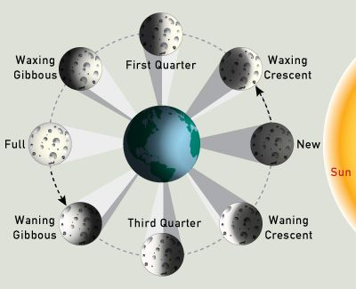
Moon Movement
The moon’s movement around earth takes approximately 28 days. Each stage is called a phase and there are 8 phases of the moon’s cycle.
https://www.bbc.co.uk/programmes/p011867y
https://www.youtube.com/watch?v=wz01pTvuMa0

Slide 3
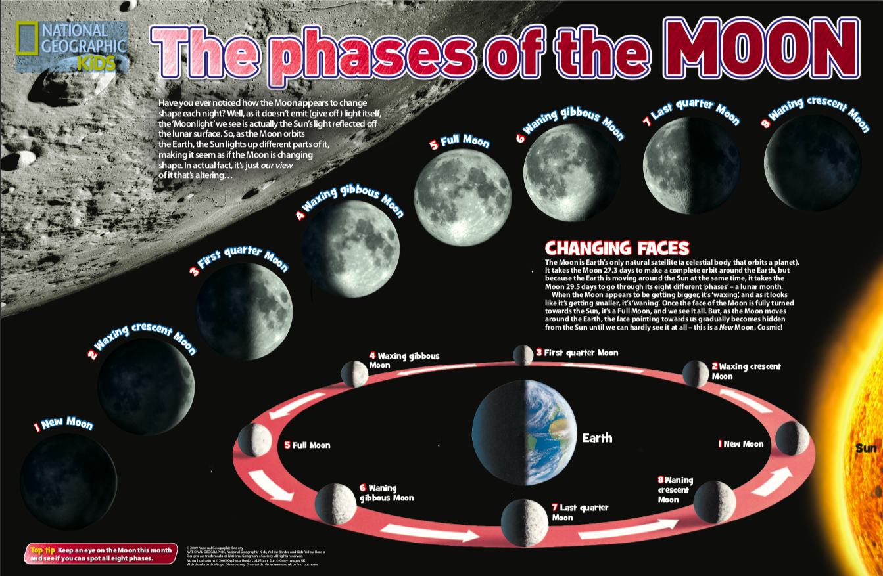

Slide 4
WALT: understand that a moon is a celestial body that orbits a planet.
Your task is to draw the phases of our moon and label
Key words: Waxing, waning, gibbous, crescent

Slide 5
WALT: understand that a moon is a celestial body that orbits a planet.
Use this catchy rap to learn the order of the phases of the moon!! Have fun!
https://www.youtube.com/watch?v=79M2lSVZiY4
There is a task on Purple mash for you to complete, describing the moon’s movement.

Slide 6
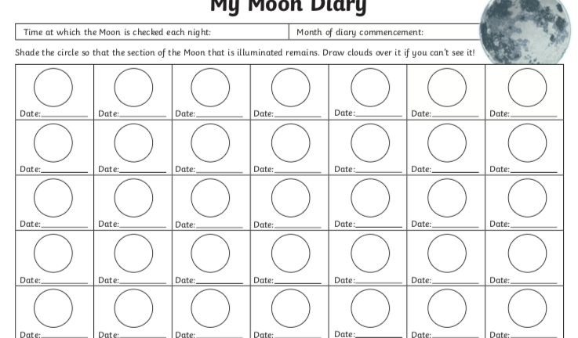
WALT: understand that a moon is a celestial body that orbits a planet.
Over the next few weeks, you will need to create a moon diary.
Every night for the next 28 days you need to draw what the moon looks like from your window.
Over the course of the moon’s cycle, you should see the change in phases and should be able to name the phases that you can see!

