Slide 1
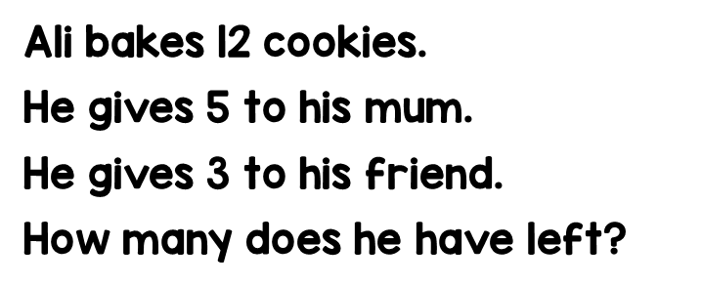
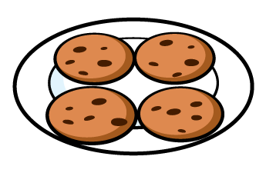
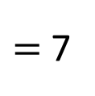
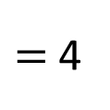
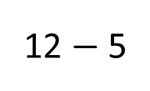

12 $−$ 5
$=$ 7
12 cookies
7 $−$ 3
$=$ 4
5
3
4
?
4
Ali has _____ cookies left.

Slide 2
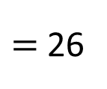
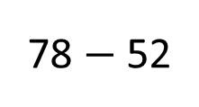
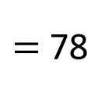
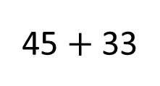
78
45 $+$ 33
$=$ 78
Rick
45
33
78 $−$ 52
$=$ 26
52
26
Ed
?
78
26
The missing number is ____.

Slide 3
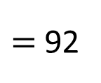
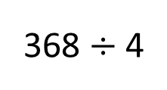
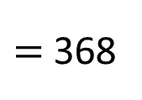
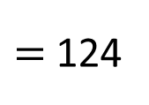
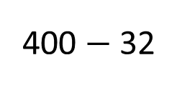
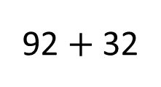
124
?
400 $−$ 32
$=$ 368
Naz
368
92
32
368 $÷$ 4
$=$ 92
400
Millie
92
92
92
$=$ 124
92 $+$ 32
124
Naz had ____ buttons at the start.

Slide 4
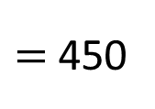

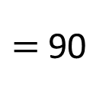
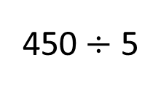
450
A
90
75 $×$ 6
$=$ 450
25%
B
450$÷$ 5
$=$ 90
75
75
20%
75
75
75
75
450
£90
Shop A increased the price by _____.

