Slide 1
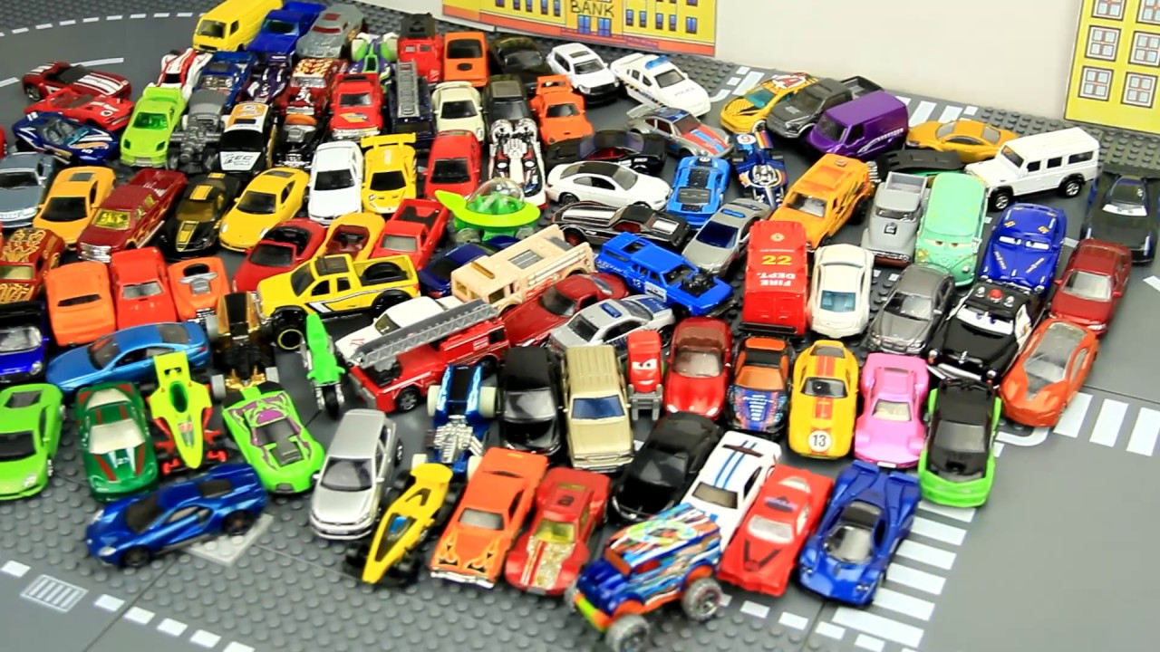
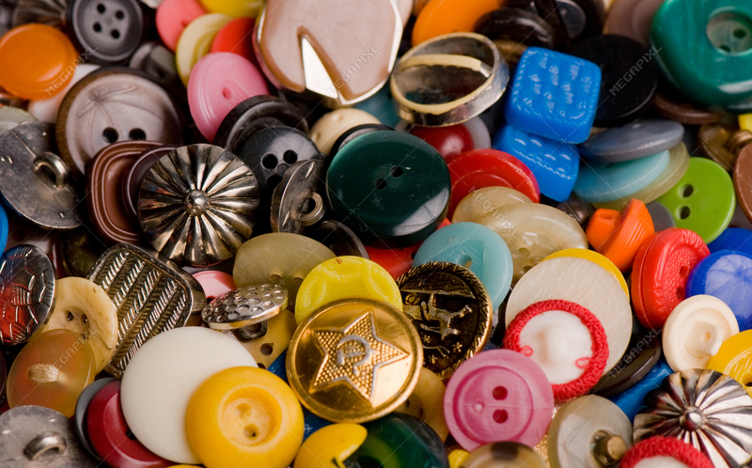
Do you have 20 small items for today’s lesson?

Slide 2
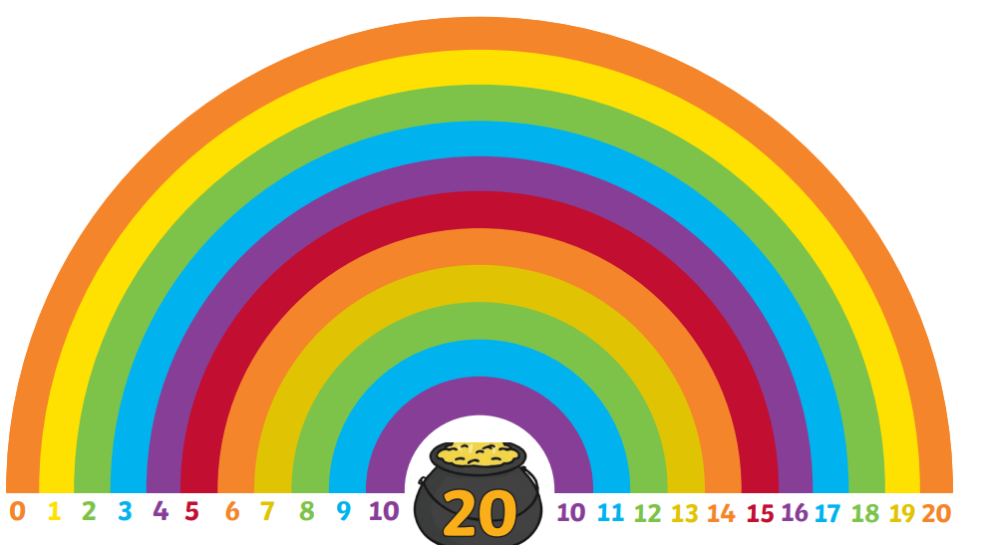
Find & Make Number Bonds
For the next two days we will look at the pairs of numbers that make 20…

Slide 3
Find & Make Number Bonds
How many number bonds make 20?
Let’s find out …
You will need 20 small items from inside your home to help.
e.g. 20 buttons or 20 lego pieces.
Notes:
Do a few examples with the children. Model writing number bonds, doesn’t have to be systematic. However remind the children to check before they record a ‘new bond’ – have you recorded this bond before?

Slide 4
Find & Make Number Bonds
How many number bonds make 20?
How many did you find out …
You
0 + 20 = 20
1 + __ = 20
2 + ___ = 20
3 + ___ = 20
4 + ___ = 20
5 + ___ = 20
6 + ___ = 20
7 + __ = 20
8 + ___ = 20
9 + ___ = 20
10 + ___ = 20
11 + ___ = 20
Notes:
Do a few examples with the children. Model writing number bonds, doesn’t have to be systematic. However remind the children to check before they record a ‘new bond’ – have you recorded this bond before?

