Slide 1
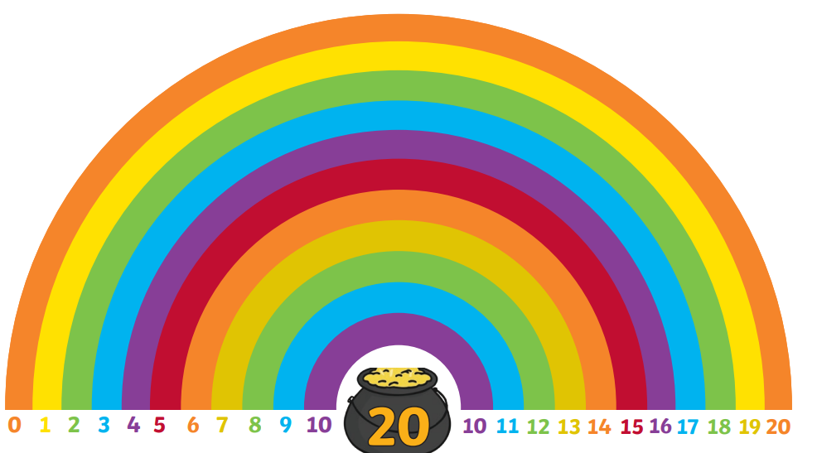
Find & Make Number Bonds
For the next two days we will look at the pairs of numbers that make 20…

Slide 2
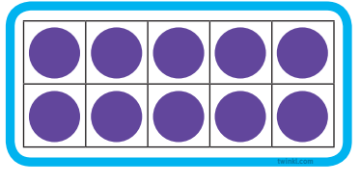
Find & Make Number Bonds
We can use our bonds to that make to help…
0 + 10 = 10
0 + 20 = 20

Slide 3
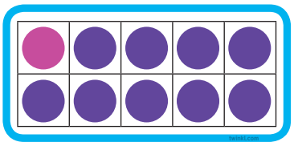
Find & Make Number Bonds
We can use our bonds to that make to help…
1 + 9 = 10
1 + 19 = 20

Slide 4
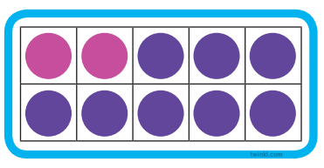
Find & Make Number Bonds
We can use our bonds to that make to help…
2 + 8 = 10
2 + 18 = 20

Slide 5
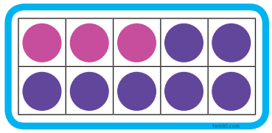
Find & Make Number Bonds
We can use our bonds to that make to help…
3 + 7 = 10
3 + 17 = 20

Slide 6
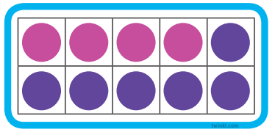
Find & Make Number Bonds
We can use our bonds to that make to help…
4 + 6 = 10
4 + 16 = 20

Slide 7
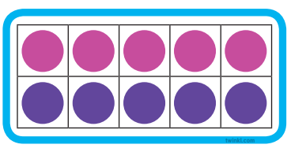
Find & Make Number Bonds
We can use our bonds to that make to help…
5 + 5 = 10
5 + 15 = 20

Slide 8
Find & Make Number Bonds
0 + 20 = 20
1 + __ = 20
2 + ___ = 20
3 + ___ = 20
4 + ___ = 20
5 + ___ = 20

