Slide 1
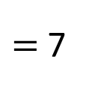
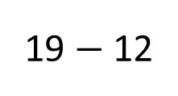
19 $−$ 12
$=$ 7
Boys
19
Girls
12
7
?
There are ____ more boys than girls in Class 2.
7

Slide 2
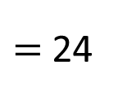

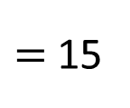
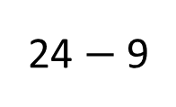
4
4
4
4
4
4
6 $×$ 4
$=$ 24
24
24 $−$ 9
$=$ 15
15
9
left
15
Eva has ____ pears left.

Slide 3
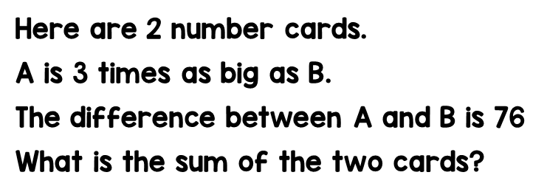
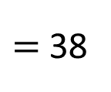

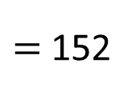

76 $÷$ 2
$=$ 38
A
38
38
38
?
38 $×$ 4
$=$ 152
B
38
76
152
The sum of the two cards is ____

Slide 4
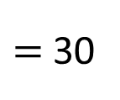

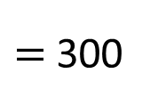

1st
60
90 $÷$ 3
$=$ 30
60
60
60
60
60 $×$ 5
$=$ 300
2nd
30
60
30
30
3rd
90
There are ____ counters in the 1st jar
300

