Slide 1
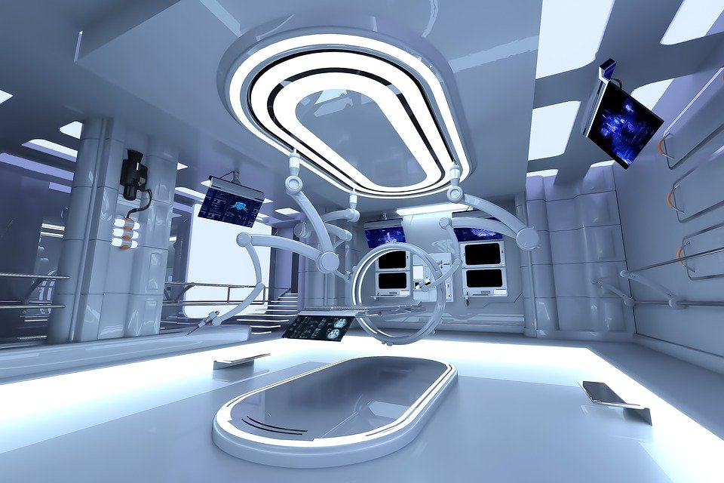
Adrift
Stage 5
Unit Focus: Science Fiction
Text Focus: Narrative

Slide 2
Today we are learning to…
identify new words when you read and discuss their meaning in context
explain and justify using evidence from the text
retrieve simple facts

Slide 3
Before reading…
This story mentions the ‘growing climate catastrophe’.
What do you think this means?

Slide 4
Before reading…
Listen to this description read by your teacher and then use it to draw a picture. What can you see in your head?
Adrift amongst the stars, in the outer reaches of the galaxy, a small ship floated towards its final destination. The SS Brigand had set out from Earth a thousand years earlier. There was a single occupant. Doctor Gwen Bigby had volunteered for the mission as soon as she’d heard about it. There was nothing left for her on Earth by that point. The growing climate catastrophe had made sure of that.

Slide 5
Task 1: Read ‘Adrift’ in pairs
After reading, discuss:
What did you like/dislike about this story?
Was there anything confusing or puzzling?
Did this story remind you of any other stories, films or TV shows you know?
Challenge:
Create a storyboard to show the main events in the story.
Notes:
You may wish to read this first and have the children follow along and then read on their own.

Slide 6
Task 1: Read ‘Adrift’ as a class Read this extract from the text. Think carefully about what Gwen might be thinking and feeling!
A sound alerted her to the fact that something was moving nearby. A vine was creeping towards her. It snaked along the floor more quickly than she could run. The thick stems were easily as thick as her arm and covered in sharp barbs. She turned back towards the ship but she was too slow.

Slide 7
Task 2: Vocabulary Check Complete this table to show your understanding of these words
Word | Have you heard the word before? | What do you think it means? | Use in a sentence of your own
destination
occupant
catastrophe
Notes:
Children could use a scale to indicate if they have heard the word before – 1 indicating no, I’ve never heard it before and 5 indicating yes, I know this word well.

Slide 8
Task 2: Quick-fire retrieval
With a partner, write the answers to these!
1) Dr Gwen Bigby was forced to take this mission. True or false?
2) Where is Gwen travelling to?
3) What is the purpose of Gwen’s mission?
4) What happens to Gwen at the end of the story?
Notes:
You could set a timer and give the children 5 minutes to find the answers.

Slide 9
Task 2: Quick-fire retrieval ANSWERS
With a partner, write the answers to these!
1) Dr Gwen Bigby was forced to take this mission. True or false? False
2) Where is Gwen travelling to? Andula
3) What is the purpose of Gwen’s mission? Assess Andula’s suitability for supporting life
4) What happens to Gwen at the end of the story? She steps out into a forest and is dragged away by a vine
Notes:
You could set a timer and give the children 5 minutes to find the answers.

Slide 10
Task 4: Vocabulary Synonyms
Travel to the distant planet of Andula and assess its suitability for supporting life.
What does the word assess mean in this sentence?
Tick one.
 | Tick one
evaluate
determination
exam
judgement

Slide 11
Task 4: Vocabulary Synonyms
She wandered over to the panoramic window…
What does the word panoramic mean in this sentence?
Tick one.
 | Tick one
parcel
narrow
sweeping
glass

Slide 12
Task 4: Vocabulary Synonyms
Dr Bigby threw the coffee away and braced herself for impact.
What does the word braced mean in this sentence?
Tick one.
 | Tick one
carry
steadied
scaffold
groaned

Slide 13
Task 5: True or false? Using information from the text, tick one box in each row to show whether each statement is true or false.
STATEMENT | TRUE | FALSE
Earth is habitable.
Doctor Gwen Bigby volunteered for the mission.
The most important device on the vessel for Gwen is the coffee machine.
Doctor Gwen Bigby lands in a barren desert at the end of the story.
Notes:
Challenge: Can children make up their own true/false statements to test a partner?

Slide 14
Task 6: Inference Using information from the text, tick one box in each row to show whether each statement is a fact or an opinion.
STATEMENT | FACT | OPINION
Doctor Gwen Bigby is a brave, determined woman.
In the story, Earth has been destroyed by a climate catastrophe.
The name of Gwen’s ship is the SS Brigand.
Notes:
Content domain: 2d – make inferences from the text / explain and justify inferences with evidence from the text. Award 1 mark for all three correct.

Slide 15
Task 7: Justify ideas
How does the setting develop the atmosphere of tension?
Refer to your favourite words and phrases from the story to support your ideas.

Slide 16
You have reached the end of the lesson!
Summarise this story in one word and explain your word choice.
Re-tell the story from Gwen’s point of view in six sentences, considering her thoughts and feelings.
Notes:
Encourage children to justify and explain.

