Slide 2
WALT
To know and identify adverbs.
WILF
I can explain what is an adverb.
I know and can identify different types of adverbs.
I can use an adverb to describe a verb, an adjective or other adverbs to answer questions like how? When? Where? How often? Or how? in a sentence.

Slide 3
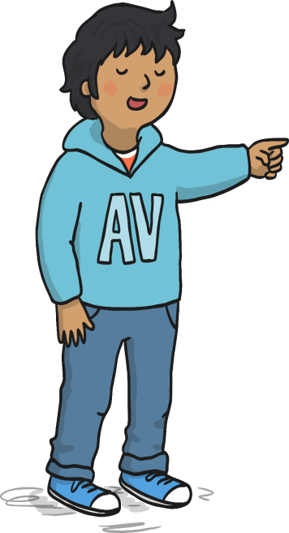
My name is Adil Adverb.
You’ll often find me close to Veronica Verb. I love to describe her actions.
For example:
Veronica Verb always laughs loudly and she runs quickly.
My job is to tell you more about a verb, an adjective or other adverbs.

Slide 4
What is an adverb?
An adverb describes a verb, an adjective or another adverb to answer the questions like how, when, where, how often or how much something is done.
For example; Adverbs tell us...
How?... angrily. She yelled at me angrily.
When?... afterwards. We rushed to the shops and afterwards we hurried off to the cinema.
How often?...always. He is always grabbing my pencil.
Where? ...above. The bird flew above the trees.
How much?...completely. I was completely exhausted.

Slide 5
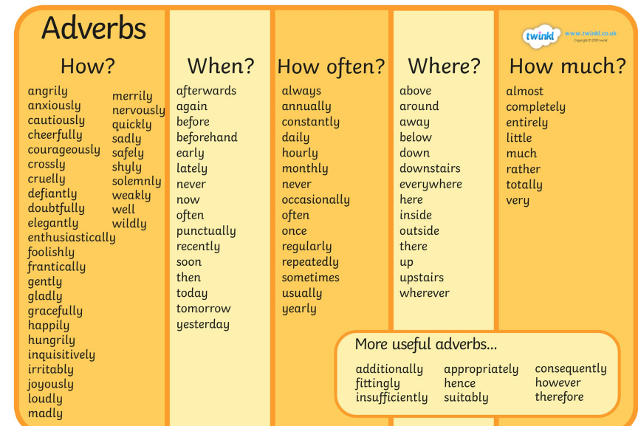
Examples of adverbs

Slide 6
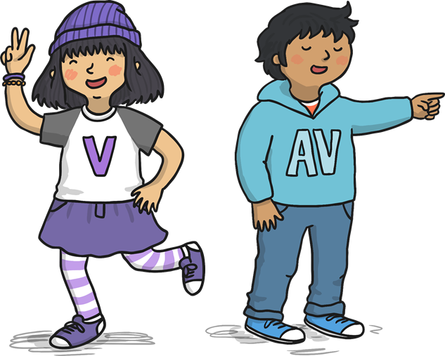
Some adverbs describe how an action is happening.
Helen laughed nervously.
Can you choose one of these adverbs and use it in a sentence?
Here, ‘nervously’ is describing how Helen laughed, which makes it an adverb.
quickly
loudly
sadly

Slide 7
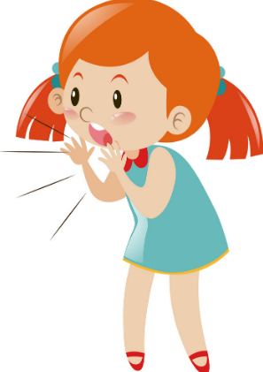
Let’s look at some examples.
Can you spot the adverb in this sentence?
Jessica shouted loudly.
Quick practice
Let’s identify the verb
What is the verb in that sentence?
Let’s think...
The adverb tells us how the verb was done...
How did Jessica shout?

Slide 8
Let’s look at some examples.
Can you spot the adverb in this sentence?
Jessica shouted loudly.
Veronica helped us spot the verb.
Adil helped us spot the adverb.
The adverb in blue tells us how Jessica shouted: she shouted loudly.
The verb (the action) is in purple.

Slide 9
Some adverbs describe where an action is happening.
Liam ran upstairs.
Can you choose one of these adverbs and use it in a sentence?
Here, ‘upstairs’ is describing where Liam ran, which makes it an adverb.
here
there
above

Slide 10
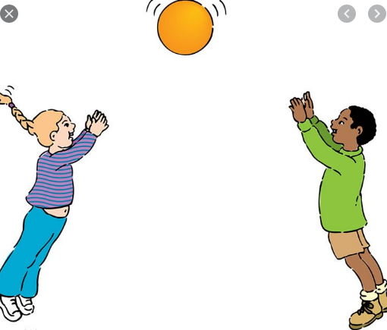
Can you spot the adverb in this sentence?
Quick practice
Abigail threw the ball up.
What is the verb in that sentence?
Let’s think...
The adverb tells us where the action was done
Where did she throw the ball?

Slide 11
Can you spot the adverb in this sentence?
Abigail threw the ball up.
Quick practice
The verb (the action) is in purple.
The adverb in blue tells us ‘where’ Abigail threw the ball.

Slide 12
Some adverbs describe when an action is happening.
The penguins swam yesterday.
Can you choose one of these adverbs and use it in a sentence?
Here, ‘yesterday’ is describing when the penguins swam, which makes it an adverb.
earlier
later
today

Slide 13
Some adverbs describe how often an action is happening.
The lion roared daily.
Can you choose one of these adverbs and use it in a sentence?
Here, ‘daily’ is describing how often the lion roars, which makes it an adverb.
weekly
always
sometimes

Slide 14
Can you spot the adverb in this sentence?
Quick practice
Isabelle tried hard.
What is the verb in that sentence?
Let’s think...
What is the adverb in this sentence?

Slide 15
Some adverbs describe how much an action is happening.
Amy tried hard to finish her homework.
Can you choose one of these adverbs and use it in a sentence?
Here, ‘hard’ is describing how much effort Amy put in, which makes it an adverb.
very
completely
almost

Slide 16
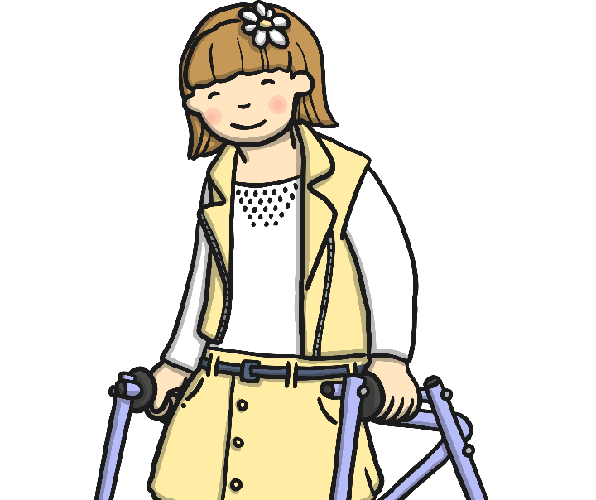
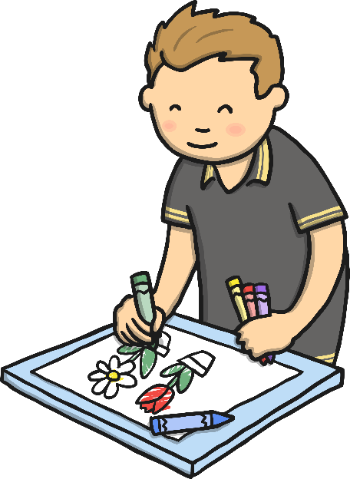
Some adverbs are made by adding ‘ly’ onto the end of the verb or adjective.
kind + ly = kindly
careful + ly = carefully
Daniel coloured his picture carefully.
Lilly smiled kindly.

Slide 17
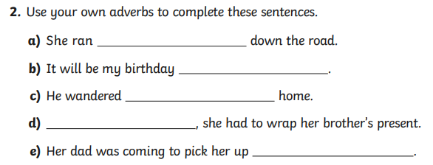
Activity: Adverbs
Rewrite each sentence in your book and end it with an adverb.
Add the suffix ly to change an adjective into an adverb.
Adjective | Adverbs -ly
happy
nice
brief
joyful
merry
swift
easy

Slide 18
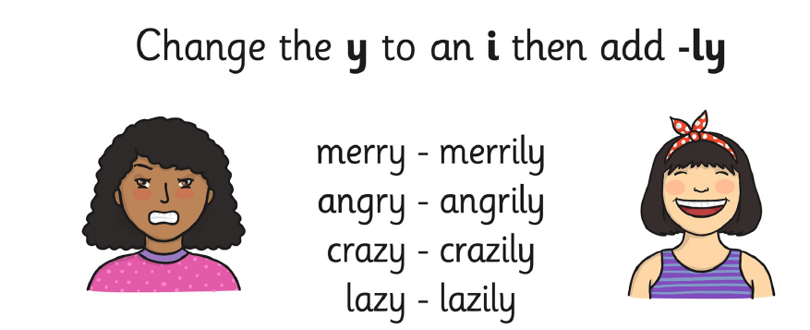
Spelling rule
Remember to look and learn the spelling rule for some of the adverbs.

Slide 19
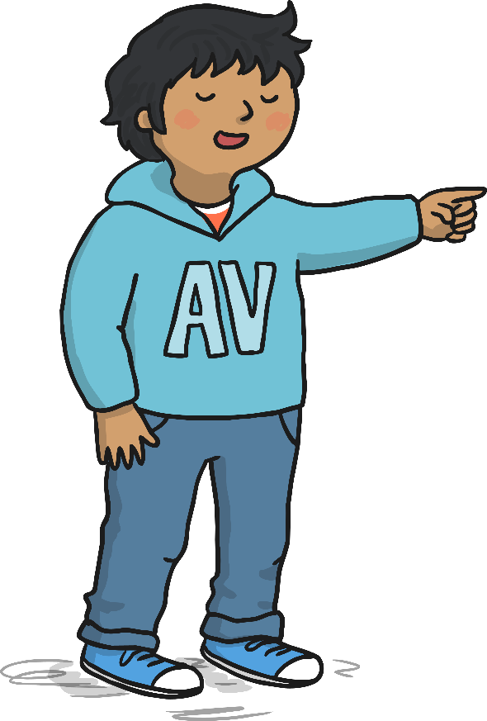
Plenary
Find the adverbs
Tom painted his picture beautifully.
Annie quickly brushed her hair.
Amjid read his books today in the library.
Neena swam well without arm bands.
Ben always rides his bike to school.

Slide 20
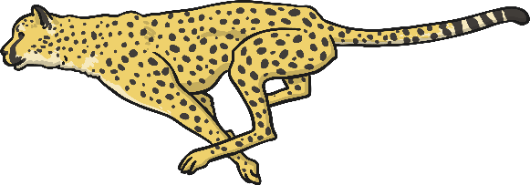
Can you read the clues to complete the crossword? Each word ends in –ly.
 |  |  |  |  |  | 1
 |  |  |  | 2
 | 3 |  |  | 4
5
f
i
r
s
t
l
y
a
b
r
i
g
h
t
l
y
r
q
u
i
c
k
l
y
l
y
Across
1. Something which is done at the beginning.
2. The sun was shining _______.
3. Fast.
5. The opposite of fast.
Down
1. When something is shared equally.
4. Doing something without making a mess.
e
a
firstly
n
brightly
quickly
s
l
o
w
l
y
slowly
y
fairly
Show answer
cleanly

Slide 22
What have you learnt today?
What is an adverb?
Use the success criteria table below to write what you have learnt today.
What do you need to improve?
Success Criteria
I can say what is an adverb.
I can give examples of adverbs.
I can use adverbs to improve my writing by answering the how, where, when, how often of something that is being done.

Slide 23
Thank you for learning adverbs with me today.
You did such a great job.

