Slide 2
Lets recap on yesterday’s lesson
What is an adverb of manner?
Do you remember?
Can you name some examples of adverbs of manner?

Slide 3
Let’s recap
Why are you learning about adverbs?
You need to use adverbs in your sentences to give more information about the characters or the action. This makes your writing more interesting and also telling the reader what the character is doing.
An adverb describes a verb, an adjective or another adverb to answer the questions like how, when, where, how often or how much something is done.

Slide 4
Recap on yesterday’s lesson.
Can you spot the adverb of manner in this sentence?
The boys continually misbehaved badly..
We learnt that adverbs of manner tell us how something was done.
The adverb ‘badly’ in the above sentence tells us how the boys behaved.

Slide 5
WALT
To know and identify adverbs of time.
WILF
I can explain what is an adverb of time.
I know and can identify different types of adverbs of time.
I can use an adverb of time to answer the question ‘when?’ in a sentence.

Slide 6
Today we are going to learn and work on adverbs of time.
The adverbs of Time answer the question “when?”.
They tells us when an action happens besides (how long) or (how often).
These are some of the examples of the adverbs of time.
Word bank

Slide 7
We know that an adverb of time describe when an action is happening.
Some adverbs of time describe the order of time- When the event happened.
Some adverbs of time describe the frequency of the event – how often something happened.
Some adverbs of time describe the schedule- how long.

Slide 8
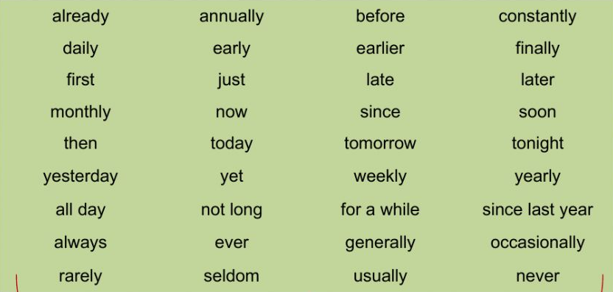
We know that an adverb of time describe when an action is happening.
Let’s look at some words.
Adverbs of...when? | Adverbs of ... How often | Adverbs of ... How long
Yesterday | repeatedly | daily
tomorrow | Hardly ever | weekly
Later | always | Monthly
Tonight | sometimes | yearly
Now | never | Fortnightly
Word bank

Slide 9
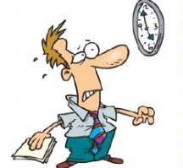
Let’s look at some sentences.
Yesterday, Samuel answered all the questions correctly.
‘Yesterday’ tells us the point in time ‘when’ the character answered the questions.
Andrew had been working very hard this week and his exhausted.
‘This week’ tells us how long Andrew has been working for and it explains to the reader why the character is tired.
Mr. Harrison hardly ever arrives on time to his appointments.
‘Hardly ever’ tells us how often Mr. Harrison makes it to his appointments.

Slide 10
Activity: Adverb of time
Look at the pictures and write a sentence in your book using an adverb of time.
2. Use the word bank to help you fill in the missing answers for the sentences below.
Afterwards, yet, eventually, tomorrow, occasionally, always, often, already, yet, earlier
a)Peter played basketball for two hours. He was very tired___________.
b) I haven’t had any lunch __________so I’m hungry.
c) They searched for ages and ____________found the missing keys.
d) I have seen that movie _______________, let’s choose a different one .
e) David is ____________ punctual for work because he leaves early for work.
f) I don’t have any spare time today but we could met ____________.
Write your own sentences using the adverbs of time below.
Tonight, Constantly, sometimes, For a while, since , monthly

Slide 11
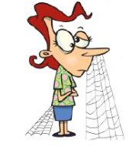
Plenary
Look at the sentence below
What adverb of time can you use?
My mum waited ------------.
Think of different ways you can write that sentence using adverbs of time?
Can you extend your sentence?

Slide 12
What have you learnt today?
What is an adverb of time?
Use the success criteria table below to write what you have learnt today.
What do you need to improve?
Success Criteria
I can say what is an adverb of time.
I can give examples of adverbs of time.
I can use adverbs of time to write sentences.

Slide 13
Thank you for learning adverbs of time with me today. You did such a great job.

