Slide 1
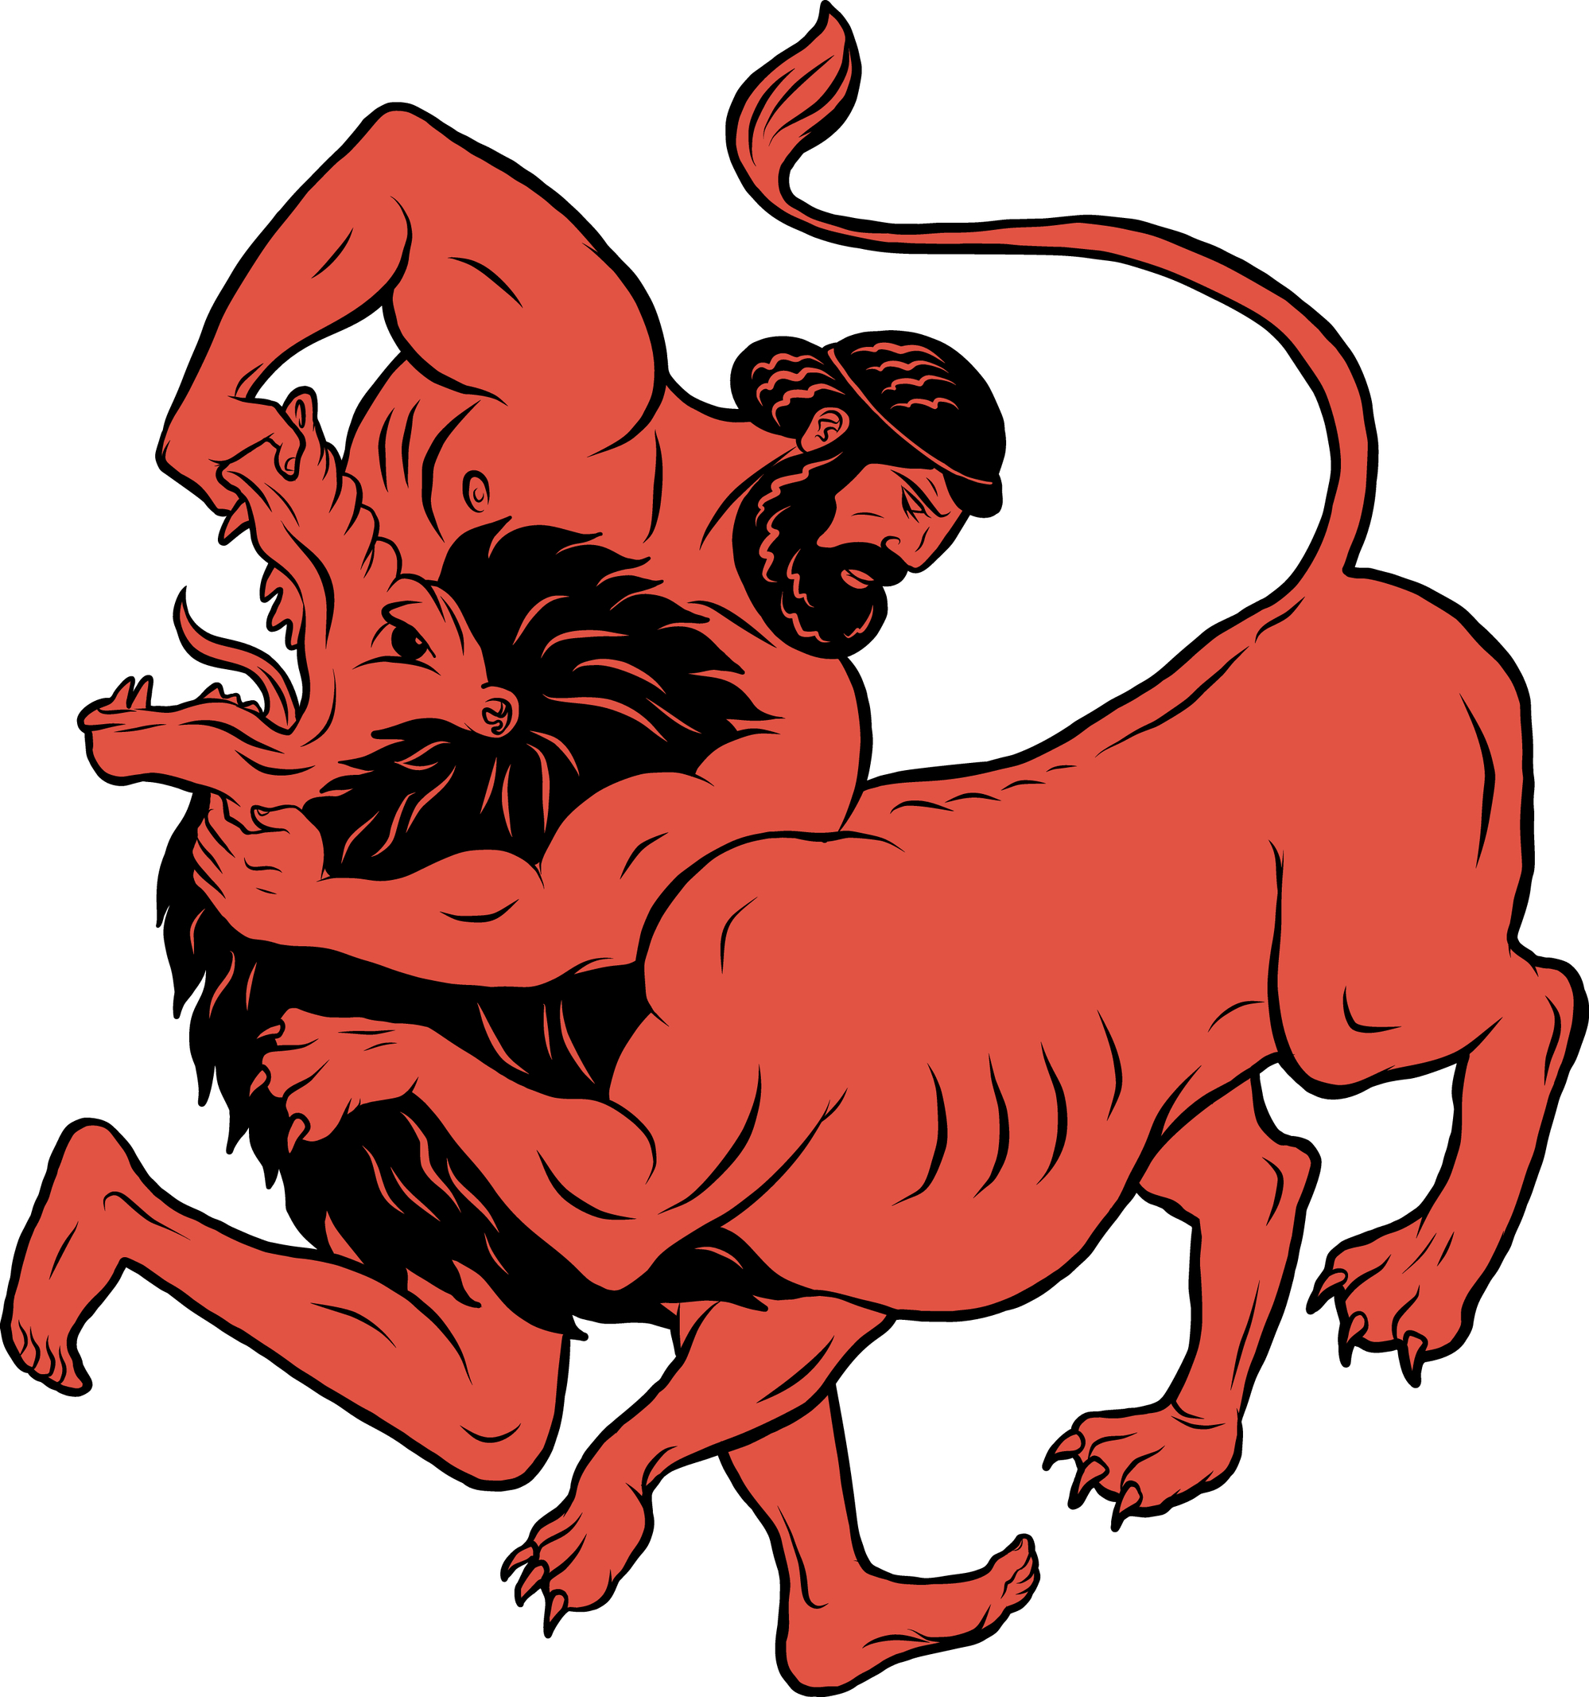
Heracles
Stage 5
Unit Focus: Ancient Greek Myths
Text Focus: Narrative

Slide 2
Today we are learning to…
identify new words when you read and discuss their meaning in context
explain and justify using evidence from the text
retrieve simple facts

Slide 3
Task 1: Read ‘Heracles’ in pairs
While you are reading, you may wish to:
Underline and identify any new, unknown words
Underline any main characters and events
Challenge:
Describe King Eurystheus in one word and explain your word choice.
Notes:
You may wish to read this first and have the children follow along and then read on their own.

Slide 4
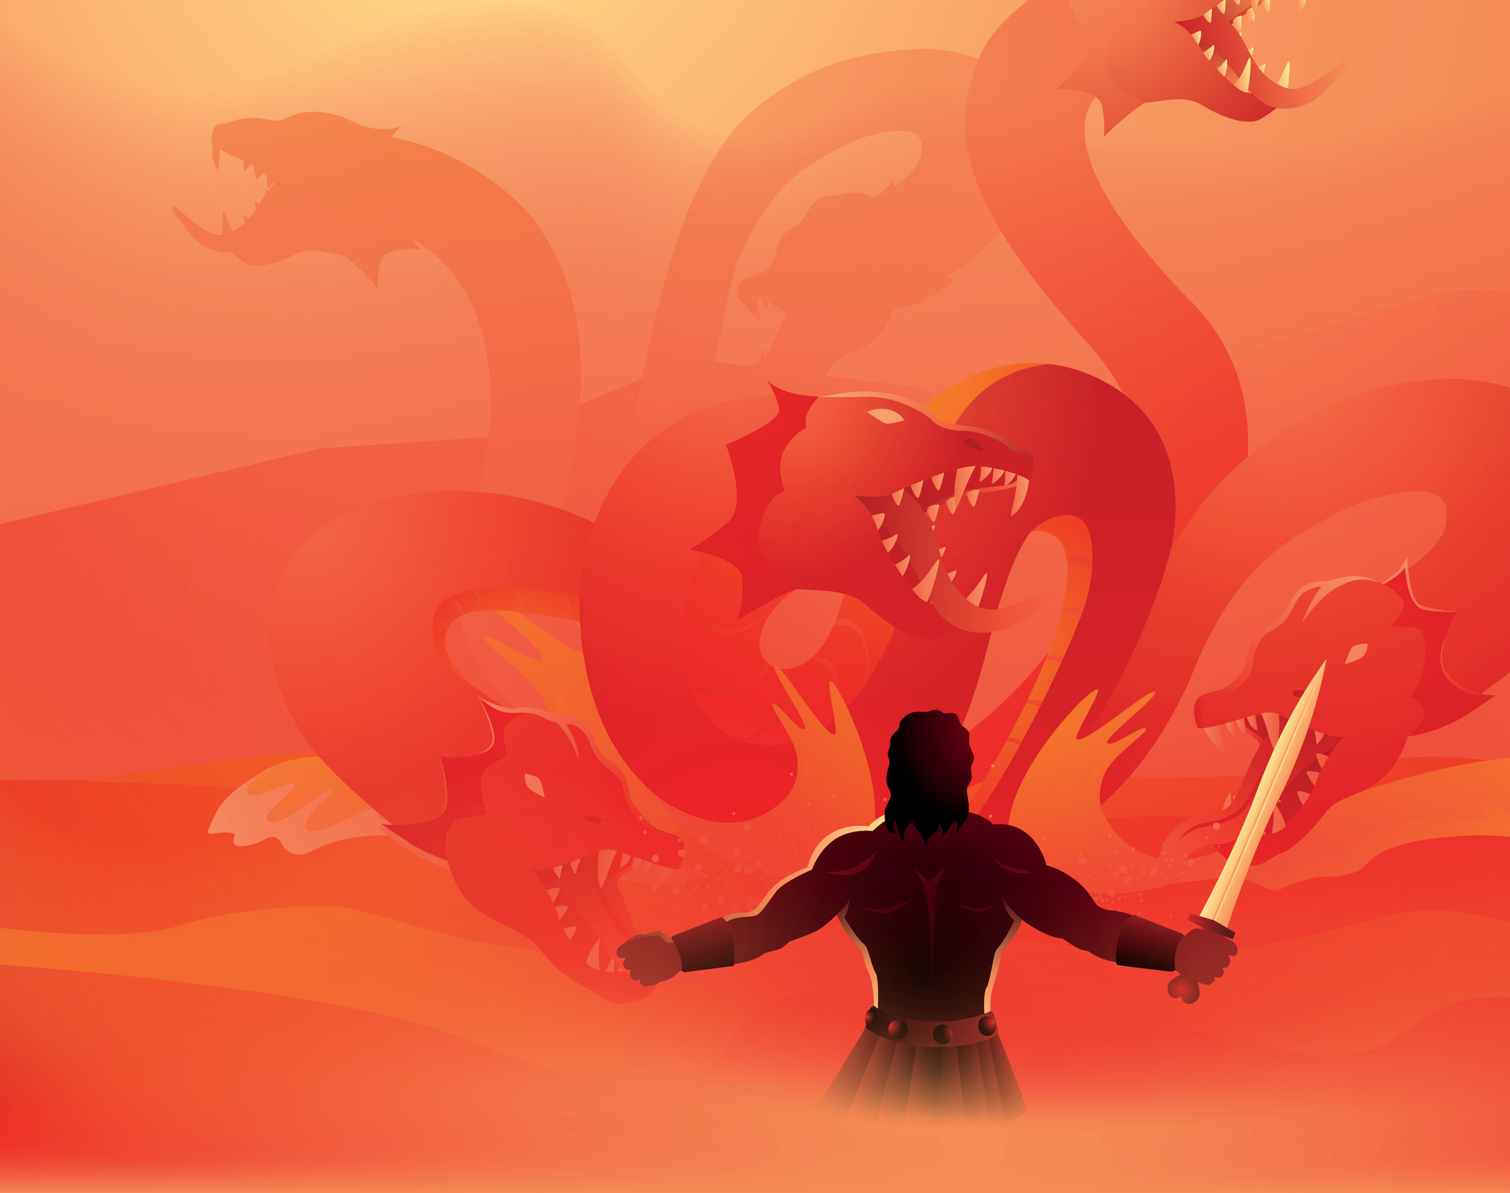
Task 1: Read ‘Heracles’ as a class Read this extract from the text. Think carefully about how to make this ending sound ominous!
From that point on, Heracles grew used to receiving the King’s increasingly dangerous demands through his herald. He never did see the king again, but he knew that his labours were only just beginning.
Notes:
Discuss pace, expression, fluency, tone, volume.

Slide 5
Task 2: Vocabulary Check Complete this table to show your understanding of these words
Word | Have you heard the word before? | What do you think it means? | Synonyms | Antonyms
terrorised
impenetrable
retreat
Notes:
Children could use a scale to indicate if they have heard the word before – 1 indicating no, I’ve never heard it before and 5 indicating yes, I know this word well.

Slide 6
Task 3: Quick-fire retrieval
With a partner, write the answers to these!
1) Who orders that Heracles should serve the king for twelve years?
2) Who offers to help Heracles?
3) What is Heracles’s first labour?
4) Why is killing the lion so difficult?
Notes:
You could set a timer and give the children 5 minutes to find the answers.

Slide 7
Task 3: Quick-fire retrieval ANSWERS
With a partner, write the answers to these!
1) Who orders that Heracles should serve the king for twelve years? Apollo
2) Who offers to help Heracles? Athena and Hermes
3) What is Heracles’s first labour? to kill a lion terrorising the people of Nemea
4) Why is killing the lion so difficult? its skin is impenetrable
Notes:
You could set a timer and give the children 5 minutes to find the answers.

Slide 8
Task 4: Vocabulary Synonyms
For many years, a grotesque lion had terrorised the area…
What does the word grotesque mean in this sentence?
Tick one.
 | Tick one
strong
handsome
monstrous
violent

Slide 9
Task 4: Vocabulary Synonyms
Heracles’s first task was to bring King Eurystheus the hide of the Nemean lion.
What does the word hide mean in this sentence?
Tick one.
 | Tick one
reveal
pelt
conceal
claws

Slide 10
Task 4: Vocabulary Synonyms
Many hunters had tried to kill it, but its skin was impenetrable.
What does the word impenetrable mean in this sentence?
Tick one.
 | Tick one
impassable
soft
close
insubstantial

Slide 11
Task 5: True or false? ANSWERS Using information from the text, tick one box in each row to show whether each statement is true or false.
STATEMENT | TRUE | FALSE
Heracles’s first task was to bring Hermes the hide of the Nemean lion.
The king ordered Heracles to complete twelve Labours.
Heracles choked the grotesque lion to death.
King Eurystheus was terrified of Heracles.
Notes:
Challenge: Can children make up their own true/false statements to test a partner?

Slide 12
Task 6: Inference ANSWERS Using information from the text, tick one box in each row to show whether each statement is a fact or an opinion.
STATEMENT | FACT | OPINION
Heracles was wrong to kill the lion.
Heracles shouldn’t be punished as it is Hera’s fault for sending him mad.
Heracles agreed with Molorchus that they would sacrifice the lion to Zeus.
Notes:
Content domain: 2d – make inferences from the text / explain and justify inferences with evidence from the text. Award 1 mark for all three correct.

Slide 13
Task 7: Justify ideas
Complete these sentences using ideas from the text and your own opinions!
Heracles is brave because…
Heracles is brave, but…
Heracles is brave, so…
Notes:
Encourage children to justify and explain and refer back to text.

Slide 14
You have reached the end of the lesson!
Describe Heracles in one word.
Summarise the story in six sentences.
Compare this story with the modern version in the Stage 4 section! How are they similar and different?
Notes:
Encourage children to justify and explain.

