Slide 2
WALT: Multiply and divide whole numbers and those involving decimals by 10, 100 and 1000.
WILF: Multiply and divide whole numbers by 10
Multiply and divide whole numbers by 100
Multiply and divide whole numbers by 1000
Explain the pattern talking about place value

Slide 3
Multiplying by 10, 100 and 1000
Diving
What number is shown on the place value chart?
HTh | TTh | Th | H | T | O
468
Complete the sentences:
4680
If I multiply this number by 10, it becomes .
The digits move place to the .
I need to put a in the empty column to act as a .
one
left
zero
place holder
46 800
If I multiply this number by 100, it becomes .
The digits move places to the .
two
left
If I multiply this number by 1000, it becomes .
The digits move places to the .
468 000
three
left

Slide 4
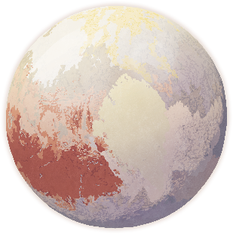
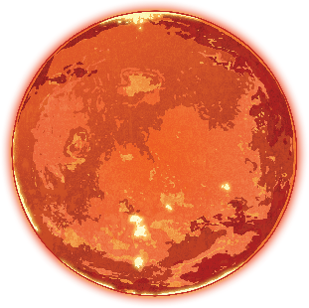
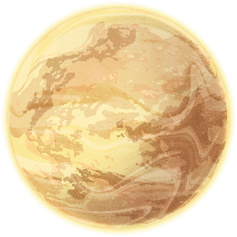
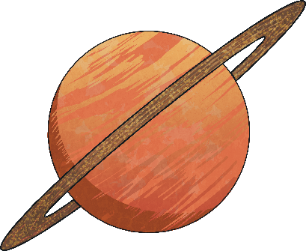
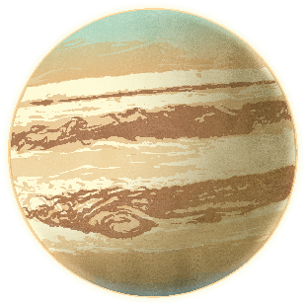
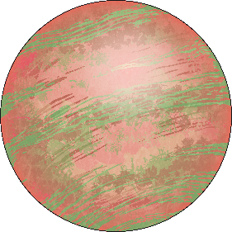
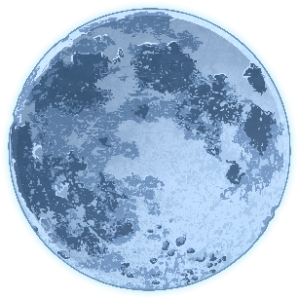
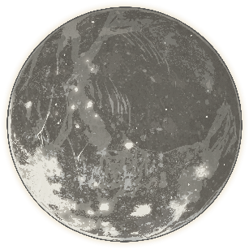
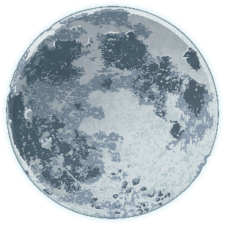
Multiplying by 10, 100 and 1000
Diving
Match each planet to its moon to complete the calculation.
63 x 100
802
100
1000
x 10
782 x
3078 x 10
57 x
705 x 1000
78 200
6300
30 780
705 000
8020
57 000

Slide 5
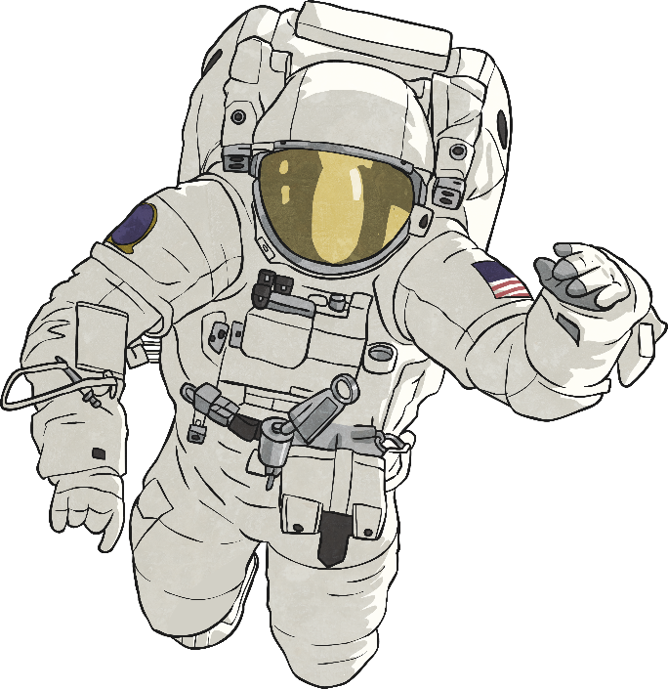
Multiplying by 10, 100 and 1000
Deeper
Jim says, “To multiply by 100, I just add two zeros.”
Kiera says, “I times by 10 and then times by 10 again.”
Do you agree with Jim and Kiera’s methods for multiplying by 100? Explain your thinking.
Jim should have said that the digits move two places
to the left. If you are multiplying a decimal number
by 100, for example 3.5 × 100, adding two zeros
results in 3.500 and not 350. If any columns on
the right of the digits have become empty, they
will need a place holder.
Kiera’s method is correct as 10 × 10 = 100.
It is the same as multiplying by 100.

Slide 6
Multiplying by 10, 100 and 1000
Deeper
Using the clues below, can you work out the diameter of these new planets?
Vesta is 100 times bigger than Athena.
Vulcan – 3624km
Athena – 1812km
Juno – 18 120km
Ceres – 362 400km
Vesta – 181 200km
Apollo – 1 812 000km
Athena has half the diameter of Vulcan.
Juno is 10 times bigger than Athena.
Ceres is 100 times bigger than Vulcan.
Vulcan is 3624km in diameter.
Apollo is 1000 times bigger than Athena.

Slide 7
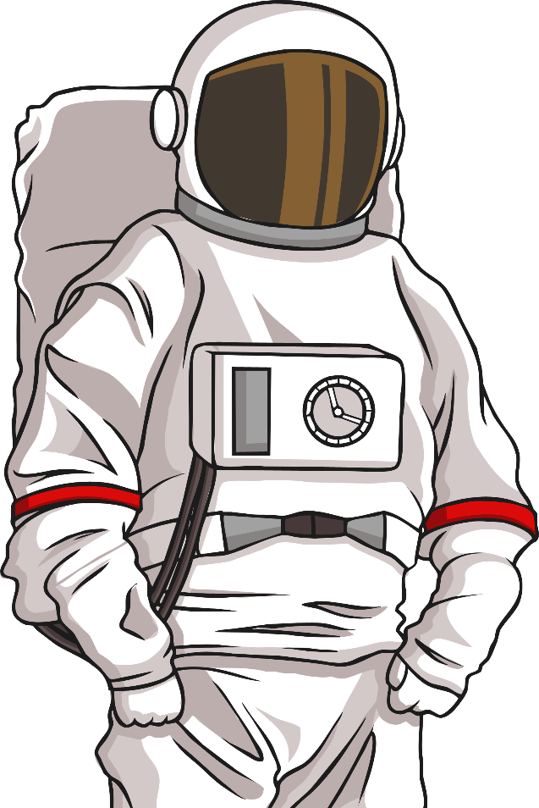
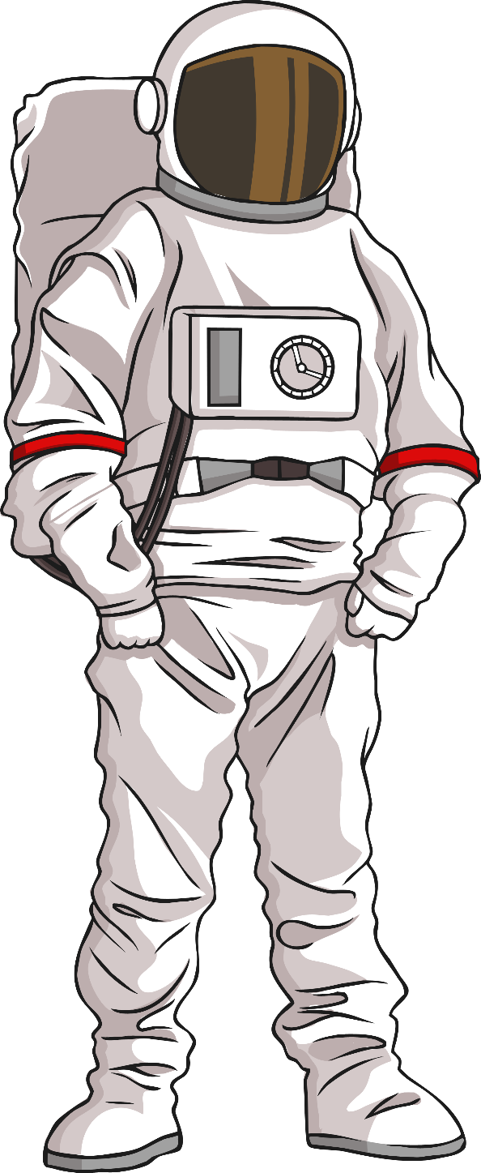
Multiplying by 10, 100 and 1000
Deeper
Alan and Astrid, the astronauts, are exploring the new planet, Vulcan.
Alan has travelled 605 steps. Astrid has travelled 100 times more steps and then walked another 550 steps. How many steps has she travelled?
605 × 100 = 60 500
60 500 + 550 = 61 050
She has travelled 61 050 steps.

Slide 8
Multiplying by 10, 100 and 1000
Deepest
What could the values of A and B be? Find 3 possible solutions.
A × 1000 = B + 800
A × 1000 = B × 10
Possible solutions include the following:
A = 4 B = 3200
A = 65 B = 64 200
A = 82 B = 81 200
Possible solutions include the following:
A = 43 B = 4300
A = 65 B = 6500
A = 8 B = 800
(B should be 100 times greater than A.)

