Slide 1
The Island
Stage 5
Unit Focus: Science Fiction
Text Focus: Narrative

Slide 2
Today we are learning to…
identify new words when you read and discuss their meaning in context
summarise and order information from paragraphs
retrieve simple facts

Slide 3
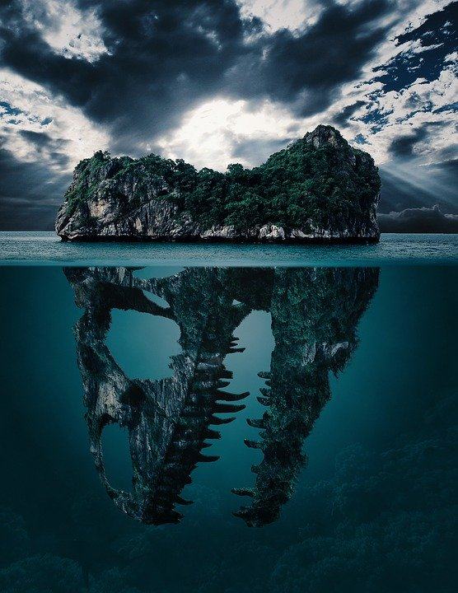
Before reading…
Can you think of adjectives and similes to describe this image?

Slide 4
Task 1: Read ‘The Island’ in pairs
While you are reading, you may wish to:
Underline and identify any new, unknown words
Underline any important characters or events
Challenge:
Jot down what you liked and disliked about this story.
Notes:
You may wish to read this first and have the children follow along and then read on their own.

Slide 5
Task 1: Read ‘The Island’ as a class Read this extract from the information text. Think carefully about your expression and the punctuation!
“I promise I won’t tell anybody,” Doran said quickly. Had the elders known about these aliens? Is that why they told children to stay away from the island?

Slide 6
Task 2: Quick-fire retrieval
These are the ANSWERS. What could the questions be?
1) Doran.
2) a small steamer.
3) Glick.
4) a hundred years ago.
Notes:
You could set a timer and give the children 5 minutes to find the answers.

Slide 7
Task 2: Quick-fire retrieval Some possible questions!
These are the ANSWERS. What could the questions be?
1) Doran. What is the name of the main character in this story?
2) a small steamer. What is Doran travelling in?
3) Glick. What is the strange creature’s name?
4) a hundred years ago. When did the creatures arrive on the planet?
Notes:
You could set a timer and give the children 5 minutes to find the answers.

Slide 8
Task 3: Vocabulary Check Complete this table to show your understanding of these words
Word | Have you heard the word before? | What do you think it means? | Synonyms | Antonyms
forlornly
mimicking
desolate
Notes:
Children could use a scale to indicate if they have heard the word before – 1 indicating no, I’ve never heard it before and 5 indicating yes, I know this word well.

Slide 9
Task 3: Sequencing
Order these events from the story from 1-5.
 | Doran sees something moving rapidly along the shore. It stops and stares at her.
 | The creature raises its arm and sends a ball of light towards Doran.
1 | Doran is out fishing when a storm begins to brew.
 | Doran finds herself stood on the beach of the island. She learns that it is inhabited by weird aliens.
 | Doran’s boat begins to drift towards a towering, strange island.
Notes:
You could set a timer and give the children 5 minutes to find the answers. Some children may need two instructions numbered.

Slide 10
Task 3: Sequencing
Order these events from the story from 1-5.
3 | Doran sees something moving rapidly along the shore. It stops and stares at her.
4 | The creature raises its arm and sends a ball of light towards Doran.
1 | Doran is out fishing when a storm begins to brew.
5 | Doran finds herself stood on the beach of the island. She learns that it is inhabited by weird aliens.
2 | Doran’s boat begins to drift towards a towering, strange island.
Notes:
You could set a timer and give the children 5 minutes to find the answers. Some children may need two instructions numbered.

Slide 11
Task 4: Matching
Match the answers to the questions.
Which word meaning ‘barren’ describes the coastline? |  | the fish have disappeared
Why is Doran hunting further afield? |  | to the edge of the sandbar
What colour and shape are the creature’s eyes? |  | desolate
How far is Doran allowed to travel? |  | oval and silver

Slide 12
Task 5: True or false? Using information from the text, tick one box in each row to show whether each statement is true or false.
STATEMENT | TRUE | FALSE
Doran is forbidden by the elders to step foot on the island.
The creature looks like a slender, tall girl.
Glick can speak in the same language as Doran.
Glick tells Doran that she will never leave the island.
Notes:
Challenge: Can children make up their own true/false statements to test a partner?

Slide 13
Task 6: Summarise Here are some summaries of the first five paragraphs from this text. Number them 1 – 5 to show the order in which they appear in the text.
Summary of paragraph | Number
Doran is hunting further afield as the number of fish to catch is dwindling.
A bright light transports Doran onto the island.
No-one can tell Doran why she can’t visit the island, but she knows she’s not allowed.
A storm gathers and Doran’s boat drifts towards the island.
Doran sees what looks like a tall girl running along the beach.
Notes:
Challenge: Can children summarise each paragraph in a few words themselves?

Slide 14
Task 6: Summarise Here are some summaries of the first five paragraphs from this text. Number them 1 – 5 to show the order in which they appear in the text.
Summary of paragraph | Number
Doran is hunting further afield as the number of fish to catch is dwindling. | 2
A bright light transports Doran onto the island. | 5
No-one can tell Doran why she can’t visit the island, but she knows she’s not allowed. | 1
A storm gathers and Doran’s boat drifts towards the island. | 3
Doran sees what looks like a tall girl running along the beach. | 4
Notes:
Challenge: Can children summarise each paragraph in a few words themselves?

Slide 15
Task 7: Class discussion
Do you think Glick is evil? Yes, no, maybe?
Use evidence from the text and your own opinions and ideas to justify your reasons.
Notes:
Encourage children to justify and explain.

Slide 16
You have reached the end of the lesson!
What do you think the MOST important piece of information in this story is? Why?
What do you think the LEAST important piece of information in this story is? Why?

