Slide 1
Thursday 28.1.21
Whilst you are waiting please write out how you might find a fraction of a whole number

Slide 2
WALT: Simplify fractions.
Write the WALT down in your books and make sure its underlined.

Slide 3
Warm up:
Draw one way to show me 4/6.
Find 1 equivalent fraction for 4/5.

Slide 4
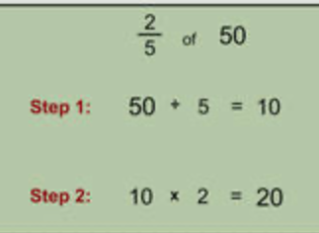
Revision questions
Remember our work from yesterday.
1/3 – 1/6 =
3/6 + 2/4 =
3/5 of 7 =
4/6 of 3 =
1/6 of 7 =

Slide 5
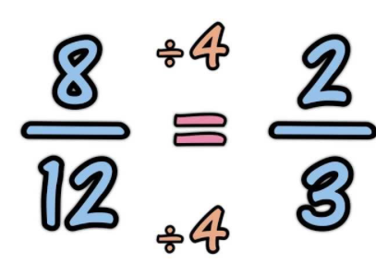
WALT: Simplify fractions.
Important: in order to simplify a fraction you need to find the highest factor that both the numerator and the denominator have in common and then divide by that number.
Times tables
1, 2, 4, 8
1, 2, 3, 4, 6, 12

Slide 6
Have a go at simplifying these fractions..

Slide 7
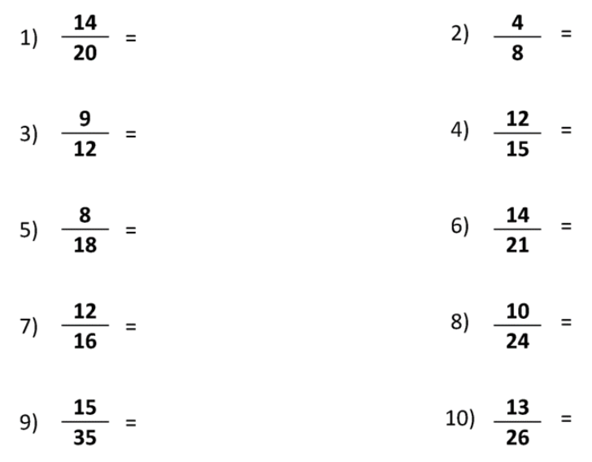
Extension questions
Have a go at simplifying these fractions

