Slide 1
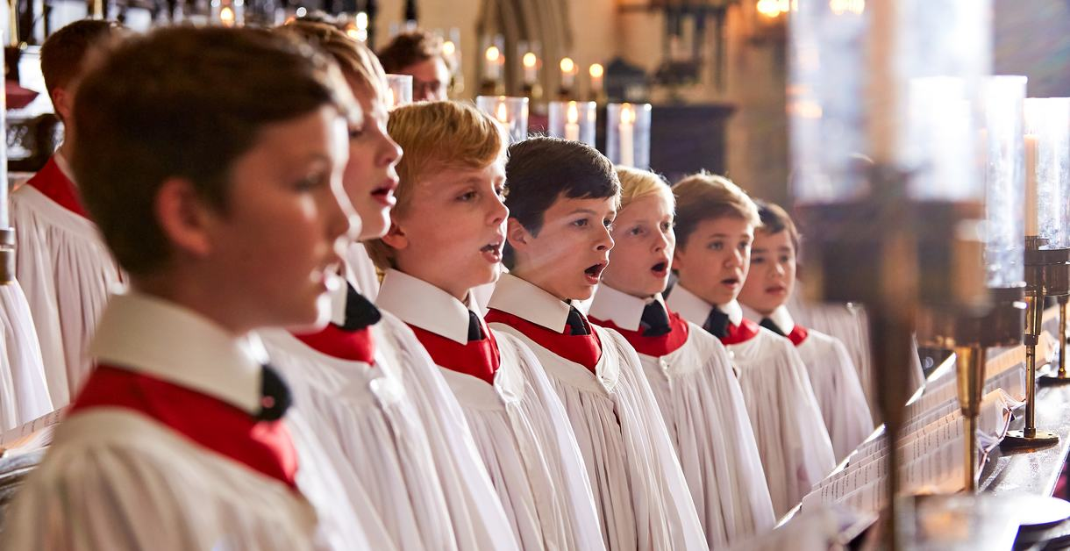
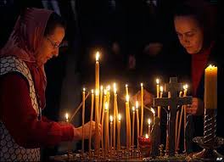
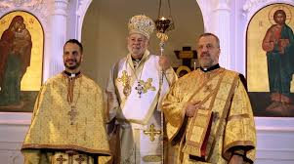
God and Church
The church is a very holy place. When we go to church we listen to the priest and we pray; sometimes we might kneel quietly to do this. In church we listen to beautiful songs sung by the choir. These special songs are called hymns. Hymns are songs that we sing to praise God. Sometimes we might sing a special hymn called ‘Kyrie Eleison’ in Greek which means ‘lord have mercy on us.’ Singing hymns and lighting candles show that Jesus is the light of our lives and singing means we are praising God.

Slide 2
Read the passage and answer these questions.
The church is a very holy place. When we go to church we listen to the priest and we pray; sometimes we might kneel quietly to do this. In church we listen to beautiful songs sung by the choir. These special songs are called hymns. Hymns are songs that we sing to praise God. Sometimes we might sing a special hymn called ‘Kyrie Eleison’ in Greek which means ‘lord have mercy on us.’ Singing hymns and lighting candles show that Jesus is the light of our lives and singing means we are praising God.
Why is the church a holy place?
What do we do in church?
Who sings the songs in a church?
What are hymns and why do we sing them?
What Greek hymn is sung in a Greek Orthodox church and what does it mean?
What does singing hymns and lighting candles mean?

