Slide 1
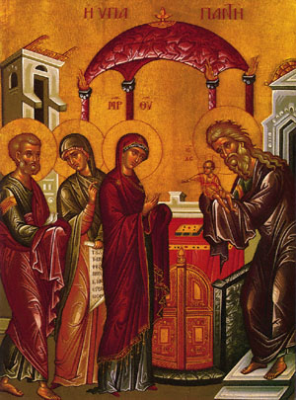
The Presentation of Jesus into
The temple

Slide 2
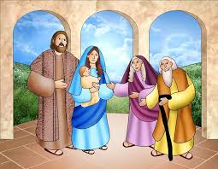
The presentation of Jesus in the temple
When Jesus was 6 weeks old Mary and Joseph took him to the temple in Jerusalem, to say thanks to God for their baby.
On the same day, an old man named Simeon was at the temple. He had been praying to God to send a new King to rule over his people. He asked Mary if he could hold Jesus and Mary said “yes.” Mary gave Simeon baby Jesus to hold in his arms.
Simeon was so happy he said “I can now die a happy man because I have seen the Son of God.” Later he peacefully died.
Another lady called Ana was also there. She started to tell everybody how special this baby was and that he was the gift that the world had been waiting for. We celebrate Jesus’ entry into the temple on February 2.

Slide 3
The Presentation of Jesus in
The temple
Imagine you are Simeon the old man that had been praying for the new King to arrive or Ana the lady in the temple.
Write a diary entry writing in first person to explain:
What happened that day?
What did you do when you saw Jesus?
How did you feel knowing that you have seen the baby Jesus being presented in the temple?
https://www.bbc.co.uk/bitesize/clips/z2wmpv4
You can even watch the video!

