Slide 1
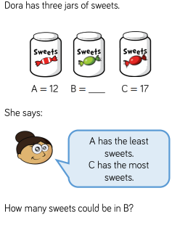
Warm-up
Notes:
Display whilst chn

Slide 2
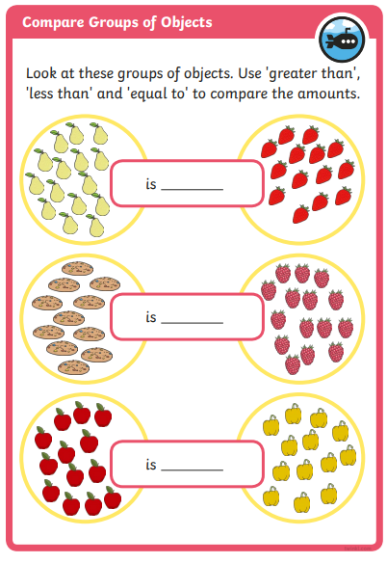
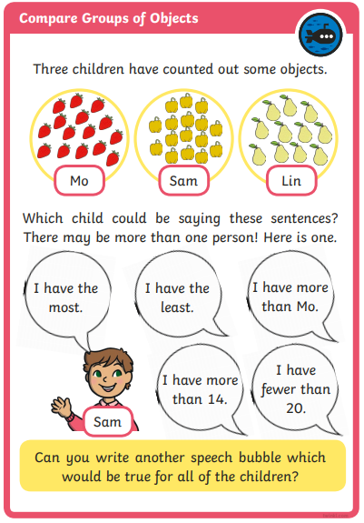
Compare groups of objects.
Let’s go through it.

Slide 3
Order groups of objects.

Slide 4
Order groups of objects.
Order the group of crayons greatest to smallest.

Slide 5
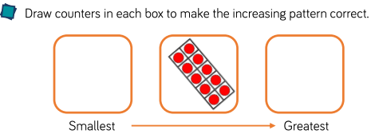
Order groups of objects.
Notes:
If time, chn could use 3 groups of toys or other objects at home to do some more examples. Take photos and upload to Purple Mash.

Slide 6
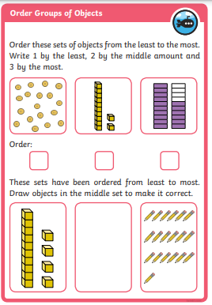
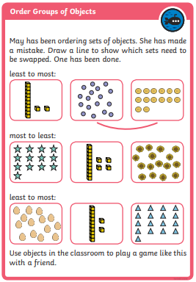
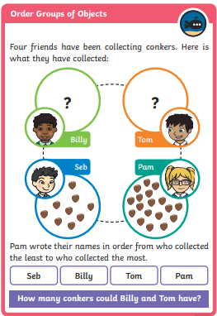
Order groups of objects.

