Slide 1
Happy New year.
Santorini.
Welcome to online learning.

Slide 2
Online learning Rules.
Please make sure you log in to the lesson on time on each school day.
Always have paper and something to write with. Most of you should have your pink homework books. This will be good to use as your work can be stored together.
Please use your First own name and write the initial for your second name. This will be used to take the class register so make sure you put your proper name (no nicknames).
E.g. John M
Do not unmute yourselves unless you are asked a question.
To unmute yourself just click on the microphone mute icon.

Slide 3
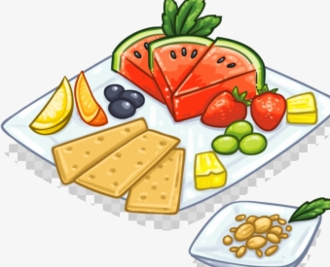
.
Break time:
Try to eat, drink or go to the toilet before or after the lesson.
If you are allocated to a breakout room then this is the group I would like you to work with.
Please do not have the TV or any other devices on in the background and try to work in a quiet area.
Limit any distractions for you and for others when you are unmuted.
When I am sharing my screen I am no longer able to see all of you at the same time. This means that I will randomly choose someone to answer.
Please ensure you are at your screen so I do not have to scroll through the whole class.

Slide 4
Warm up: Game Stop the bus.

Slide 5
Basic skills: Grammar
Different kinds of
sentences.
There are four types of sentence:
statements, commands, questions
and exclamations.

Slide 6
WALT: To be able to read and write different forms of sentences. WILF: To read a statement and check for sense by rereading the sentence. To know and write a statement and use the correct punctuation.

Slide 7
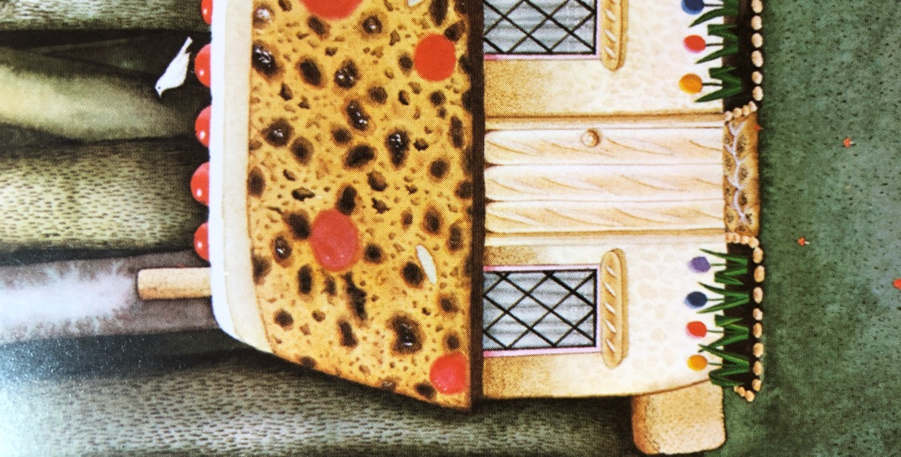
Statements
A simple sentence is a statement.
What is a Statement?
A statement simply gives the reader some information.
These are simple sentence statements.
My name is Gretel.
I thought the house looked delicious.
We felt hungry.

Slide 8
Statements
Like all sentences;
statements begin with a capital letter.
They end with a full stop.
My name is Gretel.
I thought the house looked delicious.

Slide 9
Statements
Listen to me read:
How do you read a statement: When you read a statement you use a normal speaking voice.
Writing: Remember capital letter and full stop.
You have to reread to check for sense.
My name is Gretel.
I thought the house looked delicious.
We felt hungry.

Slide 10
Statements
You can also add extra information to extend the statement : This is called a compound sentence.
My name is Gretel and I have a brother called Hansel.
I thought the house looked delicious because it had lots of colourful candy .
We felt hungry so we decided to take a bite out of the candy house.
Connectives join up two simple sentences to make a compound sentence.

Slide 11
Statements: Now your turn.
Write your own statements begin with a capital letter and ending with a full stop.
Write three simple sentences.
Extension: Try to write at least two compound sentences.
Use the connectives words: and , because, so, but

Slide 12
Plenary
Lets have a few Volunteers:
Now read your statement and use a normal speaking voice.
What have you learnt today?
What skills do you need to remember when writing a statement?
.

Slide 13
What did you notice about the compound sentence?
I thought the house looked delicious because it had lots of colourful candy .
I thought the house looked delicious.
It had lots of colourful candy.

Slide 14
Remember to keep Practising your sentences when reading and writing them.
A good sentence should have :
Subject (noun- person, animal, object, Place
Pronoun: He , she, We, They etc
Verb: run, jump, went, ate etc
Makes sense
Punctuation
Connectives, conjunctions

