Slide 1
Can you make a word list for one of these sounds?
ure | tion | cious

Slide 2
Monday 1st February 2021
Today we will…
Learn a new sound.
Practise reading words with the new sound.
Read a story and answer questions.
Write about the story.

Slide 3
e
he
me
she
be
we

Slide 4
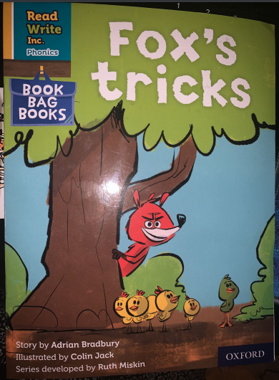

Slide 6
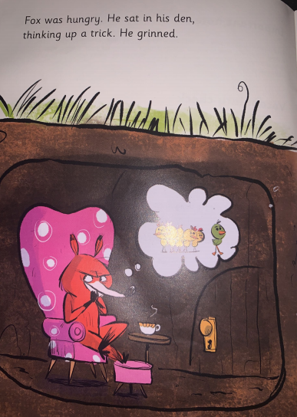
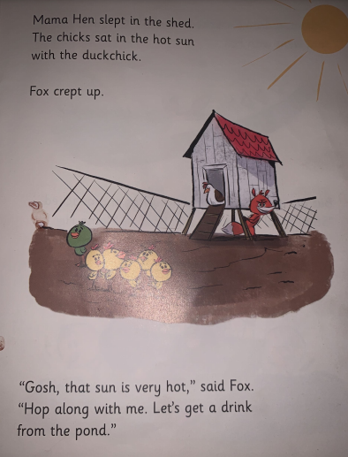

Slide 7
Read the following questions and choose the correct ending.
In the den, Fox was thinking of his mum/ a trick/ a snack.
Mama Hen slept in the den/ pond/ shed.
What do think will happen next?

