Slide 1
Tuesday 19th January 2021
Today we will…
Learn a new sound.
Practise reading and spelling words with the new sound.
Write sentences with new spellings, independently.

Slide 2
bird
girl
twirl
ir
third
dirt
whirl

Slide 3
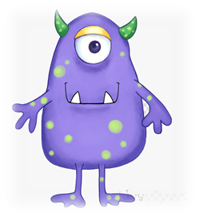
quirt
garl
smirt
thoop
zair
snigh

Slide 4
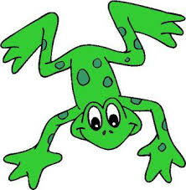
Can you help Fred the frog spell some words?
Fred is very impressed with your spellings!! He wants to know if you can write 2 sentences using two different words?

