Slide 1
Monday 25th January 2021
Today we will…
Learn a new sound.
Practise reading and spelling words with the new sound.
Write sentences with new spellings, independently.

Slide 2
fire
wire
conspire
ire
bonfire
inspire
hire

Slide 3
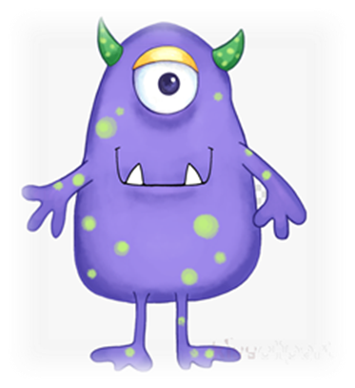
pire
baig
bire
bowg
pake
zoad
fewt

Slide 4
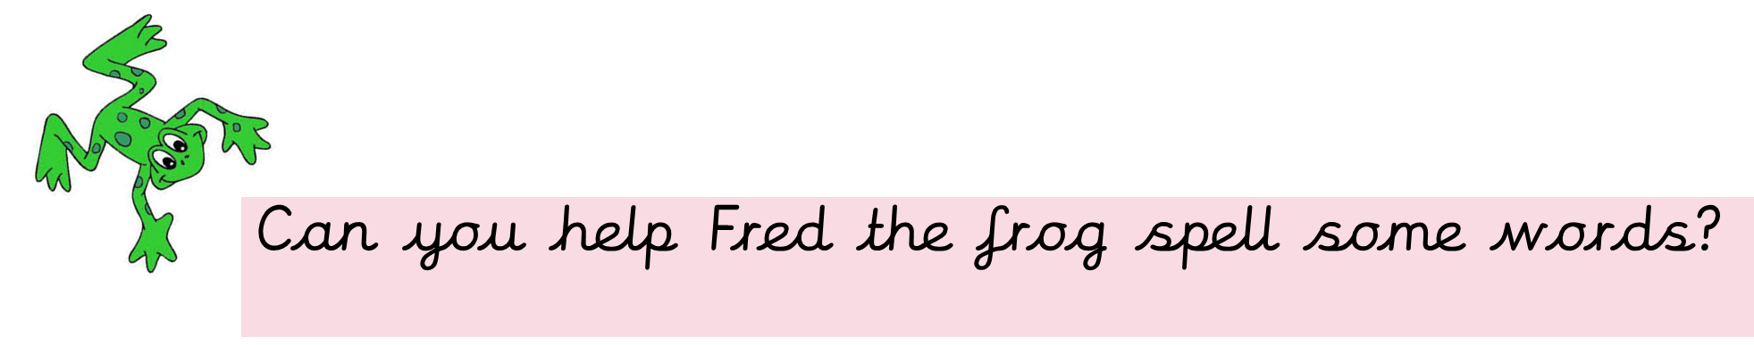
Fred is very impressed with your spellings!! He wants to know if you can write 2 sentences using two different words?

