Slide 1
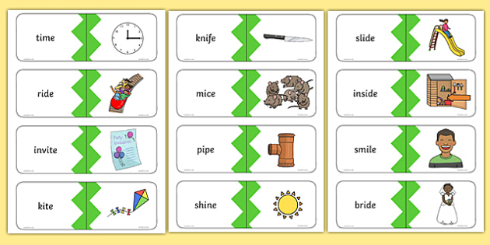
Thursday 28th January 2021
Yesterday, you aced the sound ‘i-e’. Let’s practice writing the words with this sound…

Slide 2
Thursday 28th January 2021
Today we will…
Learn a new sound.
Practise reading and spelling words with the new sound.
Write sentences with new spellings, independently.

Slide 3
phone
home
rose
hope
o-e
rope
spoke
note

Slide 4
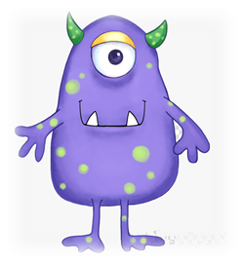
bame
fote
gime
vead
vide
nate
poit
bope

Slide 5
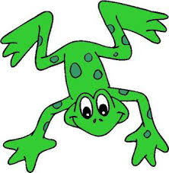
Can you help Fred the frog spell some words?
Fred is very impressed with your spellings!! He wants to know if you can write 2 sentences using two different words?

