Slide 3
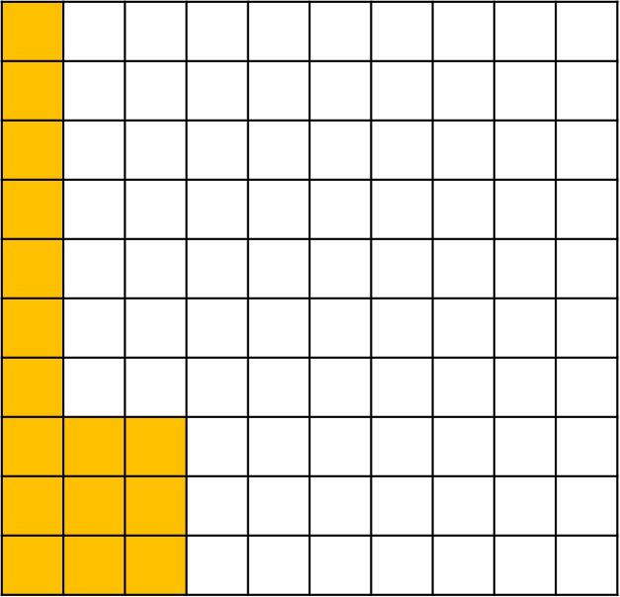
1a) What percentage of the
hundred square is shaded?
b) What fraction on the hundred
square is shaded?
2a) What percentage of the bar model is shaded?
b) What fraction of the bar model is shaded?

Slide 4



1a) What percentage of the
hundred square is shaded?
b) What fraction on the hundred
square is shaded?
2a) What percentage of the bar model is shaded?
b) What fraction of the bar model is shaded?
16 %
$$\frac{\text{16}}{\text{100}}$$
$$\frac{\text{4}}{\text{25}}$$
10%
85 %
$$\frac{\text{17}}{\text{20}}$$

Slide 6
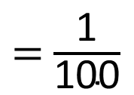
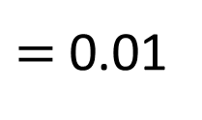
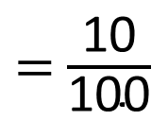
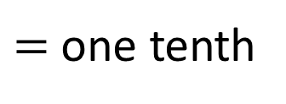
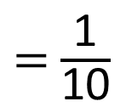
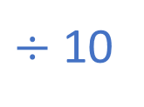
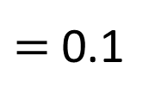
Let’s recap…
$=$ one hundredth
$=$ $\frac{\text{1}}{\text{100}}$
$=$ 0.01
1 %
$=$ $\frac{\text{10}}{\text{100}}$
$=$ ten hundredths
$÷$ 10
$=$ $\frac{\text{1}}{\text{10}}$
$=$ one tenth
$=$ 0.1
10 %
percentage
‘out of’
‘one hundred’

Slide 7
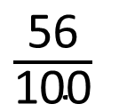
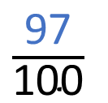
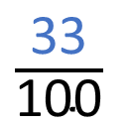
Have a think
$\frac{\text{56}}{\text{100}}$
56 %
0 . 56
56
%
c
5 tenths and 6 hundredths
56 hundredths
out of one hundred
0.
$\frac{\text{97}}{\text{100}}$
0 . 97
97 %
$\frac{\text{33}}{\text{100}}$
33 %
0 . 33
c

Slide 8
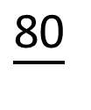
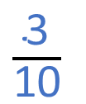



Have a think
$×$20
$\frac{\text{4}}{\text{5}}$
$\frac{\text{80}}{\text{100}}$
0
$\frac{\text{80}}{}$
80 %
0 . 8
$$=$$
c
$×$20
$÷$25
$\frac{\text{75}}{\text{100}}$
$\frac{\text{3}}{\text{4}}$
0 . 75
$$=$$
75 %
$÷$25
$÷$10
$\frac{\text{30}}{\text{100}}$
$\frac{\text{3}}{\text{10}}$
30 %
0 . 3
0
c
$$=$$
$÷$10

Slide 9
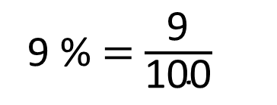
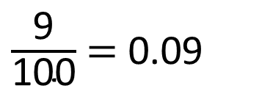
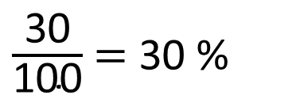
Convert 9 % and 0.3 into fractions, decimals and percentages.
Have a think
9 %
0.3
9 % $=$ $\frac{\text{9}}{\text{100}}$
$\frac{\text{9}}{\text{100}}$ $=$ 0.09
0.3 $=$ $\frac{\text{3}}{\text{10}}$ $=$ $\frac{\text{3}\text{0}}{\text{10}\text{0}}$
$\frac{\text{30}}{\text{100}}$ $=$ 30 %

Slide 10
Have a go at questions 1 - 4 on the worksheet

Slide 11
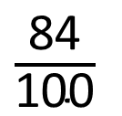
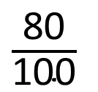
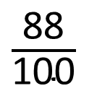
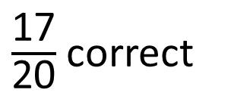
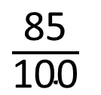
Four children were completing some maths work.
Put the children in order of who got the most correct.
Have a think
F D P
$\frac{\text{17}}{\text{20}}$ correct
$\frac{\text{85}}{\text{100}}$
0.85
85 %
2nd
$\frac{\text{84}}{\text{100}}$
84 % correct
0.84
84 %
3rd
$\frac{\text{80}}{\text{100}}$
0.8 correct
0.8
0
80 %
4th
12 % incorrect
$\frac{\text{88}}{\text{100}}$
0.88
88 %
88 % correct
1st

Slide 12
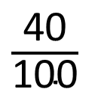
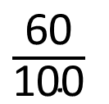
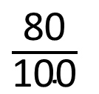
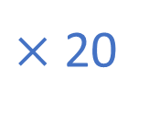
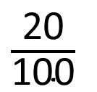
I’m thinking of a fraction – can you guess what it is?
- It is less than 73 %
- It is greater than 0.4
- It has a denominator of 5
$\frac{\text{1}}{\text{5}}$
$\frac{\text{2}}{\text{5}}$
$\frac{\text{3}}{\text{5}}$
$\frac{\text{4}}{\text{5}}$
$\frac{\text{5}}{\text{5}}$
$×$ 20
$\frac{\text{20}}{\text{100}}$
$\frac{\text{40}}{\text{100}}$
$\frac{\text{60}}{\text{100}}$
$\frac{\text{80}}{\text{100}}$
20%
40%
60%
80%
Have a think
0.2
0
0.4
0.6

Slide 13
Have a go at the rest of the questions on the worksheet

