Slide 1
Wednesday 27th January 2021
Today we will…
Learn a new sound.
Practise reading and spelling words with the new sound.
Write sentences with new spellings, independently.

Slide 2
cure
sure
pure
picture
mixture
ure
future
creature
temperature
adventure

Slide 3
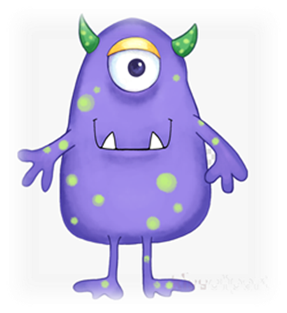
fure
smure
mear
blear
pibe
bowg
naid
bire
zoad
pake

Slide 4
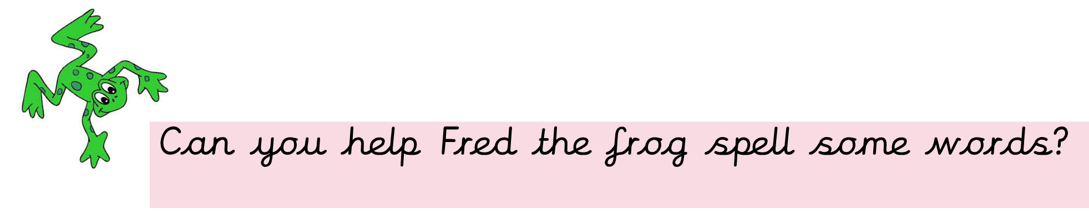
Fred is very impressed with your spellings!! He wants to know if you can write 2 sentences using two different words?

