Slide 1
Thursday 25th February 2021
Today we will…
Learn a new sound.
Practise reading and spelling words with the new sound.
Write sentences with new spellings, independently.

Slide 2
took
oo
Time to read..
Say the special friend sound
Fred the word
Say the word
look
shook
book
cook

Slide 3
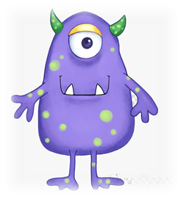
Time to read..
Say the special friend sound
Fred the word
Say the word
foo
kigh
owp
foop

