Slide 1
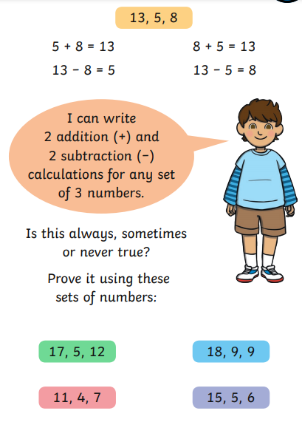
compare number sentences
Warm-up

Slide 2
compare number sentences

Slide 3
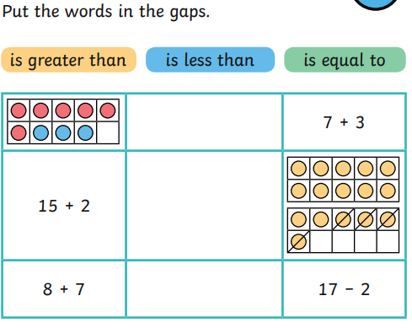
compare number sentences

Slide 4
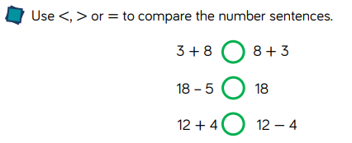
compare number sentences

Slide 5
compare number sentences

Slide 6
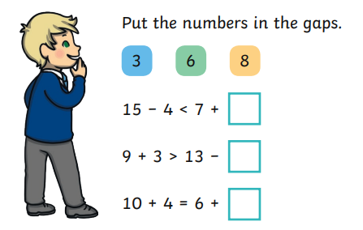
compare number sentences

Slide 7
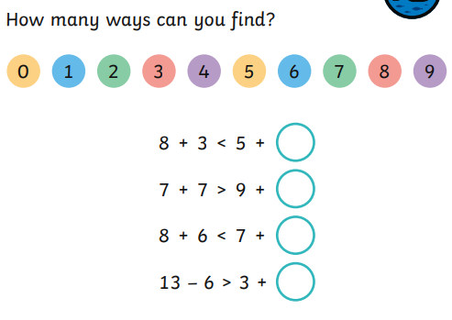
compare number sentences
After the lesson today…
Tomorrow you can share how you got on.

