Slide 1
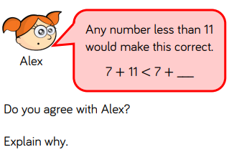
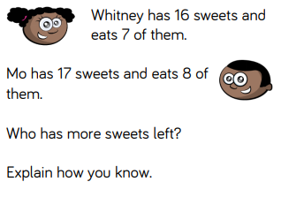
compare number sentences
Warm up

Slide 2
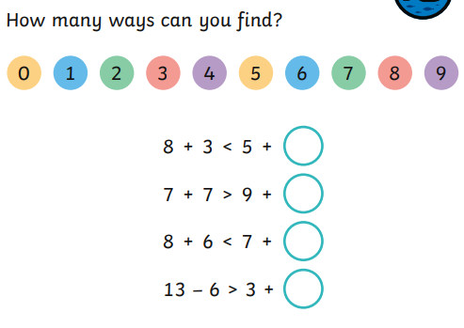
compare number sentences
Let’s review…

Slide 3
compare number sentences

Slide 4
compare number sentences

Slide 5
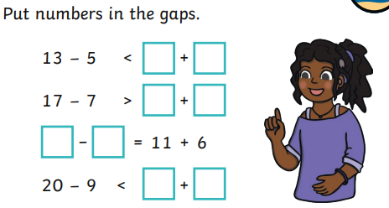
compare number sentences

Slide 6
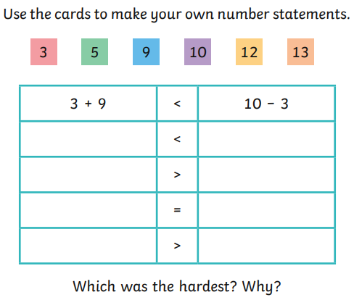
compare number sentences
After today’s session

